Slide 1
The Strategic Concept and Creative Brief

Slide 2
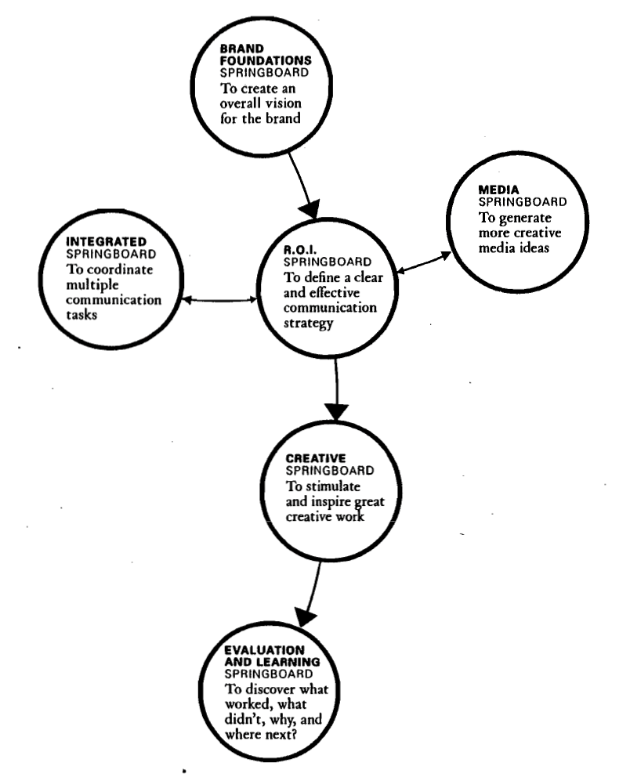
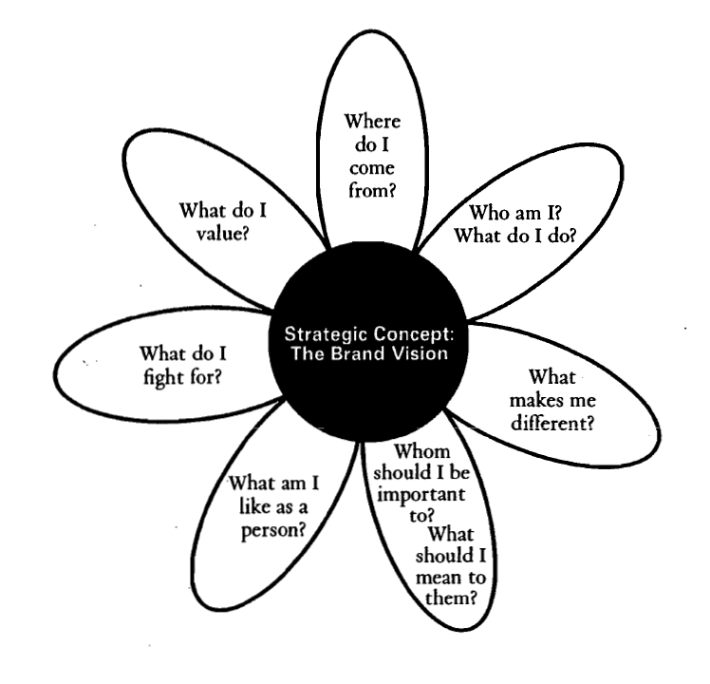
Strategic Roadmap
Springboard Approach – DDB Worldwide

Slide 3
Strategic Concept
The essence of branding
Strategic/Creative Concept = "The Big Idea"
The element that ties it all together
Grows out of a thoughtful mapping of strategy
Strategy guides the creative brief
Battle plan vs. Speech to the troops

Slide 4
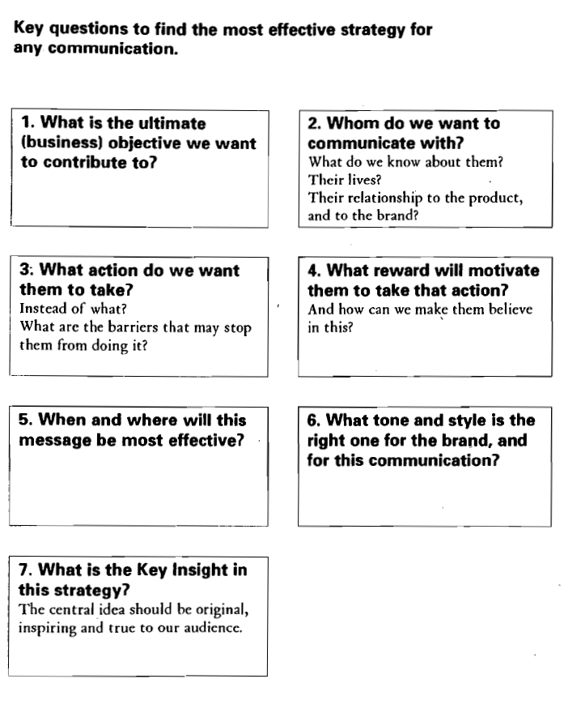
7 Question Format of Creative Brief

Slide 5
The Big Idea
“Big idea” grows from the campaign strategy
Strategic concept guides message creation
Attention-getting
Relevance breaks through the clutter
Distinctive
Originality makes the ad stand out: something different
Memorable
Impact of big ideas/vivid imagery linked to strategic objective
Strong campaigns speak consistently:
Unite ads behind common creative concept (theme)

Slide 6
Slogans and Jingles
Slogans and jingles designed to:
Increase memorability
Communicate the big idea
Identify idea with product

Slide 7
Slogans: What's the big idea?
Top Advertising Slogans from Slogan Hall of Fame:
Nike: "Just Do It"
Avis: "We Try Harder"
AMEX: "Don't Leave Home Without It"
Apple: "Think Different"
De Beers: "A Diamond is Forever"
M&Ms: "Melts In Your Mouth, Not in Your Hands"
Maxwell House: "Good to the Last Drop"
Seven Up: "The Uncola”
California Milk Processors: “Got Milk?”

Slide 8
Formats: Lectures vs. Dramas
Lectures: verbal instructions
Evidence
Authority
Maintaining attention is difficult
Cost efficient
Dramas: characters and situations
Observational learning
Viewer involvement
Connection to product
Combined lectures and dramas
Drama interrupted by short lectures

Slide 9
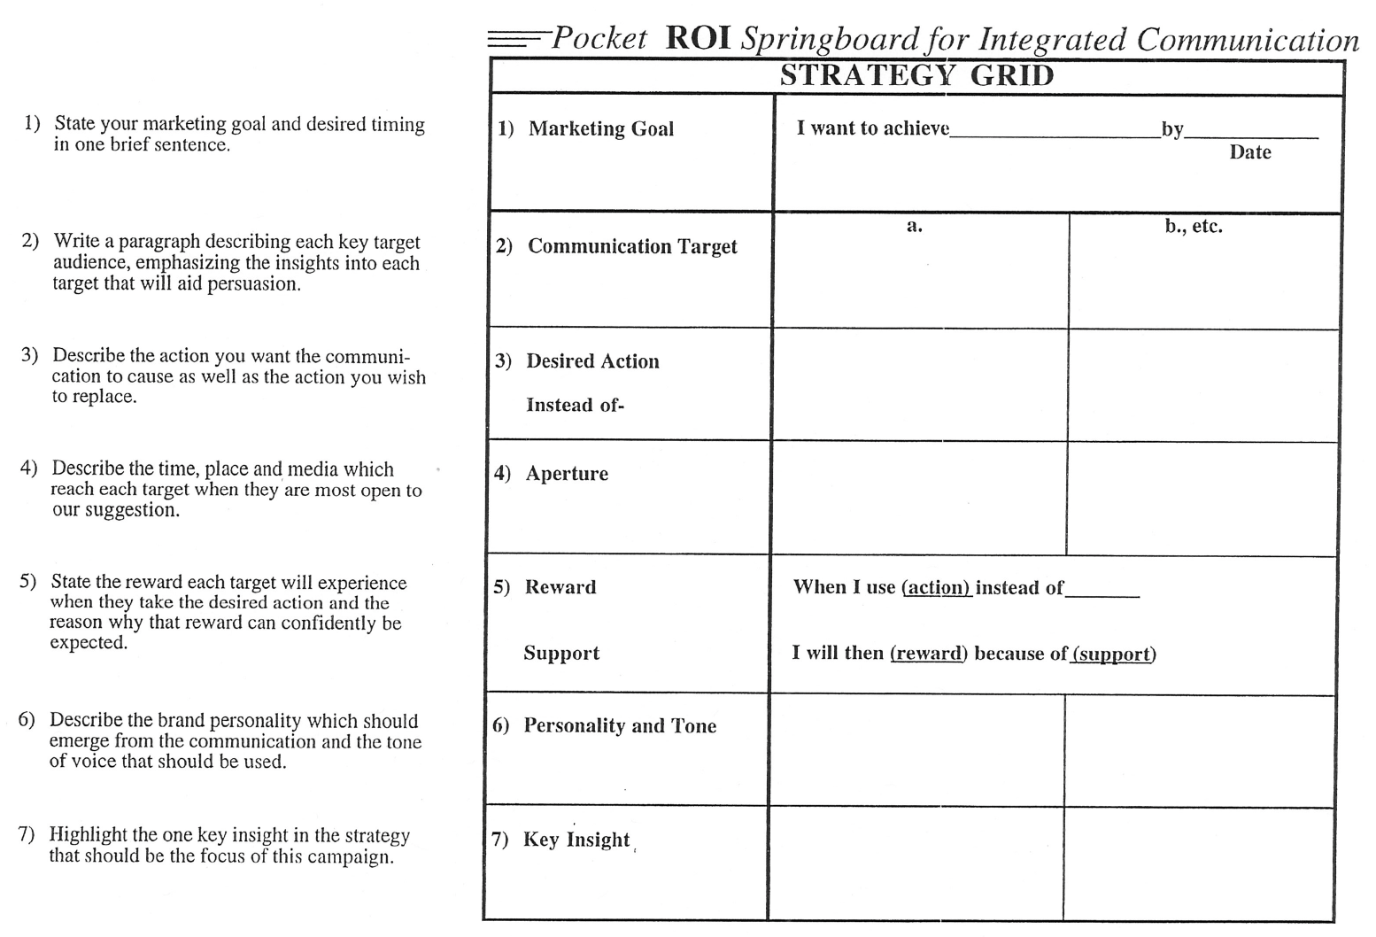

Slide 10
Message Strategy/Creative Brief
Like the ROI Springboard Technique
7 Question Strategy Format
1. Who are you talking to?
2. What's your point?
3. What's the key word?
4. Why should I care?
5. Why should I believe you?
6 What do you want me to do?
7. How should I feel?
Use language of the heart.

Slide 11
Creative Brief
Must be…
Single-minded - clear and unambiguous direction
Insightful - provide new understanding of who is being spoken to and their product relationship
Inspiring - use language and experiences that bring the briefing process to life
Collaborative - establish a dialogue in which ideas continue to evolve and grow - not the end

Slide 12
The Creative Person
Cultivated in childhood
Traits of creative problem solvers:
Observers of experience
Independent, persistent, self-disciplined
Internally driven
Skeptical and curious
Intuitive
Sense of humor
Confident and positive
Widely experienced
Copy-writers: Writing skill

Slide 13
Creative Ideas: Making the Leap
Creative thinking
Freeing oneself from "conventions"
Grounded in message strategy
Creative leap to something original

Slide 14
Creative Approaches
Identifying relevant concepts:
Finding new patterns and relationships
Open approaches
Free association
Brainstorming
Analytical approaches
Market analysis
Consumer research
Convergent vs. divergent thinking
Left-brained (logical, rationally-grounded)
Right-brained (intuitive, emotional)
Merging both forms of creativity

Slide 15
Stages of Creativity
Preparation
Incubation
Illumination
Verification

Slide 16
Creative Execution Process
Decisions
Strategy
Directives
Type of
Message
Situation
Campaign
Objectives
Product
Image
Product
Type of
Association
Target
Audience
U.S.P.
Situation
Analysis
Type of
Appeal
Advertising
Medium
Info vs.
Emotion
Tone of
Message

Slide 17
What is your goal?
Promote Brand Recall
Link Key Attribute to the Brand
Instill Brand Preference
Generate Fear or Anxiety
Transform Consumption Experiences
Situate Brand in Lived Experience
Define the Brand Image
Persuade the Consumer
Invoke a Direct Response

Slide 19
Align Method with Objective

Slide 20
And Objective with Method

Slide 21
Promote Recall: Jingles

Slide 22
Link to Key Attribute: USP

Slide 23
Instill Preference: Humor

Slide 24
Generate Fear or Anxiety

Slide 25
Transform Experience

Slide 26
Lived Experience: Slice of Life

Slide 27
Persuade: Demonstrate

Slide 28
Invoke a Response

Slide 29
Message Strategy/Creative Brief
Like the ROI Springboard Technique
7 Question Strategy Format
1. Who are you talking to?
2. What's your point?
3. What's the key word?
4. Why should I care?
5. Why should I believe you?
6 What do you want me to do?
7. How should I feel?
Use language of the heart.

