Slide 1
Public Relations Execution

Slide 2
Campaign Strategy
Objectives – What are your goals?
Targeting – Who are your best prospects?
Timing – When to market the product/service?
Geography – Where to concentrate your efforts?
Positioning – What’s your place relative to competition?
Brand personality – Human characteristics of your brand?
Competitive Advantage – What differentiate your brand?
Then do the Creative Brief

Slide 3
Public Relations Planning
Review public opinion and press coverage
Statement of public relations strategy
What issues are important to your publics?
How will you manage opinion on these issues?
Media relations and placement strategy
Target vehicle selection - Who?, What?, How?
Product placement - Where? When? Why?
Discussion of public relations tactics
Publicity Programs, Staged Events, PR Ads
Discussion of promotional activities
Contests and Incentives

Slide 4
Traditional PR Tools
House Ads
In-House Publications
Public Service Announcements (PSAs)
Corporate Advertising
Speakers, Photographs, Films
Displays, Exhibits, Staged Events

Slide 5
Online Communications
Allows direct, instantaneous connection between organization and audience
Press Kits becoming digital
On-line interviews
On-line product launches
Investor relations
No media gatekeepers
Development of corporate web sites
Extranets
Hate Sites, Chat room terrorists
Email and Intranets - can be dangerous

Slide 6
Broadcasting and PR
Television Interviews
Organizational Video
Employees, Customers, Shareholders
Other publics
Video News Releases (VNRs)
PSAs
Satellite Media Tours
Video Conferencing

Slide 7
Assessing Effectiveness
Hard to track the effects of PR
Particularly for unpaid placements
Takes effort to find output of campaign
Process Evaluation - number of placements, number of articles, number of appearances
Outcome Evaluation - measure change in audience knowledge, attitudes, and behaviors
Becoming easier with news and social media monitoring tools, but also means more accountability
Try to tie change to PR efforts

Slide 8
Content Analysis
Frequency of coverage
Placement within paper
People reached
Messages conveyed
Editing of releases
Attitude conveyed
Computational Tracking Tools Allow More Flexibility and Depth of Analysis
Tools like Synthesio and Infegy Atlas

Slide 9
The Press Release
Primary tool used to deliver messages to editors, producers, and reporters
Produced by company, used by press
Must be tailored to medium, written well, and, generally, tight and simple
Print news release, Video news release

Slide 10
Print Press Release
News Values
Conflict
Impact
Novelty
Distance
Eminence
Recency
CINDER - The spark but not the fire

Slide 11
Role of the Reporter
Reporter just needs to write the story
Have to think about how they will see you press release - what is the peg and hook
The Peg, this is what makes it news
The Hook, this is what makes it interesting
They may decide not to write about you, write something you don’t want, or write something tangential to your goals

Slide 12
Press Release Format
Double Spaced on 8.5” by 11”
Provide name, address, & phone number
Release date, typically no embargoes
Margins should be 1.5”
Length – short paragraphs
Slug lines – “more” / “###” at the bottom
Include a headline and cutlines
Timing – be sensitive to editorial deadlines

Slide 13
Press Release Style
Be fair and try to be objective
Use quotes
AP Style
Inverted pyramid
Do not misspell
Proofread

Slide 14
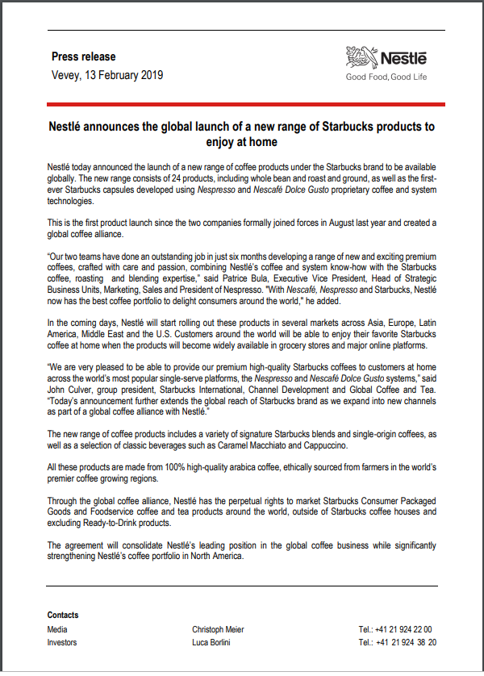

Slide 15
Media/Press Kits
Structures a successful press conference
Normally in folder form - easy access
Provides important background info
Given before or at press conference
News release
Backgrounder
Biography
Photographs
Fact Sheets
Q & A sheets

Slide 16
Media Kits
Make sure information is accurate and answers most fundamental questions
Sufficient background information to allow editor to select a story angle
Not too commercial. Balance and fair
Confine opinions to credible sources
Have visually arresting graphics

Slide 17
Backgrounder
Provide additional information to complement the shorter news release
Longer and more general
4-5 page backgrounder provides editors with more depth and details
Unlimited latitude for the writer
Subject matter dictates the form
News Release Style
Descriptive, narrative style

Slide 18
Biography
Biographical summary of key person/s
Can take many forms
Straight Biography
Narrative Biography

Slide 19
Fact Sheet or Q&A
Fact Sheet is a document that compactly profiles an organization
Company, product lines, top managers, location, sales, leading product, history
Q & A either substitutes for or complements a fact sheet
Lists the FAQs
May substitute for a personal interview

Slide 20
Supporting Materials
Photographs
In real environments, but eye-catching
Focus on product/issue
Have an underlying message

Slide 21
Press Conference
Convene media representatives to make a statement/answer questions
Risky PR activity - must be taken seriously
Will the press show up?
Will they ask the right questions?
Do you want to answer them?
Do you know how to answer?
How will you react if you are cornered or unable to field the question?

Slide 22
Press Conference Planning and Finalize Campaign Strategy
Oct 27, Oct 31, Nov 2 - Prep during class time
On Oct 27, we all meet and discuss press conference planning and finalizing the campaign strategy – break into working teams
On Oct 31, we have split meetings, with lab 301 and 302 in 5055 Vilas and labs 303 and 304 in our 2195 Vilas classroom
On Nov 2, we have split meetings, with lab 301 and 302 in our 2195 Vilas classroom and labs 303 and 304 in 5055 Vilas
Nov 2, outside class meeting for press conference
5:30 PM – 6:30 PM, Hilton Aspire – Sections 301/302
6:30 PM – 7:30 PM, Marriott Boundless - Sections 303/304

Slide 23
Press Conference Planning
10 minutes to set up & process the breaking news story
Welcome journalists and confirm press kits; share if needed
Presentation should last 10 minutes plus 10-minute Q&A
Establish information relay between research directors and account directors/spokespeople. Can select subset to present.
Will discuss event just after departure of journalists.
Press release due at 2:30 p.m. on Thursday, November 2
Send to me and TAs so we can send to 335 Students
Full Electronic Press Kit due just before press conference event
Include press release, fact sheet, pictures and graphics, copy of presentation deck (optional), and supporting materials (zipped into a single file)

Slide 24
Press Conference Roles
PR/Promotions Directors
Write Press Release; Help Prepare presentation
Account Directors
Prepare presentation; Host press conference
Research Directors
Prepare the fact sheet; IM at the press conference
Creative Directors
Make press kit + visual elements of press kit
Media Directors
Generate media contacts (about 20); 10 Tweets

