Slide 1
Interactive Strategy:
SEO & SEM

Slide 2

Interactive/Digital is HOT!
Digital is star performer. Spending increases at double the rate of other media categories. Overall, digital outpacing other media spending

Slide 3
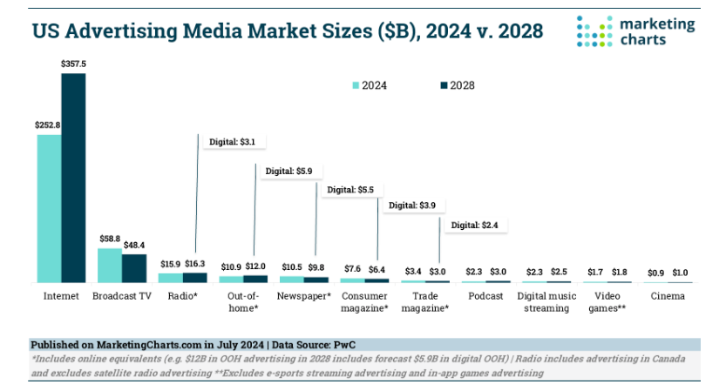
Interactive Growing Fast

Slide 4
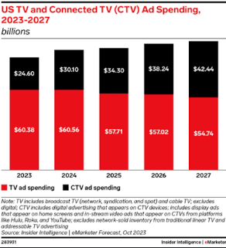
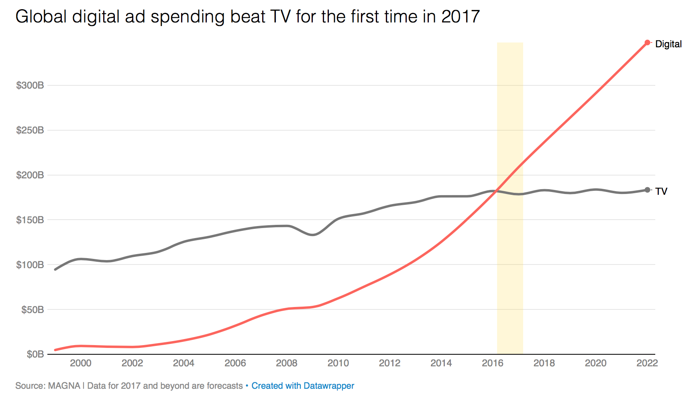
Digital Far Outpaces TV

Slide 5
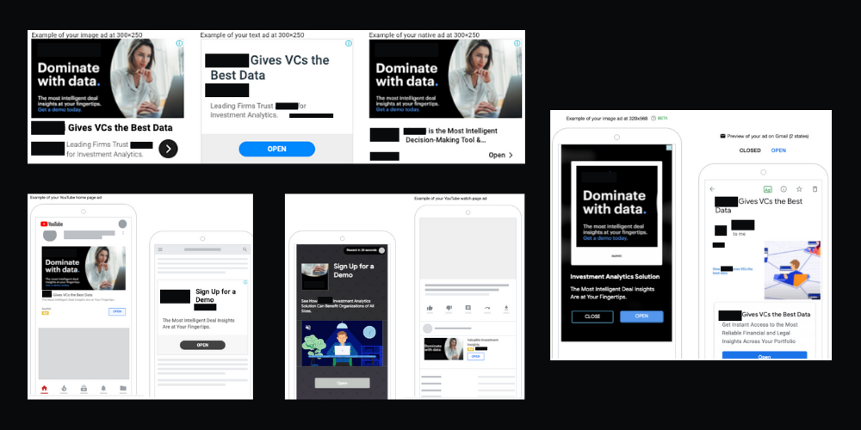
What is Online Advertising?
Advertiser’s message is shown on a destination web page, generally set off in a box at the top, bottom, or side of the page content
Also called Web Advertising / Display Advertising

Slide 6
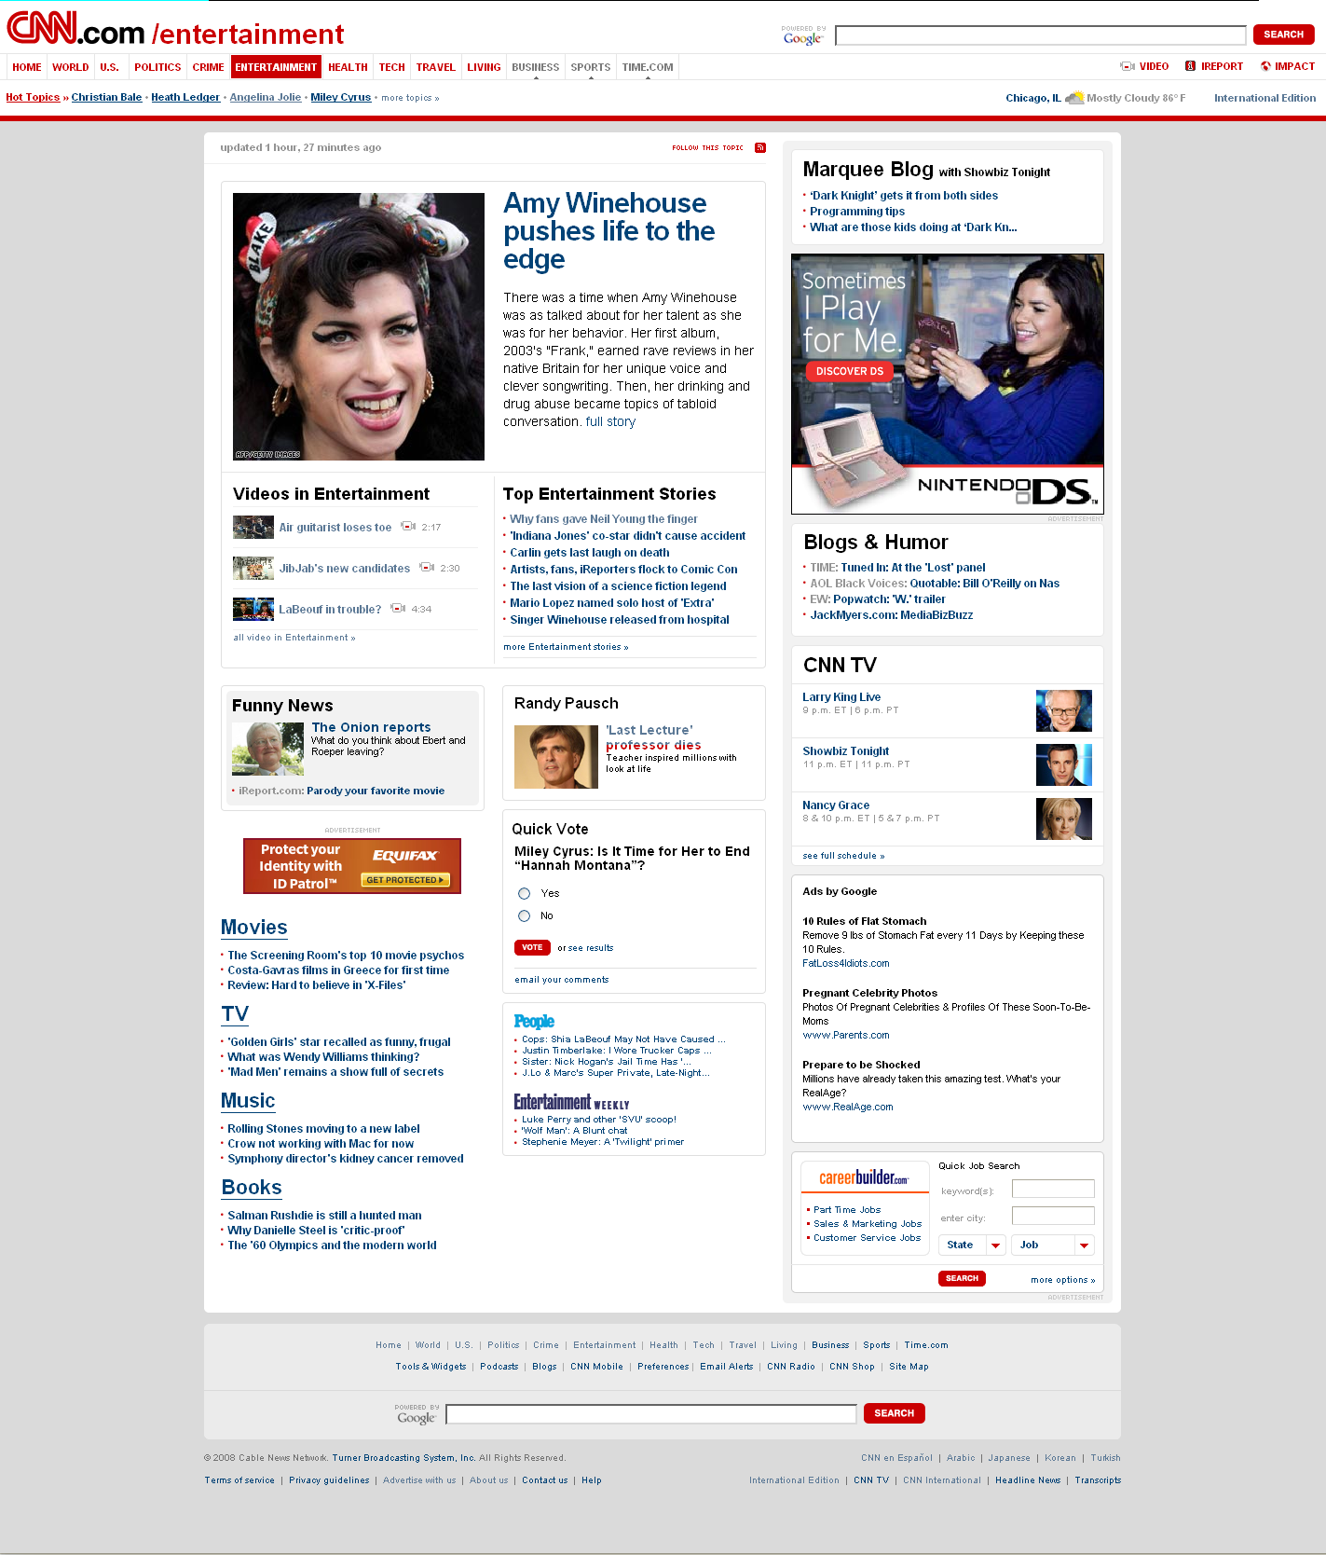
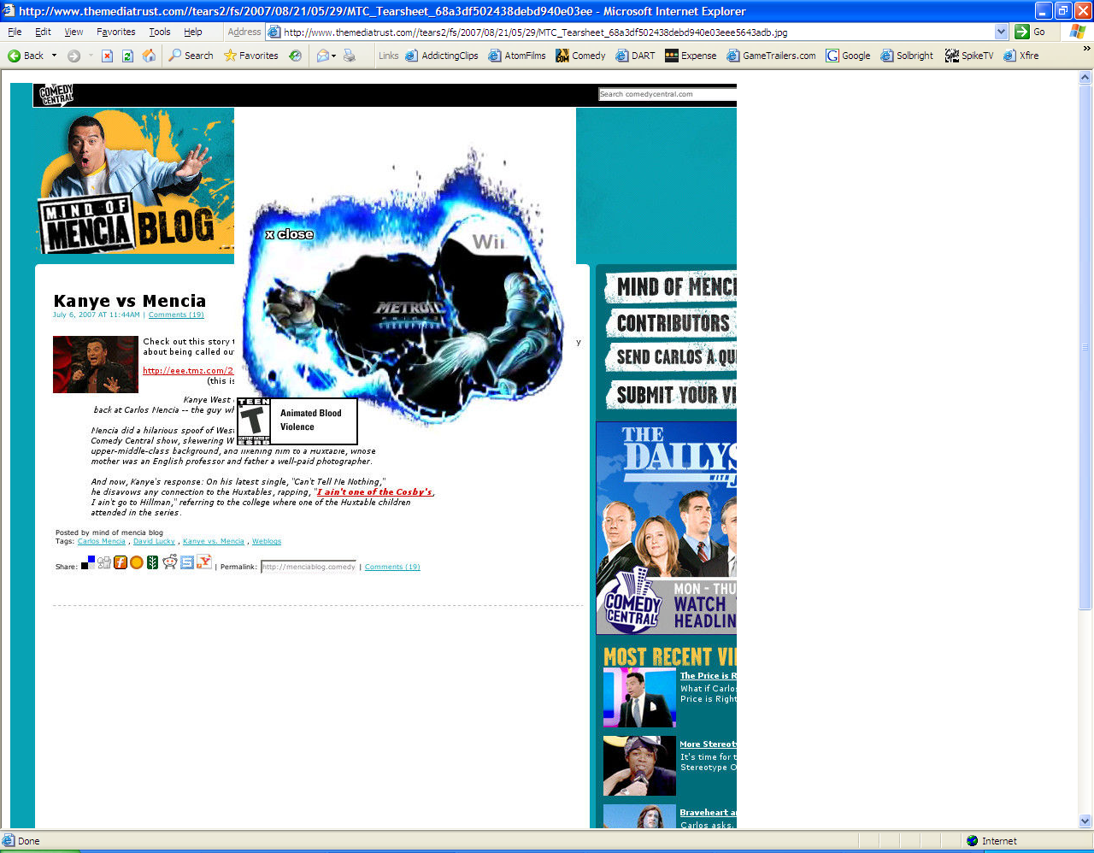
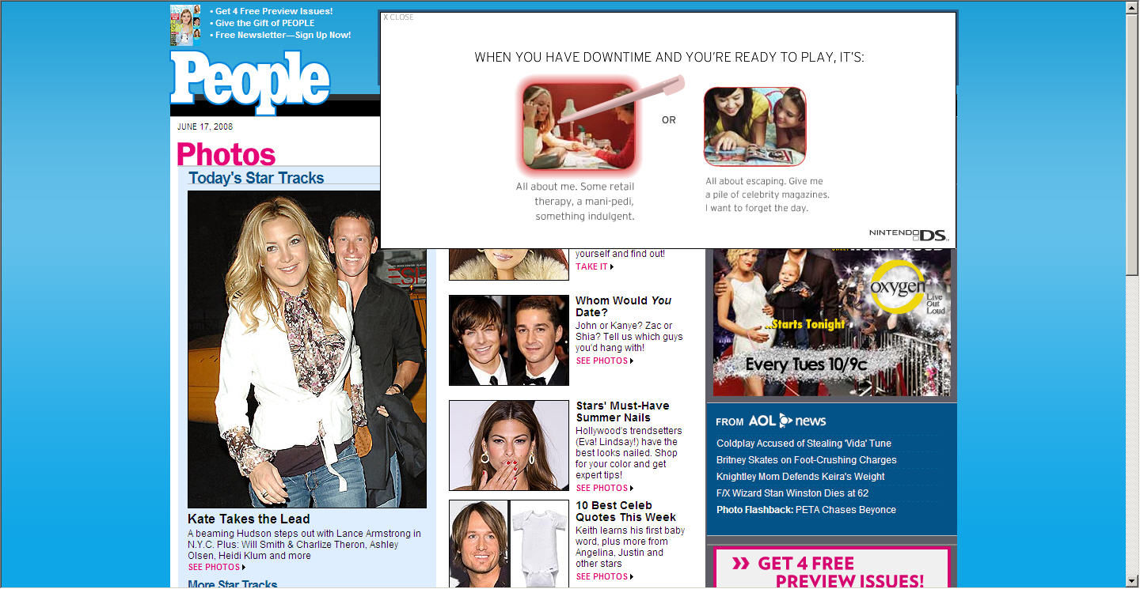
Types of Online Ad Units
Standard Unit – a banner ad that does not move or expand
Rich media Unit – an interactive banner that animates when rolled over
Dynamic Ad Units - multiple versions of copy and assets are provided and the platform runs and optimizes to different iterations
Video Ad Unit – video itself, or embedded video in an ad
Notes:
There are 3 main types of creative ad units when it comes to online advertising:
Standard – don’t move
Rich media – do move, are animated
Video ads -

Slide 7
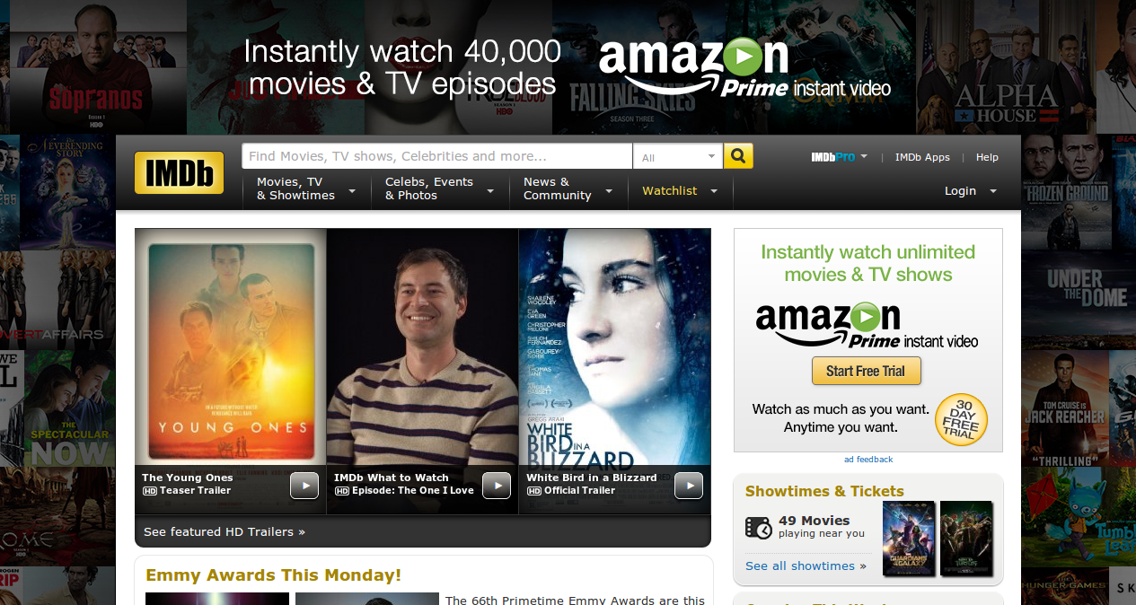
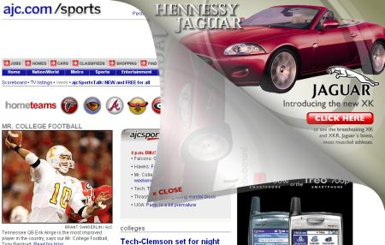
Skins and Peel Backs
Notes:
“Skin” – ads designed so that the sides of the page are seemingly integrated in to the content of the page itself. (Wii)
Page Blockers: Nintendo DS has ‘blocked’ out other competitors from being able to buy ad space – they bought the header and side banner ad on Glam magazine.
Peel back: an ad that seems to “peel back” from the page when you click on it – like this one for the original launch of Wii a few years ago.

Slide 8
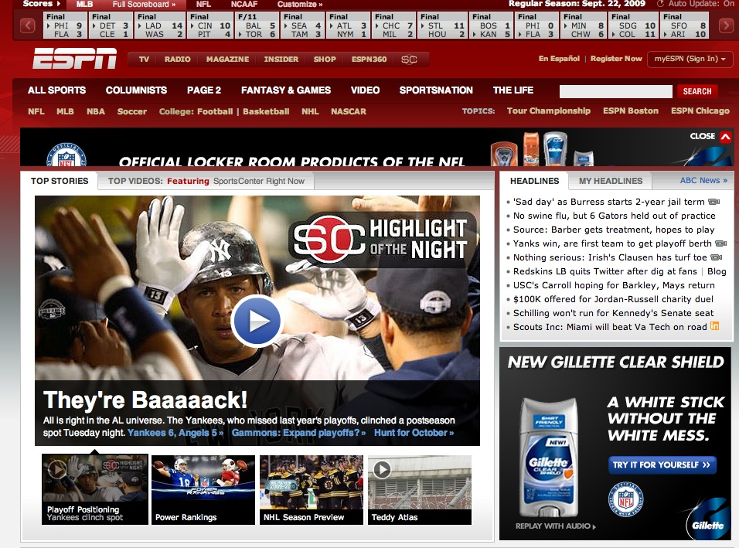
Role of Online Advertising
Immediate feedback from your target consumer
Drives web traffic
Very measurable
  Rich media and video ads have better click through rates; Dynamic can be optimized to max engagement
Extremely targetable
Notes:
What can Online Advertising – advertising do for you – that other forms of advertising can’t do?

Slide 9
Online Ads: Bought Using CPM
Cost per thousand (CPM) is the basis for buying online advertising
The CPM varies on the type of website and for the quality of the ad
  High traffic sites can charge higher CPM
  More interactive, rich media ads have higher CPM

Slide 10
Search Engine Marketing
Largest form of all interactive ad spending
There are 2 kinds of Search:
  SEM = Search Engine Marketing. Paid.
  SEO = Search Engine Optimization. “Free.”
May not seem like “advertising” to you but it is
Notes:
Search marketing is the largest source of all interactive media advertising
Even though it may not feel like ‘advertising’ to you, it is

Slide 11
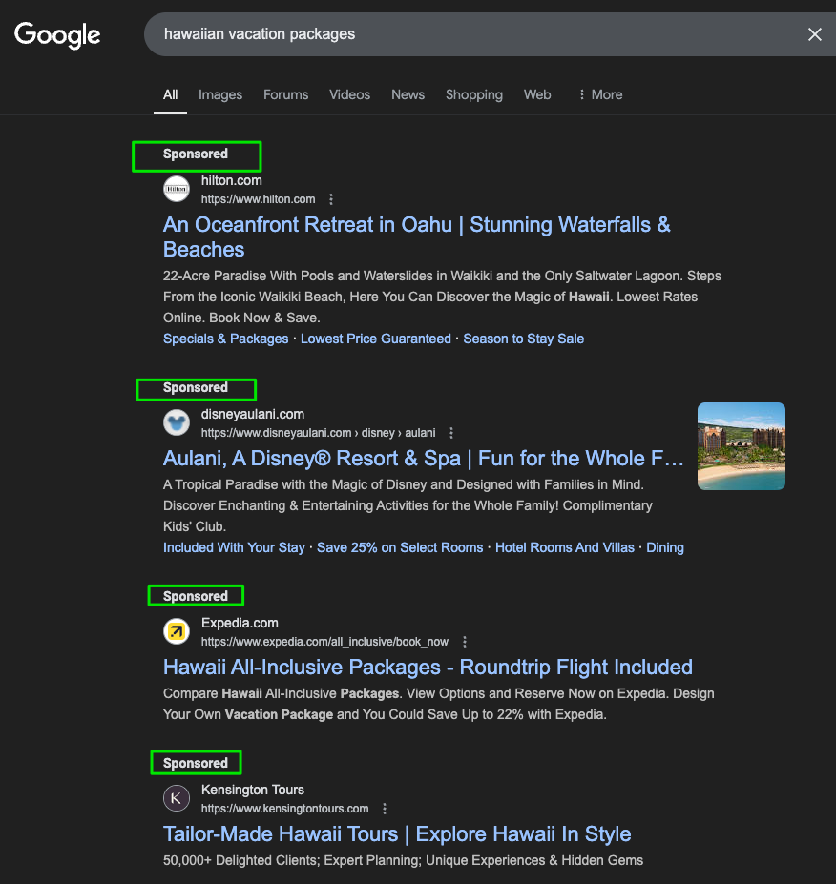
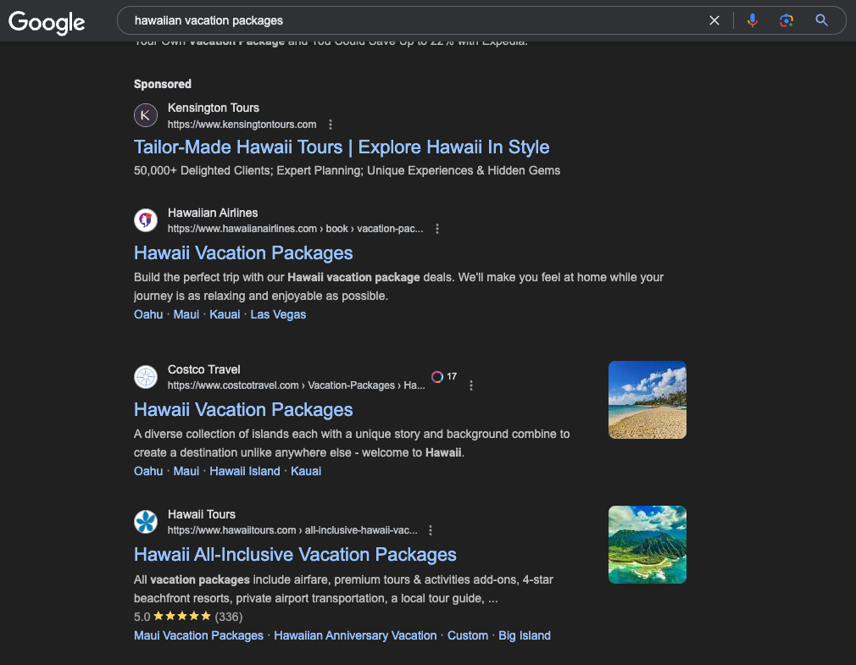
Role of Search
Allow management of vast amounts of info
Helps consumers pre-shop
Generates greater visits to your website
Target message to those who search for you
Changing with AI Search (ex Travel Planning)

Slide 12
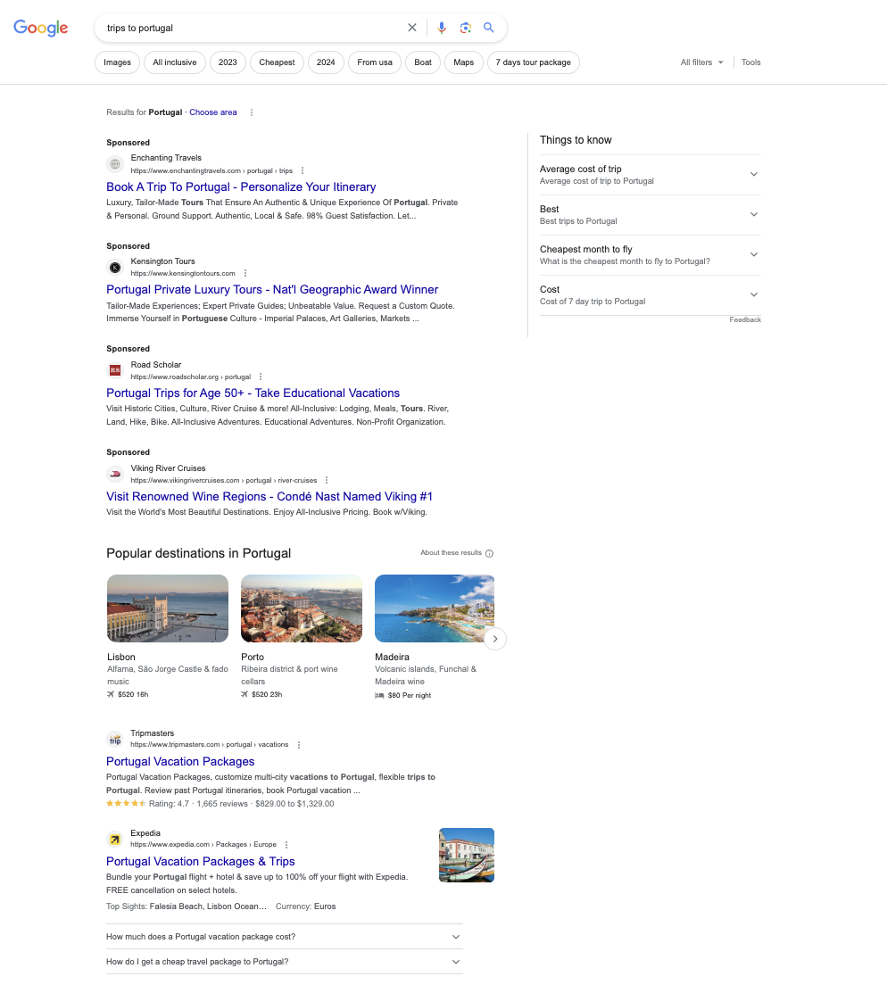
Search Engine Marketing (SEM)
SEM is 25% of all search clicks
When a specific keyword is searched, a text link appears at the top or side of the results or SERP (Search Engine Results Page)
More money a marketer pays per keyword search = the higher it will appear in the search rankings
Link your site to that search term
Companies pay for search only when a user clicks on the link
  Cost per click – Only pay if they click through
Changing with AI Search Engines

Slide 13
How to Buy SEM:
Determine the “keywords” you want to buy
  Relevant to your brand, category, product
  Ones that consumers will ‘search’ on to find you
  Can be more than one just one; some are 1 to 3
Buy it through Google AdWords (or Bing, or Yahoo, etc.)
Track and analyze your results
    Can immediately switch out words if not effective

Slide 14
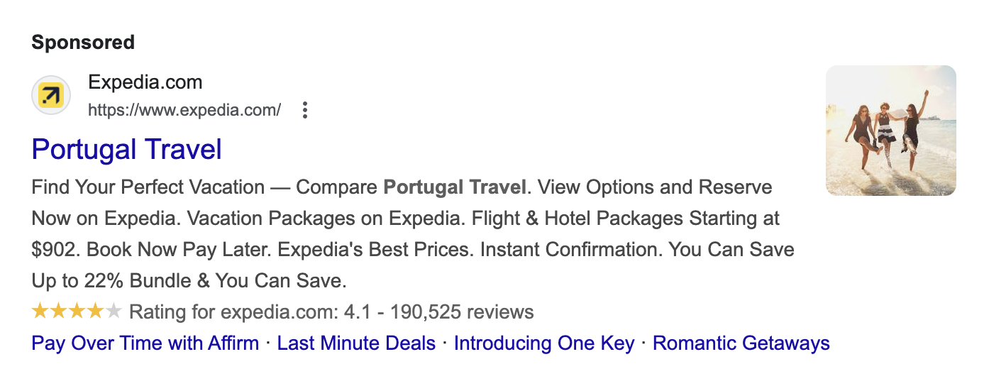
Create Your SEM Ad
1.) HEADLINE. Title – Key Idea
2.) DISPLAY URL
3.) DESCRIPTION - Key benefit phrase

Slide 15
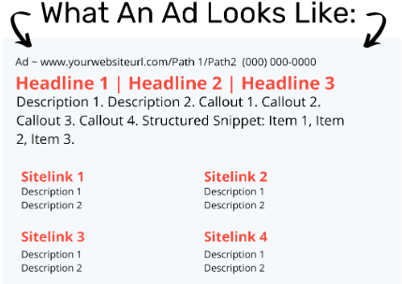
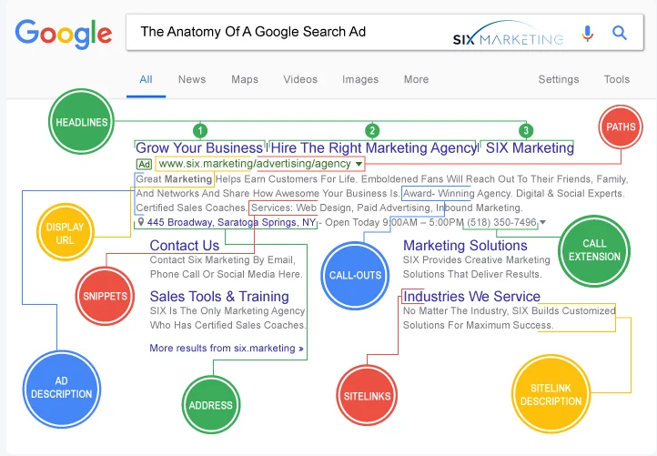
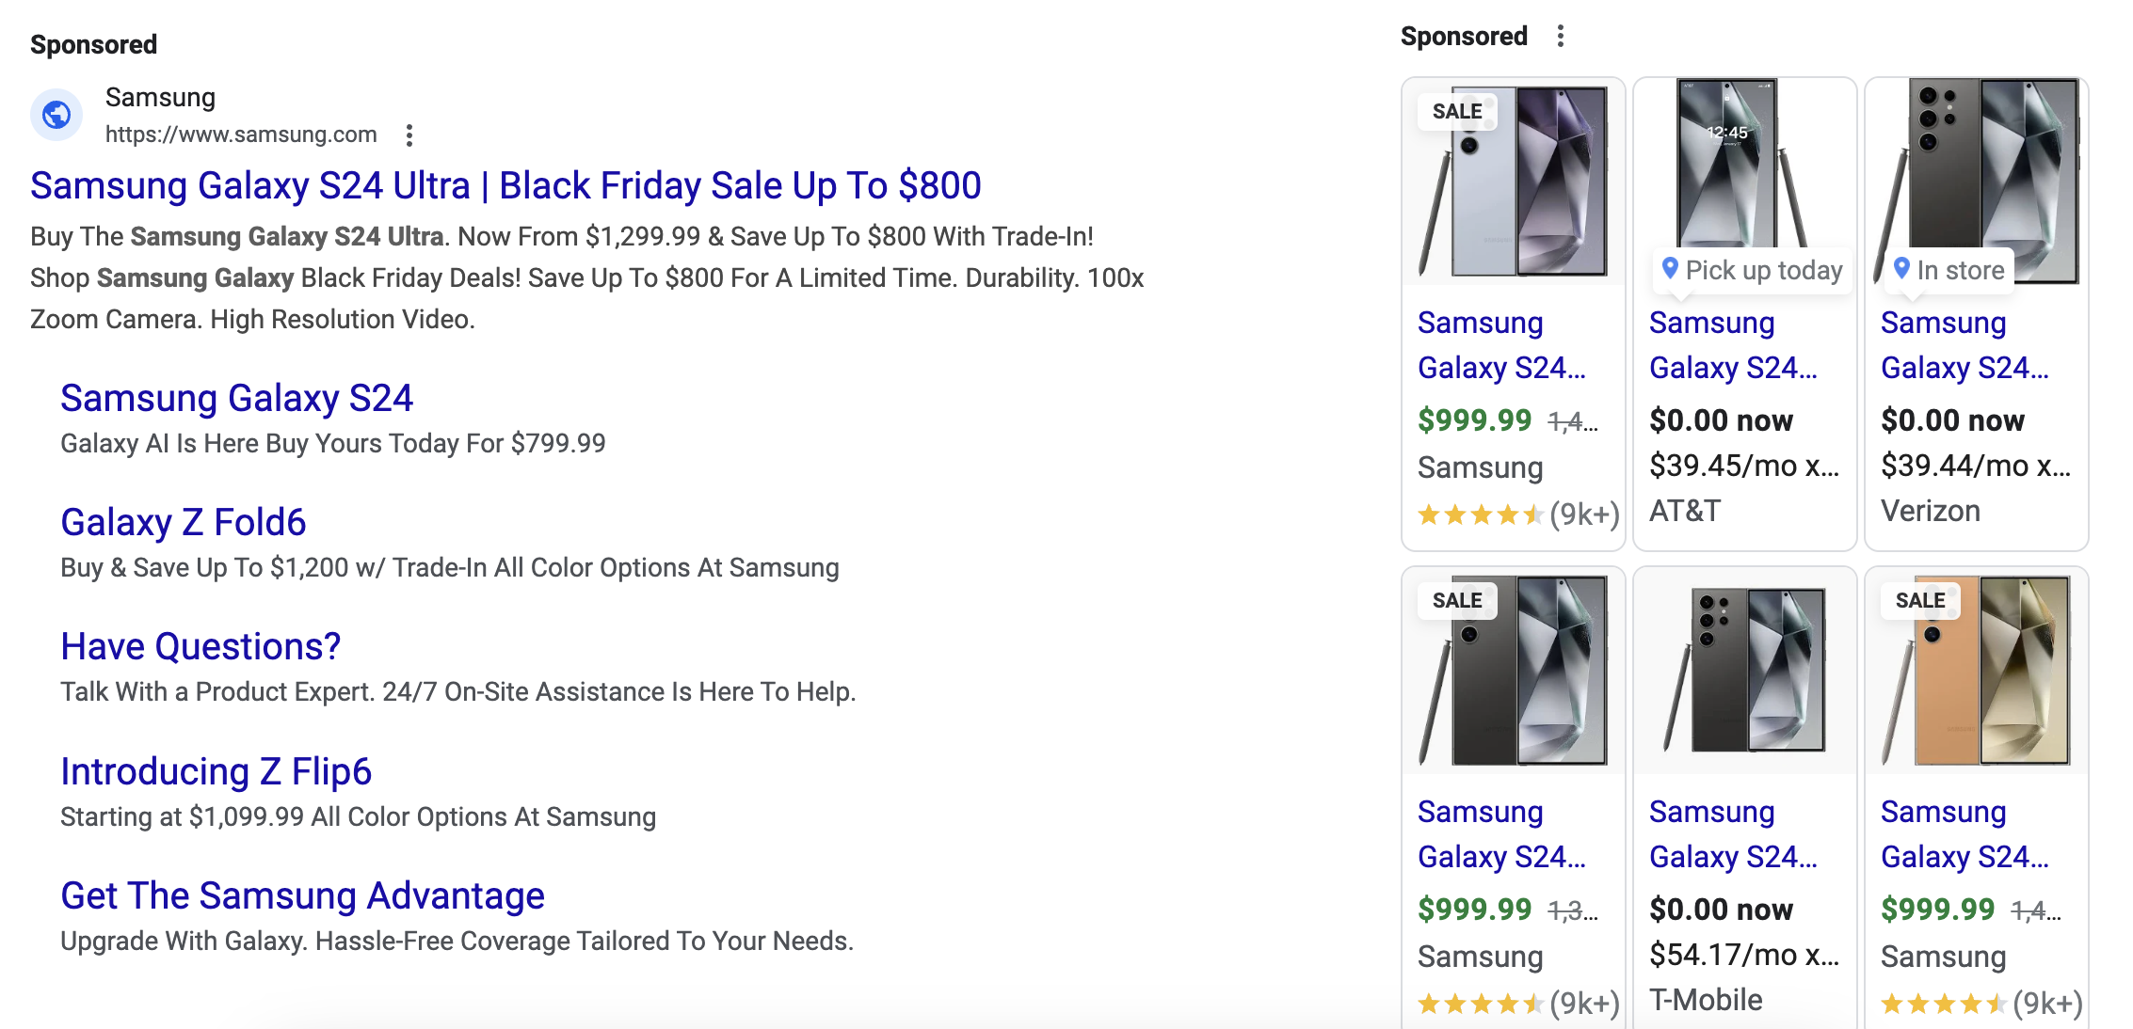

Slide 16
In Class Exercise
You are the Marketing Director for Goodyear
  New “Never Slip” Tires are launching
What are the top 4 keywords you would buy?
When would you buy them for Winter 2025?
Where would you buy SEM?

Slide 17
How to Buy SEM - Example
Samsung wants to buy SEM to promote sales of its new phone
Samsung generates a list of keywords:
  Samsung Galaxy s24, “hot smartphones”, “best smartphones” “top Android phones” “new Samsung phone”
  They agree to pay Google $1.25 per click on their sponsored content for EACH of these words/phrases – each time a consumer clicks on an ad, Google will charge Samsung $1.25
  Can set “max spending amounts” to stay within budget!
  If 1,000,000 consumers click on Samsung Galaxy Ad, how much does Samsung owe Google? 1,000,000 x 1.25 = $1,250,000

Slide 18
How to Buy SEM
SEM paid for on cost per click (CPC) basis
  That means, advertisers ONLY PAY when a consumer clicks on the SEM ad!
  CPC varies based on how popular a word is – common, competitive words have higher CPC
    Legal services, optional medical services = high $
  To buy it, you must first pick the keywords that consumers are most likely to search for related to your product or brand
Question: why NOT buy SEM, then?

Slide 19
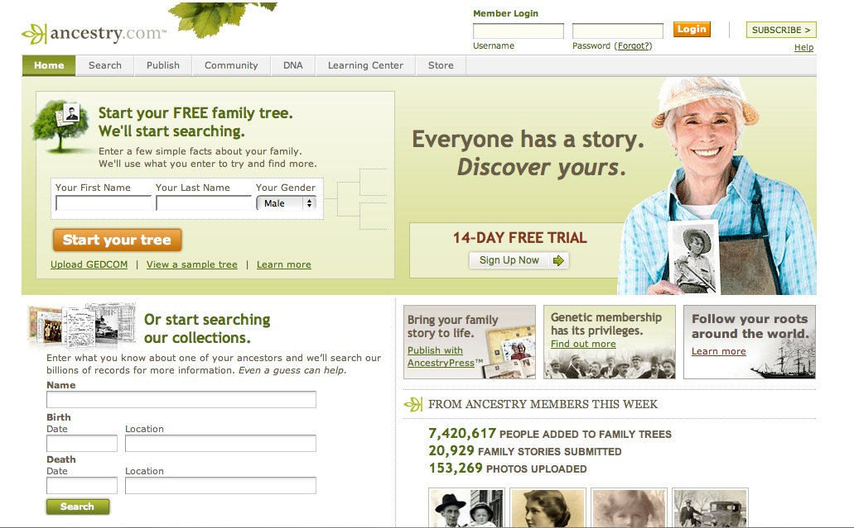
SEO = Search Engine Optimization
SEO = Trying to get your site as high as possible on search algorithm
Results in increasing the traffic to your site
SEO is “free” – you don’t buy it. But, you may have to pay someone on your staff or at an agency to run your site to get good SEO

Slide 20
Search Engine Optimization (SEO)
6 times more effective than a banner ad
Delivers qualified leads - high prospect value
Most user sessions begin at search engines
Most online purchases are made on sites found through search engine listings

Slide 21
SEO is NOT Paid Advertising
SEO – influence rankings in the “natural” (a.k.a. “organic”, a.k.a. “algorithmic”) search results
PPC – paid search advertising on a pay-per-click basis. The more you pay, the higher your placement.
  If you stop paying = stop receiving traffic.
SEM – encompasses both SEO and PPC

Slide 22
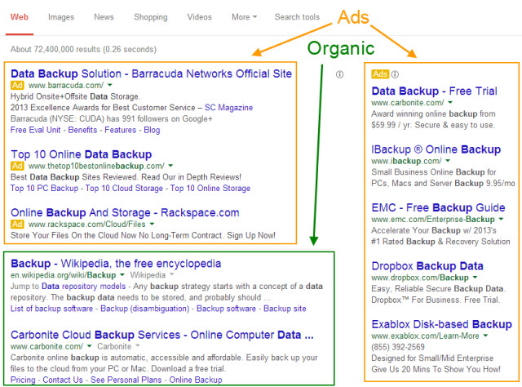
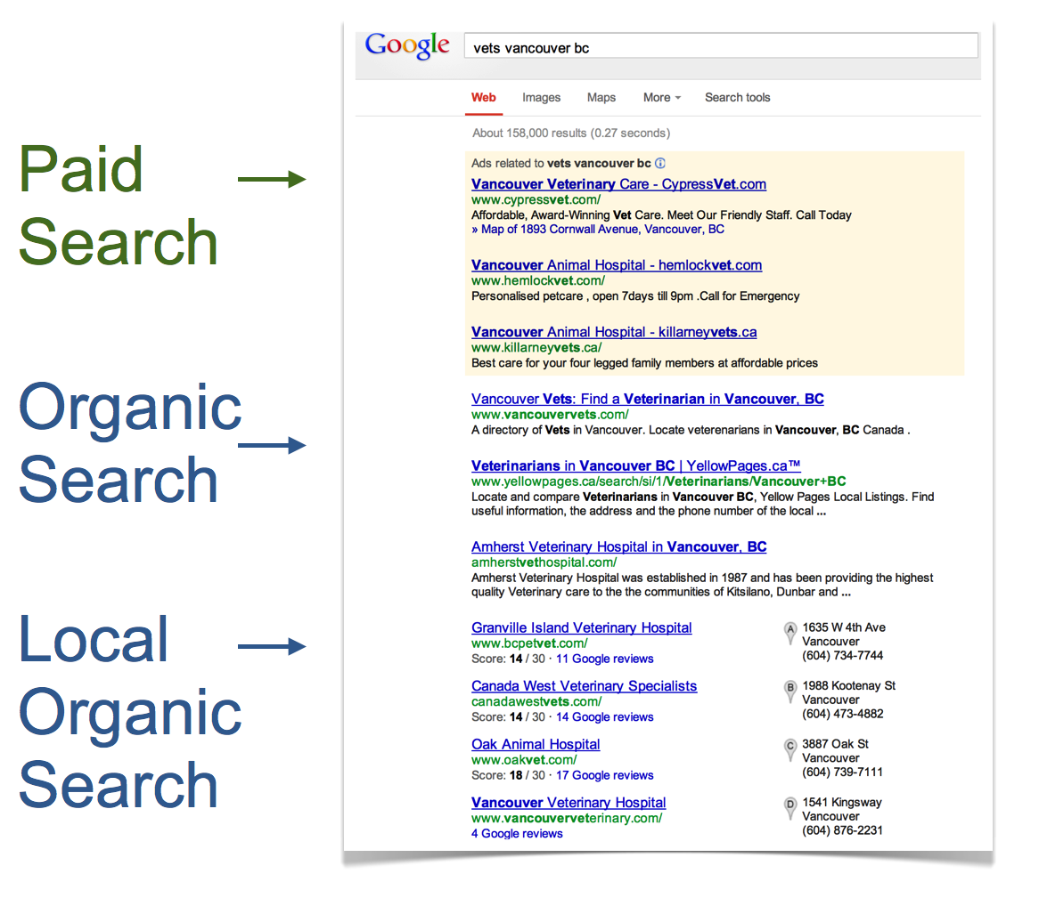

Slide 23
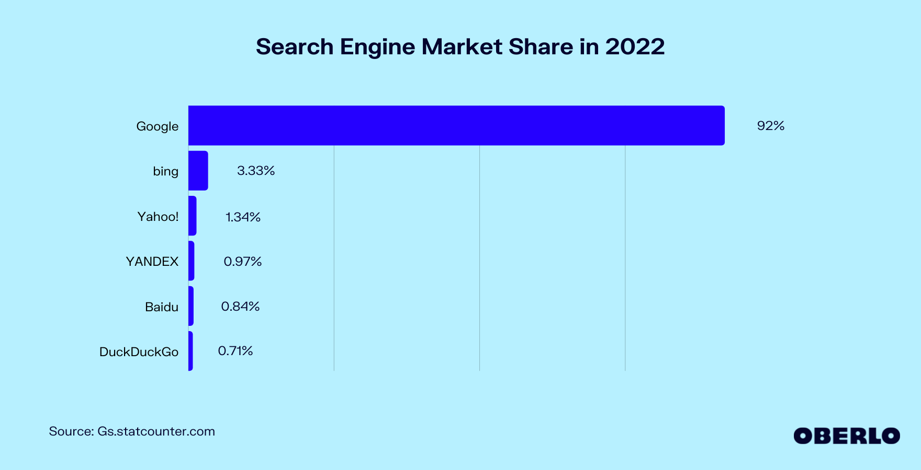
Most Important Search Engines

Slide 24
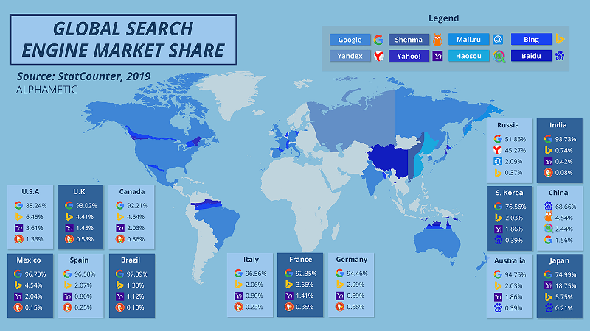
Search Engines Vary By Country
Newest race is in AI-powered Search using LLMs

Slide 25
What Are Searchers Looking For?
Keyword Research
  “Target the wrong keywords and all your efforts will be in vain.”
The “right” keywords are…
  relevant to your business
  popular with searchers
  Score 8-10 on Google’s

Slide 26
Keyword Research
Tools to check popularity of keyword searches
  http://WordTracker.com
  http://KeywordDiscovery.com
  http://adwords.google.com/KeywordPlanner
  http://www.google.com/trends/
  http://ubersuggest.org/

Slide 27
Begin The 7 Steps
1) Get Your Site Fully Indexed
2) Get Your Pages Visible
3) Build Outlinks & PageRank
4) Build Backlinks – outside links in
4) Leverage Your PageRank
4) Encourage Clickthrough
6) Track the Right Metrics
7) Avoid Worst Practices

Slide 28
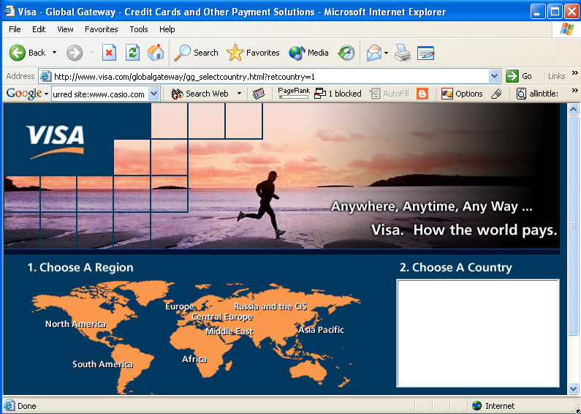
Pretty good title

Slide 29
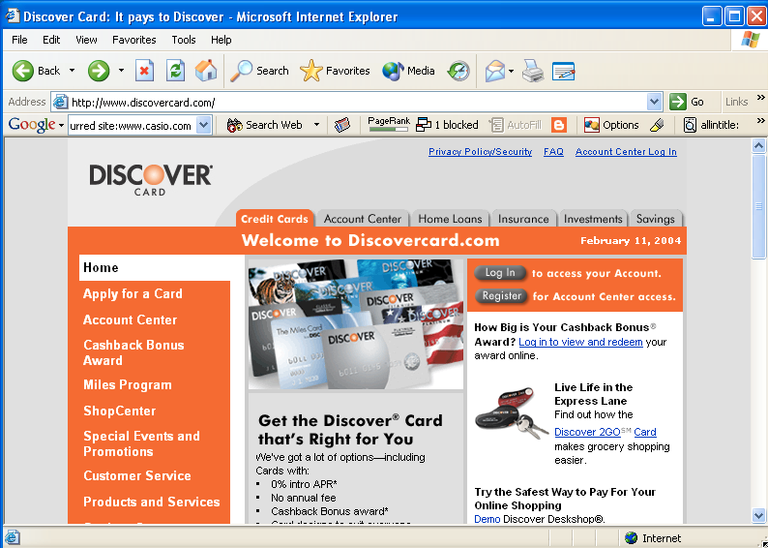
Not so good title – where’s the phrase “credit card”?

Slide 30
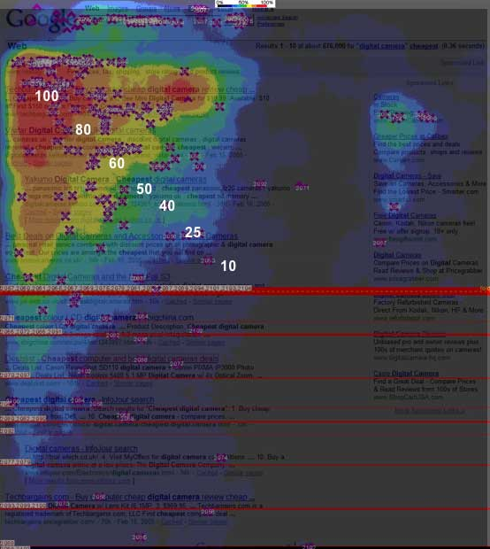
Where do searchers look?
(Enquiro, Did-it, Eyetools Study)

Slide 31
In Summary
Focus on the right keywords
Have great keyword-rich content
Build links, and thus your PageRank™
Spend that PageRank™ wisely within site
Measure the right things
Continually monitor and benchmark

