Slide 1
Media Strategy and Connections Planning

Slide 2
Campaign Strategy
Objectives – What are your goals?
Targeting – Who are your best prospects?
Timing – When to market the product/service?
Geography – Where to concentrate your efforts?
Positioning – What’s your place relative to competition?
Brand personality – Human characteristics of your brand?
Competitive Advantage – What differentiate your brand?
Then do the Creative Brief

Slide 3
Objectives
Sales objectives – focused on direct action, such as a buying response
Goal: generate short-term increases in sales. Be realistic. Ex. 1-2% increase
Communications objectives – focused on building awareness or image.
Goal: create and improve knowledge or favorable perception of the product. Ex. 8 to 10% increase

Slide 4
Advertising Pyramid
Action
Desire
Conviction
Comprehension
Awareness

Slide 5
Targeting
Determining your best prospects
Not all prospect groups should be targets
Must prioritize among possibilities
Primary, secondary, tertiary markets
Users, buyers, and influencers
Research identifies prospects
Strategy defines targets
Define them demographically - broader
Profile them to create a portrait - specific

Slide 6
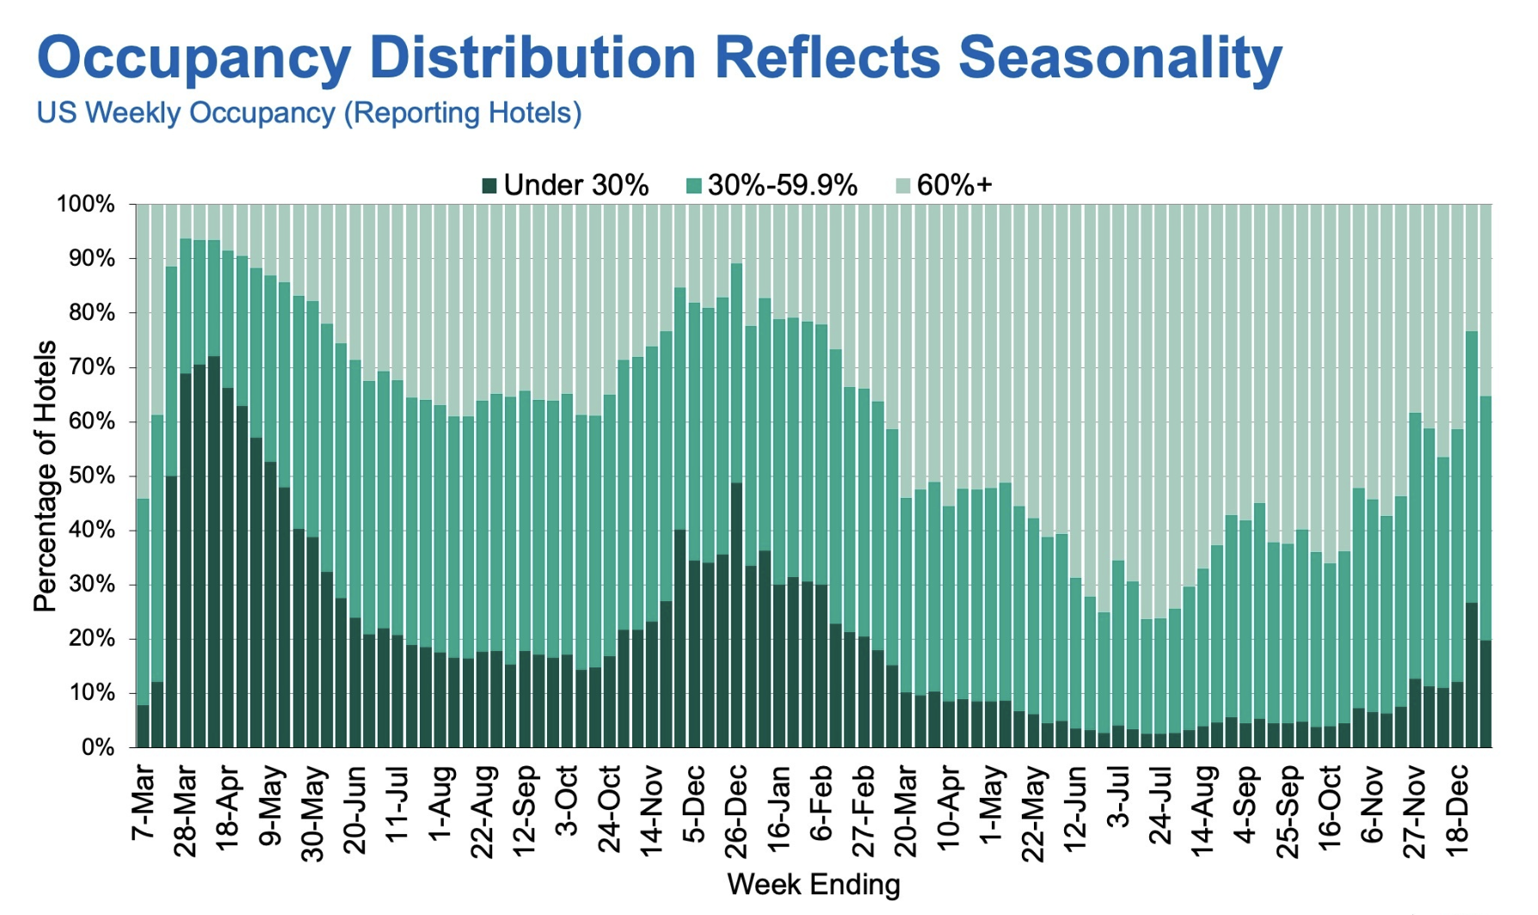
Geography and Timing
What parts of the country? What types of markets? What areas of a market?
Regions, DMAs, metro rings
What times of the year? What holiday seasons? What other timing factors?
Time of year, month, week, and day

Slide 7
Position and Personality
What is your place in the market?
How are you understood by consumers?
What can you deliver to consumers?
What human characteristics/personality traits can be attributed to your brand?
Must be something consumer can relate to

Slide 8
Competitive Advantage
What give you an edge on competitors?
A unique set of features that are seen as significant and superior by consumer
Key to brand loyalty and brand equity
Cost – Maximize value to consumers (Walmart)
Differentiation – Unique experience (Apple)
Niche – Focus on narrow market (Rolex)

Slide 9
Message Strategy/Creative Brief
Like the ROI Springboard Technique
7 Question Strategy Format
1. Who are you talking to?
2. What's your point?
3. What's the key word?
4. Why should I care?
5. Why should I believe you?
6 What do you want me to do?
7. How should I feel?
Use language of the heart.

Slide 10
Focus Situation Analysis to Align
As you finalize the campaign strategy, you should also revisit the situation analysis to focus on those aspects that the account strategy addresses
Chekhov's gun – every element in a narrative must be necessary, and irrelevant elements should be removed - a gun in Act 1 must be fired by Act 3. Attributed to famous Russian playwright, Anton Chekhov.
Sections on public opinion, media coverage, media use of prospects, and category creative may be used to introduce those sections. Other elements eliminated.

Slide 11
Questions?

Slide 12
All Linked to Media Planning
Function of Media Planning
Media Planning Objectives/Strategies
Media Selection
Media Information Sources
Media Outlets and Options
Notes:
Coverage: Broadcasting
Targeting: Narrowcasting
Support:
1. Multii-channel visibility
2. Local directives
What makes someone involved:
1. Expense
2. Infrequent purchase
3. Complicated decision
4. Complicated product
5. Negative consequences of bad decision
6. Importance of product to daily life
7. Connectiion to self-image

Slide 13
Functions of Media Planning
Goal: Delivering ad to target audience
The Big Decisions:
Which audience?
Where?
When?
How long?
Increasing complexity of media planning
Notes:
Coverage: Broadcasting
Targeting: Narrowcasting
Support:
1. Multii-channel visibility
2. Local directives
What makes someone involved:
1. Expense
2. Infrequent purchase
3. Complicated decision
4. Complicated product
5. Negative consequences of bad decision
6. Importance of product to daily life
7. Connectiion to self-image

Slide 14
Aperture in Media Planning
The ideal moment for exposure to ad
Consumer in info-seeking mode
Consumer in purchase mode
Interest and attention are high
Notes:
Coverage: Broadcasting
Targeting: Narrowcasting
Support:
1. Multii-channel visibility
2. Local directives
What makes someone involved:
1. Expense
2. Infrequent purchase
3. Complicated decision
4. Complicated product
5. Negative consequences of bad decision
6. Importance of product to daily life
7. Connectiion to self-image

Slide 15
Media Planning Objectives
Reaching the target: vehicle selection
Geography: where to advertise
Timing: when to advertising
Duration: how long to advertise
Notes:
Coverage: Broadcasting
Targeting: Narrowcasting
Support:
1. Multii-channel visibility
2. Local directives
What makes someone involved:
1. Expense
2. Infrequent purchase
3. Complicated decision
4. Complicated product
5. Negative consequences of bad decision
6. Importance of product to daily life
7. Connectiion to self-image

Slide 16
Reaching the Target
Matching info on:
Target audience profile
Mass media audiences
Categories of information:
Audience demographics
Product user characteristics
Notes:
Coverage: Broadcasting
Targeting: Narrowcasting
Support:
1. Multii-channel visibility
2. Local directives
What makes someone involved:
1. Expense
2. Infrequent purchase
3. Complicated decision
4. Complicated product
5. Negative consequences of bad decision
6. Importance of product to daily life
7. Connectiion to self-image

Slide 17
Geography: Where
Geographic sales differences
Differential dollar allocations
Regional distribution patterns
Focused advertising expenditures
Targeted markets or hubs
Spot market emphasis on core locations
Notes:
Coverage: Broadcasting
Targeting: Narrowcasting
Support:
1. Multii-channel visibility
2. Local directives
What makes someone involved:
1. Expense
2. Infrequent purchase
3. Complicated decision
4. Complicated product
5. Negative consequences of bad decision
6. Importance of product to daily life
7. Connectiion to self-image

Slide 18
Timing: When
Seasonal timing
Holiday timing
Days-of-the-week timing
Hours-of-the-day timing
When is as important as Where
Notes:
Coverage: Broadcasting
Targeting: Narrowcasting
Support:
1. Multii-channel visibility
2. Local directives
What makes someone involved:
1. Expense
2. Infrequent purchase
3. Complicated decision
4. Complicated product
5. Negative consequences of bad decision
6. Importance of product to daily life
7. Connectiion to self-image

Slide 19
Duration: How Long
Size of the advertising budget
May need to select times to focus
Consumer-use cycles
When are sales highest, when is purchase?
Competitors’ advertising
Share of voice / Share of dollars
Notes:
Coverage: Broadcasting
Targeting: Narrowcasting
Support:
1. Multii-channel visibility
2. Local directives
What makes someone involved:
1. Expense
2. Infrequent purchase
3. Complicated decision
4. Complicated product
5. Negative consequences of bad decision
6. Importance of product to daily life
7. Connectiion to self-image

Slide 20
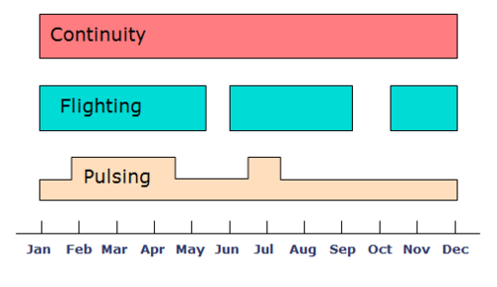
Timing/Duration Strategies
Continuity
Flighting w/ hiatus
Pulsing
Notes:
Coverage: Broadcasting
Targeting: Narrowcasting
Support:
1. Multii-channel visibility
2. Local directives
What makes someone involved:
1. Expense
2. Infrequent purchase
3. Complicated decision
4. Complicated product
5. Negative consequences of bad decision
6. Importance of product to daily life
7. Connectiion to self-image

Slide 21
The Media Environment
Content context:
compatibility with product
Media clutter
Share of voice in a given medium
Notes:
Coverage: Broadcasting
Targeting: Narrowcasting
Support:
1. Multii-channel visibility
2. Local directives
What makes someone involved:
1. Expense
2. Infrequent purchase
3. Complicated decision
4. Complicated product
5. Negative consequences of bad decision
6. Importance of product to daily life
7. Connectiion to self-image

Slide 22
Staging the Media Plan
Starting point is grounded in planning:
Situation Analysis and Account Strategy
Media objectives
What are the media goals?
Strategy: Media selection
Finding the most appropriate media
Flow Chart
Scheduling
Month-by-month budget allocation
Notes:
Coverage: Broadcasting
Targeting: Narrowcasting
Support:
1. Multii-channel visibility
2. Local directives
What makes someone involved:
1. Expense
2. Infrequent purchase
3. Complicated decision
4. Complicated product
5. Negative consequences of bad decision
6. Importance of product to daily life
7. Connectiion to self-image

Slide 23
Marketing Sources
Important factors:
Area sales patterns
Month-by-month sales/demand patterns
Distribution patterns
Competitors’ advertising patterns
Notes:
Coverage: Broadcasting
Targeting: Narrowcasting
Support:
1. Multii-channel visibility
2. Local directives
What makes someone involved:
1. Expense
2. Infrequent purchase
3. Complicated decision
4. Complicated product
5. Negative consequences of bad decision
6. Importance of product to daily life
7. Connectiion to self-image

Slide 24
Media Sources
Media selection based on:
Audience research
Media costs
Important factors:
Media popularity/usage
Media audience profiles
Media cost forecasting
Media characteristics
Notes:
Coverage: Broadcasting
Targeting: Narrowcasting
Support:
1. Multii-channel visibility
2. Local directives
What makes someone involved:
1. Expense
2. Infrequent purchase
3. Complicated decision
4. Complicated product
5. Negative consequences of bad decision
6. Importance of product to daily life
7. Connectiion to self-image

Slide 25
Strategic Use of Advertising Media
Purpose
Coverage – lots of reach – blanket the market
Targeting – focused on core demo - narrowcast
Support – media to remind and reinforce
Audience/Product Involvement
High vs. Low Involvement
Type of Appeal
Rational (Cognitive) vs. Emotional (Affective)
Notes:
Coverage: Broadcasting
Targeting: Narrowcasting
Support:
1. Multii-channel visibility
2. Local directives
What makes someone involved:
1. Expense
2. Infrequent purchase
3. Complicated decision
4. Complicated product
5. Negative consequences of bad decision
6. Importance of product to daily life
7. Connectiion to self-image

Slide 26
Advertising Media
Print Media
Place Media
Broadcast Media
Narrowcast Media
Digital / Interactive Media
More on this in Week 12/13

Slide 27
Print Media
Print Media
Newspapers
National Newspapers
Metro Daily Newspapers
Regional Daily Newspapers
Local Weekly Newspapers
Magazines
General circulation magazines
Specialized Magazines
Trade Magazines

Slide 28
Newspaper Readers
Mass market (relatively wide coverage)
Metro market coverage of some demos
Readership increases with:
Age
Education
Income

Slide 29
Advantages and Disadvantages of Newspapers
Geographic targeting +
High credibility +
Permanence/User-paced +
High information potential +
Poor reproduction quality -
One day life span -
Unattractive layouts -
Hard to measure actual exposure -
Massive decline in readership -

Slide 30
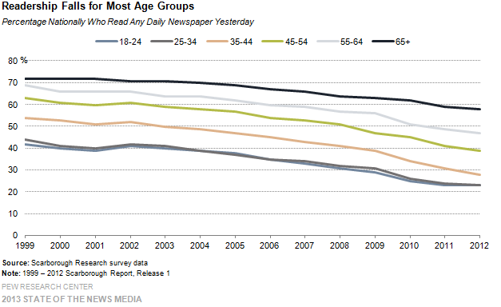
Decline Across Ages

Slide 31
Strategic Use of Newspapers
Coverage medium
Geographic targeting
Local retail ads
High involvement consumers/products
Rational appeals
Notes:
Mass coverage within a given market

Slide 32
Advantages and Disadvantages of Magazines
High color reproduction quality +
High credibility +
Permanence/User-paced +
Pass along factor +
High information potential +
Hard to measure actual exposure -
Longer lead times -
Expensive: High CPMs -
Decline in readership, esp. news magazines -

Slide 33
Strategic Use of Magazines
Highly specialized target marketing
Geographic targeting with zip editions
High involvement consumers/products
Rational and emotional appeals
Notes:
Zip editions target:
1. Particular zip codes
2. Particular types of zip codes

Slide 34
Place/Outdoor Media
Billboards
Transit
Ambient

Slide 35
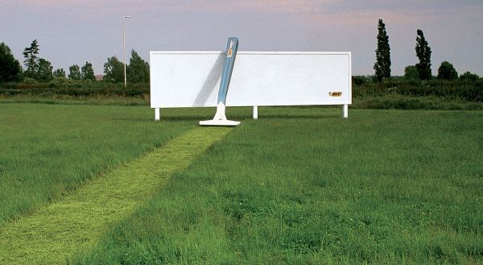
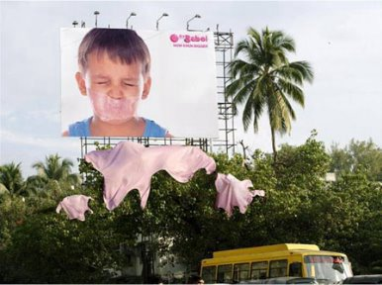
Billboards

Slide 36
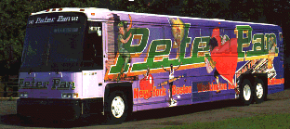
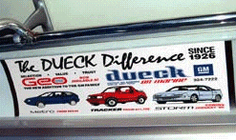
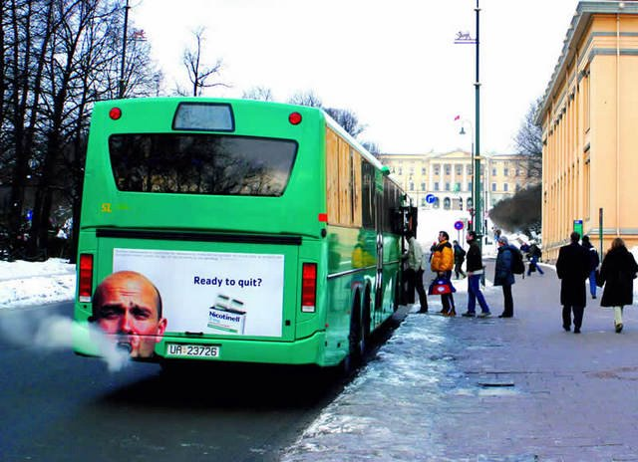
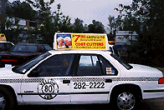
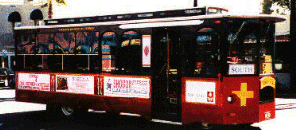
Transit Advertising

Slide 37
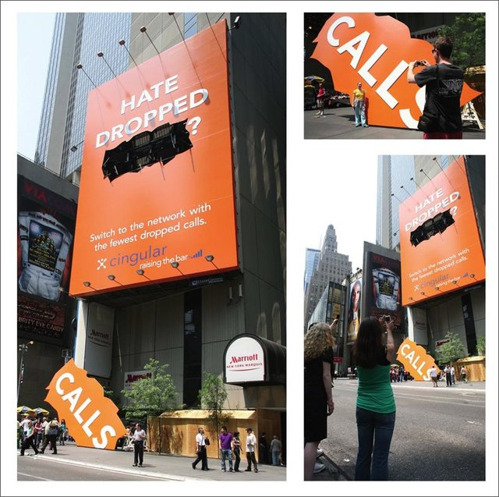
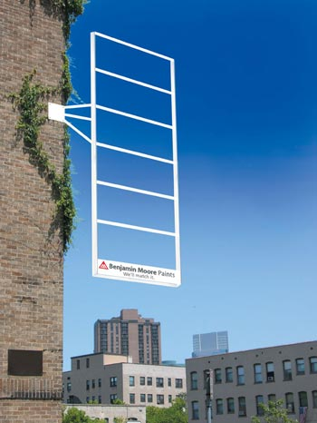
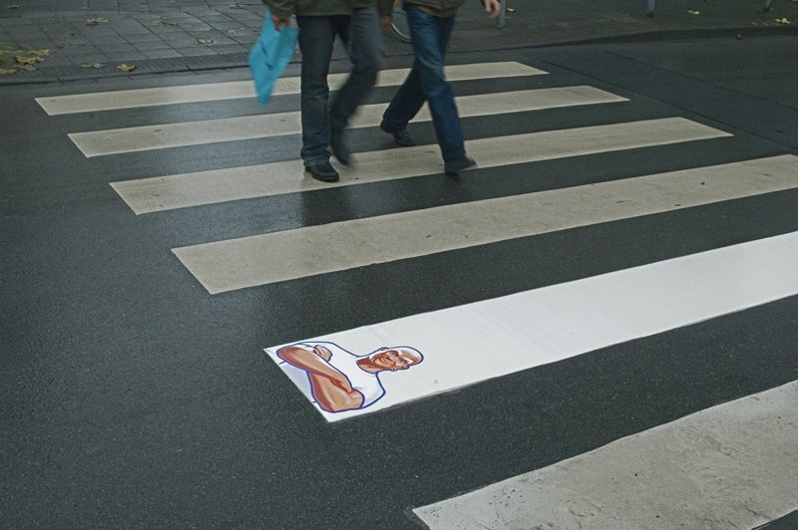
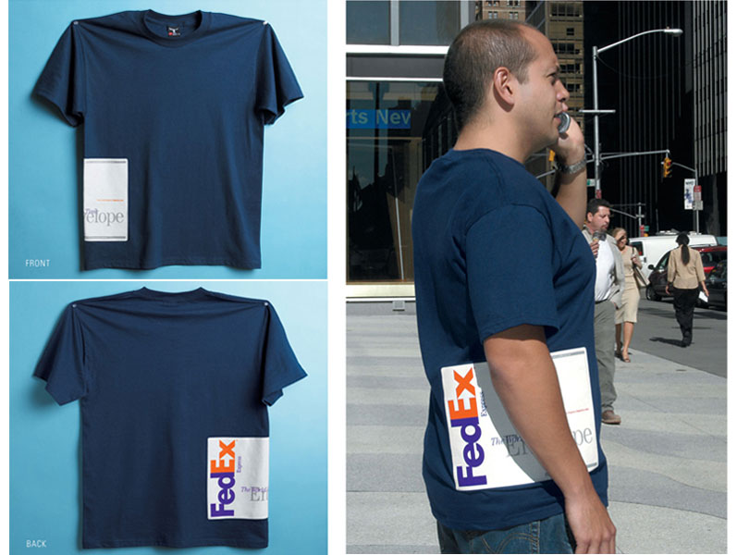
Ambient

Slide 38
Advantages and Disadvantages of Billboards
High frequency +
Geographic flexibility +
Low cost per exposure +
Fleeting message -
Limited information -
Long lead times -
Location unavailability -
Visual pollution -

Slide 39
Advantages and Disadvantages of Transit
Captive audience +
Low cost +
Supports mass transit systems +
Lack of status -
Cluttered environment -
Limited information potential -

Slide 40
Strategic Use of Outdoor
Good coverage medium
Localized support medium
Low involvement products (billboards) vs. High and low involvement products (transit)
Notes:
Localization:
1. Connecting to local retailers
2. Giving the local angle
3. Building multi-media visibility
4. Closet to point of purchase

Slide 41
Explosion of Ambient
Reasons for growth of ambient media:
A decline in power of traditional media.
Greater demand for point-of-sale contact.
Narrowcasting to specific audience.
Extremely versatile.

Slide 42
Broadcast Media
National Television
Local Television
Cable Television
Syndicated Television
Radio

Slide 43
Advantages of TV
Mass coverage
Relatively Low cost per thousand (CPM)
Some content-based targeting
Can target by spot/local markets
High impact
Creativity/stopping power
Notes:
CPMs used to:
1. Set advertising rates
2. Compare the costs of different media and vehicles

Slide 44
Disadvantages of TV
High production costs
High absolute media costs, even for spot
Impermanence/Not user-paced
Brevity = Low information potential
Clutter
Zipping and Zapping

Slide 45
Strategic Use of National TV
Coverage medium
Low involvement consumers/products
Emotional appeals

Slide 46
Cable Television
Superstations
News channels
Entertainment channels
Specialized channels

Slide 47
Advantages and Disadvantages of Cable TV
Similar to National Television
Low cost: absolute and CPM +
More specialized audiences for targeting +
Often around lower quality ads -
Limited reach / coverage -
Fragmented audience -

Slide 48
Strategic Use of Cable TV
Targeting with television
Some high involvement consumers with specialized channels
Emotional / rationale appeals

Slide 49
Syndicated Television
First-run syndication
Rerun syndication (off network)

Slide 50
Forms of Television Advertising
Sponsorships
Infomercials
Participation
Breaks within a program
Spot announcements
Breaks between programs

Slide 51
Radio
Network Radio
Syndication
Unwired networks
Satellite Radio
Local Spot Radio

Slide 52
Advantages and Disadvantages of Radio
Low media cost +
Low production costs +
Short lead times +
Captive audiences +
Specialized audiences +
No visuals -
Low information potential -
Impermanence/Not user-paced -
Fragmented audiences -
Complicated media buys -
Clutter -
Streaming alternatives -
Notes:
Users of radio:
1. Station Listeners
2. Music Listeners
3. Talk Listeners
4. News Listeners

Slide 53
Strategic Use of Radio
Good targeting medium
Localized support medium
High and low involvement products/consumers
Rational and emotional appeals
Notes:
Localization:
1. Connecting to local retailers
2. Giving the local angle
3. Building multi-media visibility
4. Closet to point of purchase

Slide 54
Narrowcast Media
Direct marketing
Telemarketing
Direct mail
Yellow pages
Interactive media (The Internet)
Notes:
Reaching consumers to seek an immediate response

Slide 55
Direct Media
Direct Mail
Catalogues
Broadcast media
Infomercials
800 numbers
Telemarketing
Notes:
Reaching consumers to seek an immediate response

Slide 56
Advantages and Disadvantages of Direct
Personalized impact +
Elaborate databases for targeting +
Reaches inaccessible audience +
Measurable exposure/success +
High CPMs -
Junk mail -
High audience refusal rates -
Environmental concerns -
Low-quality mailing lists -

Slide 57
Strategic Use of Direct
Target marketing
Relationship marketing
High involvement consumers/products

Slide 58
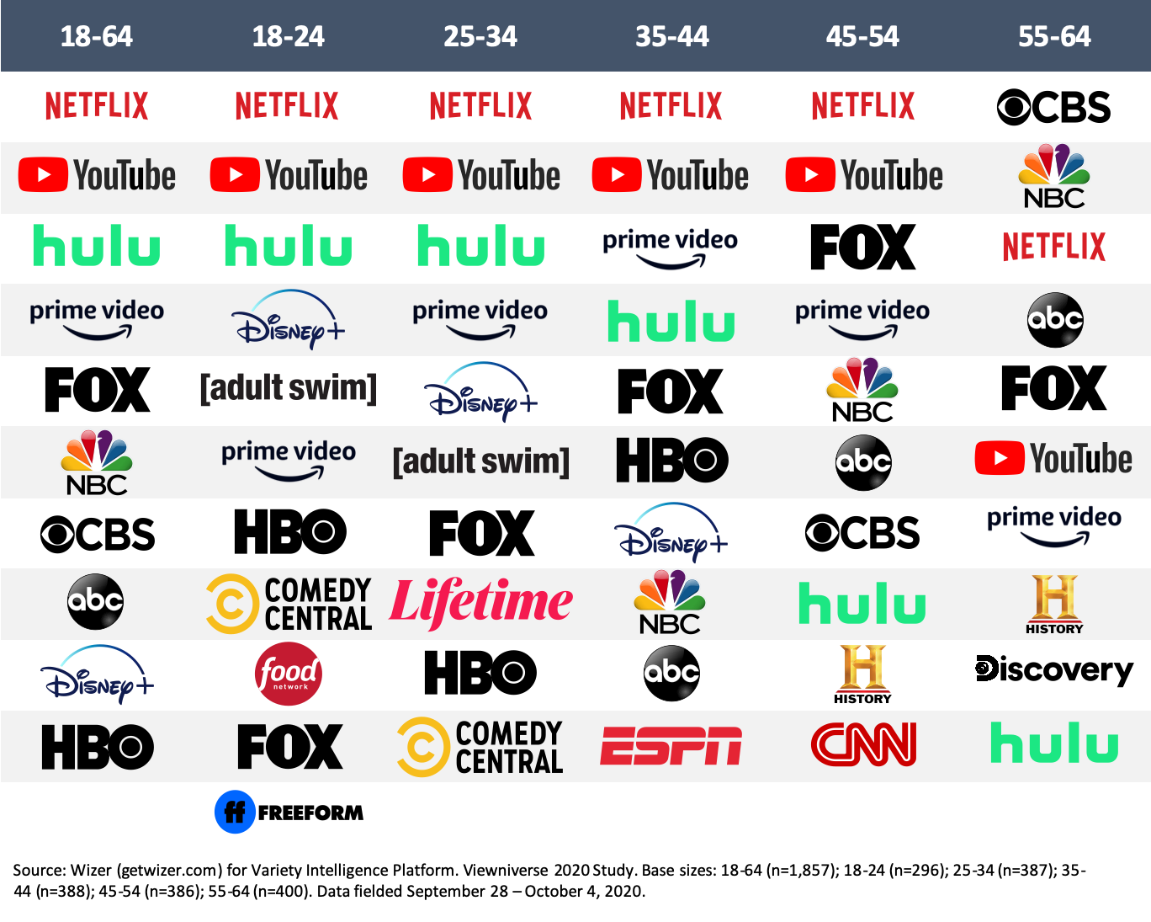
Digital and Social
Rapid adoption/growth
Importance as an advertising medium
Massive shift in advertising dollars

Slide 59
Adoption Curves for Various Media
120
80
60
50
40
20
0
Millions of Users
Radio
TV
Cable
Internet
1922 ‘26 ‘30 ‘34 ‘38 ‘42 ‘46 ‘50 ‘54 ‘58 ‘62 ‘66 ‘70 ‘74 ‘78 ‘82 ‘86 ‘90 ‘94 ‘98 Est
The Internet is the fastest growing medium in history
* Launch of HBO in 1976 was used to estimate the
beginning of cable as an entertainment/ad medium.
** Morgan Stanley Technology Research estimate
(Chart shows the Internet beginning as an entertainment/ad
medium in 1994 because its earlier use was restricted to
governmental activities)
Years to reach 50 MM users
Radio 38
TV 13
Cable 10*
Internet 5**

Slide 60
Advantages and Disadvantages of the Internet
Interactive medium/Active audience +
Affluent, younger, active market +
Permanence/User-paced +
High information potential +
Immediate response +
Micro-fragmented audience -
Different download speeds / connectivity -
Security and privacy issues -
Notes:
Co mbines advantages of other media:
1. Newspapers high info content
2. Slick presentation like magazines
3. Impact of television
4. Can be locally tailored like radio
5. Broadcast and Narrowcast
6. Immediate response like direct response media

Slide 61
Miscellaneous Advertising
Movie trailers
Controlled by motion picture companies and distributors, not theaters
Blimps and planes
Sporting events
Grocery carts
Ticket backs
Rapidly growing list of other ad media

