Slide 1
Media Buying

Slide 2
Lots of Questions
Who am I trying to reach?
How many can I afford to reach?
How often do people need to encounter my message?
In which vehicles should I pursue message space?
When should I communicate (day, week, month, year)?
What markets and regions should receive extra emphasis and which ones can be ignored?
How can I take advantage of emerging media?

Slide 3
Media Selection Procedures
Selection based on audience and costs
What does your target consume?
How much can you afford?
Audience measures
Gross impressions & Gross rating points (GRPs)
Reach & Frequency - How many and how often
Cost per thousand (CPM) and Cost per point (CPP)
Notes:
Coverage: Broadcasting
Targeting: Narrowcasting
Support:
1. Multii-channel visibility
2. Local directives
What makes someone involved:
1. Expense
2. Infrequent purchase
3. Complicated decision
4. Complicated product
5. Negative consequences of bad decision
6. Importance of product to daily life
7. Connectiion to self-image

Slide 4
Gross Impressions
In media, primarily concerned with accumulation of audience
Each audience member exposed to the message is considered an “impression”
Summed to equal “gross impressions”
Audience size = gross impressions for single show
For multiple programs, add audience sizes together for total gross impressions (GI)

Slide 5
Gross Rating Points
Same logic applies to rating points
Rating for individual programs are added together to calculate the total rating points accumulated across a schedule
Gross Rating Points = GRPs
Ex. Rating for Program 1 +
Rating for Program 2 +
Rating for Program 3
Gross Rating Points

Slide 6
GI and GRPs
Gross impressions (GI)
Total number of exposures - duplication counts
Exposures (Ad 1) + Exposures (Ad 2) + Exposures (Ad 3)…
2 ads in 60 minutes each generate 6.5 Million HH impressions + 1 ad in NCIS: Los Angeles generates 8.5 Million HH Impressions
Total impressions = 21.5 Million or 21,500,000 Gis
To Convert to Ratings, must know the total audience size, in this case, Total TV HHs (119.6 Million TV HH in US)
Gross rating points (GRPs)
GRPs = GI / Total population (x 100 to convert to %)
Can be over 100, and often is
5.4 rating + 5.4 rating + 7.1 rating = 17.9 GRPs
GRP’s are easier way of allocating media weight
Notes:
Coverage: Broadcasting
Targeting: Narrowcasting
Support:
1. Multii-channel visibility
2. Local directives
What makes someone involved:
1. Expense
2. Infrequent purchase
3. Complicated decision
4. Complicated product
5. Negative consequences of bad decision
6. Importance of product to daily life
7. Connectiion to self-image

Slide 7
Media Schedules
Program. Rating Aud. Size Units GRPs GI
NCIS: LA 7.1 8.5 10 71.1 85.0
Big Bang 6.0 7.2 8 48.2 57.6
60 Minutes 5.4 6.5 14 76.1 91.0
Olympics 3.7 4.4 9 33.1 39.6
Total 41 228.4 273.2

Slide 8
Huh?
Your schedule generates 273.2 mm HH GI yet there are only 119.6mm TV HH
How is this possible?
Your schedule generates 228.4 GRPs, with each GRP equal to 1% of the audience
How can you have more than 100%

Slide 9
Duplication of Impressions
GRPs and GI allow for the duplication of impressions
Someone might see more than one ad in your schedule
Ex. NCIS and 60 Minutes
Ex. multiple episodes of NCIS
Ex. multiple ads in a single show

Slide 10
Reach and Frequency
Percent of audience exposed at least once
Overall - Household reach
Target - Reach of specific audience
Average Number of times exposed
Average frequency x Reach = GRP
Notes:
Coverage: Broadcasting
Targeting: Narrowcasting
Support:
1. Multii-channel visibility
2. Local directives
What makes someone involved:
1. Expense
2. Infrequent purchase
3. Complicated decision
4. Complicated product
5. Negative consequences of bad decision
6. Importance of product to daily life
7. Connectiion to self-image

Slide 11
Reach and Frequency
Viewers Average Number
GRPs = Counted X of Times
Once They View
GRPs = Reach X Frequency
Reach is net unduplicated audience
Frequency is average number of exposures

Slide 12
Estimating Reach and Calculating Frequency
Back to our 41-unit schedule of ads
GRPs = 228.4
Reach = 75.0 (estimated)
Frequency = 3.04
Numbers comes from “reach curves” that contain reach estimates for various media vehicles and GRP levels
Frequency is then calculated from reach

Slide 13
Frequency Distribution

Slide 14
Effective Frequency
Combines reach and frequency
Threshold: minimum effective frequency
Usually 3+
Ideal exposure frequency
Varies by message complexity
Varies by strategic goals
Notes:
Coverage: Broadcasting
Targeting: Narrowcasting
Support:
1. Multii-channel visibility
2. Local directives
What makes someone involved:
1. Expense
2. Infrequent purchase
3. Complicated decision
4. Complicated product
5. Negative consequences of bad decision
6. Importance of product to daily life
7. Connectiion to self-image

Slide 15
Cost Efficiency
Cost in relation to target delivered
Cost per thousand (CPM)
Cost per rating point (CPP)
CPP used to compare efficiency of advertising media to one another
Notes:
Coverage: Broadcasting
Targeting: Narrowcasting
Support:
1. Multii-channel visibility
2. Local directives
What makes someone involved:
1. Expense
2. Infrequent purchase
3. Complicated decision
4. Complicated product
5. Negative consequences of bad decision
6. Importance of product to daily life
7. Connectiion to self-image

Slide 16
Ad Schedule with CPM/CPP
Program | Rating | Aud. Size | # Ads | GRPs | GI | Cost / unit | Total Cost | CPM | CPP
NCIS | 7.1 | 8.5 | 10 | 71.1 | 85.0 | 400,000 | 4,000,000 | $47.06 | $56,282
Big Bang Theory | 6.0 | 7.2 | 8 | 48.2 | 57.6 | 350,000 | 2,800,000 | $48.61 | $58,139
60 Minutes | 5.4 | 6.5 | 14 | 76.1 | 91.0 | 275,000 | 3,850,000 | $42.31 | $50,600
Olympics | 3.7 | 4.4 | 9 | 33.1 | 39.6 | 200,000 | 1,800,000 | $45.45 | $54,364
Total/Overall |  |  | 41 | 228.4 | 273.2 |  | 12,450,000 | $45.57 | $54,503

Slide 17
CPM
CPM = Cost per thousand impressions
CPM = Cost of ads / Total GIs in (000)
Ex. CPM for NCIS
CPM = $400,000 / 8,500(000) = $47.06
Ex. CPM for 41-unit schedule
CPM = $12,450,000 / 273,200(000) = $45.57

Slide 18
CPP
CPP = Cost per rating point
CPP = Cost of ads / Total GRPs
Ex. CPP for NCIS
CPP = $400,000 / 7.1 = $56,282
Ex. CPP for 41-unit schedule
CPP = $12,450,000 / 228.4 = $54,503

Slide 19
Media Plan Steps
Choose your mediums
Fill out the Media Buying Spreadsheet
Figure out how much you want to spend across year
Fill out the Media Buying Flow Chart
Write up your media plan, which includes:
Reach and frequency goals
Duration, Timing, Regional Emphasis
Scheduling strategy (spreadsheet/flow chart explanation)
Rationale of strategy

Slide 20
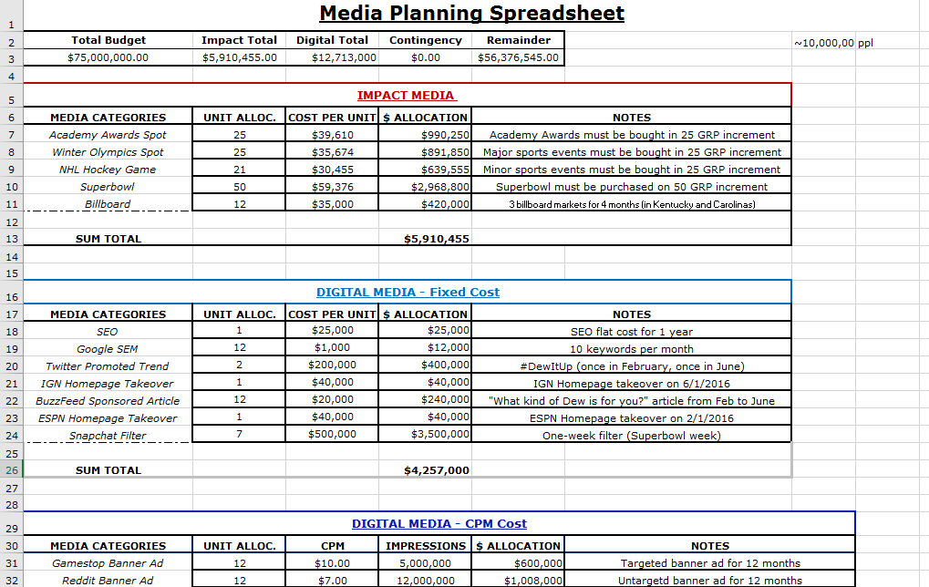
Media Buying Spreadsheet

Slide 21
Media Buying Spreadsheet
Impact Media
Digital Flat-Rate
Digital CPM
Traditional Media

Slide 22
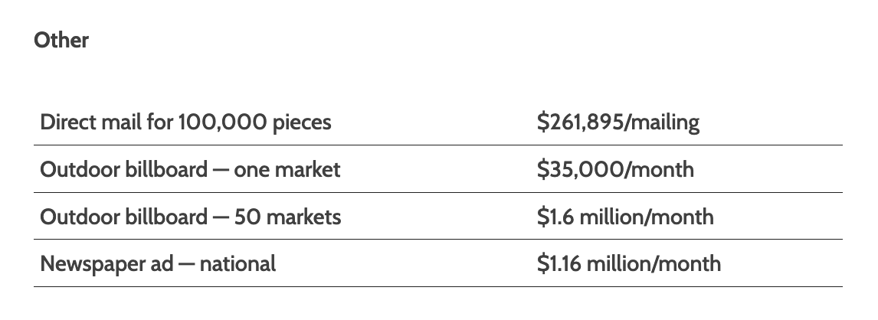
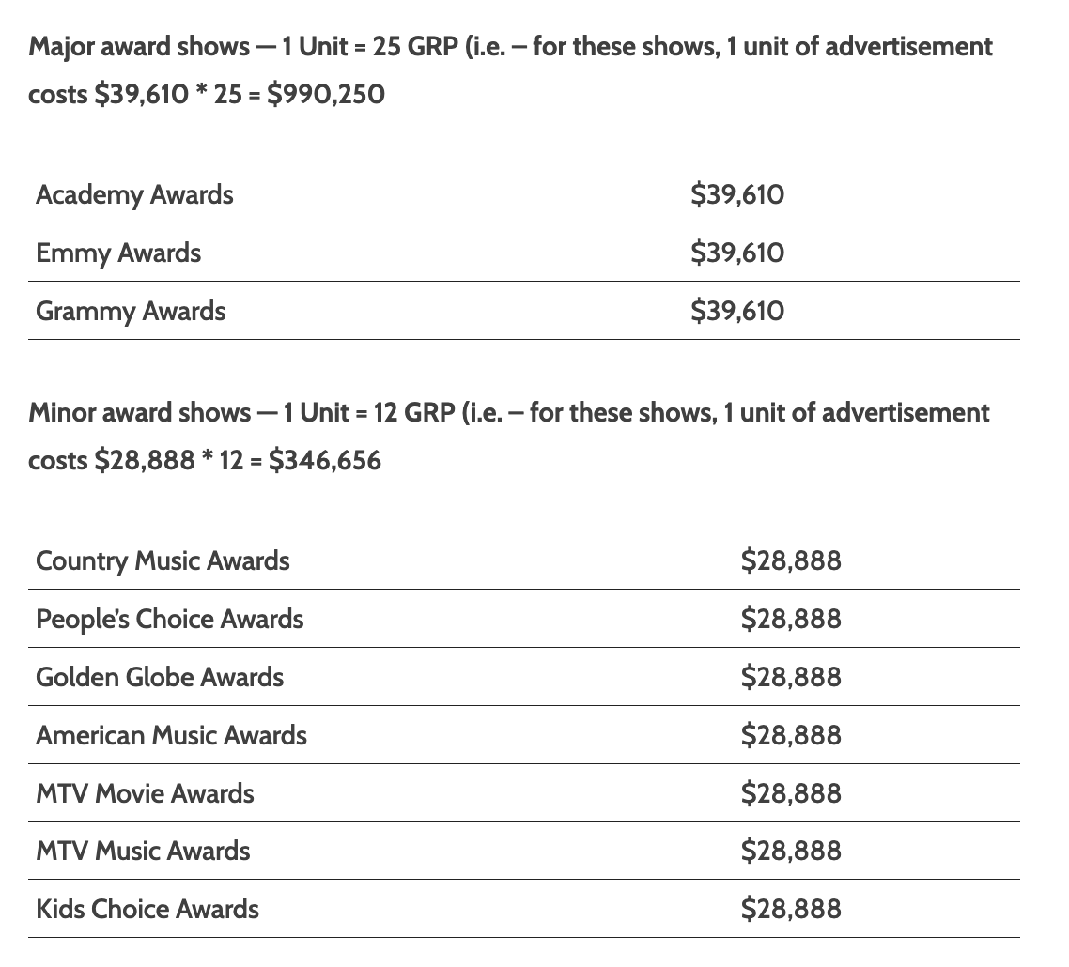
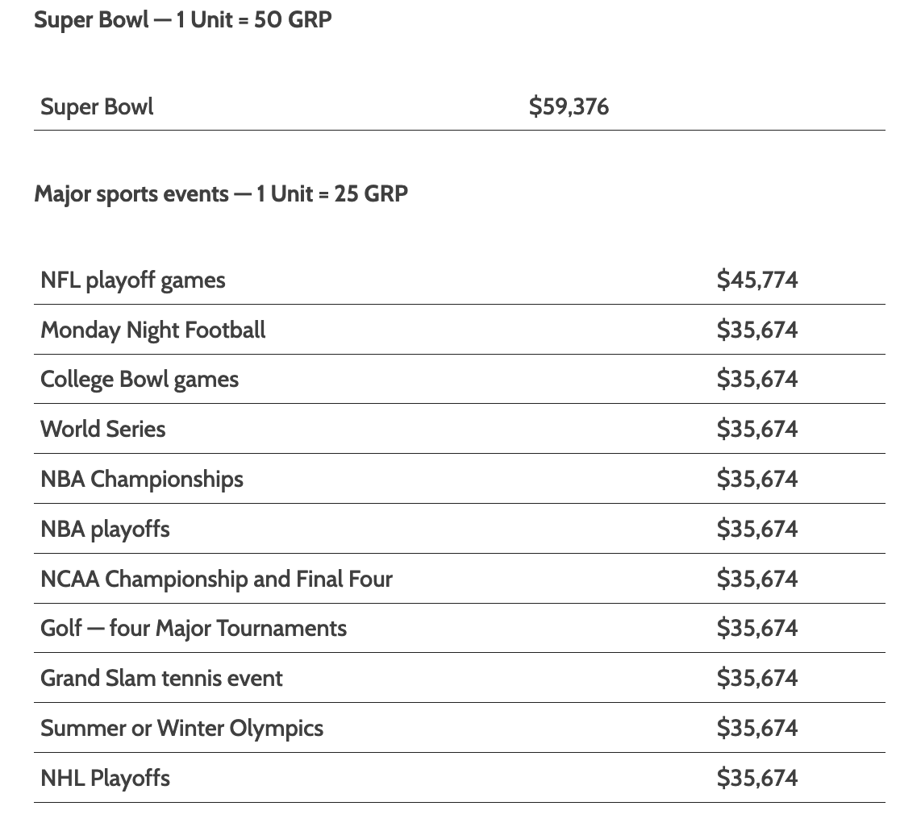
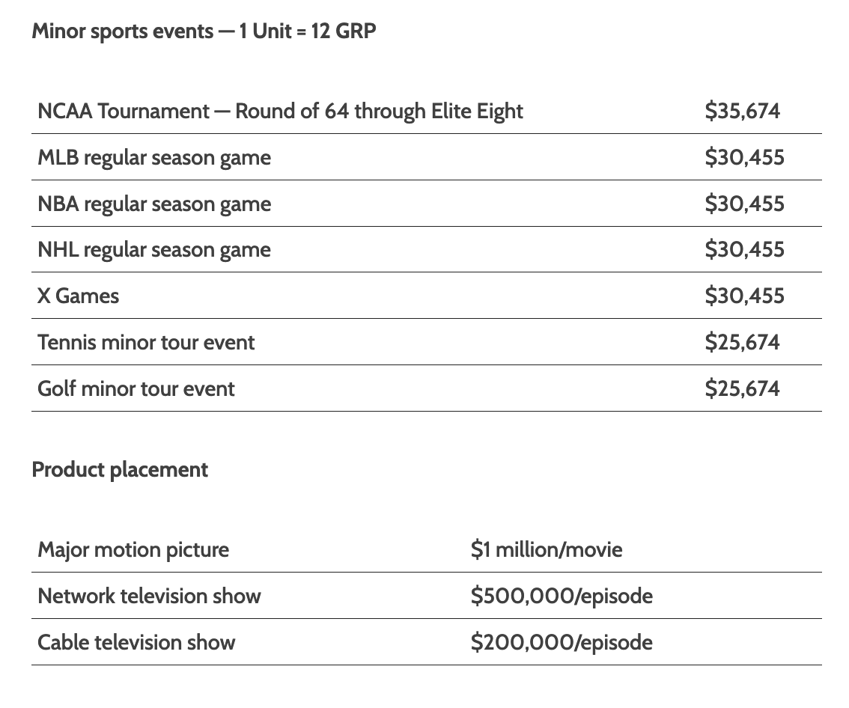
Impact Media - CPP
What you need:
# “units” per media buy – All “units” have minimum levels
Cost per point (CPP) x minimal points (found in manual)
What the spreadsheet will calculate:
Overall cost ($ allocation)

Slide 23
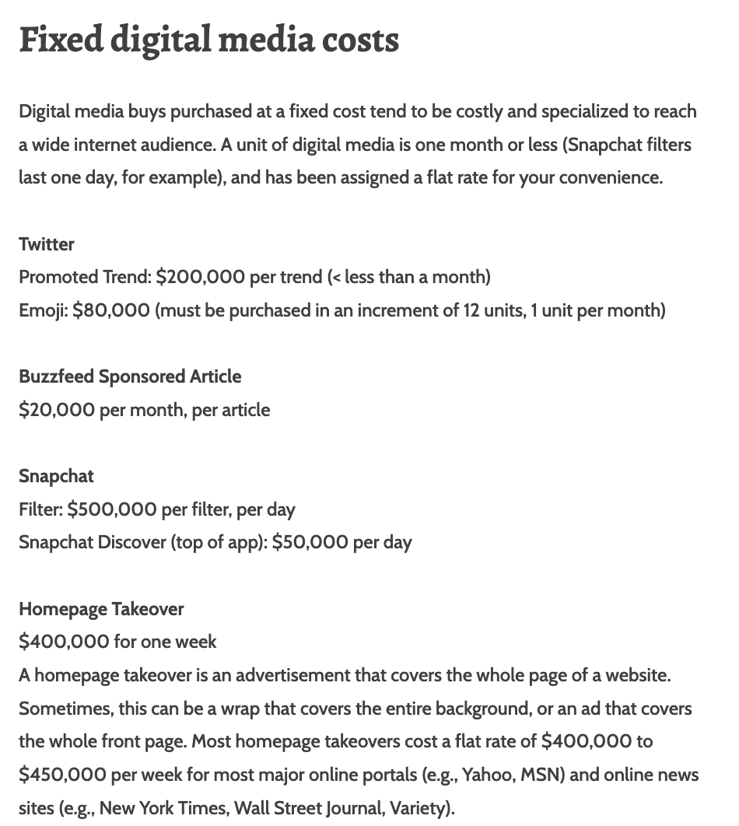
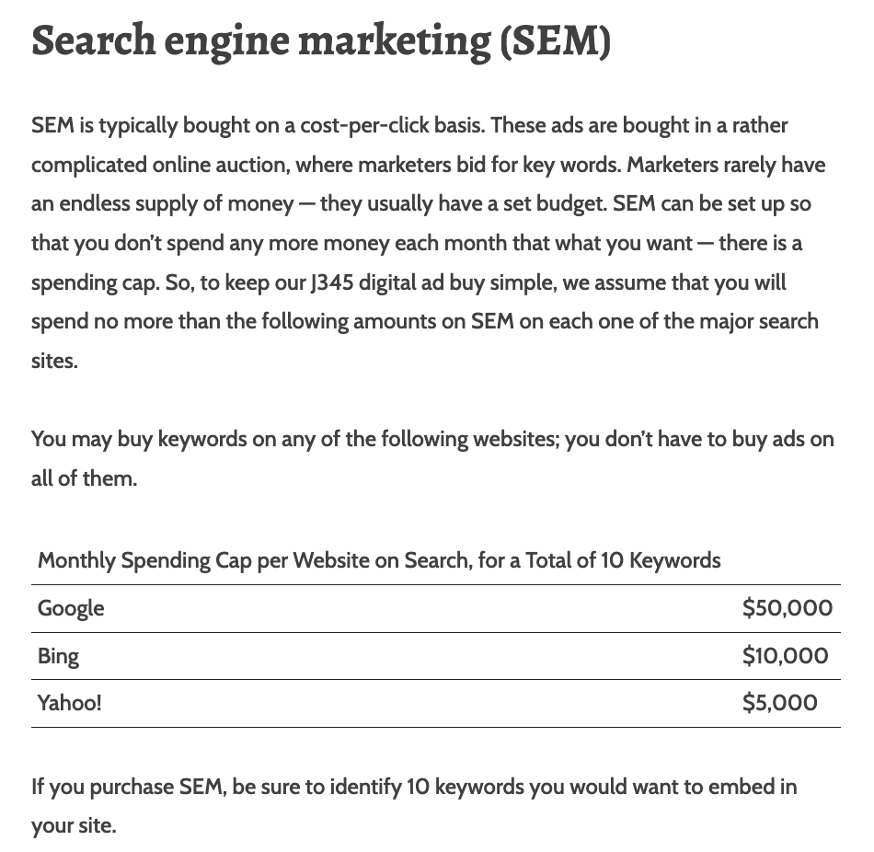
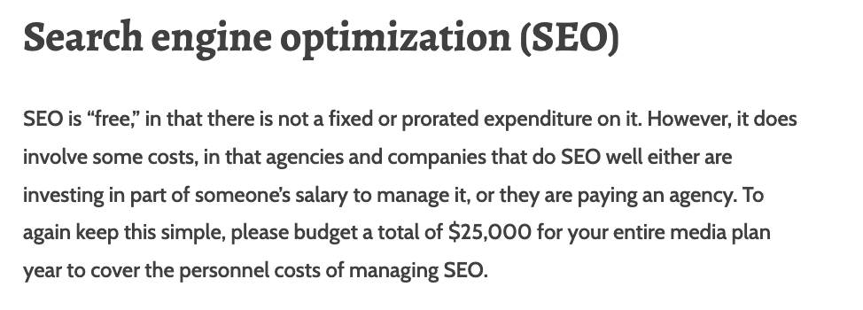
Digital Flat-Rate Media
What you need:
# Units per media buy (1 unit = 1 month, 1 set of ads)
Cost per unit (found in manual)
What the spreadsheet will calculate:
Overall cost ($ allocation)

Slide 24
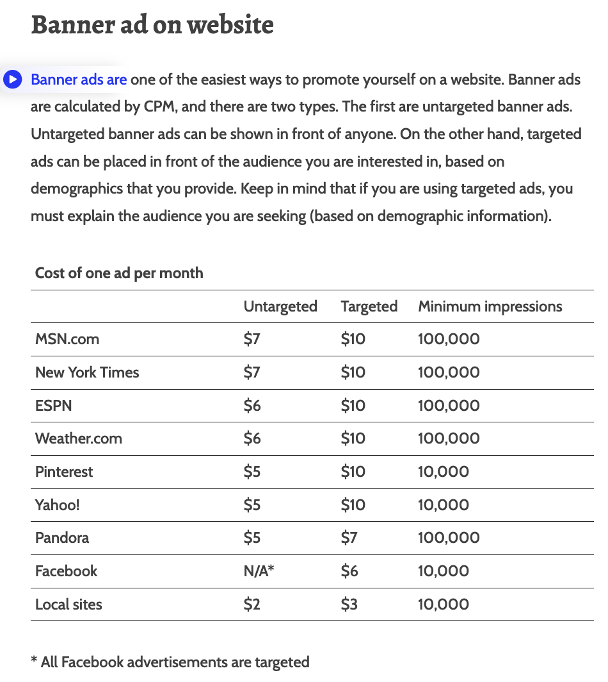
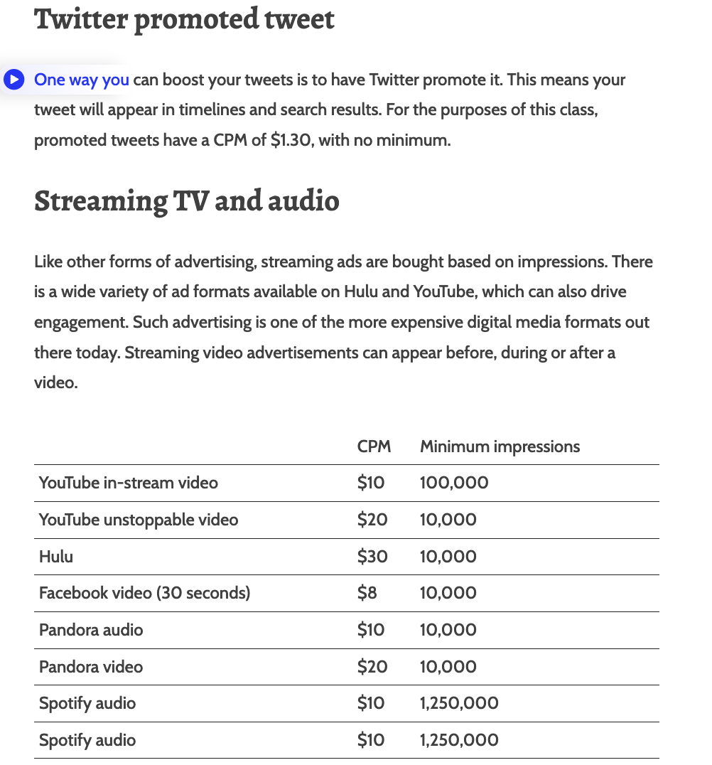
Digital-CPM Media
What you need:
# units per media buy (1 unit = 1 month, 1 ad)
Cost per mille (price per 1,000 impressions) (found in manual)
# impressions desired
What the spreadsheet will calculate:
$ allocation
Notes:
Includes Mobile and digital
Note: 5-6 impressions is the norm

Slide 25
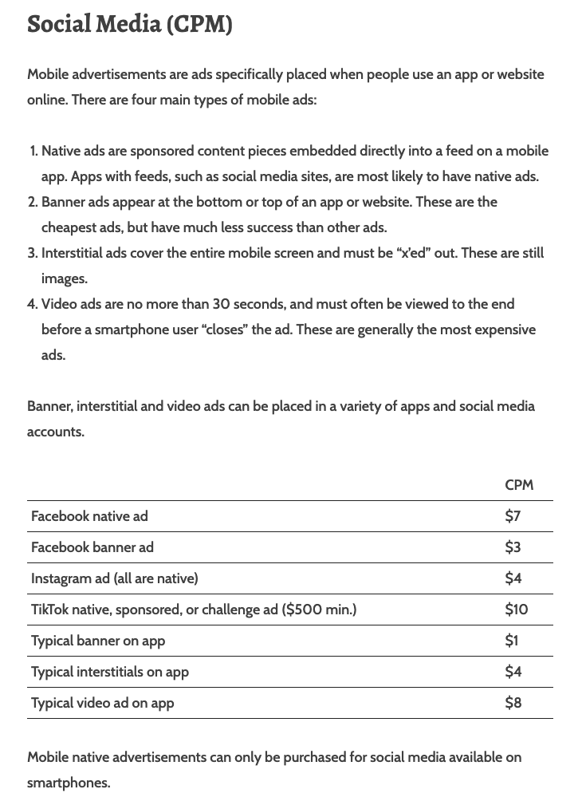
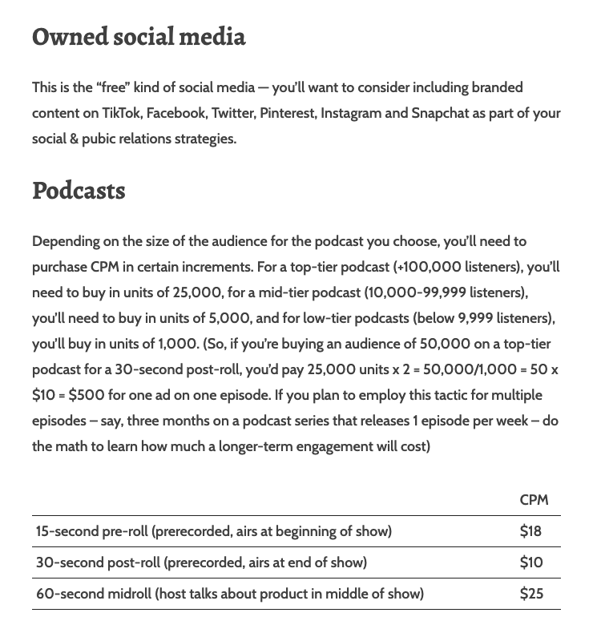

Slide 26
Traditional Media - CPP
Traditional media is calculated from the “remainder” of your budget on a CPP basis for National and Spot (Local Market) Media
What you need:
Cost per point - CPP(found in manual)
% you want to allocate
What the spreadsheet will calculate:
$ Allocation
GRPs (Gross Rating Points – you will use this in the flow chart)
Notes:
GRPs are basically the units of traditional media buys

Slide 27
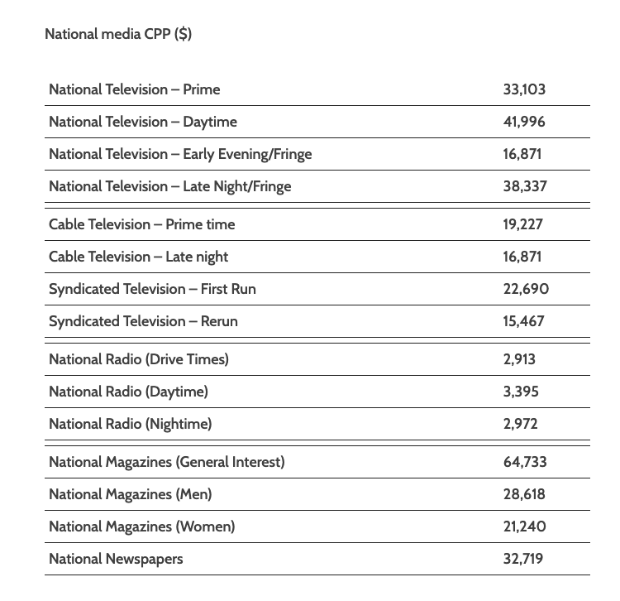
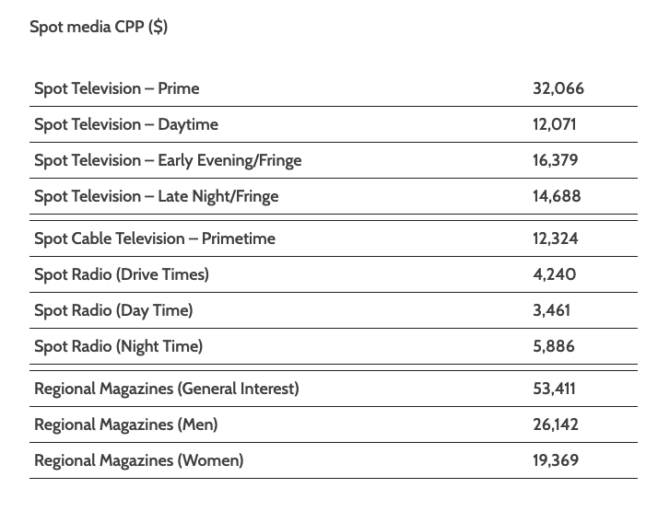

Slide 28
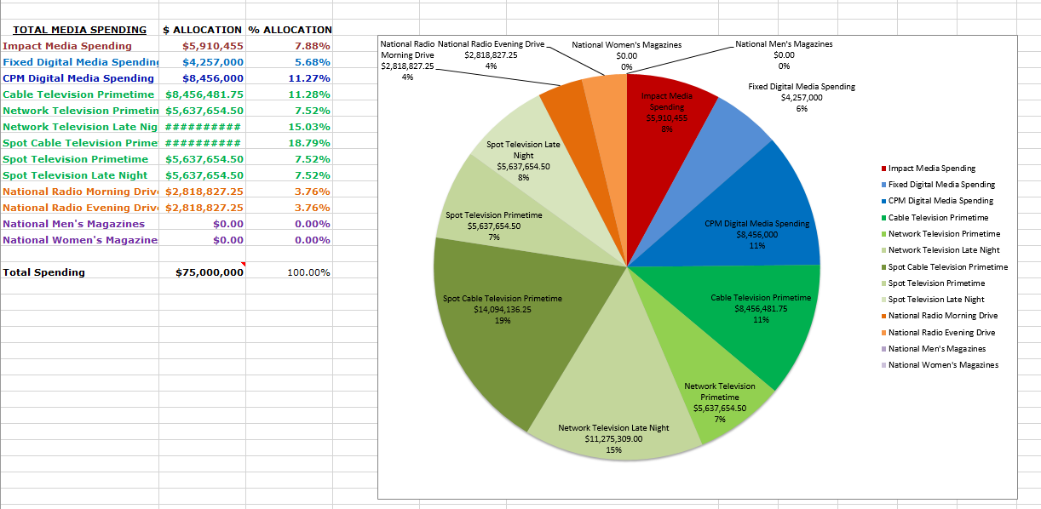
Final Product

Slide 29
Media Buying Spreadsheet Activity
Say I wanted to buy the following things:
Academy Award Ad Spot
1 month of billboards in the NYC market (January)
Five Promoted Tweets
A Buzzfeed Article
An Instagram Ad with 10,000,000 impressions
How much would this cost? – Spreadsheet
How will it be scheduled overtime - Flowchart

Slide 30
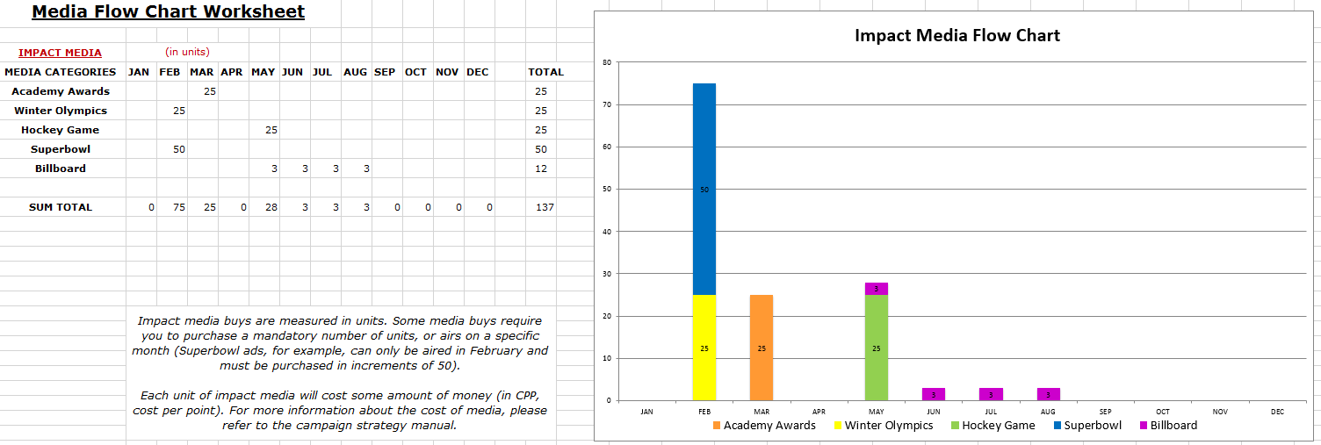
Media Buying Flow Chart
4 Spreadsheets
Impact
Digital
Traditional
Summary Chart
Notes:
The purpose of the flow chart is to plan out your campaign over time

Slide 31
Media Buying Flow Chart Tips
Impact media used to launch campaigns or promotions
Some media (e.g., radio, SEM) make sense to buy continuously,
Others (e.g., prime time) usually bought in pulses to manage costs
Digital and traditional media strategy doesn’t need to be the same
Notes:
The purpose of the flow chart is to plan out your campaign over time

Slide 32
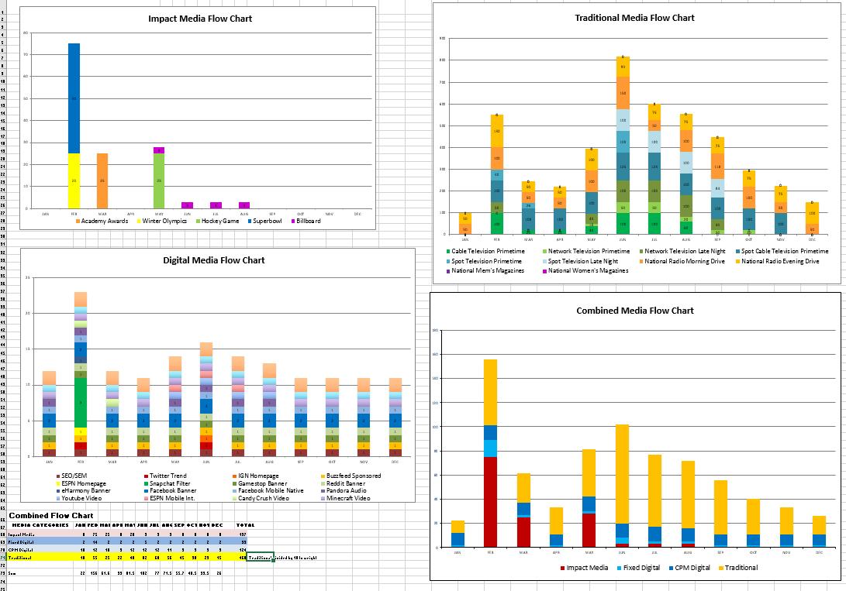
Media Buying Summary Charts
Notes:
Fourth Chart – Where are the pulses in this strategy?

Slide 33
Media Plan Steps
Choose your mediums
Fill out the Media Buying Spreadsheet
Figure out how much to spend across the year
Fill out the Media Buying Flow Chart
Write up your media plan, which includes:
Reach and frequency goals
Duration, Timing, Regional Emphasis
Scheduling strategy (explanation supporting the spreadsheet/flow chart)
Rationale of media selection strategy

Slide 34
Reach and Frequency Goals
Reach: How large is your audience?
National audience or a specific region?
Target a specific demographic group?
Must decide whether reaching all is a priority
Frequency: How often is audience seeing ad?
How often should your audience see it?
Sometimes we need more frequency to be noticed
The broader your audience, the harder it is to reach them frequently.

Slide 35
Duration, Timing, and Region
Duration: When to when?
Timing: When are your pulses?
Media aperture: What daypart will you focus on?
Example: When would you advertise for coffee?
Region: Are you emphasizing a region
Part of the country, metro area, county size
This should be reflected in your spreadsheets.

Slide 36
Scheduling Strategy
What is your overall strategy? (Pulse, flight, continuous)
Do you have different strategies for different media?
Describe the media plan for each media category (impact, digital-flat, digital-CPM, and traditional)
You can describe digital together
Be specific about which magazines, websites, radio formats, tv shows, cable networks, social platforms, etc you want to use.
Editorial compatibility – Why does this medium’s content make sense with your ad?
Rationale for these choices – How do you know these choices put the ads in front of the right people?

Slide 37
Media Buying
From class

Slide 38
GI & GRPs
GI: Gross Impressions, total # of impressions GI = Ad1 Views + Ad2 Views + Ad3 Views
GRP: Gross Rating Points GRP = GI / total population GRP = viewers (reach) x # of times seen (frequency) GRP = Rating of ad 1 + rating of ad 2 + rating of ad 3
I have an advertisement that will be aired twice on a show with a rating of 2.5. What is the GRP?
5.0

Slide 39
Another example
I have an ad that will be aired four times. In the first two instances, it will be viewed 5,000,000 times each. Then, it will air in a more popular outlet, where it will be viewed 8,000,000 times. We will finally put the ad online, where it will be seen an additional 3,000,000 times.
What are the Gross Impressions of this advertisement? – 21,000,0000

Slide 40
CPM & CPP
CPM: Cost per thousand CPM = cost of ad / total GI (in 1,000’s)
CPP: Cost per point CPP = cost of ad / total GRP
I have an advertisement that cost $100,000 dollars, that will be viewed 20,000,000 times. What is the CPM?
100,000 / 20,000(000) = $5.00
Notes:
Need> CPP to GRP question (If I have this much money, and an ad is this CPP, how much GRP)

Slide 41
GRP and CPP
CPP: Cost per point CPP = cost of ad / total GRP
GRP: Gross Rating Points
I am placing an advertisement in a magazine that generates a 1.3 rating at a CPP of $50,000. How much is the advertisement? = $65,000
Notes:
Need> CPP to GRP question (If I have this much money, and an ad is this CPP, how much GRP)

