Slide 1
Interactive media

Slide 2
Interactive/Digital is HOT!
Digital is star performer. Spending increases at double the rate of other media categories. Overall, digital outpacing other media spending and will soon dominate.

Slide 3
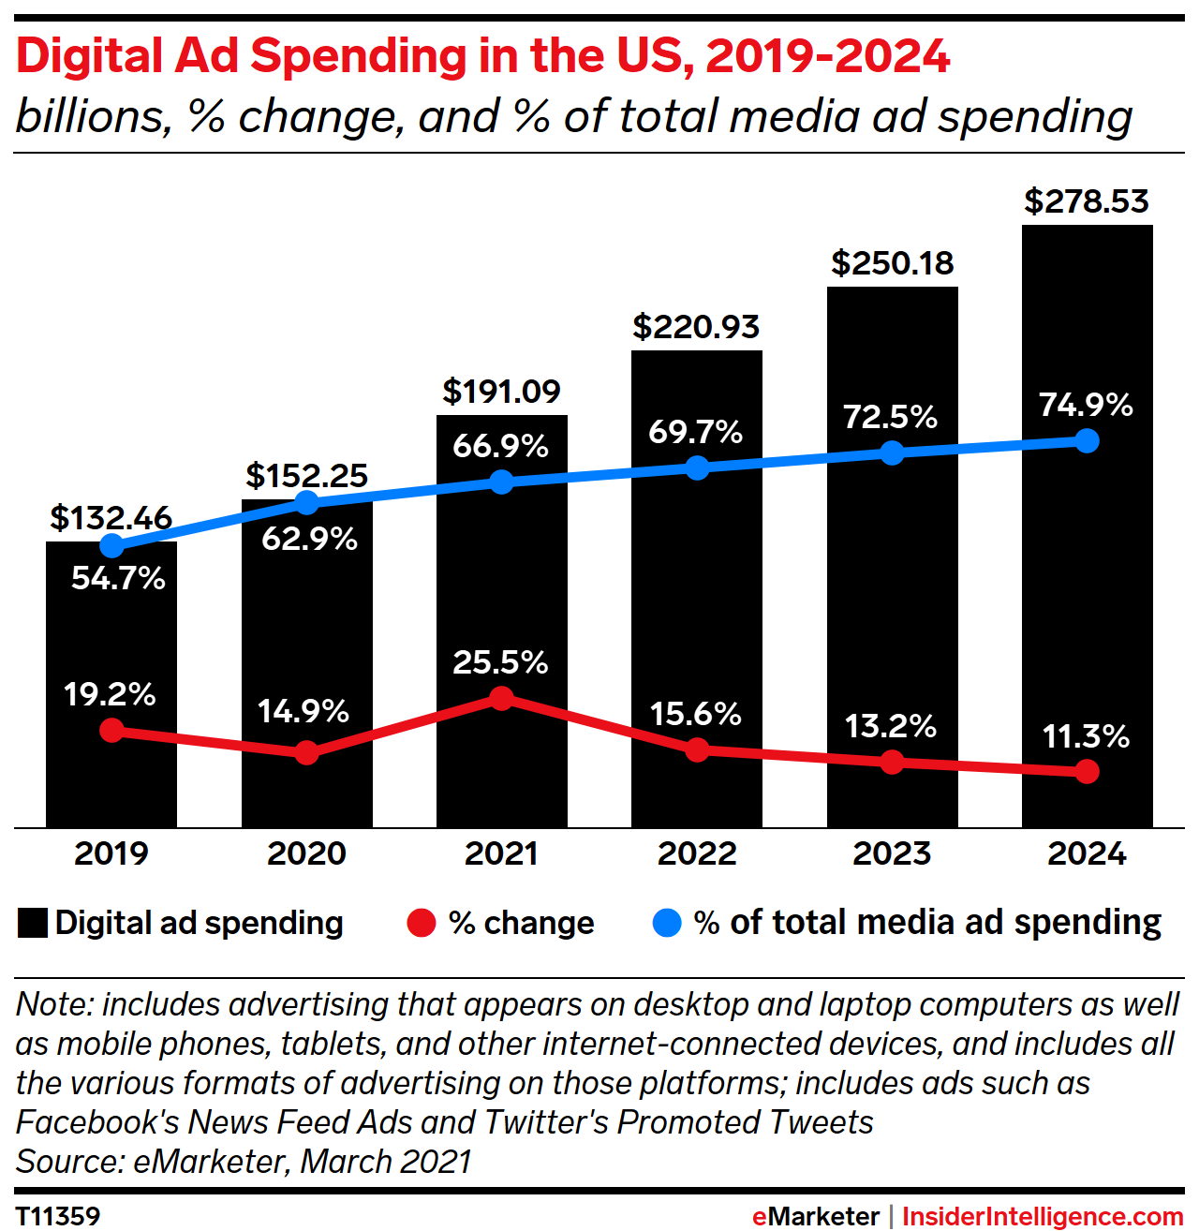
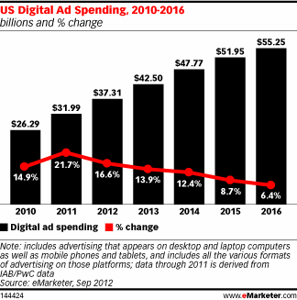
Interactive Growing Fast
Source: eMarketer, Sept 20, 2012

Slide 4
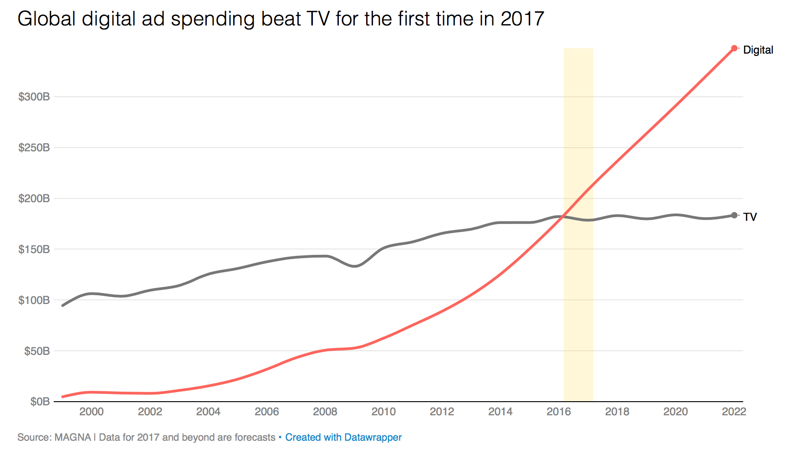
Digital Finally Outpaces TV
“Digital ad spending reached $209 billion worldwide — 41 percent of the market — in 2017, while TV brought in $178 billion — 35 percent of the market — in 2017.”

Slide 5
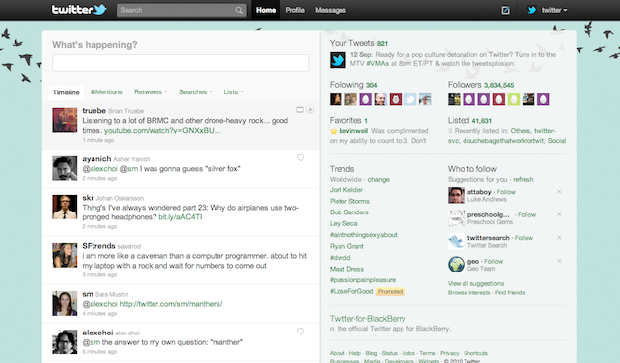
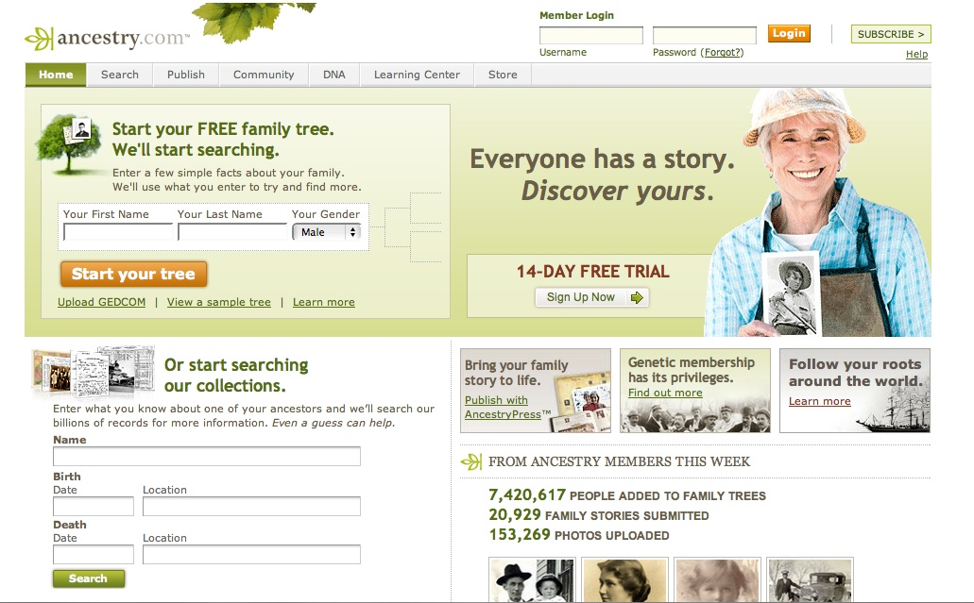
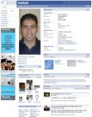
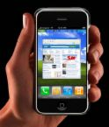
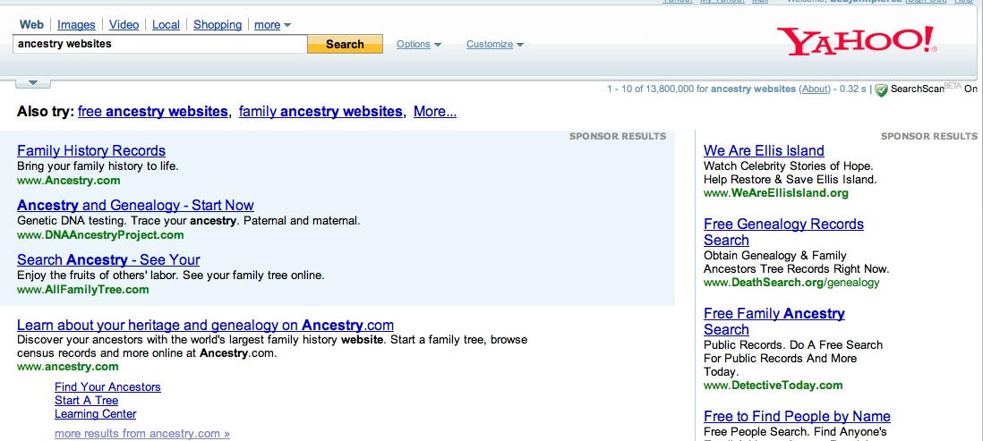
Interactive Media Tactics
Notes:
Online advertising
Hulu – streaming TV
Pandora – streaming audio
Search Engine marketing and Search Engine Optimization – SEM, SEO
Mobile
Social – Facebook, plus others

Slide 6
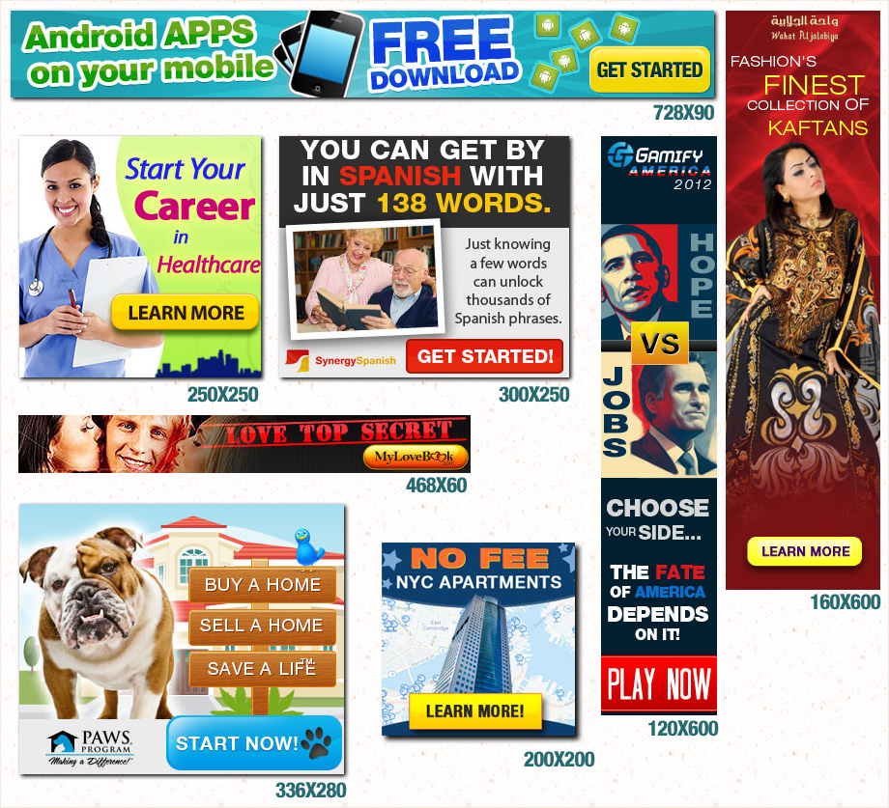
What is Online Advertising?
It’s a……“form of online advertising where an advertiser’s message is shown on a destination web page, generally set off in a box at the top or bottom, or to one side of the content of the page”
Online advertising is also called:
Web Advertising
Display Advertising (not to be confused with the newspaper version of ‘display’ advertising)
Source: Glossary of Interactive Advertising Terms 2.0

Slide 7
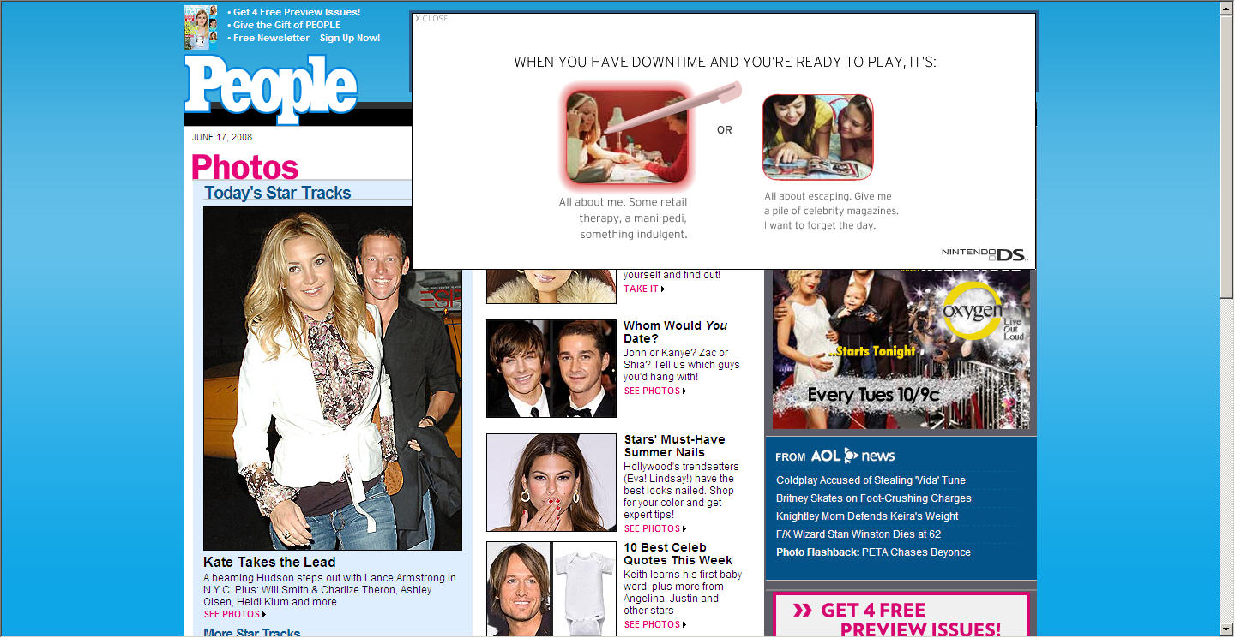
Types of Online Advertising Units
Standard Unit – a banner ad that does not move or expand
Rich media Unit – an interactive banner that expands when rolled over, pops up, floats, or is animated
Video Ad Unit – video itself, or embedded video in an ad
Notes:
There are 3 main types of creative ad units when it comes to online advertising:
Standard – don’t move
Rich media – do move, are animated
Video ads -

Slide 8
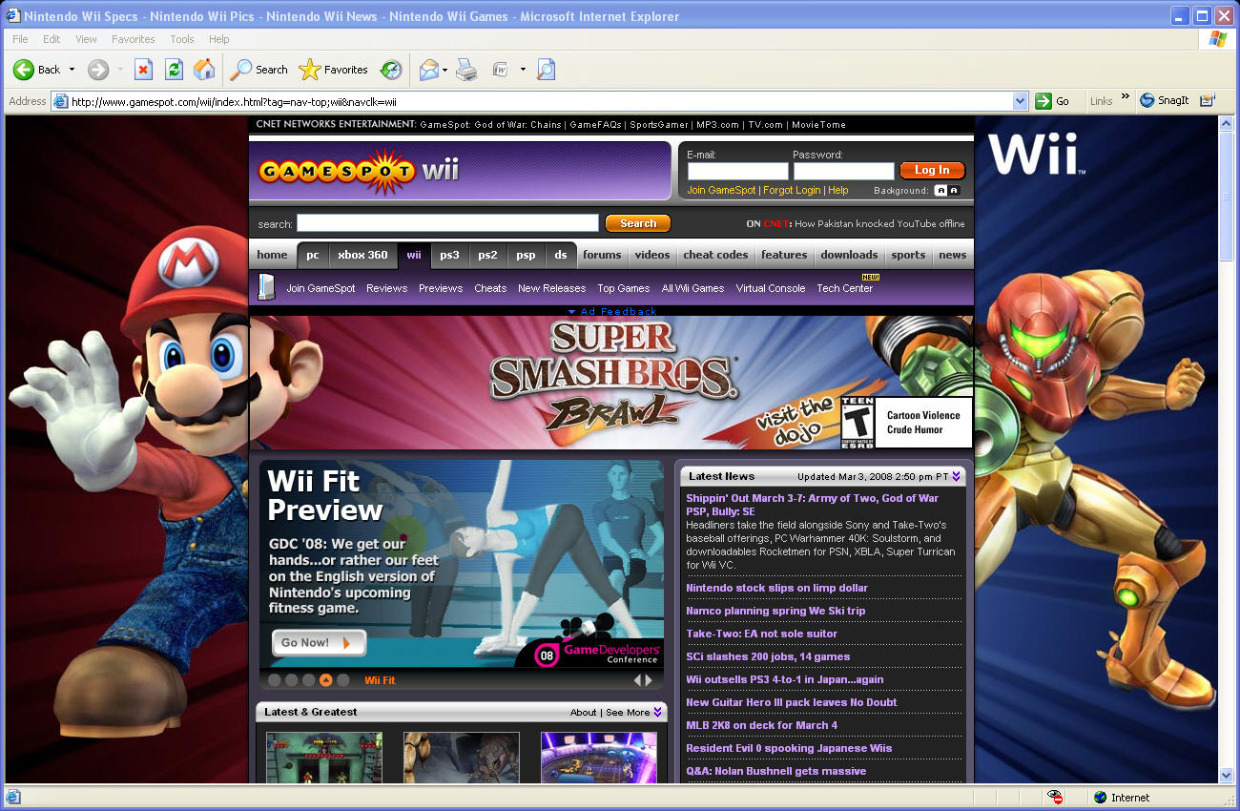
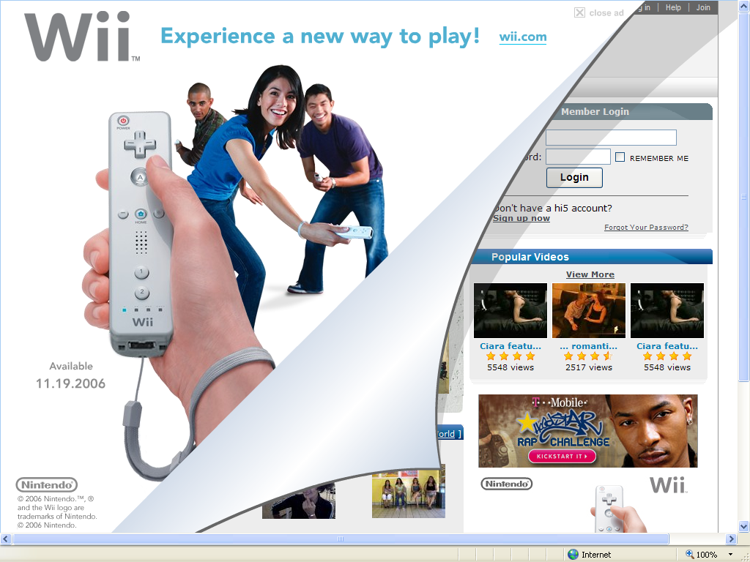
Skin, Page Blocker, Peel Backs
Notes:
“Skin” – ads designed so that the sides of the page are seemingly integrated in to the content of the page itself. (Wii)
Page Blockers: Nintendo DS has ‘blocked’ out other competitors from being able to buy ad space – they bought the header and side banner ad on Glam magazine.
Peel back: an ad that seems to “peel back” from the page when you click on it – like this one for the original launch of Wii a few years ago.

Slide 9
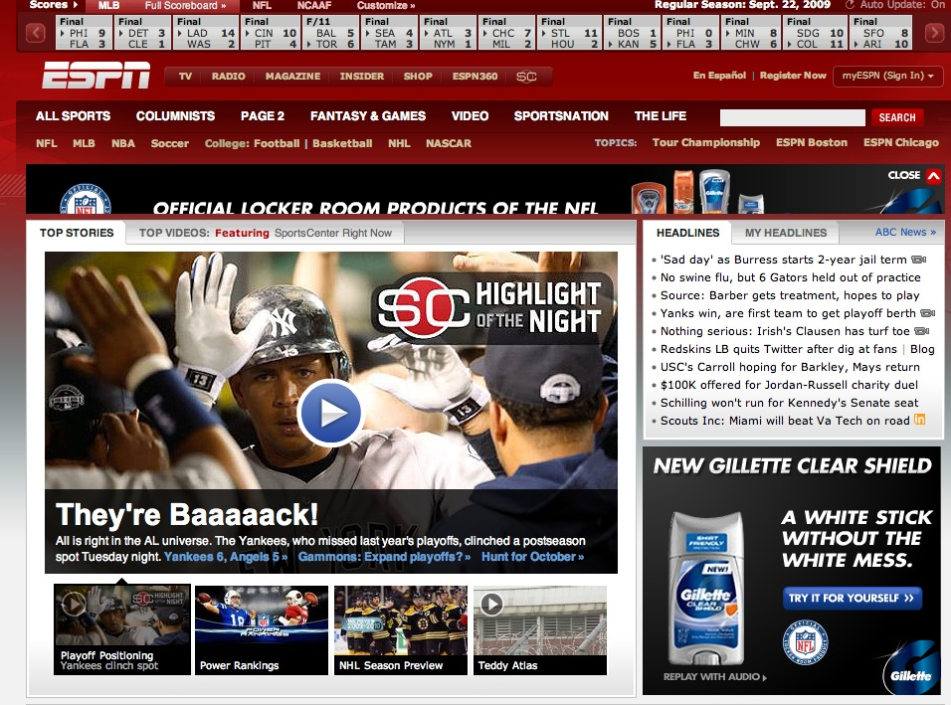
Role of Online Advertising
Creates interactive with your target consumer
Drives web traffic
Very measurable
Rich media and video ads have better click through rates
Extremely targetable
Notes:
What can Online Advertising – advertising do for you – that other forms of advertising can’t do?

Slide 10
Online Ads: Bought Using CPM
Cost per thousand (CPM) is the basis for buying online advertising
The CPM varies on the type of website and for the quality of the ad
High traffic sites can charge higher CPM
More interactive, rich media ads have higher CPM

Slide 11
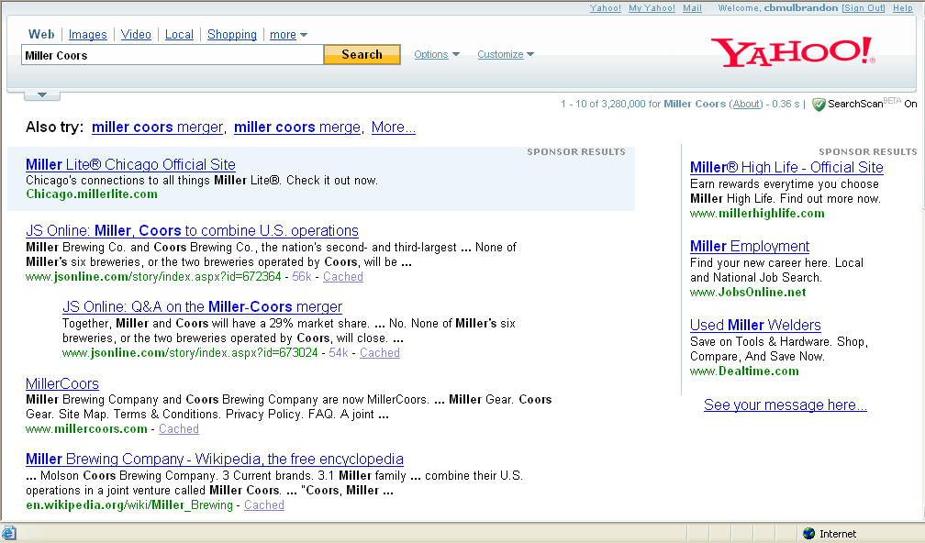
Search Marketing
Largest form of all interactive media ad spending
There are 2 kinds of Search:
SEM = Search Engine Marketing. Paid.
SEO = Search Engine Optimization. “Free.”
Does it seems like “advertising” to you?
Notes:
Search marketing is the largest source of all interactive media advertising
Even though it may not feel like ‘advertising’ to you, it is

Slide 12
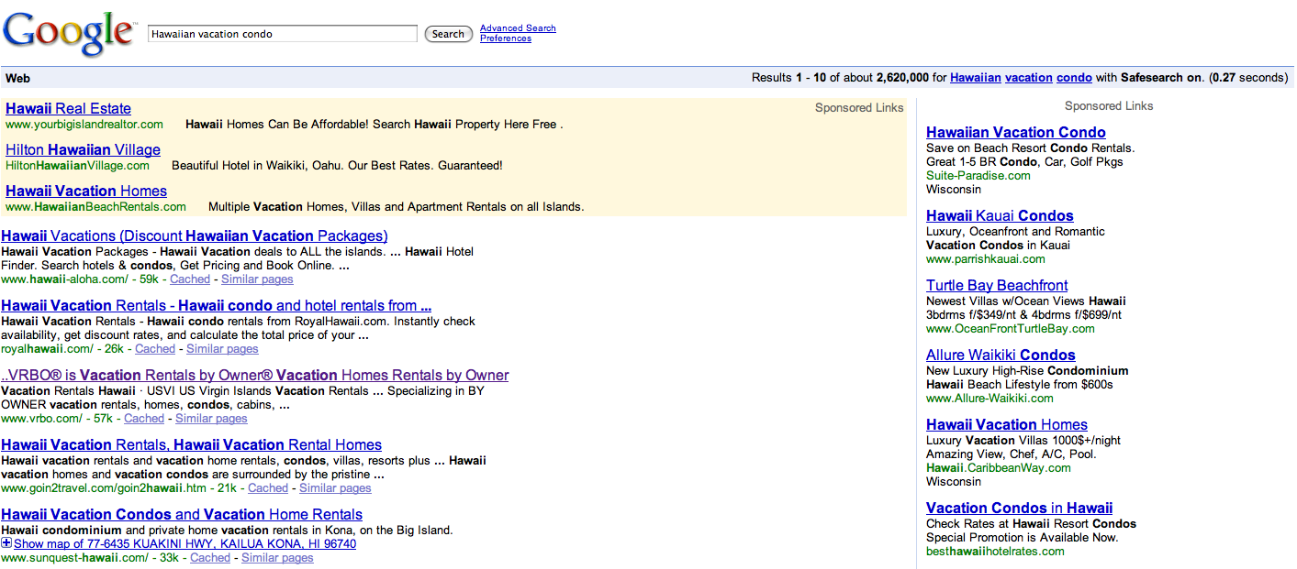
Role of Search
Provides a consumer convenience: manage vast amounts of internet info
Helps consumers pre-shop
Generates greater clicks to your website
Drives “leads” – names of new people, and new business!
Target your message to those who want to search for you

Slide 13
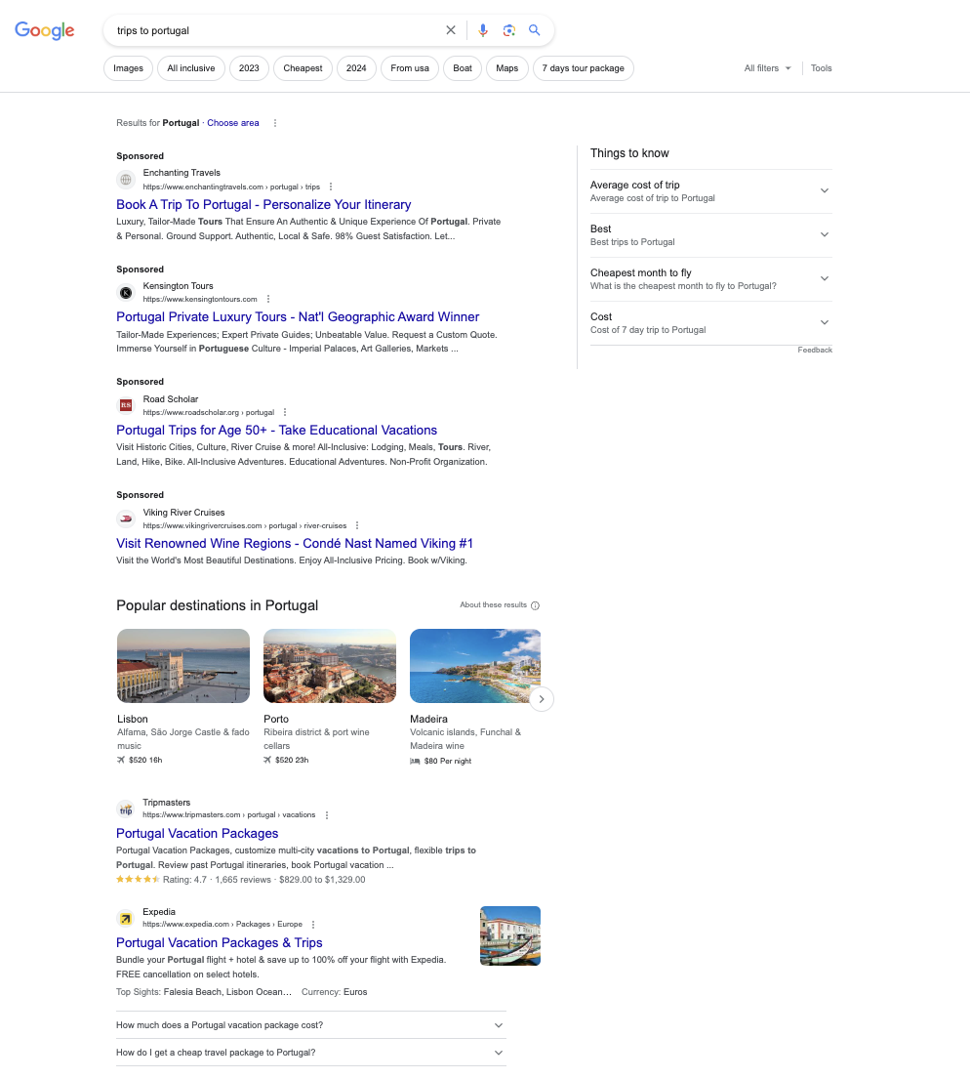
Search Engine Marketing (SEM)
SEM is 25% of all search clicks
When a specific key word is searched, a text link appears at the top or side of the search results
More money a marketer pays per keyword search = the higher it will appear in the search rankings
Link your site to that search term
Companies pay for search only when a user clicks on the link
Changing with AI Search Engines

Slide 14
How to Buy SEM:
Determine the “keywords” you want to buy
Relevant to your brand, category, product
Ones consumers will ‘search’ on to find you
Can be more than one just one; most are 1 to 3 words
Buy it through Google AdWords (or Bing, or Yahoo, etc.)
Track and analyze your results
Can immediately switch out words if not effective

Slide 15
Create Your SEM Ad
1.) HEADLINE. Title – Key Idea
2.) DISPLAY URL
3.) DESCRIPTION - Key benefit phrase
Ads can also include a visual

Slide 16
In Class Exercise
You are the Marketing Director for Goodyear
New “Never Slip” Tires are launching
What are the top 4 keywords you would buy?
When would you buy them for Winter 2024?
Where would you buy SEM?

Slide 17
How to Buy SEM - Example
Samsung wants to buy SEM to promote sales of its new phone
Samsung generates a list of keywords:
Samsung Galaxy s23, “hot smartphones”, “best smartphones” “top Android phones” “new Samsung phone”
They agree to pay Google $1.25 per click on their sponsored content for EACH of these words/phrases – each time a consumer clicks on an ad, Google will charge Samsung $1.25
Can set “max spending amounts” to stay within budget!
If 1,000,000 consumers click on Samsung Galaxy Ad, how much does Samsung owe Google? 1,000,000 x 1.25 = $1,250,000

Slide 18
How to Buy SEM
SEM paid for on cost per click (CPC) basis
That means, advertisers ONLY PAY when a consumer clicks on the SEM ad!
CPC varies based on how popular a word is – common, competitive words have higher CPC
Legal services and optional medical services = high $
To buy it, you must first pick the keywords that consumers are most likely to search for related to your product or brand
Question: why NOT buy SEM, then?

Slide 19
SEO = Search Engine Optimization
SEO = Trying to get your site as high as possible on search algorithm
Results in increasing the traffic to your site
SEO is “free” – you don’t buy it. But, you may have to pay someone on your staff or at an agency to run your site to get good SEO

Slide 20
Search Engine Optimization
6 times more effective than a banner ad
Delivers qualified leads - high prospect value
Most user sessions begin at search engines
Most online purchases are made on sites found through search engine listings

Slide 21
SEO is NOT Paid Advertising
SEO – influence rankings in the “natural” (a.k.a. “organic”, a.k.a. “algorithmic”) search results
PPC – paid search advertising on a pay-per-click basis. The more you pay, the higher your placement.
If you stop paying = stop receiving traffic.
SEM – encompasses both SEO and PPC

Slide 22
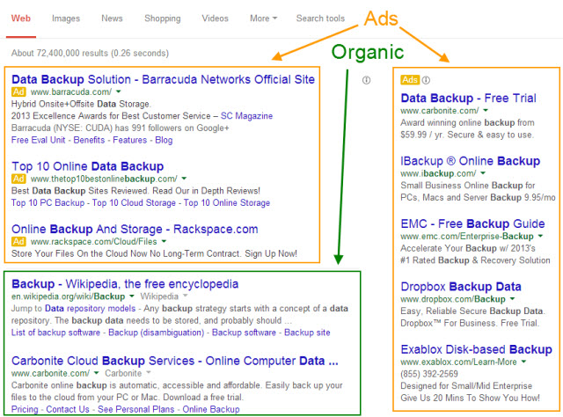
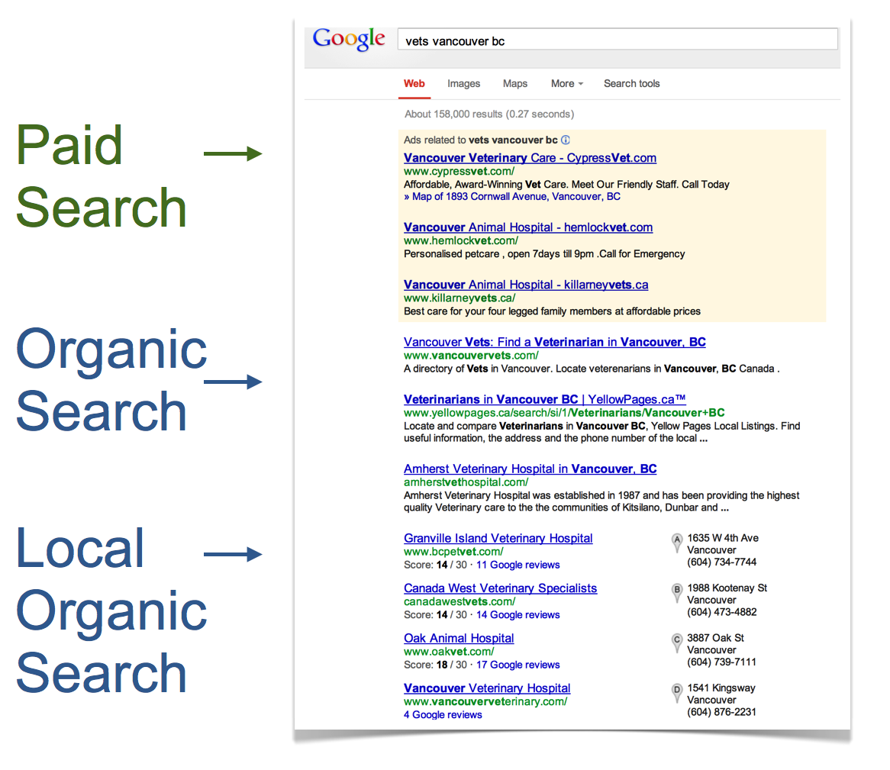

Slide 23
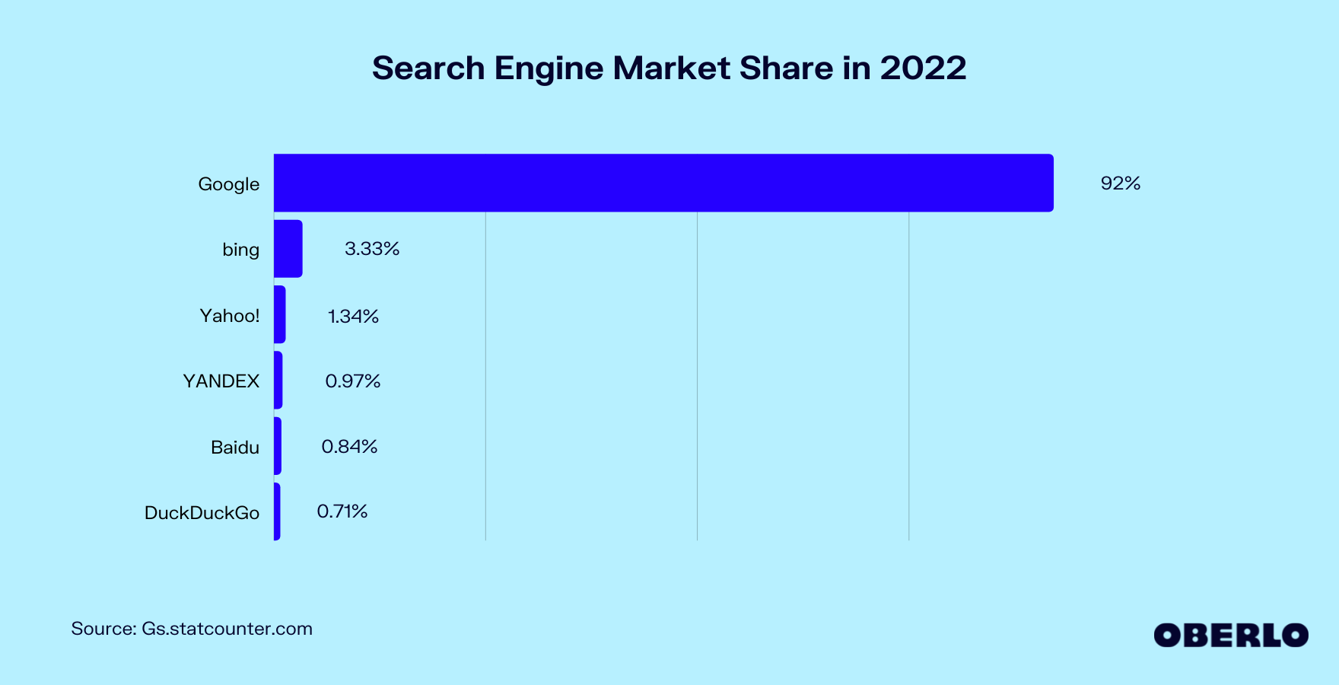
Most Important Search Engines

Slide 24
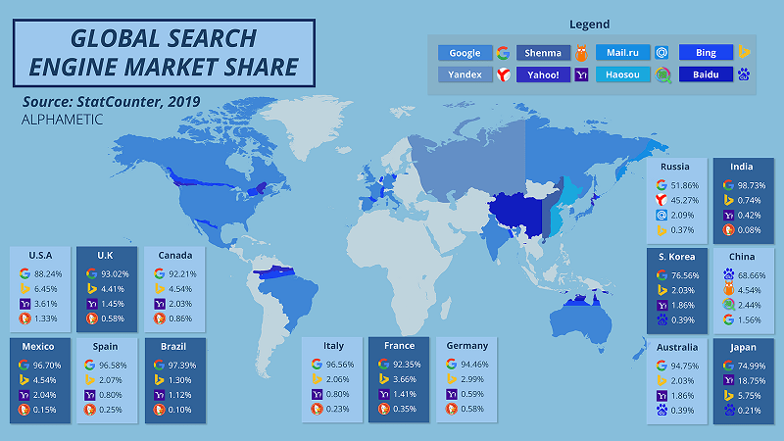
Search Engines Vary By Country
Newest race is in AI-powered Search using LLMs

Slide 25
What Are Searchers Looking For?
Keyword Research
“Target the wrong keywords and all your efforts will be in vain.”
The “right” keywords are…
relevant to your business
popular with searchers

Slide 26
Keyword Research
Tools to check popularity of keyword searches
http://WordTracker.com
http://KeywordDiscovery.com
http://adwords.google.com/KeywordPlanner
http://www.google.com/trends/
http://ubersuggest.org/

Slide 27
Begin The 7 Steps
1) Get Your Site Fully Indexed
2) Get Your Pages Visible
3) Build Links & PageRank
4) Leverage Your PageRank
4) Encourage Clickthrough
6) Track the Right Metrics
7) Avoid Worst Practices

Slide 28
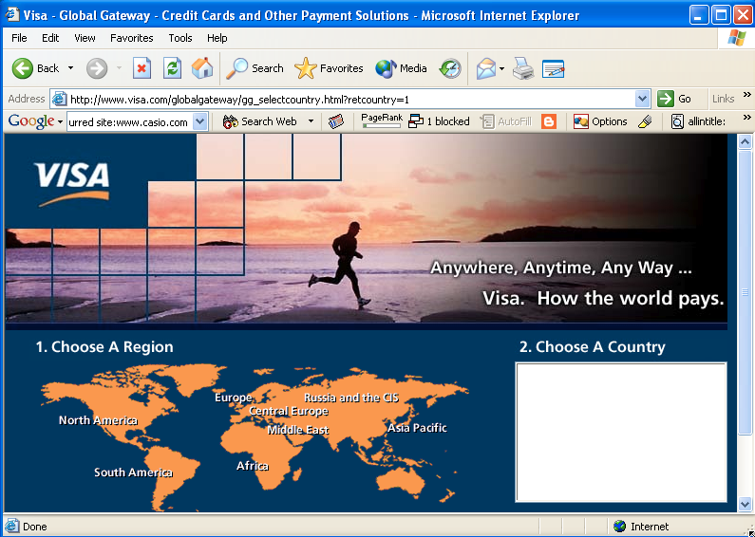
Pretty good title

Slide 29
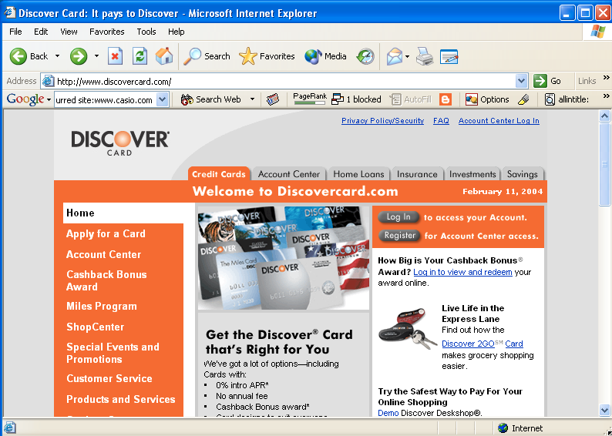
Not so good title – where’s the phrase “credit card”?

Slide 30
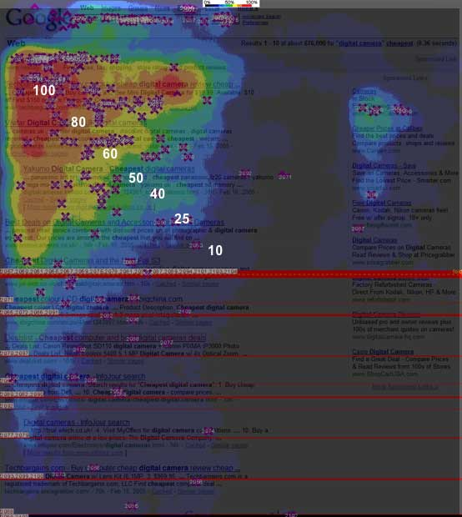
Where do searchers look? (Enquiro, Did-it, Eyetools Study)

Slide 31
In Summary
Focus on the right keywords
Have great keyword-rich content
Build links, and thus your PageRank™
Spend that PageRank™ wisely within site
Measure the right things
Continually monitor and benchmark

Slide 32
For Your Project
For your project, assume SEO is $25K
Identify what keywords you would want to embed in your website/s, PR materials, online materials, in order to rise to the top of the ‘organic’ search engine
What other sites do you want to cultivate inbound links from? What interlinking do you wish to do?

