Slide 1
Political Marketing and Campaigning

Slide 2
Beyond Marketing Communication
The principles and practices you have encountered in this class are flexible and can be applied across contexts.
  Social Marketing
  Health Campaign
  Non-profit Communication
  Political Campaign Management

Slide 3
Political Marketing
Candidate elections
  President and Congress, State Executives and Legislatures, Local Mayoral and Council Seats
  Decline of political parties - Independents
Issue referenda
  Public decisions about issues
  Increased lobbying of politicians through media
Costs have exploded

Slide 4
Political Advertising
Key means of communication with public
  Though 2016 saw the rise of social media
Advertising spending accounts for majority of campaign budgets, especially for presidency
  Nearly $1 billion in ads for presidency in 2012
    $10 Billion across all political races for marketing
  10% spent in last week - ad blitz
  Concentrated on 1/3 of population
    battleground states, battleground markets

Slide 5
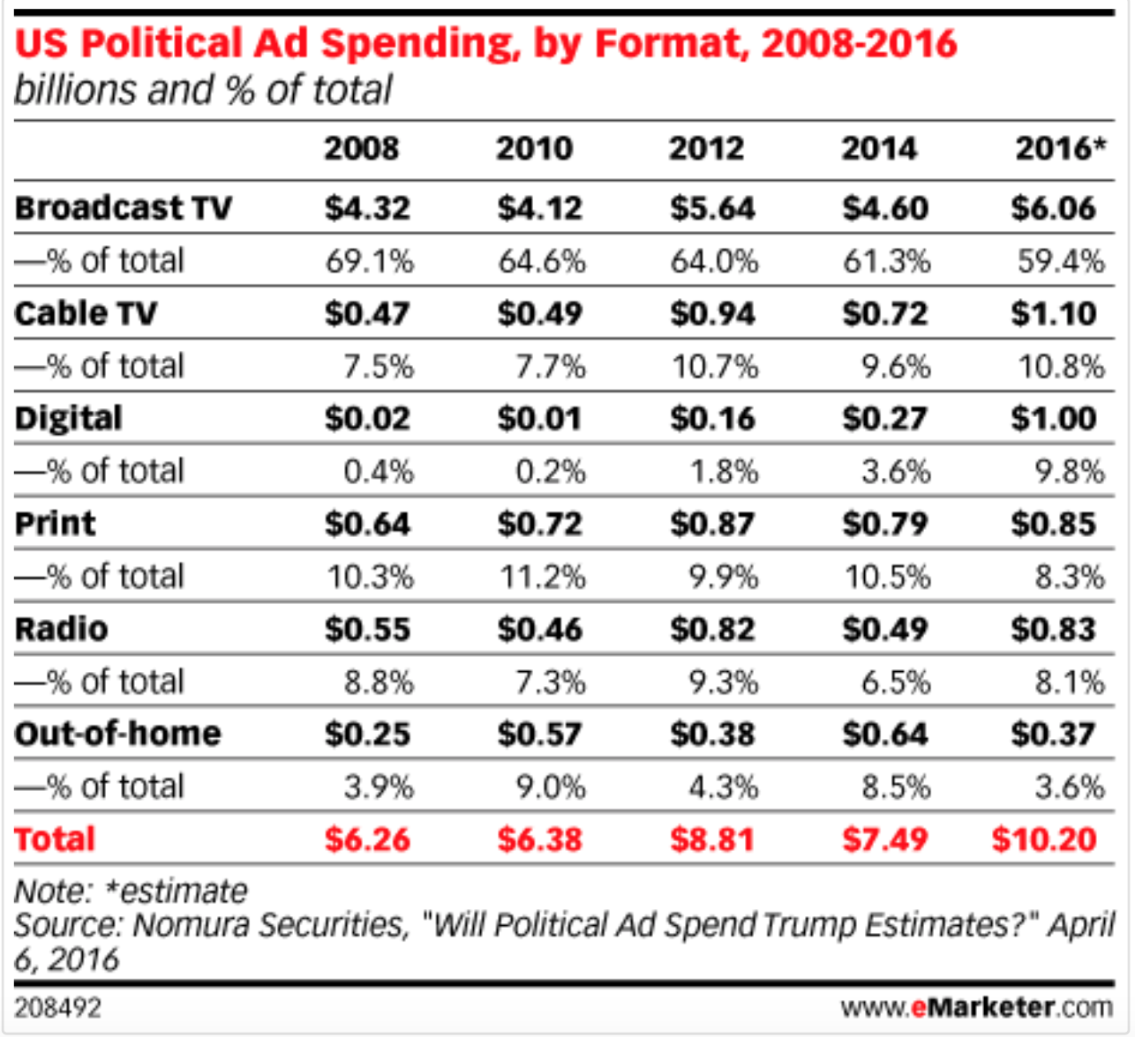
And Spending Explodes…

Slide 6
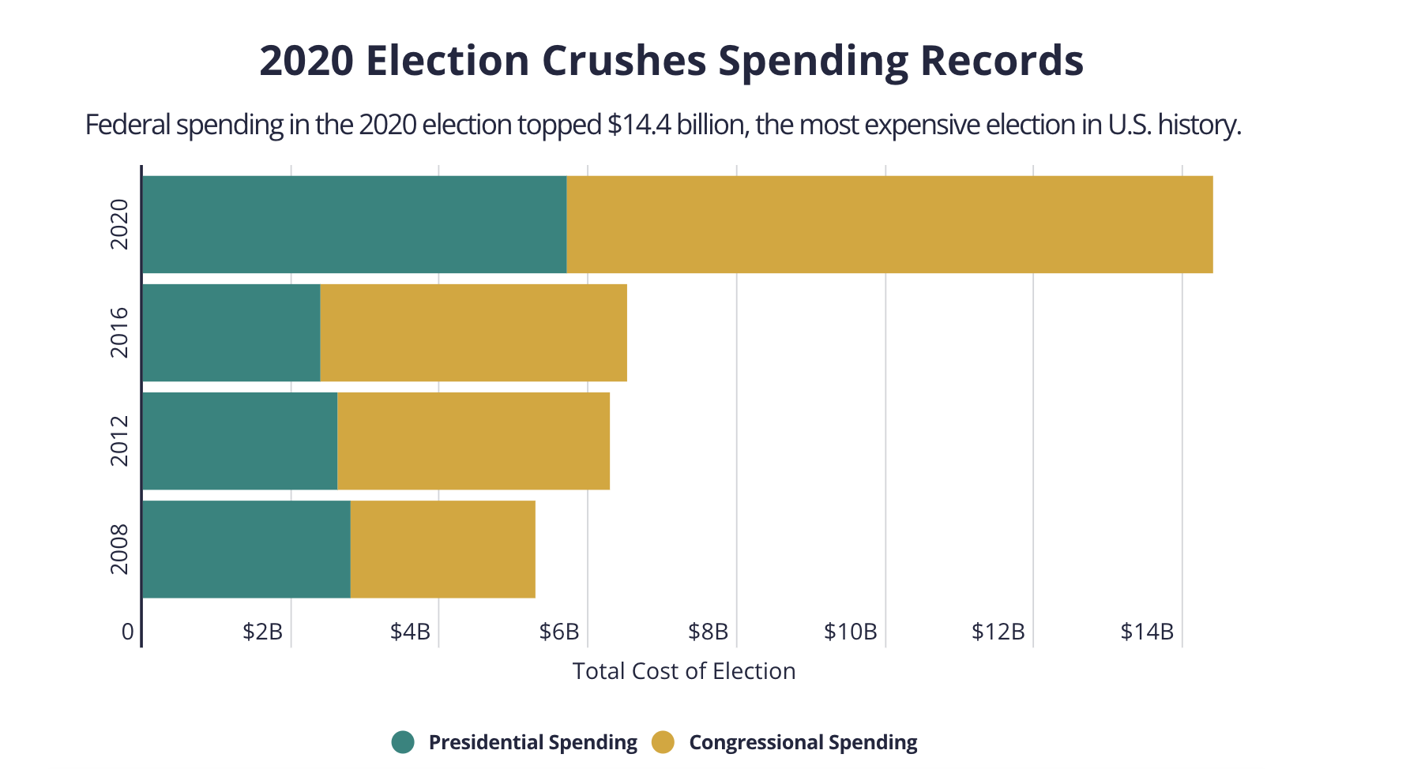
Total Election Spending for Federal Elections,
not counting State Races, has more than doubled

Slide 7
2016 Marked a Shift
Actual was below projection: $9.8 billion.
  Broadcast TV, the mass media mainstay of political advertising, still dominant but down 20%
    From $5.45 billion to $4.4 billion in 2016
Lost share to Cable and Digital, both up
  Digital up to $1.4 billion, growing 789% from $159 mil. in 2012.
  Cable television, up 52% to $1.35 billion in 2016

Slide 8
Broadcast Still Dominant

Slide 9
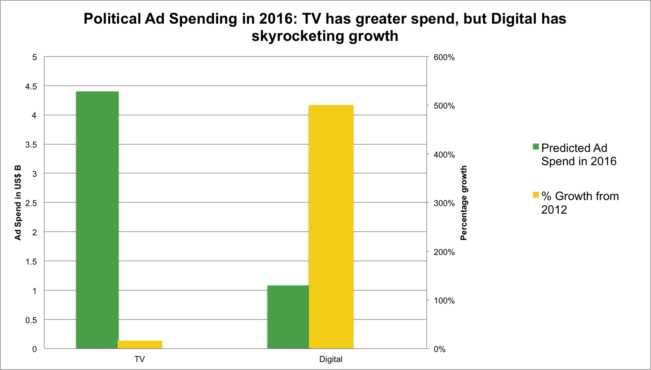
Digital Shift in 2016

Slide 10
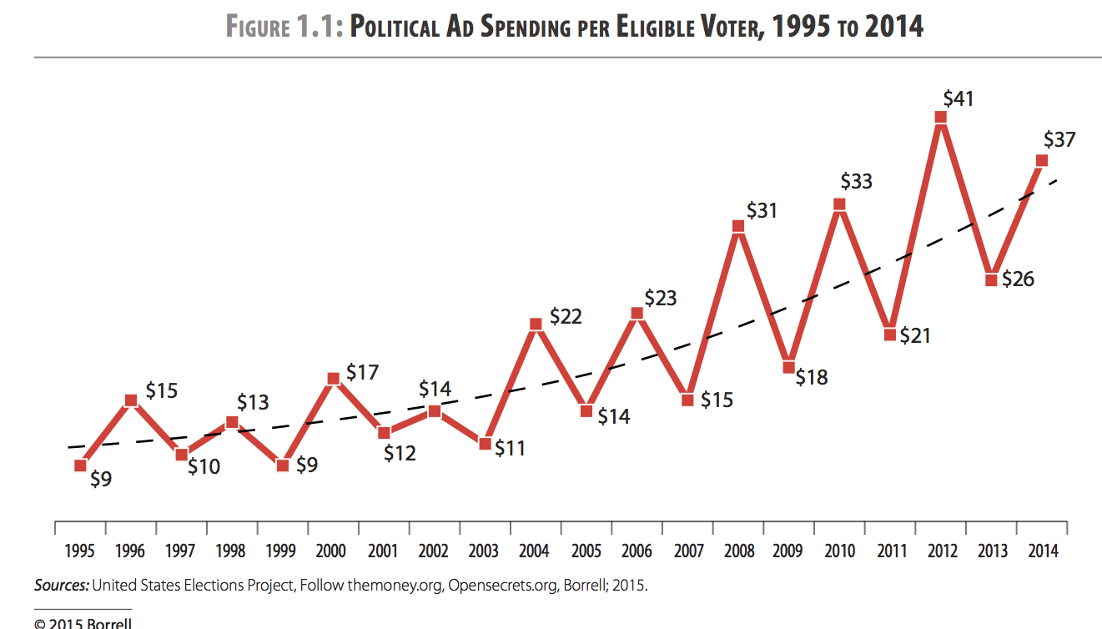
Cost Per Voter Rising

Slide 11
Trump Outspent on TV
But got nearly $3 Billion in “Earned Media” Coverage.
Driven by coverage of his Tweetstorms, Staged Media Events, and Public Events
Social Media and Public Relations

Slide 12
Crowded out the News Cycle
Dominated the news agenda, with constant cycle of stories so that subsequent coverage includes his views
  Trump got $2.8 billion in primary coverage; Clinton $1.1 billion; Cruz $770 million, making up for ad spending difference – “Trump sucked the oxygen out of the room”
  Differences set before Super Tuesday, with Trump way up; click-bait candidate, who drove up news consumption
  Same pattern playing out in 2020. Biden dominating the ad war and Trump dominating the news cycle

Slide 13
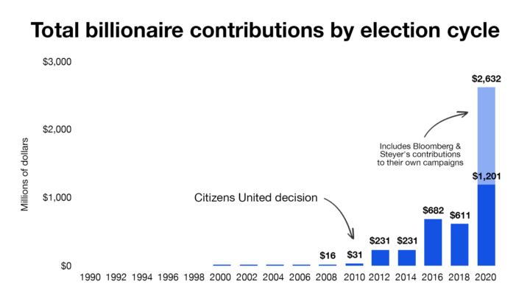
Citizens United decision brings dramatic changes

Slide 14
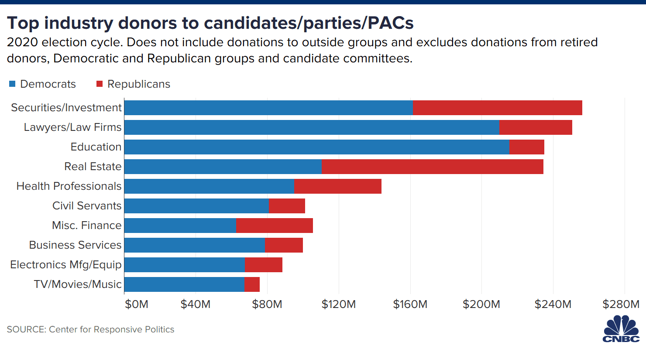
Lobbying, Fundraising, PACs, and Parties

Slide 15
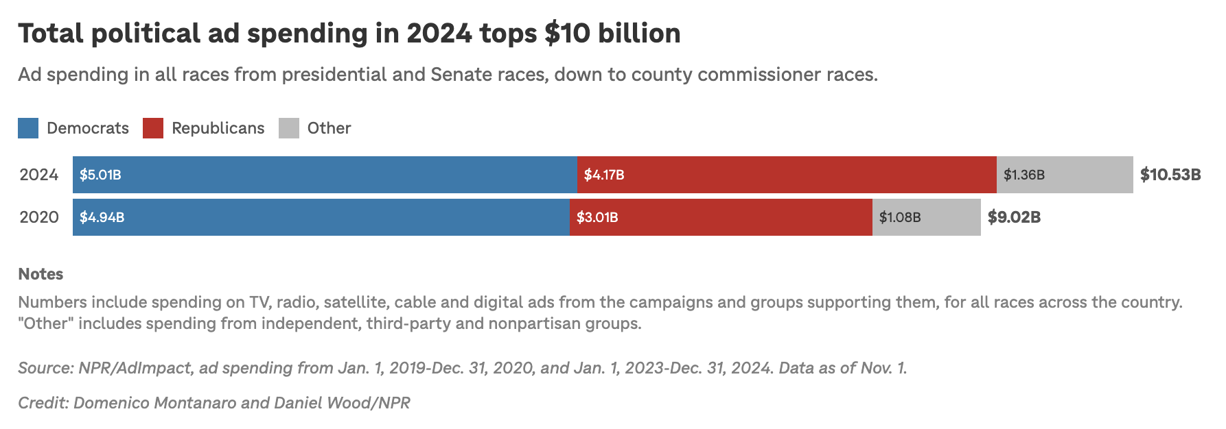
And Spending Continues to Grow…

Slide 16
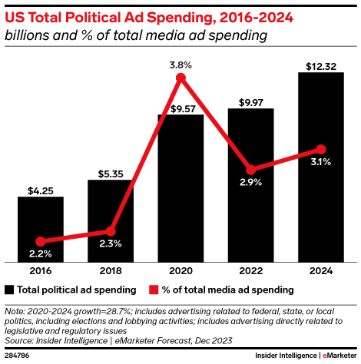
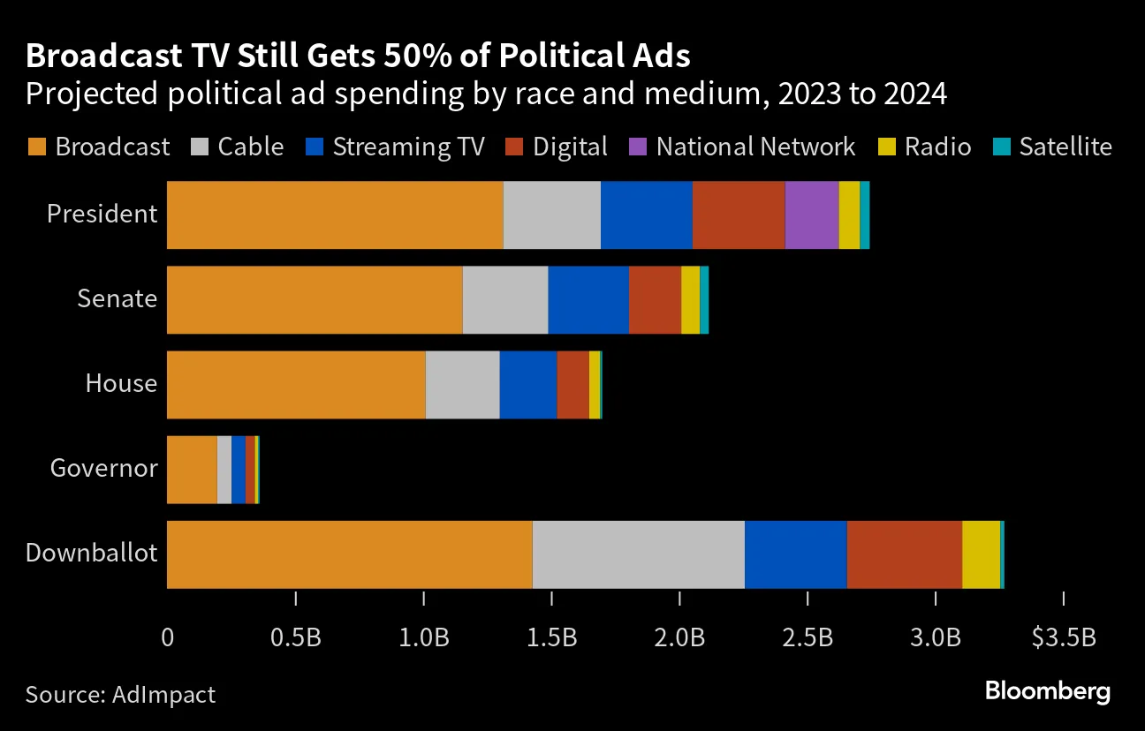
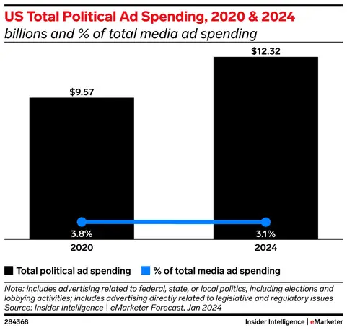
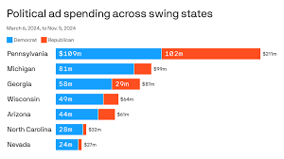

Slide 17
Branding of Politics and Product Politicization
Politicians are branded like products
And product use is politically skewed
Choose to feature certain imagery, brands, symbols, and products in ads as a way to brand the candidate

Slide 18
Republican consumers are different from Democratic consumers.
Alcoholic beverage consumption by party

Slide 19
Media consumption: Cable viewers and newspaper readers by party

Slide 20
Ownership of car makes by party

Slide 21
Things to Watch in Ad Composition
Importance of non-verbal cues
Sounds and music sets tones
Graphics
Editing
Code words

Slide 22
Highly Controversial
Question quality and accuracy of info
  Mudslinging and misrepresentations
Fear about impact on citizens
  Fosters cynicism and demobilization
Distort opinions and alter elections
  Switching vote based on ad claims

Slide 23
Lessons from Modern Campaigs
Candidates don’t dictate the news discourse
  Though gatekeepers sometimes let them
Campaigns do control websites, broadcast ads & direct media (mailers, telephone calls, social posts etc.)
  Can amplify inaccuracies and distortions
Elections are won locally - ex. electoral college
  Swing states, specific regions, local precincts
Play good cop, bad cop - makes attacks worse
  PACs, 527s, and stealth campaigning

Slide 24
Negative Advertising
Not a new occurrence – since the 50s
  Eisenhower attacks Democrats
  Johnson’s “Daisy Girl” against Goldwater
Important part of recent election bids
  Beginning in 1980, PACs used ads to support certain candidates as an “independent expenditure”
  Willie Horton Ad – PAC against Dukakis

Slide 25
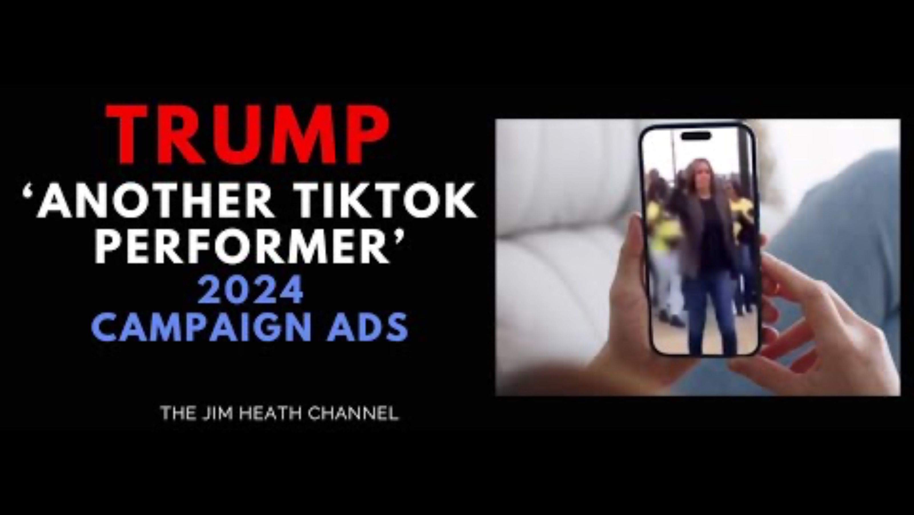
Negative Ads
Focus on criticisms of the opponent, fault character, accomplishments, or issue positions – “attack advertising”
Negative are growing in prominence and visibility

Slide 26


Used Across Campaigns

Slide 27


Comparative Ads
Contrast the sponsoring candidate with opponent on issue positions or character

Slide 28

Types of Positive Ads
Positive Ads – focus on good characteristics, accomplishments, or issue positions of sponsor
  Morning in American
    Reagan
  Boy from Hope
    Clinton
Image Oriented – focus on character and personal traits
Issue Oriented – focus on the issue/policy positions

Slide 29
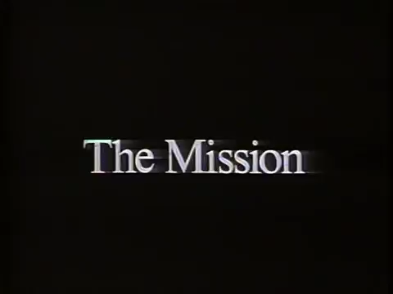

Image vs. Issue

Slide 30
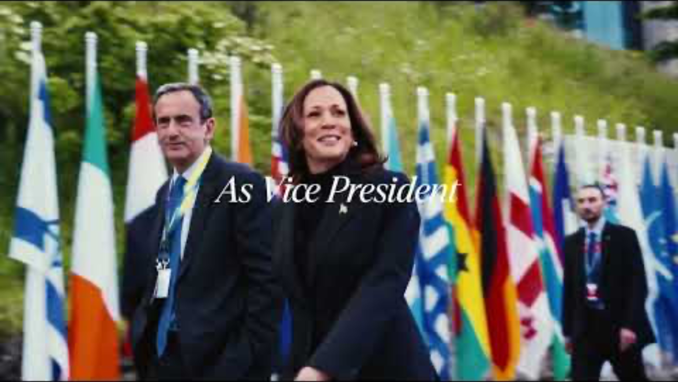

Slide 31


Rise of Viral Videos
Segmented targeting of groups
Appeals based on affinity and humor

Slide 32
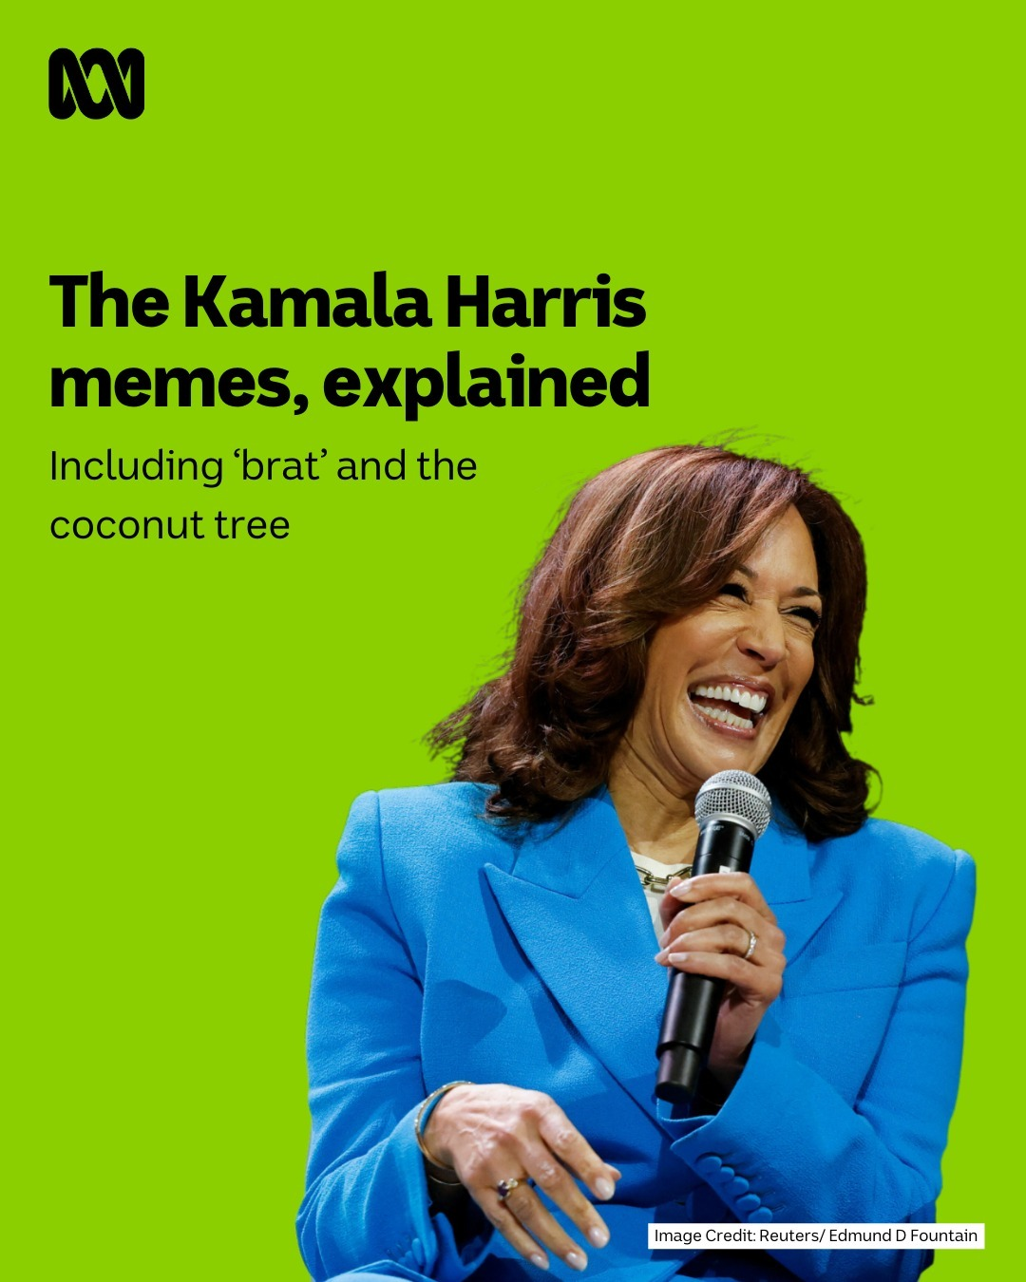
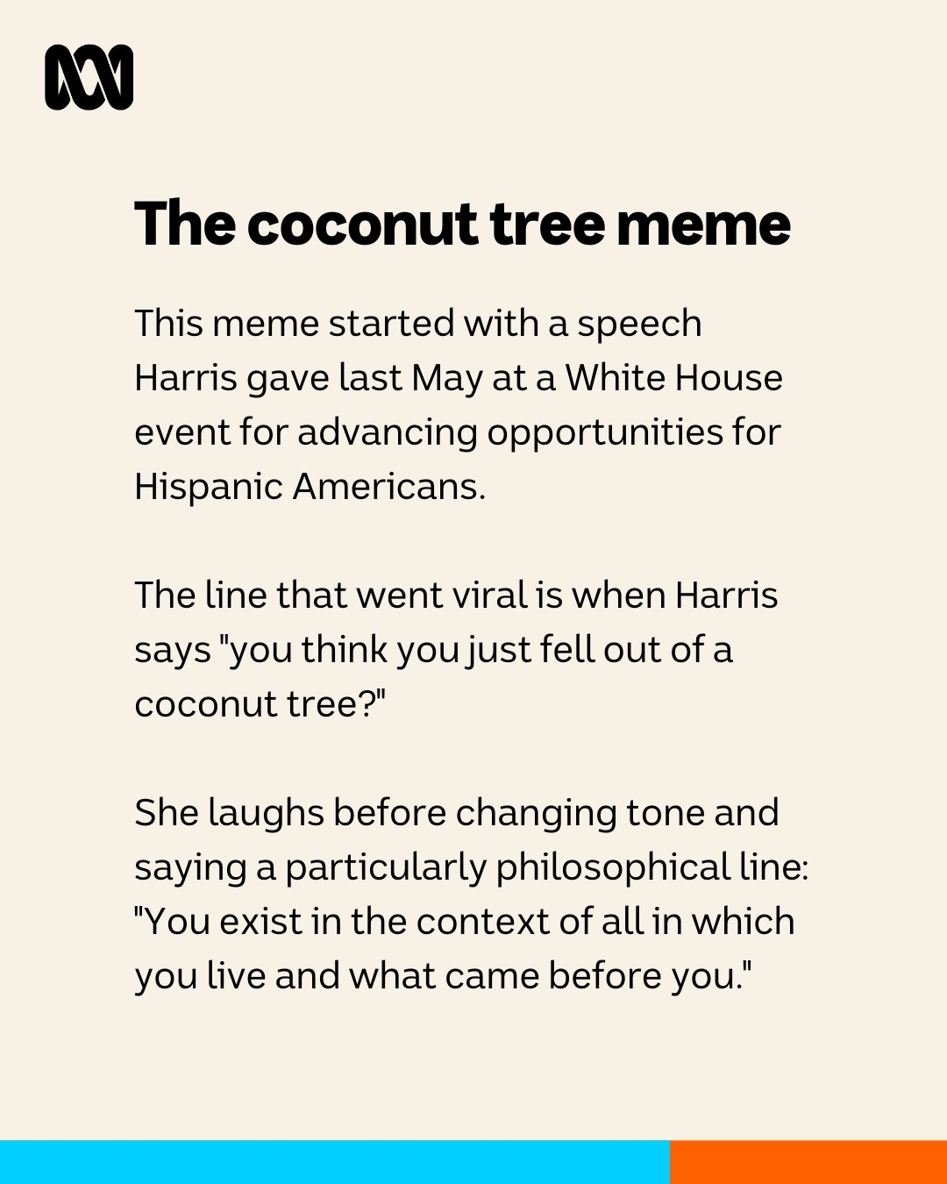
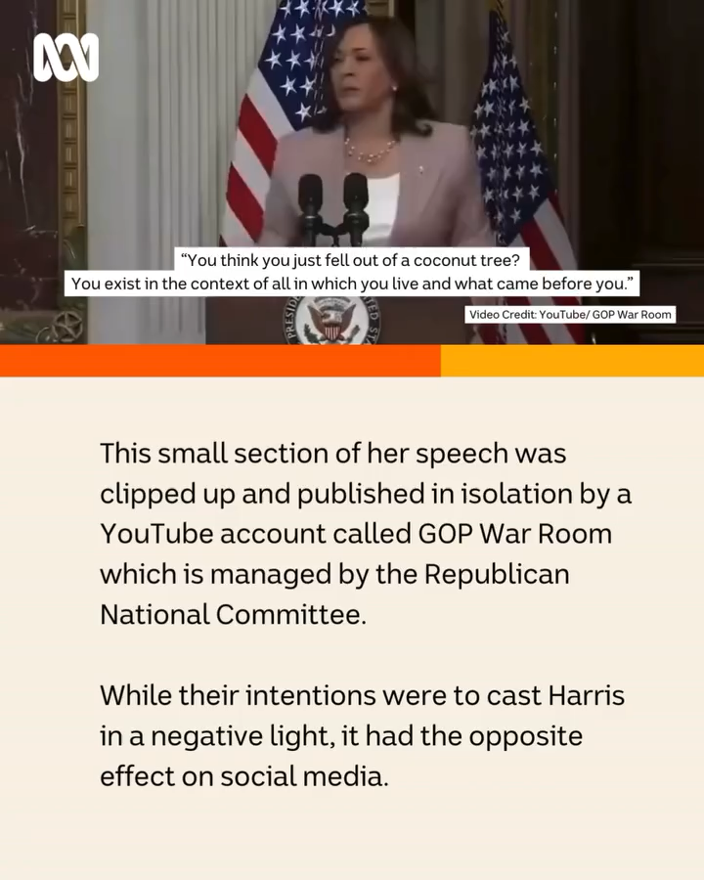
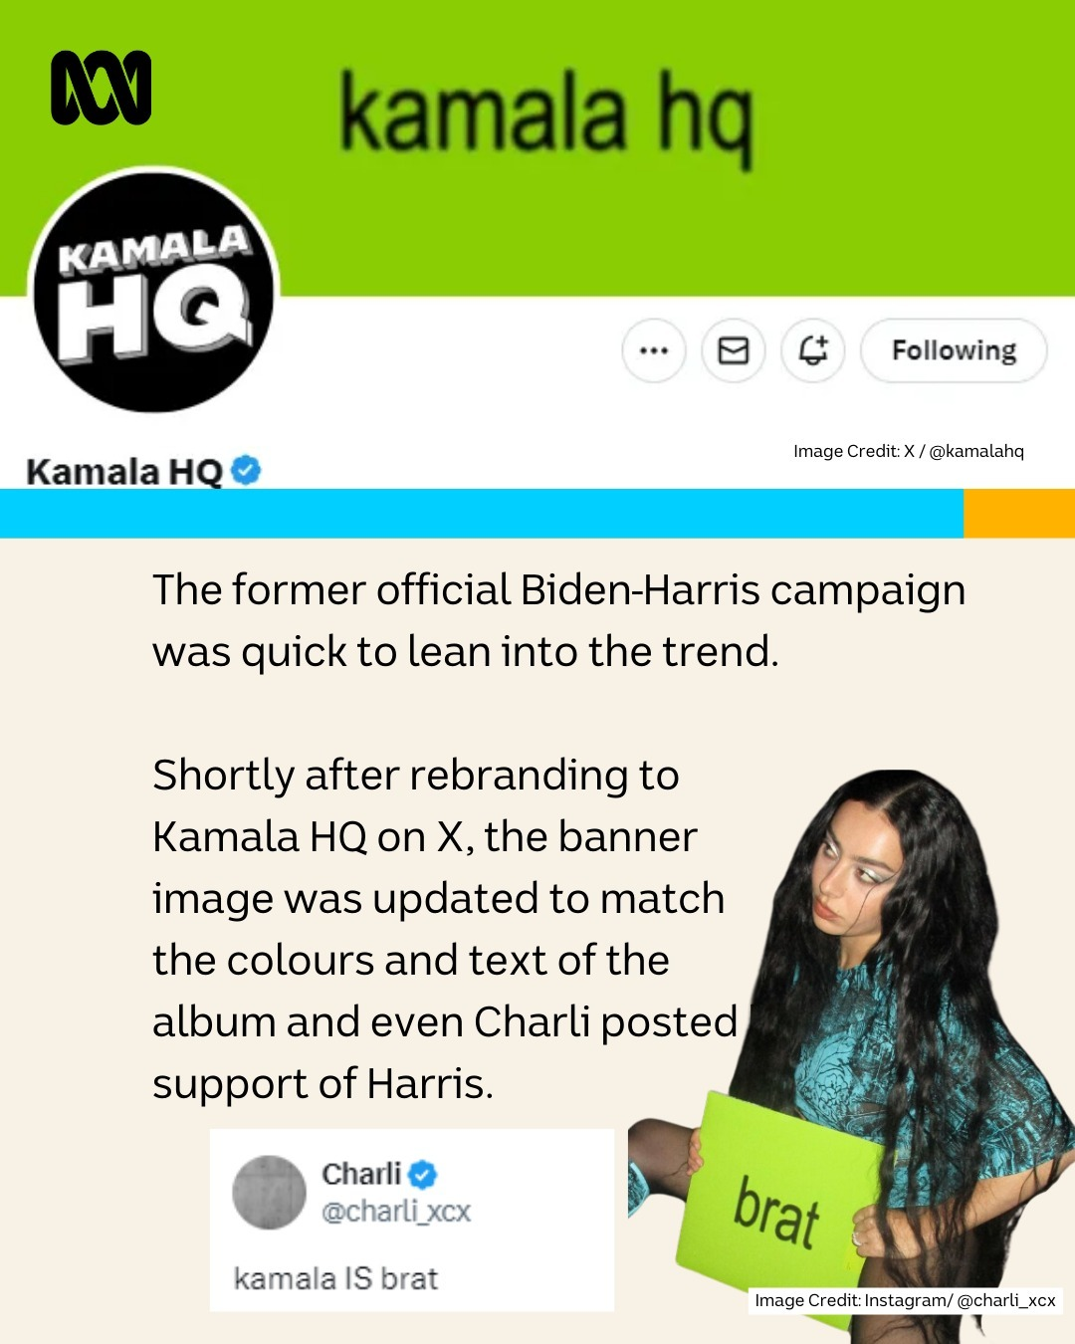
Campaigning via Memes

Slide 33

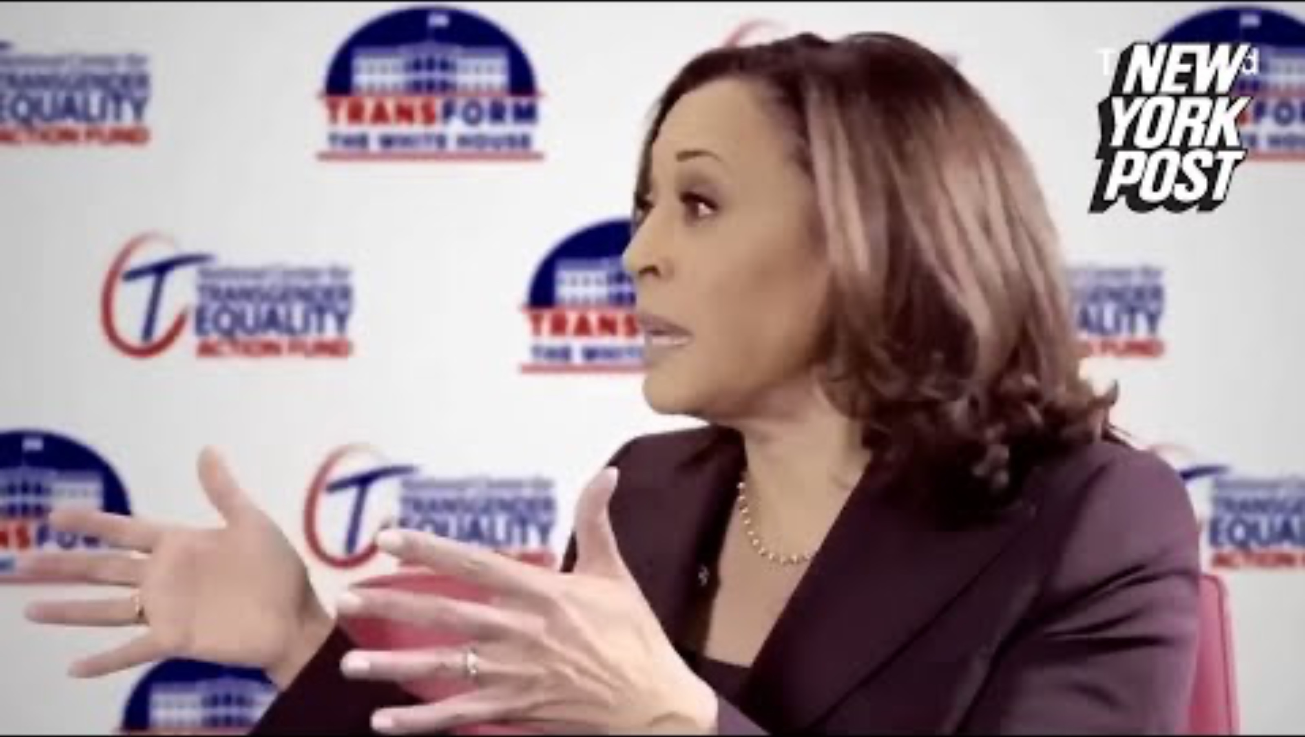
Increasingly Contentious Politics

Slide 34
Mobilize thru Social Media

Slide 35
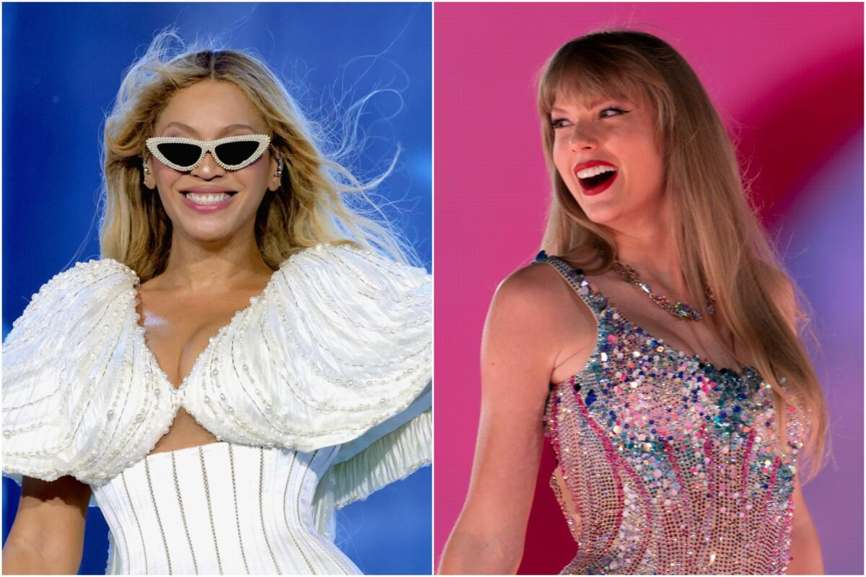
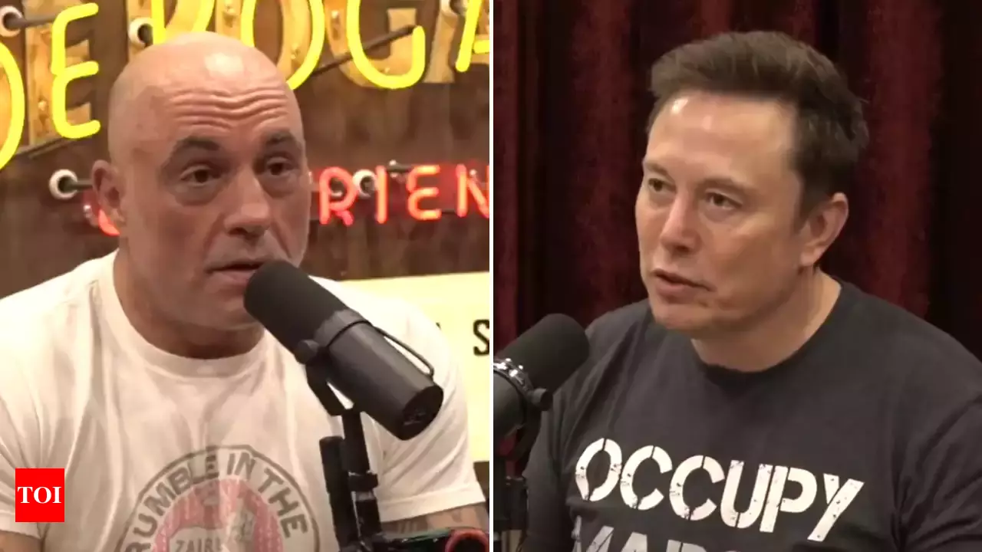
Celebrity Endorsements
Podcasts, Twitter/X, “Stan Communities, Rogan Bros

Slide 36
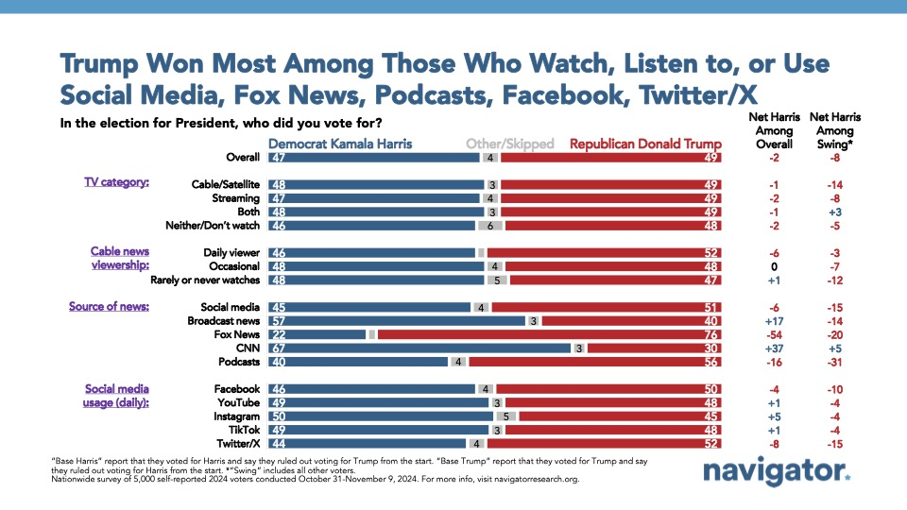
What Drove the Vote in 2024?

Slide 37
Political Ad Effects
The Negativity Effect
  Yes, Negative Ads more easily recalled
The “Demobilizing” Effect
  No, Negative ads are actually mobilizing
The Backlash Effect
  Yes, Negative as can help the attacked

