Slide 1
Your Future in
Strategic Communication

Slide 2
Pitch Meeting
Nafziger Conference Room, 5th Floor Vilas
6:00 – 8:00 PM (301/303) on Dec 11th
8:00 – 10:00 PM (302/304) on Dec 11th
  For the 8:00 start, please be quiet as you wait outside of 5055, as the prior session finishes.
  Will have Ian’s Pizza delivered to the room to provide some sustenance before we start at 5:55 and 7:55
  Please bring your own drinks or change for the vending machine down the hall

Slide 3
Final Exam
Emailed exam study guide; covers lectures 11 through 22.
You can bring one 8½” by 11” sheet with notes, double-sided, in any font size
You will complete peer evaluations when you take the final – last sheet of the test

Slide 4
Final Exam
Exam time for the final in 2195, this classroom
Listed time: 5:05 PM –7:05 PM, December 13th
Exam will be the same format as midterm exam
50 items, multiple-choice format
Please let us know if you need accommodations!!!!

Slide 5
Future Trends
Data Analytics
  Need to measure, interpret and evaluate campaigns
Hybrid Integrated Marketing
  Bridging traditional, digital, and alternative media
Digital Convergence
  Digital appliances, interactive, and mobile
Co-creation of Brand Content
  Consumer and marketer jointly create brand
Connections Planning
  Deeper focus on insights for media plans

Slide 6
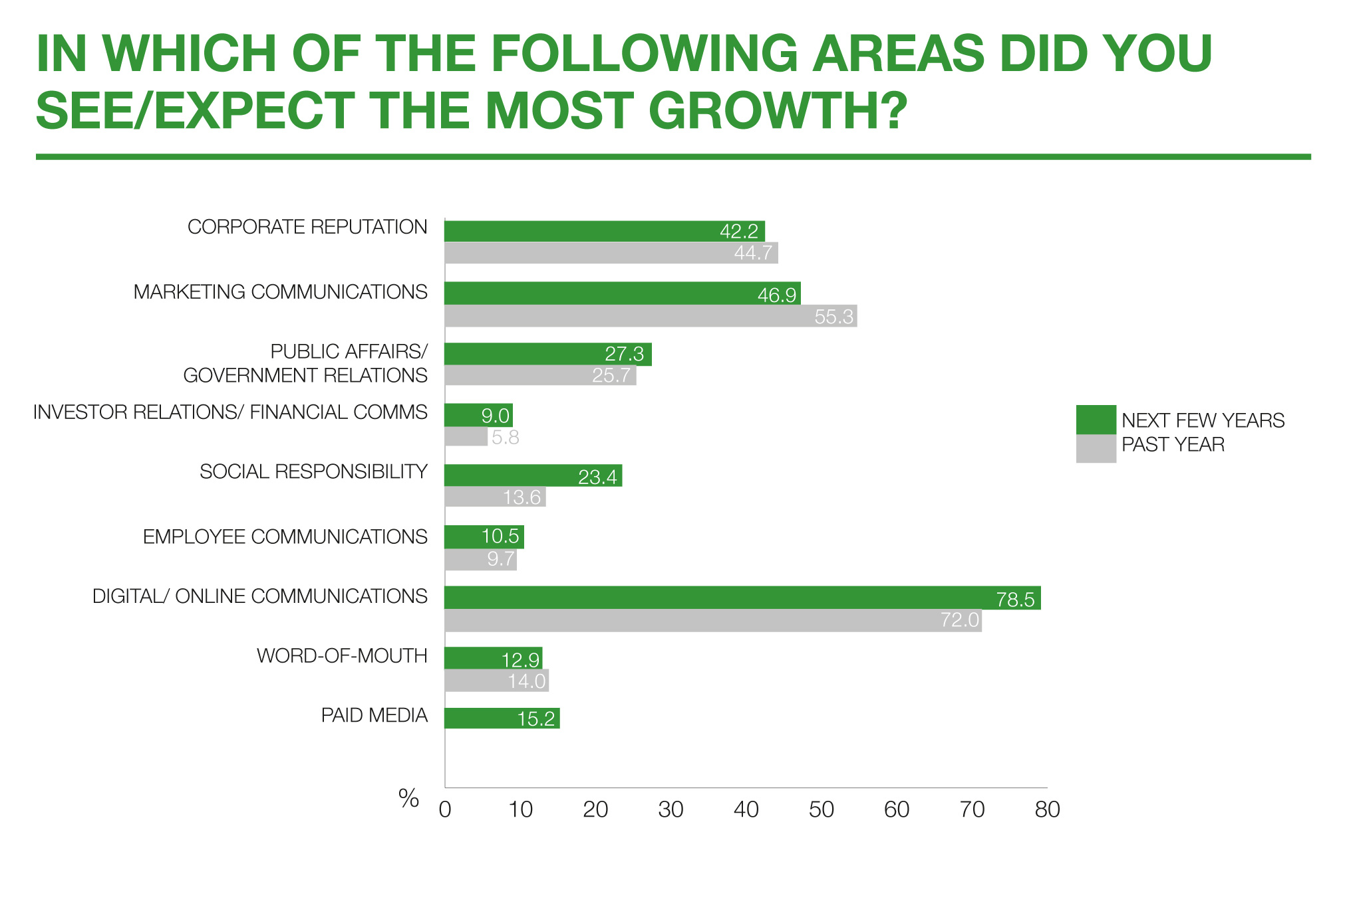
Biggest Growth Areas

Slide 7
Careers/Courses
Market Research and Account Planning
  Entry level: Research Assistant or Jr. Planner
  J566 – Communication and Public Opinion
  J658 – Communication Research Methods
  J677 – Data Analysis and Visualization
Account Management
  Entry level: Assistant Account Executive/Planner
  J449 Account Planning and Strategy
  J470: Strategic Communication Campaigns
Creative and Design
  Entry level: Junior Copywriter or Assistant Art Director
  J445 - Creative Campaign Messages
  J465: Social Media Marketing Communications
Media & Interactive
  Entry level: Assistant Media Planner or Buyer
  J447 - Strategic Media Planning
  J463 – Digital Media Strategy
PR and Promotions
  Entry level: PR/Promotions Account Executive
  J464 – Public Relations Planning
  J453 – Media Relations Planning
  J566 – Communication and Public Opinion

Slide 8
Preparing for a Career
Self-education
  Read ad trade journals: Ad Age - http://adage.com
  Go to the big websites - http://adsoftheworld.com
  Major ad bloggers and marketing consultants - https://www.inc.com/travis-wright/16-top-marketing-blogs-and-publications-you-need-to-be-following.html
Internships
Identifying job prospects
Create and update resume
Specialized cover letters
Assemble portfolio
Volunteer and be a self-starter

Slide 9
Getting a Job
Focus areas:
  Cultivating leads
  Honing your resume
  Drafting cover letters
  Successful interviewing

Slide 10
Cultivating Leads
Leads can:
  Offer you a job
  Refer to other contacts
  Identify opportunities
  Point you in the right direction
Build a list of contacts (Networking)
  Professionals, friends and family, alumni, employers, professors, clubs and groups
Courtesy interviews

Slide 11
Honing Your Resume
1. Update regularly
  Career goals
  Work experience
  Education
  Personal
2.Concise: one page, statements in <10 words
3. Professional look
  Won’t get you a job, but might lose it
4. Seek opportunities to flesh out resume

Slide 12
Honing Your Resume
5. Emphasize accomplishments not just jobs:
  “Organized,” “created,” “established,” “revamped,” “developed,” “initiated,” “streamlined,”
6. XYZ format:
  Achieved X through Y with Z impact
6. What image is conveyed?
  Leader
  Organized
  Ambitious
  Goal-directed
  Smart and thoughtful

Slide 13
Drafting a Cover Letter
Be Direct; Get to the point
Stress accomplishments
Don’t over sell
Research the company and know the executive’s name, position, clients
  Call company to double-check info
Be positive and show enthusiasm
  DO NOT SAY “I know I don’t have…”

Slide 14
Drafting a Cover Letter
Format:
  Purpose
    What are you seeking?
  Presentation:
    Why is it worth the reader’s time to see you?
  What’s next?:
    Call to action
    Leave yourself room to initiate contact

Slide 15
Successful Interviewing
Preparation:
  Selling yourself
  Five-minute resume in 90 seconds
  Be different, but be yourself
    Interviewing can be fun
  Emphasize success/accomplishments
  Practice, practice, practice
    Mirror, voice recorder, video
  Do your homework
    Learn as much as you can about the organization
      Clients, leaders, accomplishments, awards, and direction

Slide 16
Successful Interviewing
Concerns of the interviewer:
  Can you do the job?
    Skills and experiences
  Will you do the job?
    Motivation
  Do you fit with the organization?
    Personality

Slide 17
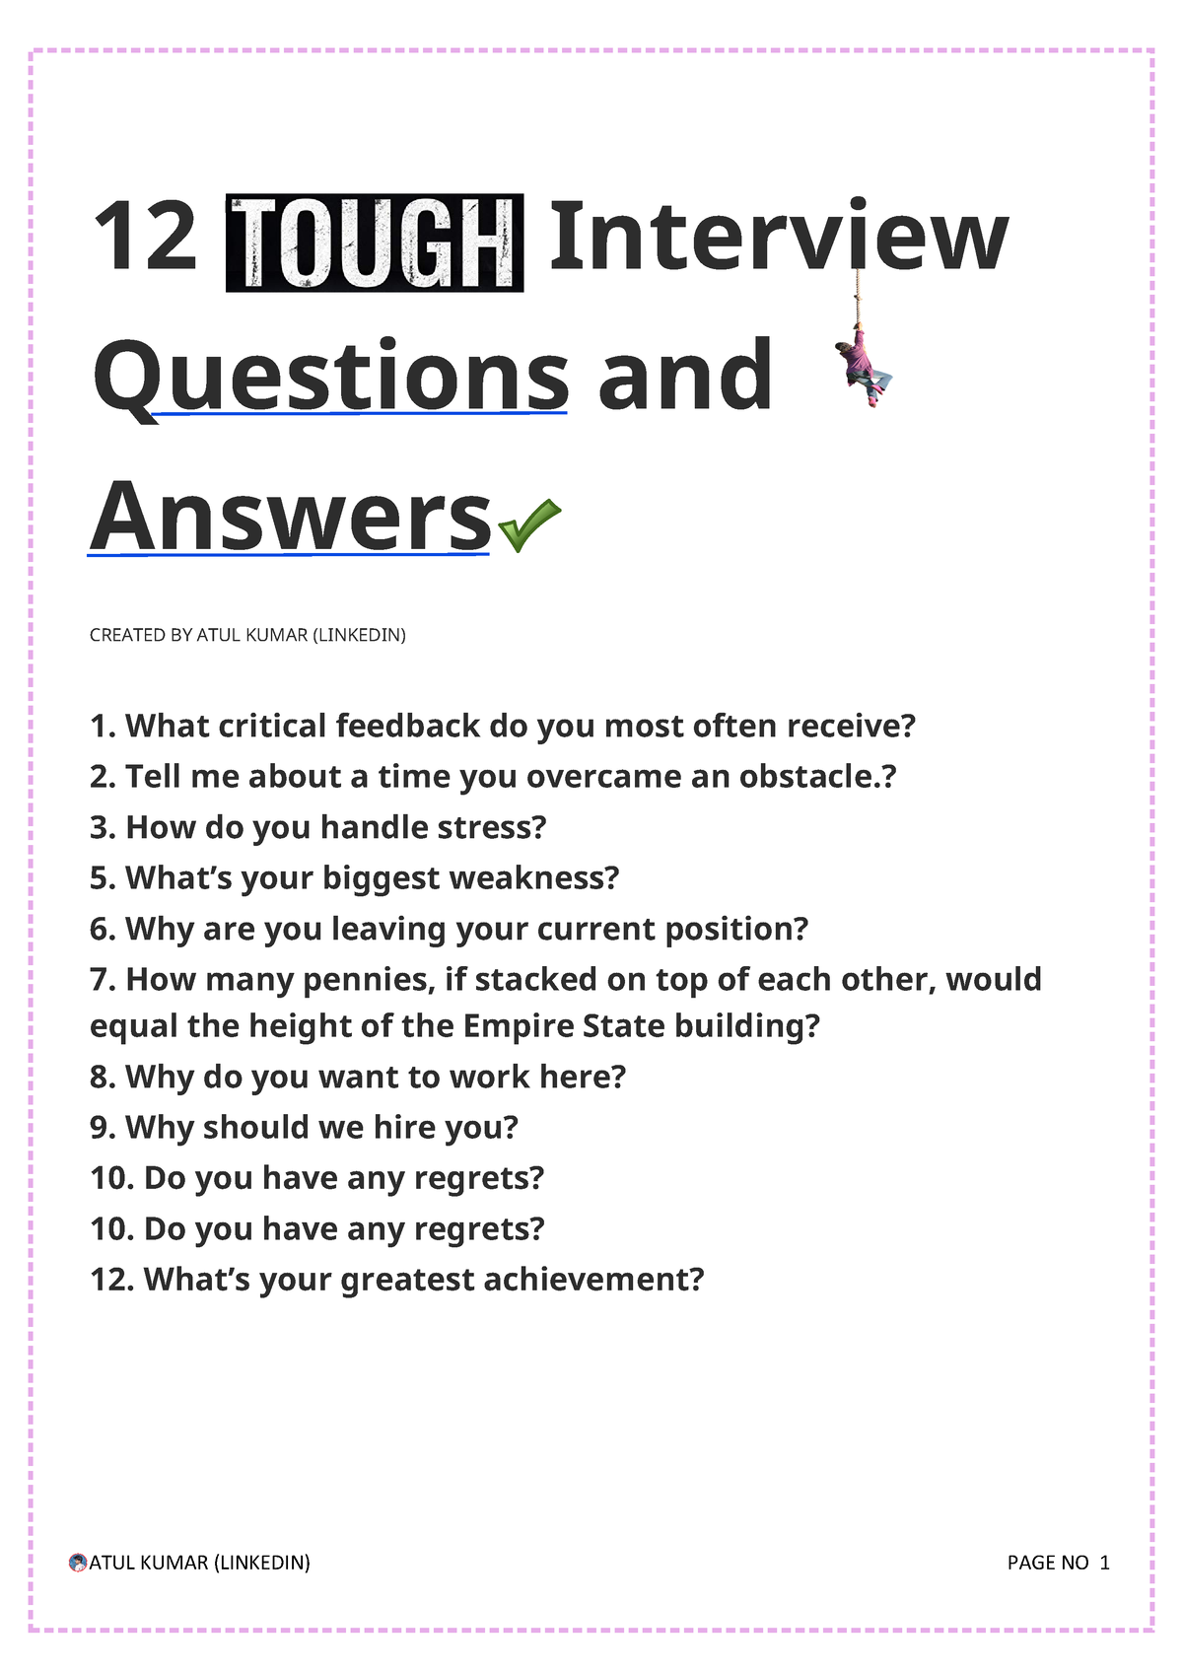
Interview Questions
Personality Questions
The "Weakness" Questions
Previous Work Questions
Tough "On the Job" Questions
Tricky Interview Questions
  Rock or a Cloud?
  Dinner Guests?
  Favorite Book?
  Favorite Movie?

Slide 18
Successful Interviewing
Reminders:
  Look and feel your best
  Be prompt
  Be warm, enthusiastic, observant and polite
  Have a brief list in mind of what to stress
  Listen to questions and dialogue
  Take notes
  Evaluate your performance: strengths/weaknesses
  Relax, be confident and have fun
    The more you do the better you get

Slide 19
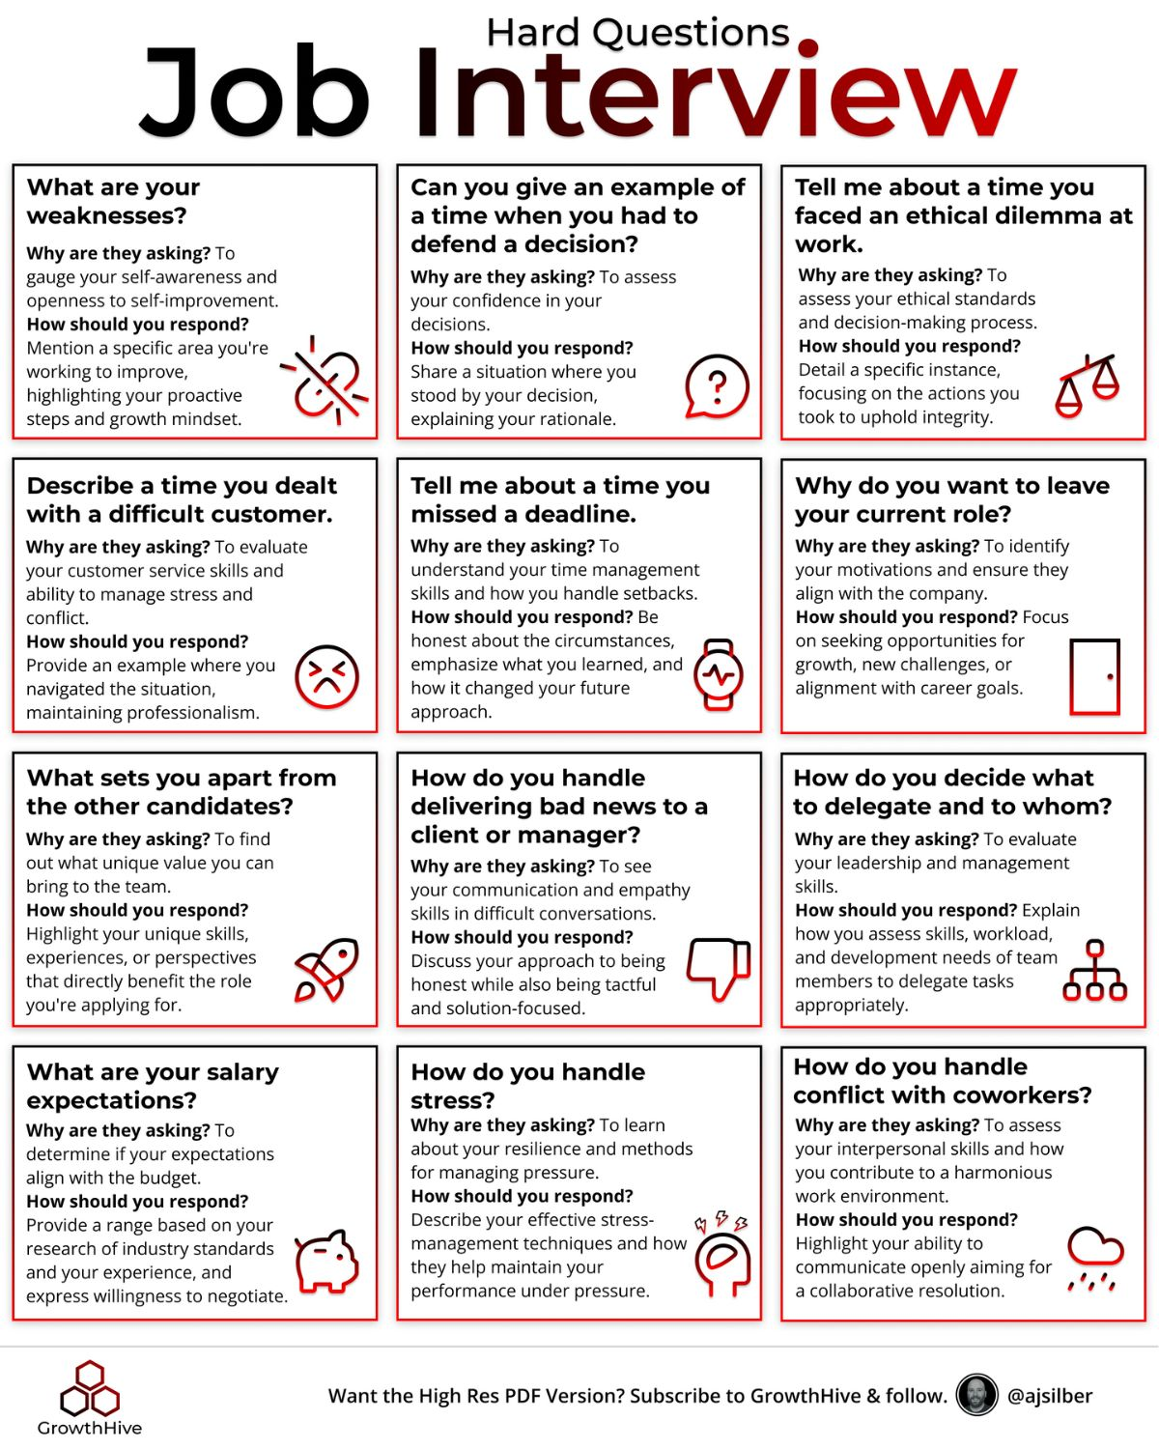

Slide 20
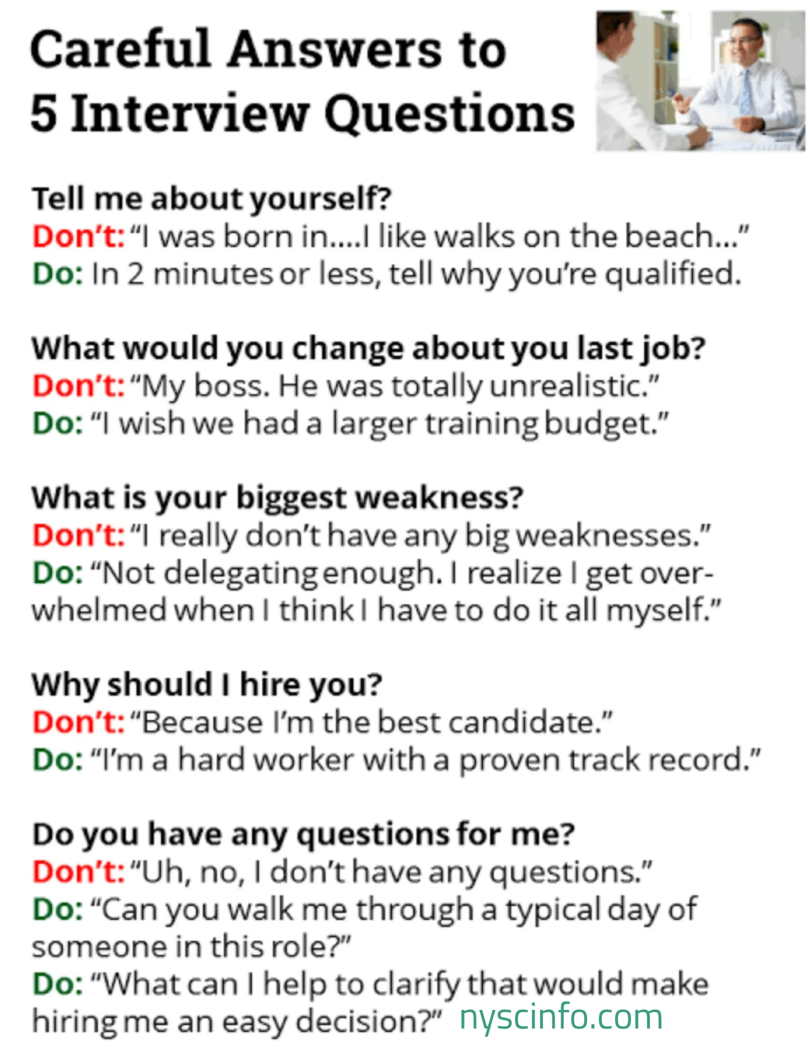
Unsuccessful Interviewing

Slide 21
What Makes a Successful...
Strategic communication professional?
    Writing
    Thinking
    Speaking
  Communication skills
  Analytical skills
  Computational skills
  Creativity and problem solving
  Dedication/effort
  Persistence
First job vs career mobility

Slide 22
Building the UW Network
Alumni Association
Maintaining contact with the SJMC
  Provide the school with career updates
  Professors/TAs – stay in touch with us
Benefits
  Networking
  Jobs
  Pipeline to new graduates

Slide 23
Course Evaluations
Course evaluation is online:
https://it.wisc.edu/services/heliocampusac/
Higher rate of completion if done during class, so we are hoping you can take a few minutes to do so now.

Slide 24
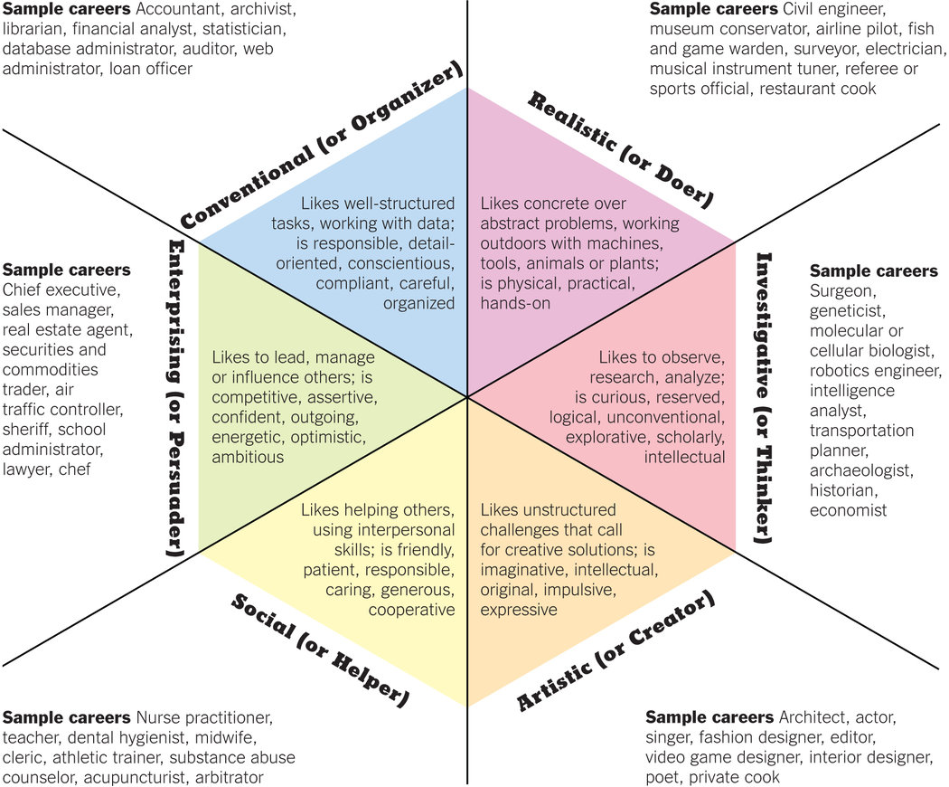
Find Your Fit

Slide 25
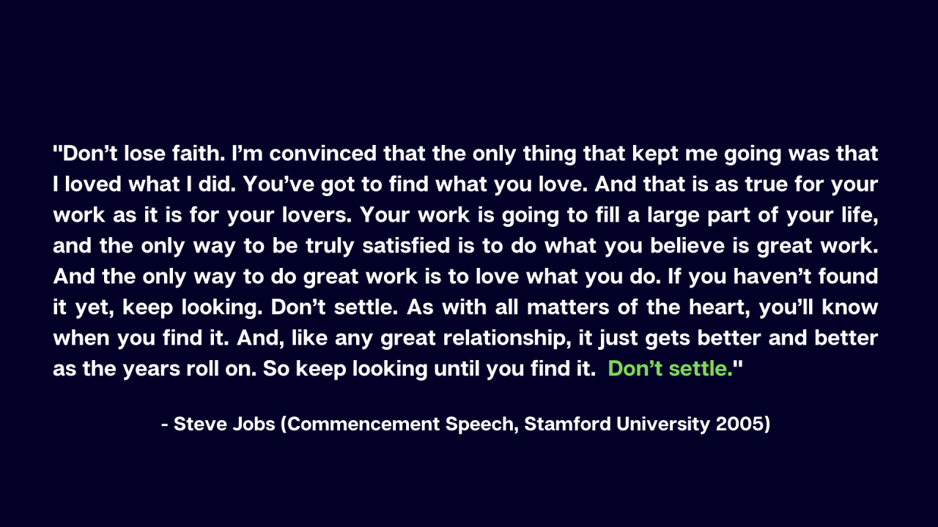

Find your Passion

