Slide 1
Interactive Media: Social Media

Slide 2
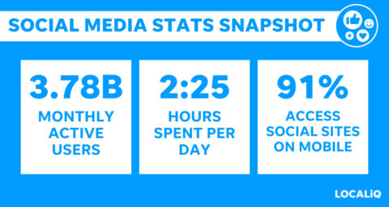
Social media has exploded
$173 billion in ad spending in 2022
$268 billion estimated spending in 2023
Over 90% of marketers use social media for marketing, paid and unpaid

Slide 3
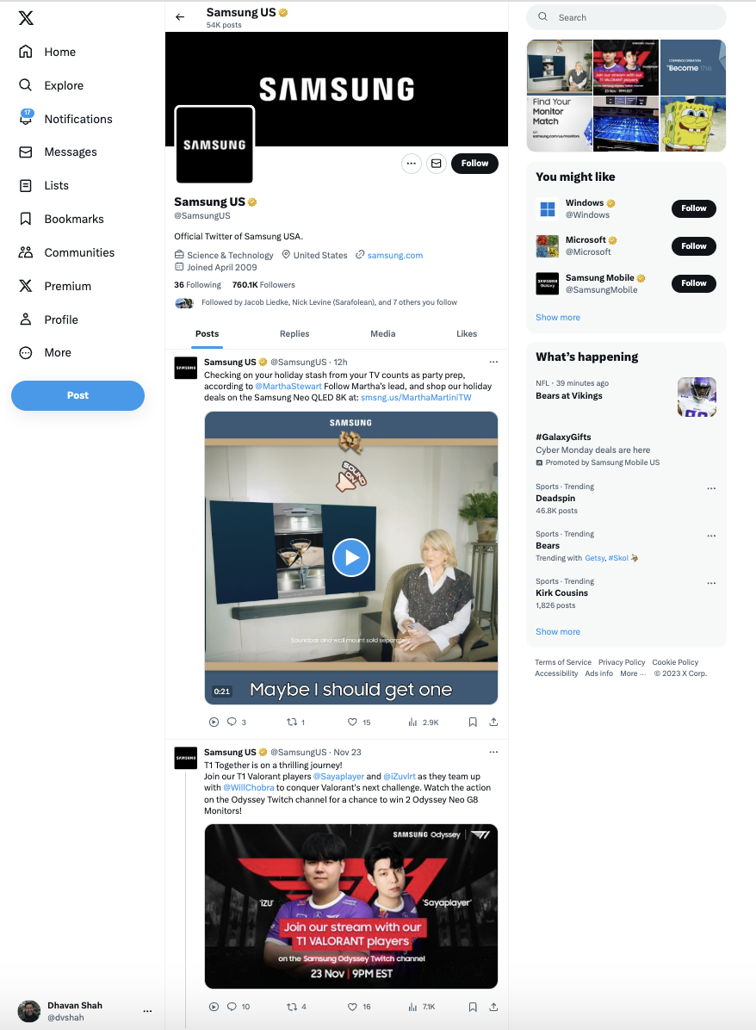
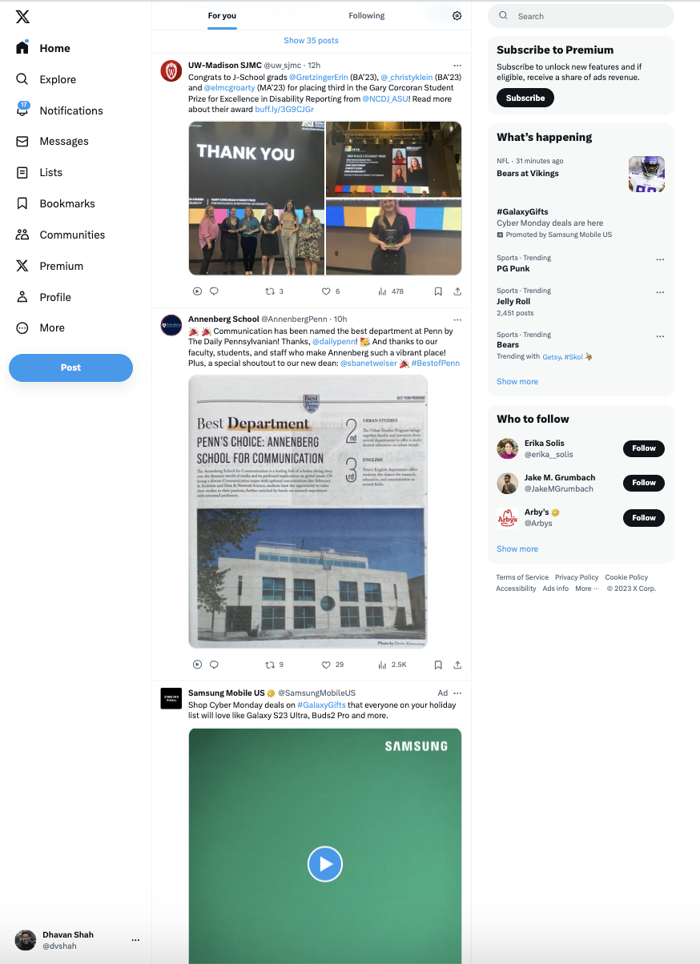
Social Media Tactics
2 main ways to use social media in your interactive media plan:
Unpaid - manage ‘free’ content on your page
Paid – buying ads on social media sites
Notes:
Online advertising
Hulu – streaming TV
Pandora – streaming audio
Search Engine marketing and Search Engine Optimization – SEM, SEO
Mobile
Social – Facebook, plus others

Slide 4
Social Media Marketing
Optimize your platform profile
Accurate, complete, active, and interlinked
Post content to your profile page
Useful and entertaining posts, videos, stories, live feeds
Engage with followers and audiences
Like, share, comment & follow – customers/influencers
Advertise on platform using sponsored content
Paid methods to target key audiences
Measure your impact
Use web analytics to see what is working

Slide 5
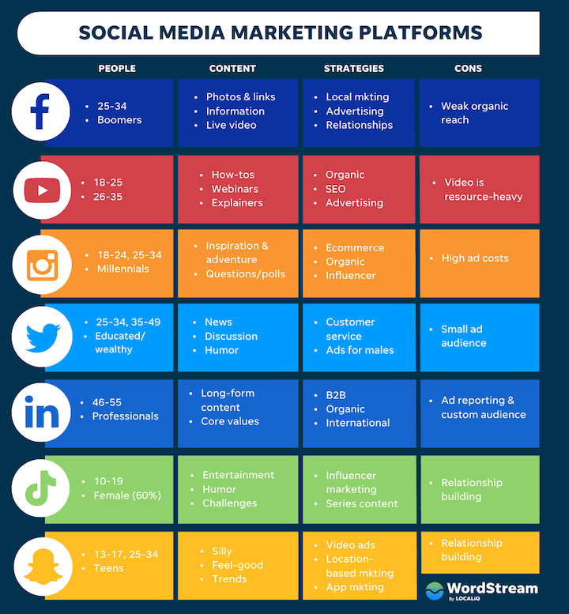

Slide 6
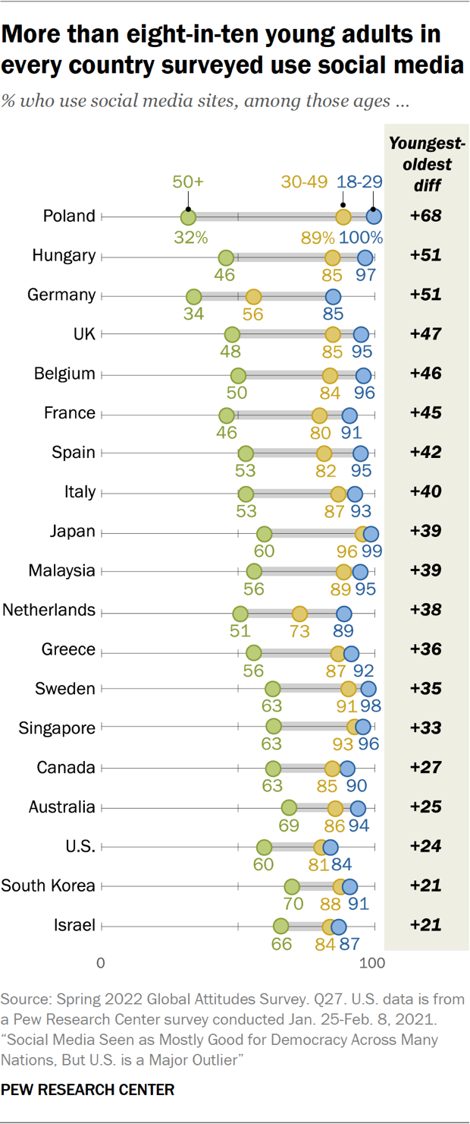

Slide 7
Success in Unpaid Social Media
Know when and how to find your audience
Engage in 2-way communications
Not just talking to them, but listening as well
Integrate marketing messages from social media into all forms of your marketing mix
Create Awesome Content!!!

Slide 8
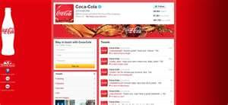
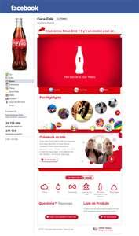
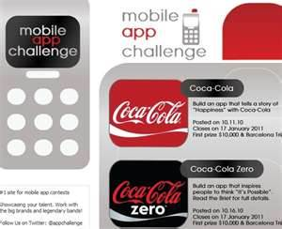
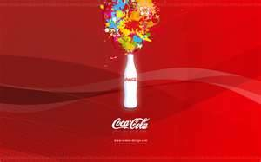
Content (and Branding) Drives All!
Lives across all points of consumer contact

Slide 9
Content Creation Skills
Wanted: We “need strong hybrids …. understand technology, but also have a sense of story and interconnectivity.”
Analytical skills
Communications
Writing
Creative

Slide 10
The Three ”A” of Social Media Engagement
Ask, Answer, and Acknowledge

Slide 11
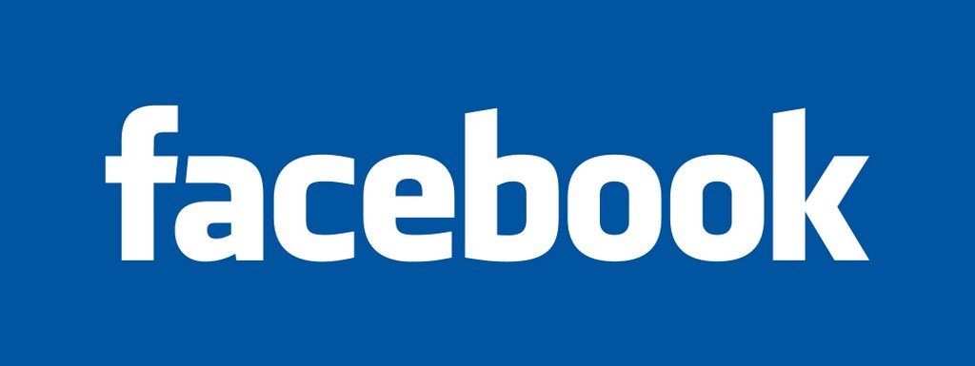
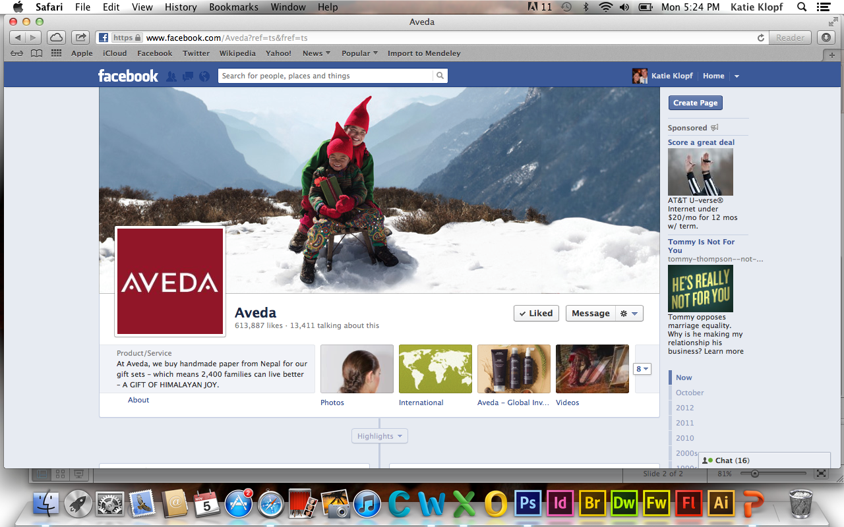
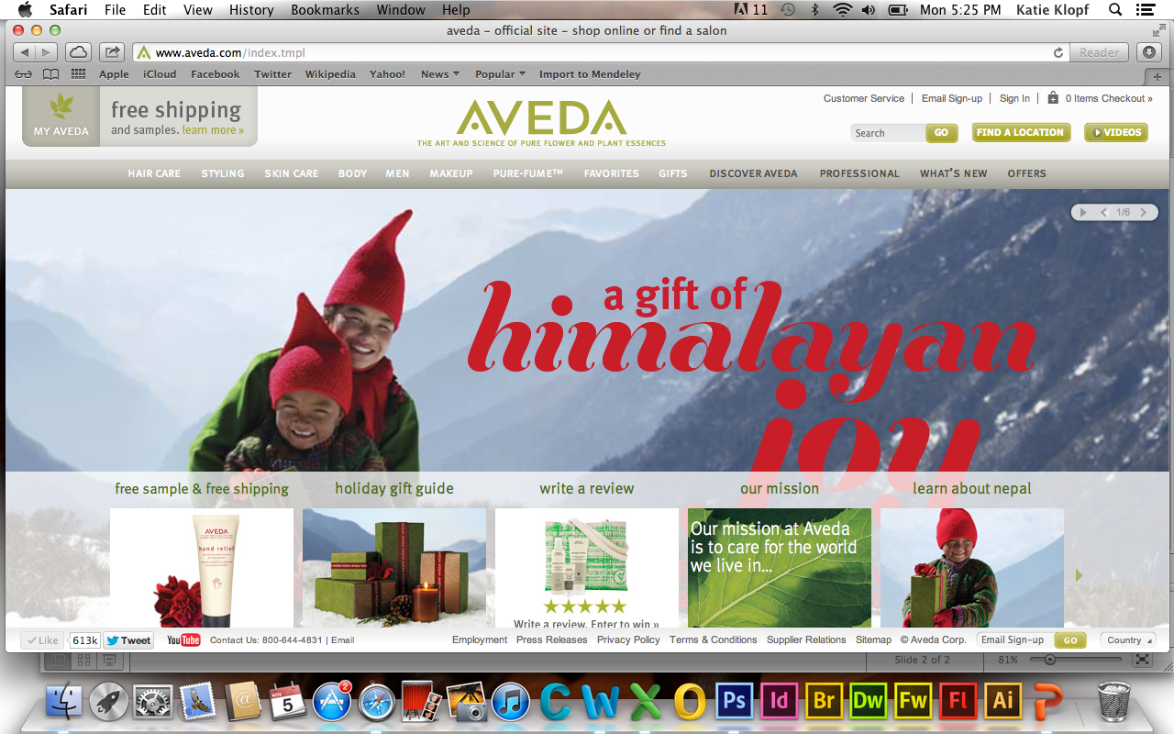
Principles for leveraging Facebook
Follow marketing message (pictures, language, etc.)
Network and interact with those who view profile
Integrate with other social media platforms
AVEDA successfully leverages these principles
Follows their marketing message of being environmentally friendly. Pictures of products, places they get ingredients, and ask people to write reviews of their AVEDA experience
Network with customers of their products as well as salon/spas that carry their products. Also connect to celebrity hairstylists that recommend AVEDA
Have their own website, X and YouTube Channel which all follow the same marketing message and strategy, provide incentives, foster relationships
AVEDA Facebook page
AVEDA Website
Notes:
Aveda is an example of how a company has successfully used Facebook as part of its interactive media plan

Slide 12
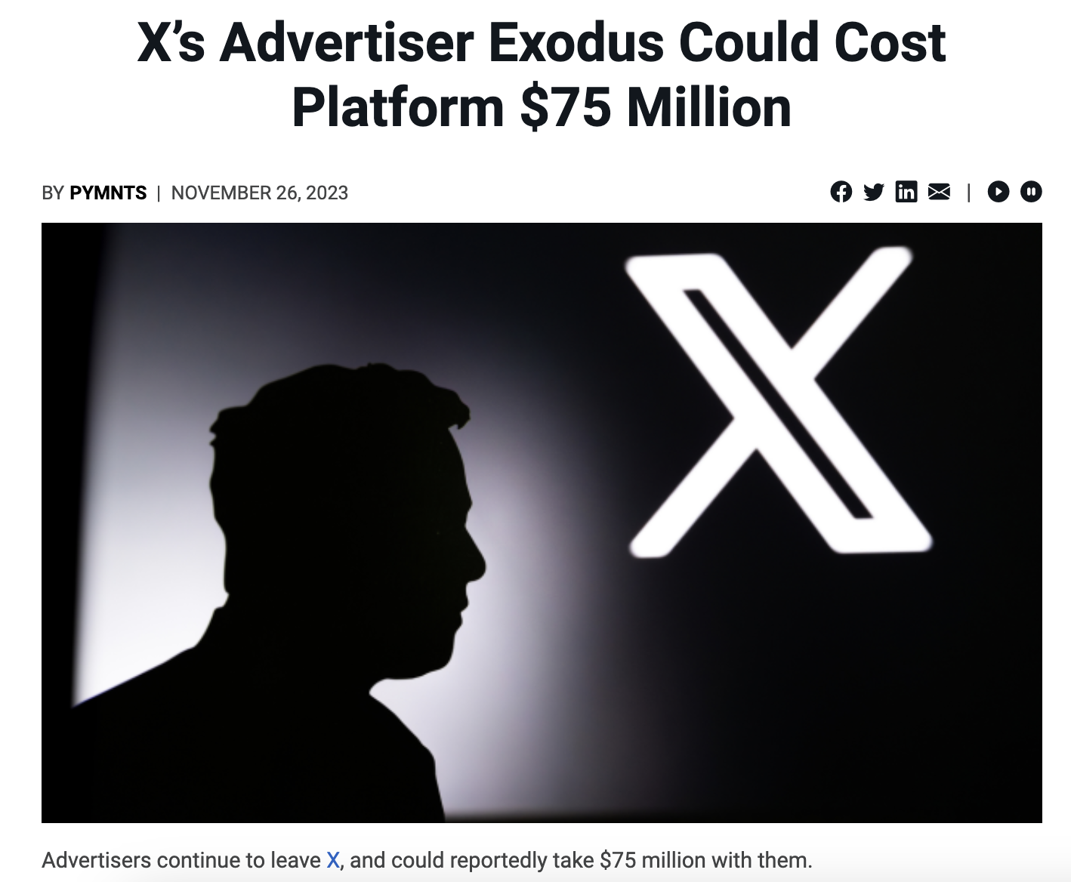
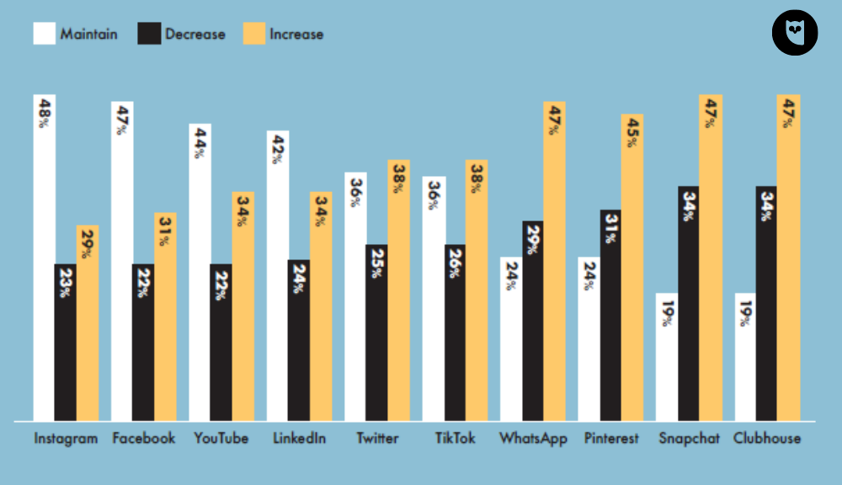
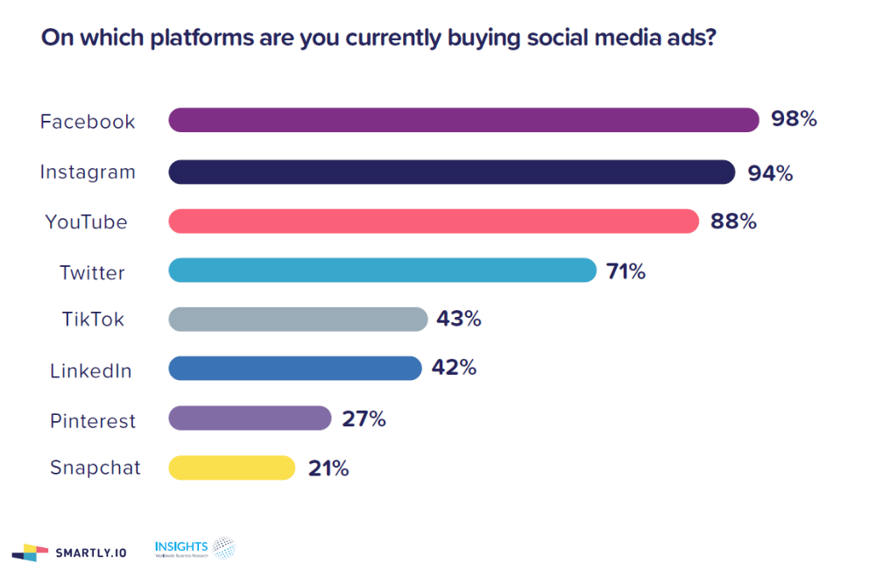
As Spending on Social Up over 50% from 2022… but can shift

Slide 13
Facebook Display Advertising
Marketers can buy space on Facebook, in addition to having their own pages
Cost per ads on Facebook is same as other online ads
Buy them on a CPM basis

Slide 14
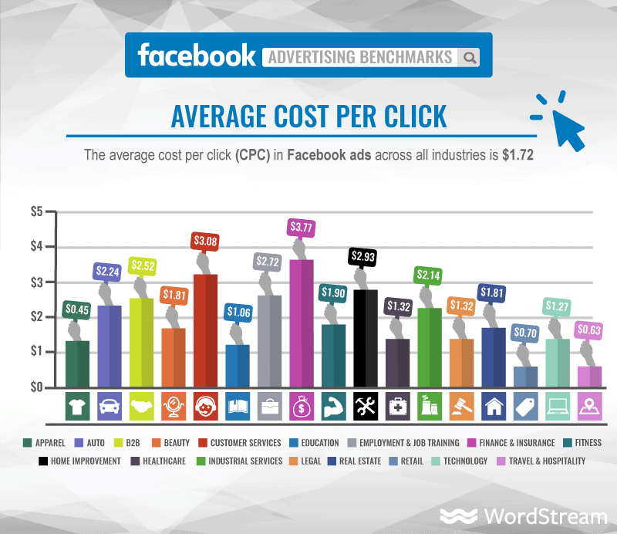
Some Social Media Ads Moving to Cost Per Click

Slide 15
Facebook Allows you to Target Your Ads Based on Many Different Factors
Location
By State or Province, or by City
Sex and Orientation
Age and Lifestyle Cluster
Keywords
By any key activity word found in profiles
Education
College grad, in college, in high school
Freshman, sophomore, junior, senior
Specific colleges
Workplace
Relationship status: Single, In a relationship, Engaged, Married
Relationship interests: Men, Women
And much, much more about what they are posting, reading, and messaging

Slide 16
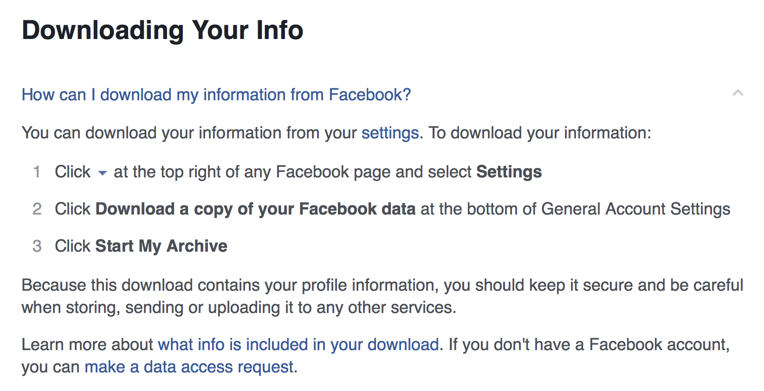
Download Your Data

Slide 17
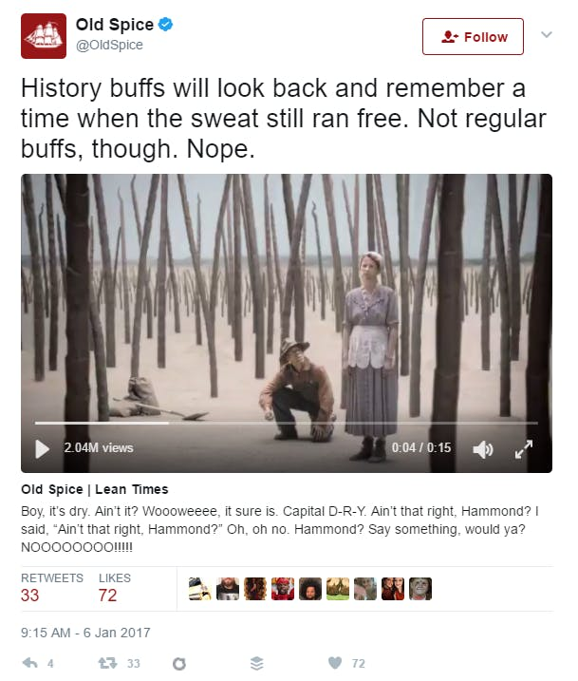
X’s Role in Marketing
Brand awareness and extended interaction
Customer Service: track conversations, respond to complaints and requests
Promote your product – even offer exclusive deals and contests
Increase sales through coupons and incentives
Notes:
Okay so what’s the big deal right? I don’t need to know what everyone is having for breakfast.
But Dunkin Donuts might want to know.
Or they might want to hear that I’m enjoying some donuts.
Or they might want to let me know that there’s a special deal on lattes until 7 a.m. today only.
So we as just average people (no offense) are out on Twitter talking about everything from news stories to breakfast foods to celebrity gossip to drunken shenanigans. And then there are businesses and brands out there using Twitter as a way to directly reach their consumers.
And they have good reasons.
Twitter is basically made for public relations. Twitter has a place for anyone looking to portray an image or reach fans. Businesses, news sources, educational institutions, political figures, sports teams, celebrities and even their unborn children are using the medium to reach out.
Two ways to leverage it – we’ll start with FREE.
1) BRANDING
Anyone can set up a free account.
Another medium for brands to extend a sense of brand personality.
2) CUSTOMER SERVICE
Twitter is basically made for costumer service.
Brands and businesses can reach their most avid fans (or at times, disappointed critics) directly.
For example, my friend Kevin was in India and his Keen’s broke after just weeks of having them and he tweeted to @Keens about it. They shipped him a new pair. Makes customer complaints public, which could be a terrible thing if not handled. But if they’re handled, they come across as trustworthy and reliable, even if their product itself fails.
3) PROMOTIONS
Free event publicity.
Once you share it, your followers can share it with their followers and spread the word for you.
All about making relationships with followers and consumers.
It gets them involved in ways that TV commercials can’t.

Slide 18
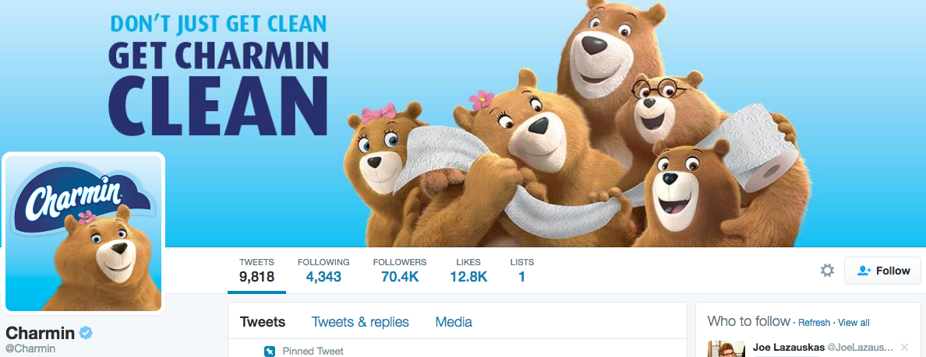
Advertising on X
There are 2 main ways to do paid ads on Twitter:
Promoted accounts
Promoted tweets

Slide 19
Promoted Accounts
Promoted accounts are the “first results that come up in searches” and in the “Who to Follow section”
For example: I follow Southwest airlines. United Airlines knows that. They pay Twitter to promote the United account in the Who to follow” section.
On average, it costs $2.50 to $4.00 per follower
Can ‘bid’ to the be promoted account – bigger bid wins
Can set a budget, so don’t overspend

Slide 20
Promoted Tweets
Marketers pay to have a greater ‘reach’ or distribution of a regular tweet, sent to more people
More people than just your current followers
Can be used to generate new followers, drive behavior, or increase awareness

Slide 21
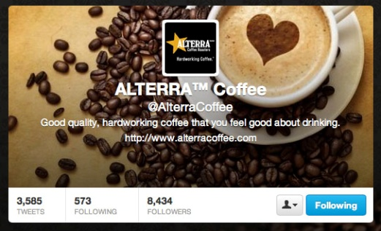
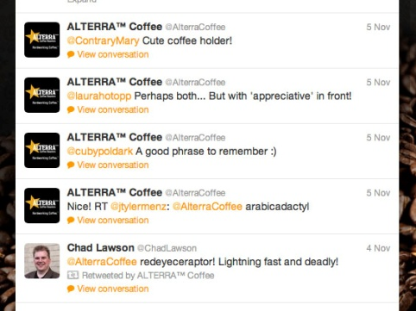
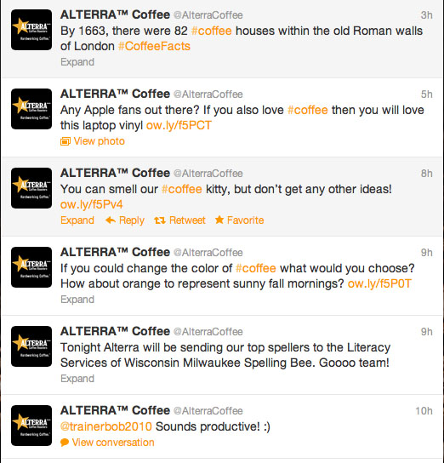
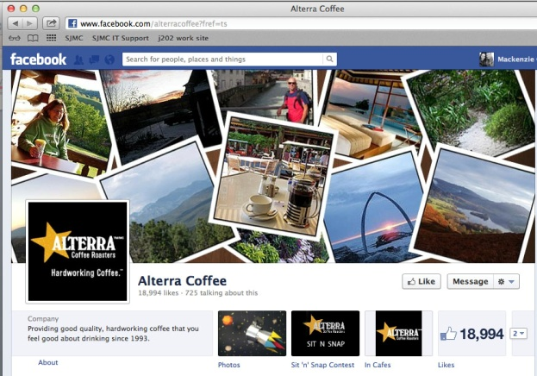
Principles for leveraging Twitter:
Knowing when and how to interact with your audience.
Creative Content:
Video, Image, Facts, Questions
Integrated Marketing continues
the conversation.
Evans, L. (2010). Social media marketing. Indianapolis, Indiana: QUE.
Notes:
Alterra is a great example of a company that has successfully used Twitter in its interactive media plan
Source: Evans, L. (2010). Social media marketing. Indianapolis, Indiana: QUE.
Examples of how Alterra successfully leverages these principles.
Knowing when and how to reach your audience: Alterra does this effectively by staying true to their brand message (Good Quality, Hard Working Coffee), tailoring it’s tone to the industrial/urban feel of downtown Milwaukee, and by listening to their consumers through creating conversation. In the first two examples shown on the slide, Alterra is replying to multiple consumers. The brand is not trying to initiate a conversation to market their brand and is not solely responding to negative comments for damage control, but they see mentions and/or related topics of interest and engage in a conversation. This messaging avoids marketing to the target audience. Rather, it allows the brand to speak for itself through a conversation with them.
Creative Content: When looking at Alterra’s timeline it is clear they have put time into creating a mix of content. Some content includes: historical facts about the company, questions to learn more about the consumer, brief videos, images, and photos from their consumers. The snapshot of their timeline shown in the slide displays a series of “tweets” that range in content.
Integrated Marketing continues the conversation: Alterra utilizes multiple mediums to increase brand awareness and interaction. Some of the additional social media platforms used by Alterra are Facebook and Flickr. Alterra also has a blog-like app on Facebook that allows their target audience to look at the latest deals, events, and news by location. By expanding their message across these outlets, Alterra is enabling the consumer to interact with the brand on their preferred platform… or, ideally, continue the conversation on all platforms. It is important to keep in mind brand consistency when having an integrated marketing campaign. Too many ideas can confuse the consumer. Alterra effectively incorporates brand messaging, deals, events, and specific location news into all platforms.

Slide 22
Visual Sharing Sites
Instagram vs. Pinterest
Instagram is about sharing your own photos, Pinterest is about curation.
Instagram is more about revealing, while Pinterest is more about discovering.
Instagram’s audience is more diverse, and larger than Pinterest’s. Pinterest’s audience skews female and more affluent
Instagram is mainly mobile, while Pinterest in for mobile and desktop use.

Slide 23
Pinterest
Launched March 2010, growing to more than 10 Million Users in First Two Years: the fastest growing platform, until TikTok.
Pinterest’s Social Commerce Potential: What Brands and Retailers Need to Know. Emarketer, 10/15/2012.

Slide 24
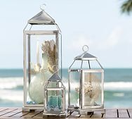
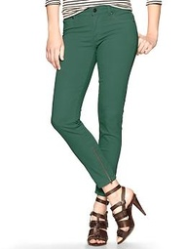
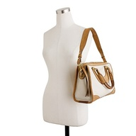
Linking ‘Pin’ Viewing with Buying
Fewer users than Twitter or Facebook, but they are valuable
Spend more per session and buy more items each time they buy
More likely to share their experiences with brands
Home goods, apparel and accessory retailers are benefiting!
Pinterest’s Social Commerce Potential: What Brands and Retailers Need to Know. Emarketer, 10/15/2012.

Slide 25
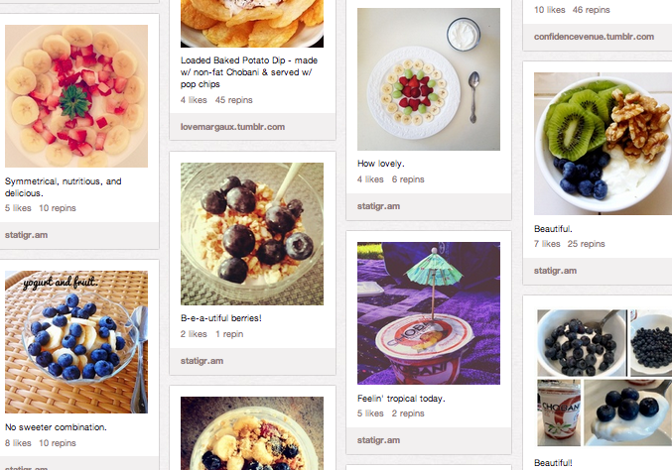
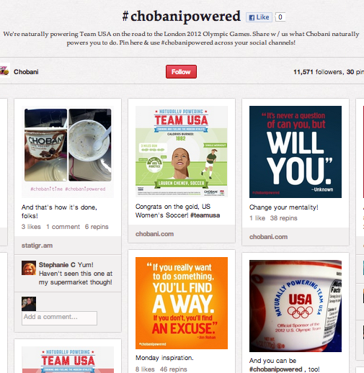
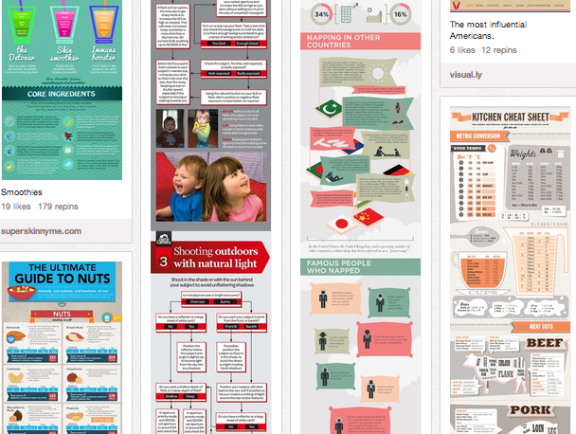
Chobani on Pinterest
Principles for leveraging Pinterest
Don’t just promote. Showcase the brand lifestyle.
However, Pinterest has a policy against using the site for direct marketing, advertising, or sales, work within this framework.
“Create group pin-boards and crowdsource.”
“Offer valuable information.”
Chobani does a lot of things well on Pinterest.
Variety of subjects reflecting Chobani’s healthy lifestyle through boards dedicated to fitness, general wellness and nutrition, healthy recipes.
“Insta-piration” board and #chobanipowered hashtag used to crowdsource.
Provides valuable information, like how to use Chobani to eat healthier, as well as information about living a healthy lifestyle in general
Diverse Content –variety of image types (pictures, text, infographics), as well as videos.⁸
Notes:
¹ Hayden, B. (2012). “Pinterest Marketing: Pinning with a Purpose.” Retrieved from http://www.entrepreneur.com/article/223947
² Gunelius, S. (2012). “The Do’s and Don’ts for Marketing with Pinterest.” Retrieved from http://www.entrepreneur.com/article/223489
³ Gunelius
⁴ Moritz, D. (2012). “The 10 Commandments of Using Pinterest for Business (Infographic).” Retrieved from http://www.entrepreneur.com/blog/223759
⁵ pinterest.com/chobani
⁶ pinterest.com/chobani
⁷ pinterest.com/chobani
⁸ pinterest.com/chobani

Slide 26
For Your Project
For final project, work with the following assumptions for Social Media:
Having a brand page on Facebook, Instagram, X, YouTube and/or Pinterest are free
Facebook, Instagram, X, YouTube, other Social Advertising cost $ as noted in the project manual.
Purchase space and allocate as explained

Slide 27
mobile

Slide 28
Core Benefits: Any Time, Any Where

Slide 29
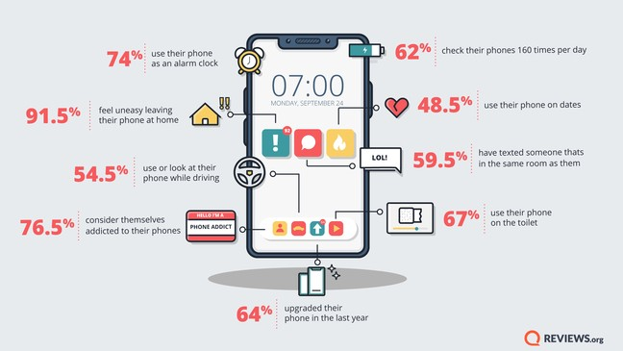
Smart Phone Usage is Exploding
2018 data

Slide 30
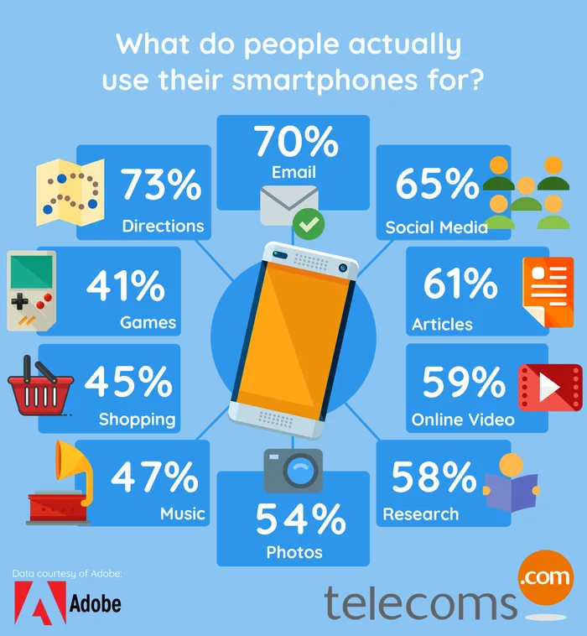
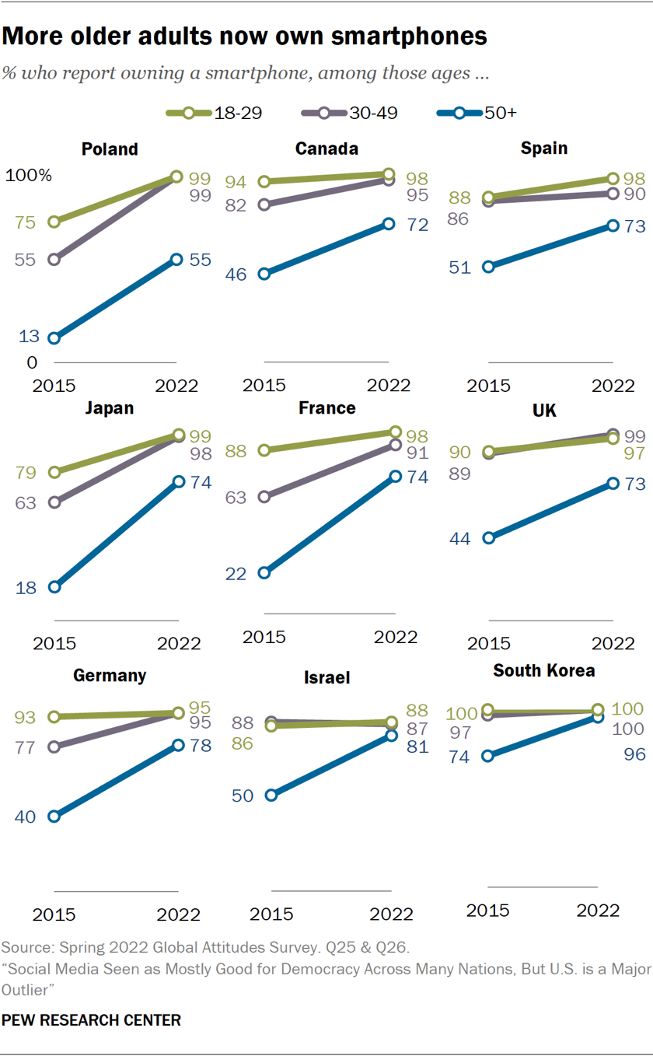
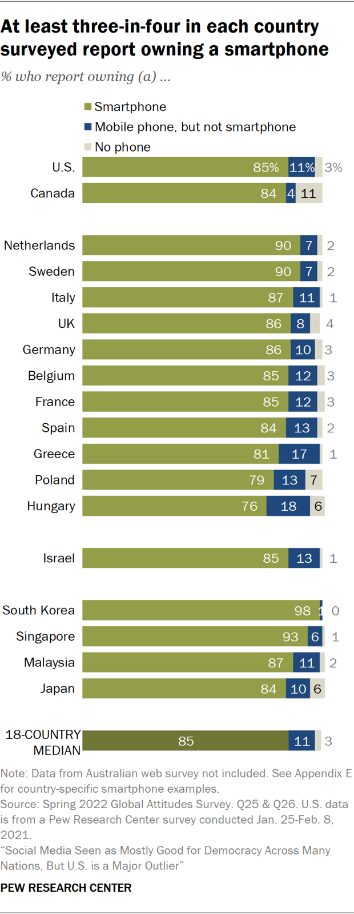
Global and cross-generational

Slide 31
Mobile “Advertising” Tactics
Text Messaging
Mobile Display Advertisements
Mobile Promotions
Mobile Search
Mobile Social

Slide 32
Streaming video and audio

Slide 33
Streaming Video
Ads placed within streaming video content on the internet
Free or lower cost online video content
Video ads are placed generally within the content of the TV show or movie
Growing opportunity as content consolidation grows
About $1 billion was spent on streaming video ads in 2007
Over $13 billion was spent on streaming video ads in 2017
Hulu
Peacock
Sling
Paramount+
HBO Max
Pluto TV

Slide 34
And Growing Very Fast
Over $47 billion spent on digital video in 2022
Over $55 billion estimated in 2023

Slide 35
Hulu’s Advertising Model
Hulu gets double the CPMs of broadcast television because:
Fewer ads per hour
Can’t fast-forward through the ads
Hulu ads are also among the best-testing ads in terms of recall

Slide 36
Music Streaming’s Mobile Explosion
More than half of all Spotify / Apple Music usage comes from mobile
Spotify among the most used apps, with 365 million active monthly users in 2023

Slide 37
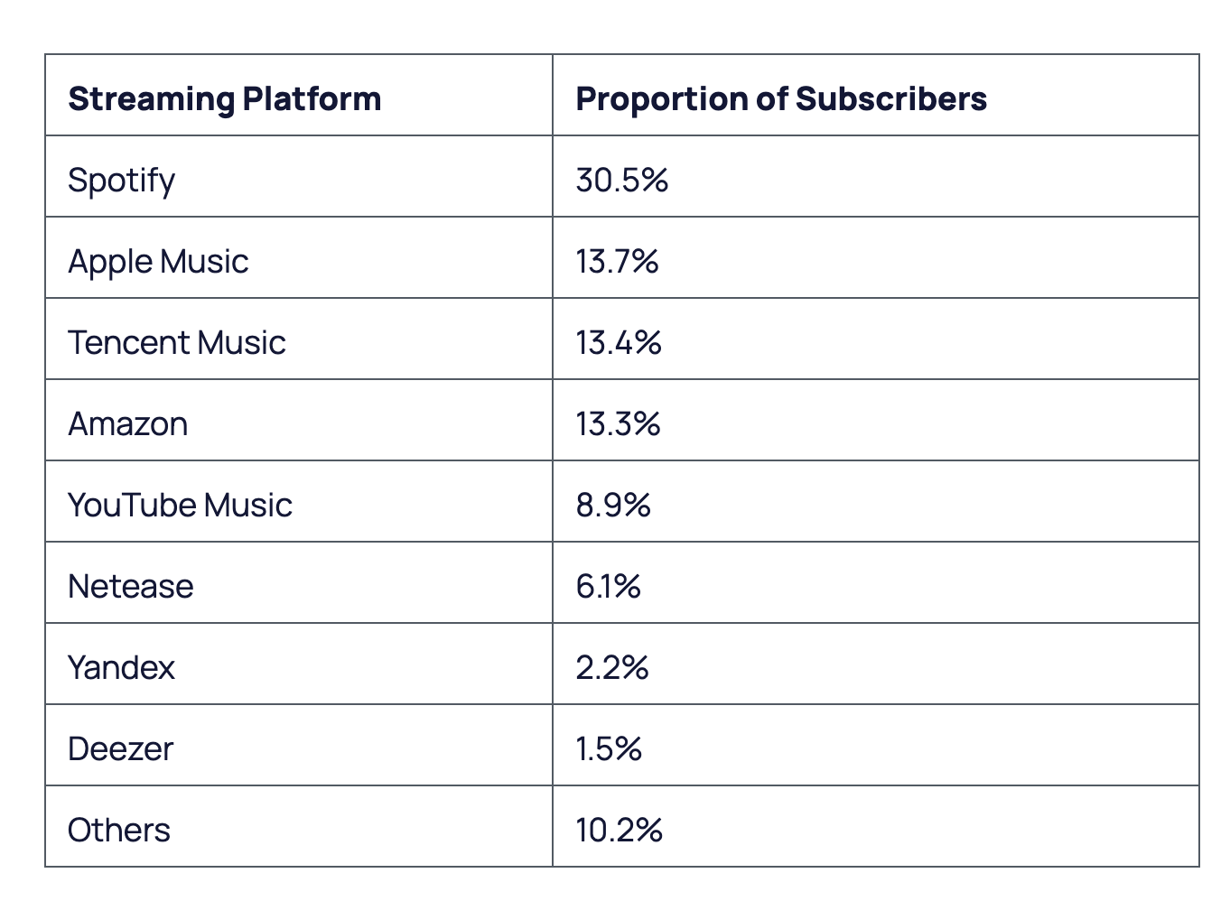

Slide 38
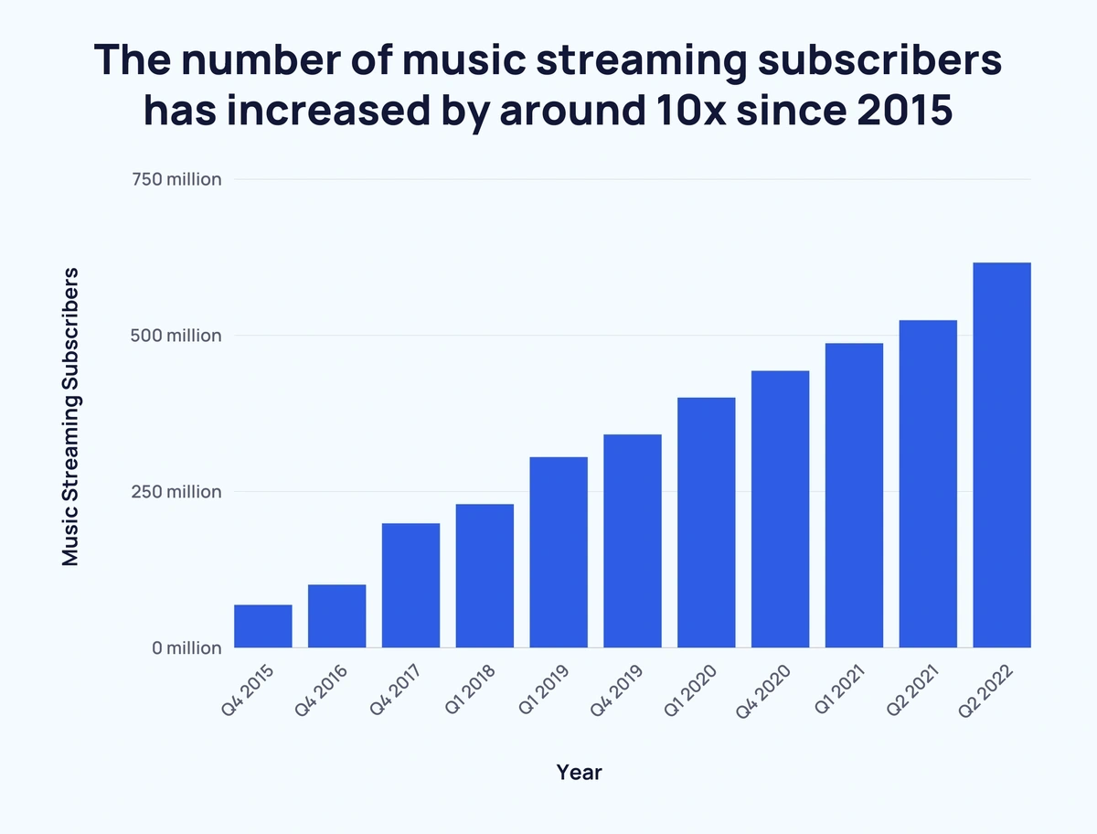

Slide 39
Highly Targetable
Via the user, through their sign-up profile
Basic Demographic Characteristics
Geographic: register via their zip code
Genre: type of music
By the type of device

