Slide 1
Social Marketing and Health Interventions

Slide 2
Beyond Marketing Communication
The principles and practices you have encountered in this class are flexible and can be applied across contexts.
Social Marketing
Health Campaign
Non-profit Communication
Civic and Public Communication
Political Campaign Management

Slide 3
Social Marketing
First introduced formally in 1970
But around before that…
Defined as the use of marketing principles and techniques to influence the acceptance of a social idea for the benefit of individuals, groups, or society.
Rooted in both commercial and social reform campaigns

Slide 4
Public Safety

Slide 5
Interactive Ambient Public Safety Campaign

Slide 6
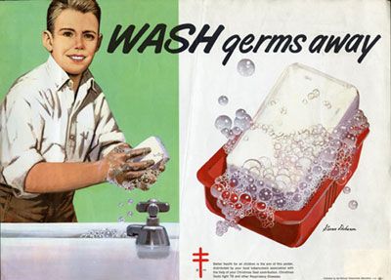
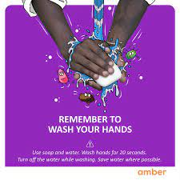
Preventative Health

Slide 7
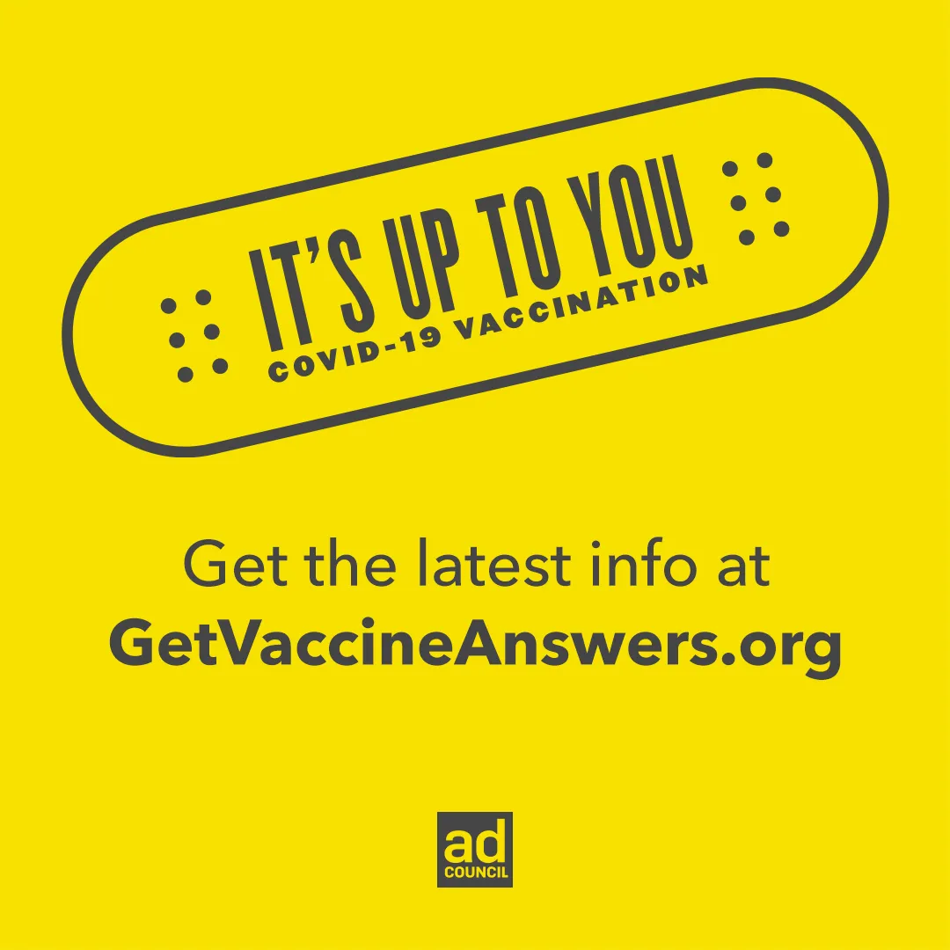
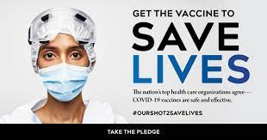
Vaccine Hesitancy

Slide 8
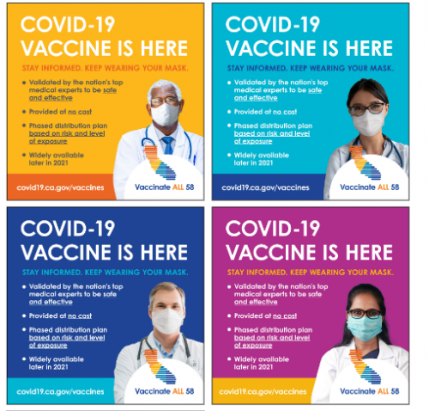
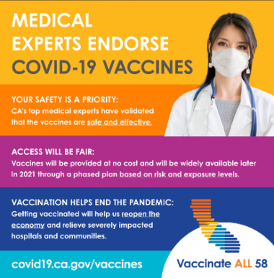
Targeted Campaigns
Tailored by race, gender, and age

Slide 9
Health Communication Campaigns
Interventions intended to
1) generate specific health outcomes or effects
2) in a relatively large number of individuals
3) within a specified period of time, and
4) through an organized set of activities
Health Marketing
eHealth Applications
(Rogers & Storey, 1987)

Slide 10
Elements of Social Marketing
Audience - Identify, segment, and target tailored health messages.
Campaigns – Coordinate messaging with other interventions.
Channels - Distribute, deliver, and promote outreach strategy.
Eductainment - writers and producers developing health storylines.

Slide 11
…Elements Continued
Research – Formative and summative to establish and assess goals.
Risk Communication - Principles of risk and crisis response.
Tools & Templates – Effectively use interactive tools for health literacy
Social Media – expression and connections for health support

Slide 12
Health Campaigns/Social Marketing
Public Health Campaigns
Strategic campaigns designed:
to promote healthy behaviors
to discourage unhealthy behaviors
Social Marketing Campaigns
Campaigns for social improvement
To encourage global human rights
To encourage environmental protection
Public Information Campaigns
Dissemination of information

Slide 13
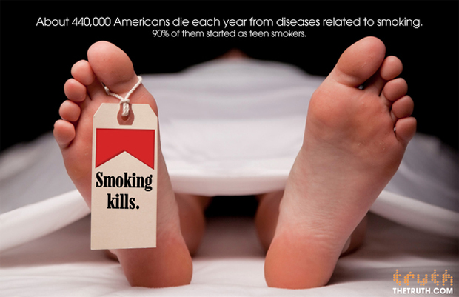
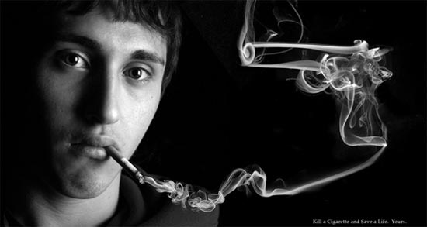
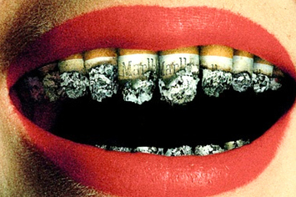
Anti-Smoking

Slide 14
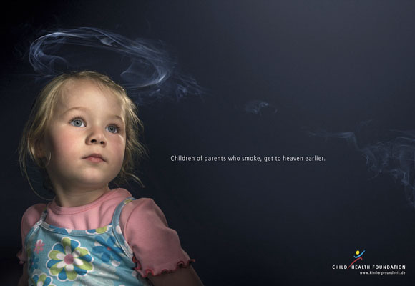
Second-Hand Smoke

Slide 15
Anti-Smoking PSAs

Slide 16
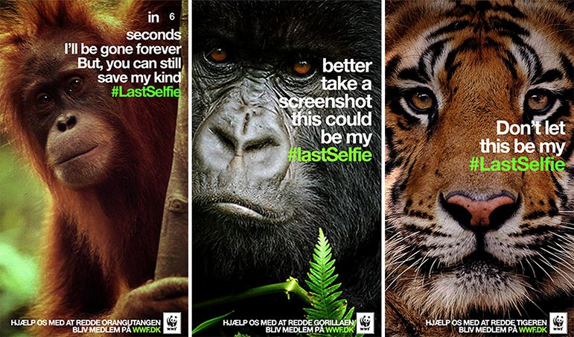
Environmental Efforts
World Wildlife Fund and Snapchat

Slide 17
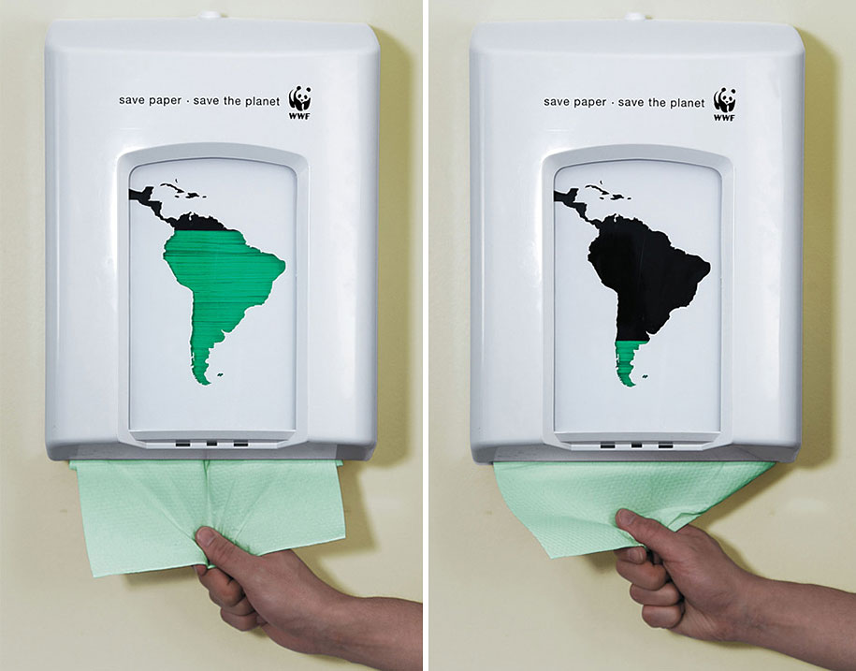
Ambient Messages

Slide 18
Social Marketing Principles
Concepts and principles of strategic communication campaigns (Ad/PR)
Strategic campaigns designed to:
spread knowledge
change attitudes
alter behaviors
spreading messages of social change

Slide 19
Social Marketing Challenges
Value-laden activities
Engineering social change
Decisions about what is good and bad
Conflicts of interests
E.g., anti-smoking from Phillip Morris
Tension between:
Social good and individual freedoms

Slide 20
Social vs. Commercial Marketing Campaigns
 | Social Marketing | Commercial Marketing
Amount of change expected | Large proportion of population | Small shifts in market share
Time frame of expected benefits | Delayed / Probable | Instant gratification
Presentation | Cannot be hyped | Lots of scope for window dressing
Available budget | Miniscule | Massive
Evaluation | Primarily summative | Formative and summative

Slide 21
The 7 P’s of Social Marketing
Product: Tangible, physical products (e.g. condoms) services (e.g. medical exams), practices (e.g. drunk driving), or intangible ideas (e.g. global poverty)
Price: Monetary, opportunity cost, contribution
Place: Retailer, doctor’s office, mass media
Promotion: Integrated use of advertising, PR, promotion, media advocacy, personal selling
Partnership: Work with other groups to max effects
Policy: Work with policy to capitalize on laws
Politics: Work with politicians to change policy

Slide 22
Successful Social Marketing Campaigns
Success is subjective and case-specific
Goals should be SMART:
Specific
Measurable
Attainable
Realistic
Time-limited
Types of evaluation:
Knowledge gain
Attitude change
Behavioral indicators

Slide 23
Advantages of Social Marketing Efforts
Legitimate source
Government, non-profits
No obvious self-interest
Social desirability of change

Slide 24
Problems with Social Marketing Efforts
Faulty assumptions
Change is not simply a function of spreading information; social norms, engrained behaviors
Lack of adequate resources
Psychological resistance
Discounting the message and/or source
Immunity perceptions
Inability to change habitual behaviors

