Slide 1
Integrated Marketing and the Modern Agency

Slide 2
Definitions of “Market”
Different uses of the term “market”:
Region
E.g., Chicago, Midwest, Urban areas
Type of consumer
E.g., Women, Hispanic, Upscale
Type of product
E.g, Tires, Laundry detergents, Athletic shoes
Locus of exchange….

Slide 3
Locus of Exchange
Consumer
Business-to-business
Institutional
E.g., Government, Schools
Reseller
E.g., Retailers

Slide 4
The Marketing Concept
Old model:
Make product => Figure out how to sell it
New model:
Developed since World War II
Study consumers to identify needs => Make or modify product to satisfy those needs
Goal: understanding consumers
Strategic communication: relative advantage
Based on need satisfaction
Real vs imagined needs
Rational vs irrational needs

Slide 5
The Marketing Process
Discover consumer needs
Develop product to satisfy needs
Emphasizing existing needs is easier than trying to create them
Ads as information and persuasion

Slide 6
The Marketing Mix (The Four Ps)
Integrated strategies for:
The Product
The Price
The Place (distribution)
The Promotion

Slide 7
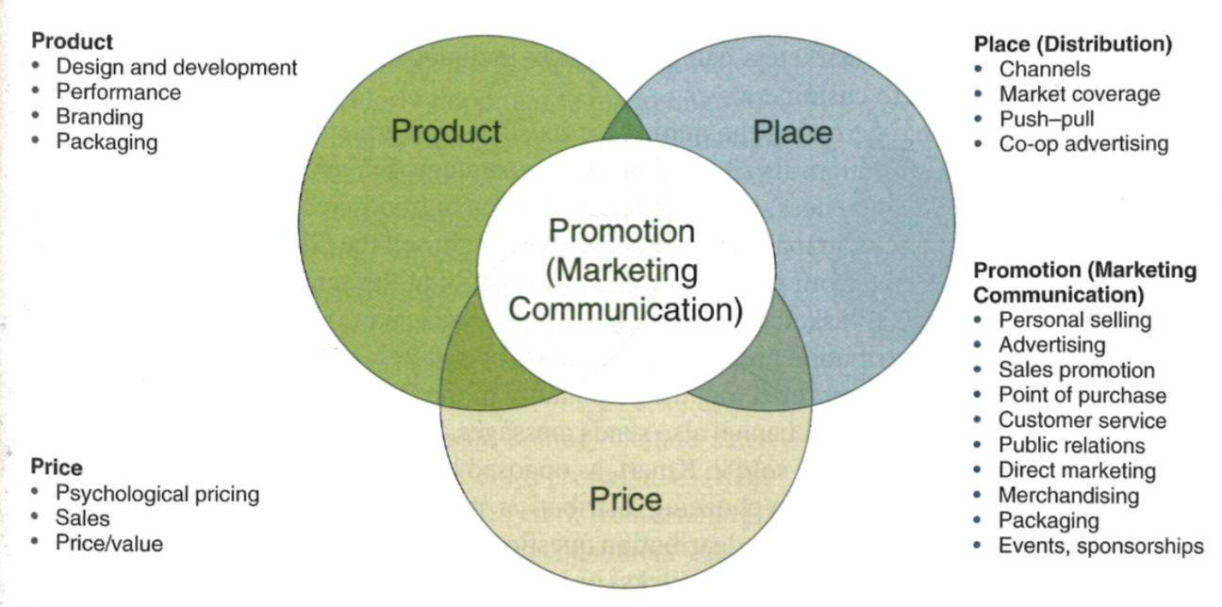

Slide 8
The Product
Design, development, branding and packaging
Product life cycle
Introduction
Growth
Maturity
Decline
Reformulation

Slide 9
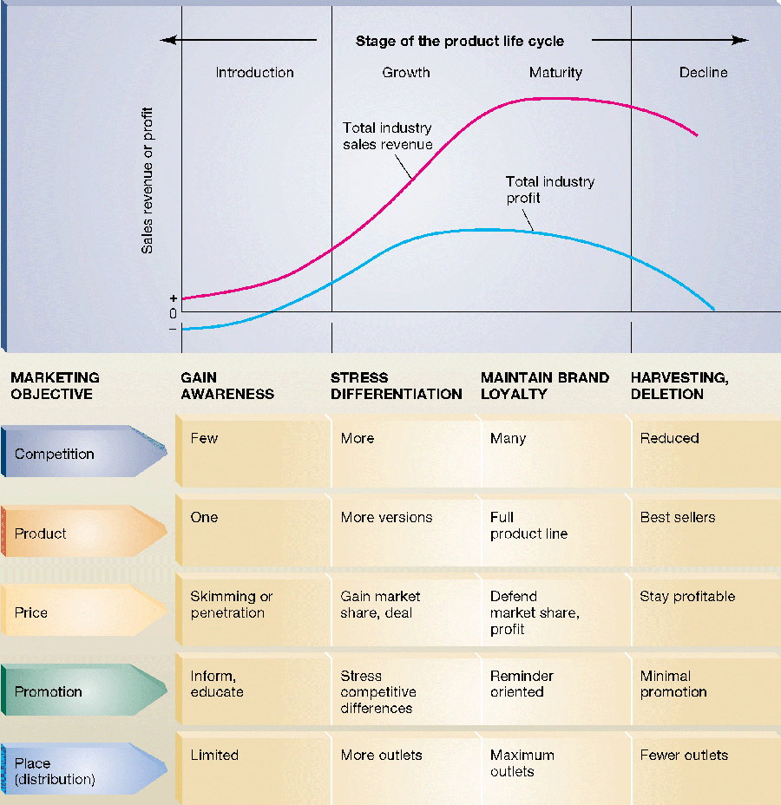

Slide 10
Place (distribution)
Moving products to consumers
Channels:
Wholesalers
Retailers
Transportation modes

Slide 11
Place (distribution)
Push vs pull marketing
Push: targeting resellers
Pull: targeting consumers
Market coverage strategy
Exclusive distribution
Selective distribution
Intensive distribution

Slide 12
Pricing
Sale vs manufacturer price
Psychological pricing
Advertising and price
Promotional costs add to price
Ads create product legitimacy
Thereby permitting higher pricing

Slide 13
Promotion
Strategic communication to selected target audiences
Forms of promotion:
Personal selling
Advertising
Sales promotion
Public relations
Direct marketing
e.g., direct mail, telemarketing
Point-of-sale

Slide 14
The Marketing Mix
Product drives the marketing mix
Technical products:
emphasize personal selling
Low-involvement products:
emphasize advertising, emotional appeals, and brand image
High-involvement products
Advertising can include more information

Slide 15
Stages of Marketing Plan
Research
Background on product and competition
Strategic
Formulating campaign strategy
Implementation
Putting plan into effect
Evaluation
Evaluating the plan

Slide 16
IMC – Integrated Marketing Comm.
Merge advertising, public relations, direct marketing, sales promotion, event planning, trade communication, retail marketing, package design and other marketing communication elements
Attempt to unify the various marketing communications approaches into a seamless whole
Harmonize
Utilize unique strengths of the different marketing communication channels in a coordinated fashion
Synchronize

Slide 17
Why do it?
Whole is greater than sum of its parts
By emitting an united message, more likely to build awareness, raise recollection, and foster trial
Less likely to confuse consumers with multiple, potentially contradictory, ideas
Yet IMC is difficult to execute because of “functional silos” within agencies
Specialists trying to protect their turf, their autonomy, their data, their budgets

Slide 18
How do you do it?
Need specialists to share information and ideas with one another
Open lines of communication
Must adopt open decision making
Great ideas can come from anyone
Requires a commitment to coordination
Must share work and responsibility

Slide 19
Techniques in IMC
Mass marketing vs. “market-driven” approaches
“Micro-marketing”
Speak to specialized market segments
“Data mining”
Building information profiles of consumers
“One-to-one targeting”
create over-time ties with consumers
“Consumer-initiated”
customers begin communication process

Slide 20
The IMC Landscape
Limited effects of advertising and PR compelled many marketers to look to consumer sales promotion and direct response for “fast” results
However, these “limited time offers” don’t help build a brand image -- too much and brand equity is sacrificed

Slide 21
The Solution
Integrate the behavior-oriented efforts of sales promotion and direct response with the image-oriented efforts of public relations and advertising
Tactically-oriented -- “Integrated” communication executions
Strategically-oriented -- “Coordinated” communications campaigns

Slide 22
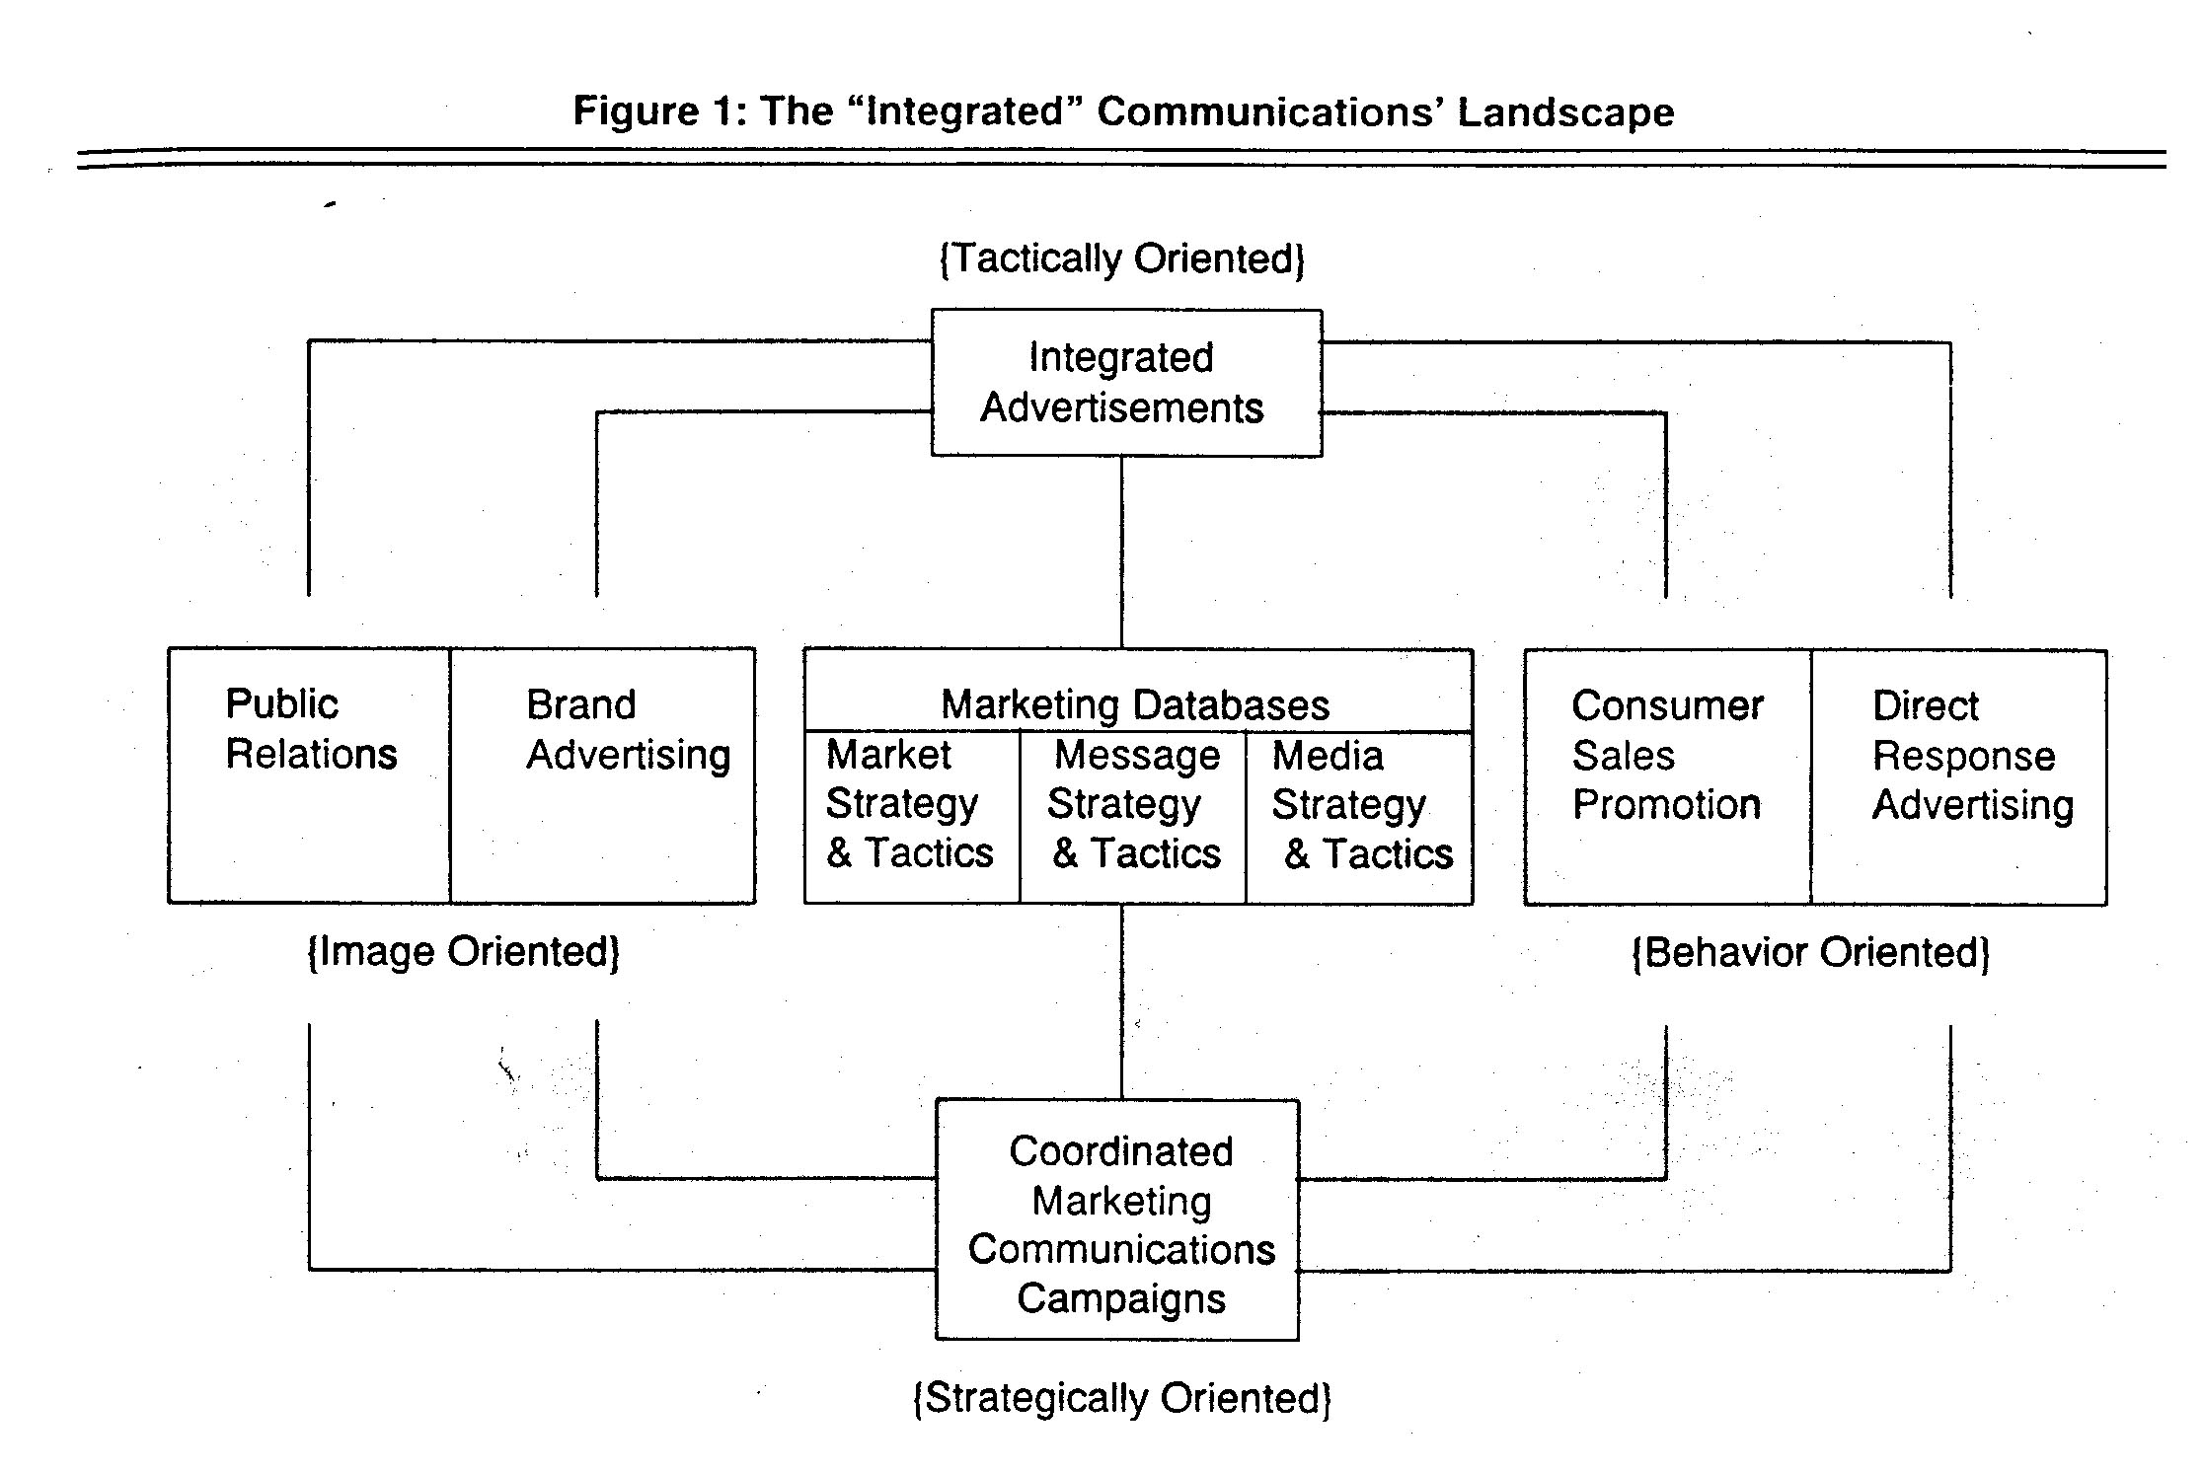
Model of IMC

Slide 23
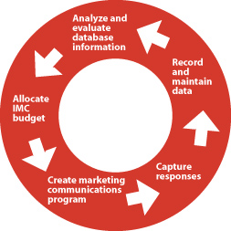
A Cyclical Process

Slide 24
Issues of Structure
Agencies have tried many methods to get disciplines to work together
Bring in external specialists shops
70s and 80s - Merger Mania
Centralize power under an account executive to coordinate different departments/specialties
Early 90s - Large Agencies
Change structure of the agency itself
Merge job descriptions -- “generalize” tasks
Late 90s - Smaller Agencies

Slide 25
Organization of Agencies
Organized around departments
Organized around clients
Organized around tasks
Organized by ownership

Slide 26
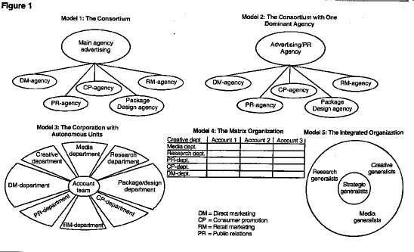
Organizing Agencies

Slide 27
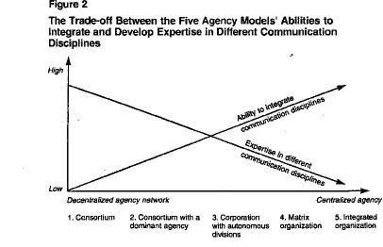
Tradeoffs in Agency Organization

Slide 28
Your Position; Your Agency; Your Choices
Join your agency with a specific role
Make decision about work meeting
What virtual meeting tool/system?
Make decision about agency structure
How integrated do you want to be?
Make decision about agency name
What does your name say about you?

Slide 29
Coordinate First
Set up a discussion list or thread
Set up an email contact list for docs
Set of a phone list so you can connect
Set a weekly meeting time all can attend
Find a virtual meeting tool/system
Account Director creates a list with this info and share with your team and us.

Slide 30
Next Agency Structure
Get in your agencies and decide what structure you want to adopt
Greater integration usually results in more coherent campaigns
More need to negotiate decisions - share responsibilities for sections
Be realistic about level of integration

Slide 31
Then Pick an Agency Name
Agency Name Generators: Use at your own risk!
http://adage.com/agency-name-generator/index.php
Changing norms of agency naming
https://www.thebalanceeveryday.com/ad-agency-names-great-vs-dull-39001

Slide 32
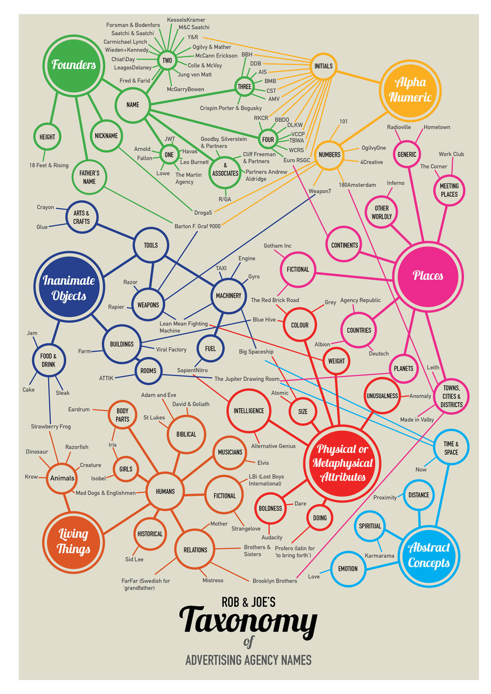

Slide 33
Know your position; Organize your agency
Exchange contact info (e.g., email), discuss workspaces (e.g., Google docs), and schedules.
Do not need to land on a specific name today but will need a name for your agency.
Schedule regular team meeting when all can attend; same for outside class meetings with me
Come prepared to lab and in-class “campaign planning” sessions throughout term

