Slide 1
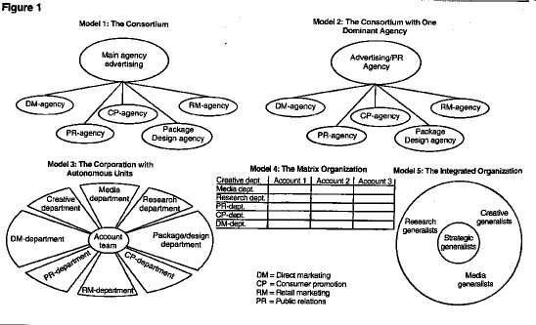
Organizing Agencies

Slide 2
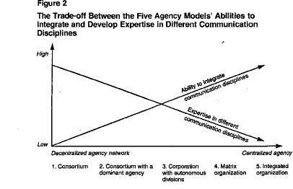
Tradeoffs in Agency Organization

Slide 3
Your Position; Your Agency; Your Choices
Join your agency with a specific role
Make decision about work meeting
What virtual meeting tool/system?
Make decision about agency structure
How integrated do you want to be?
Make decision about agency name
What does your name say about you?

Slide 4
Coordinate First
Set up a discussion list or thread
Set up an email contact list for docs
Set of a phone list so you can connect
Set a weekly meeting time all can attend
Find a virtual meeting tool/system
Account Director creates a list with this info and share with your team and us.

Slide 5
Next Agency Structure
Get in your agencies and decide what structure you want to adopt
Greater integration usually results in more coherent campaigns
More need to negotiate decisions - share responsibilities for sections
Be realistic about level of integration

Slide 6
Then Pick an Agency Name
Agency Name Generators: Use at your own risk!
http://adage.com/agency-name-generator/index.php
Changing norms of agency naming
https://www.thebalanceeveryday.com/ad-agency-names-great-vs-dull-39001

Slide 7
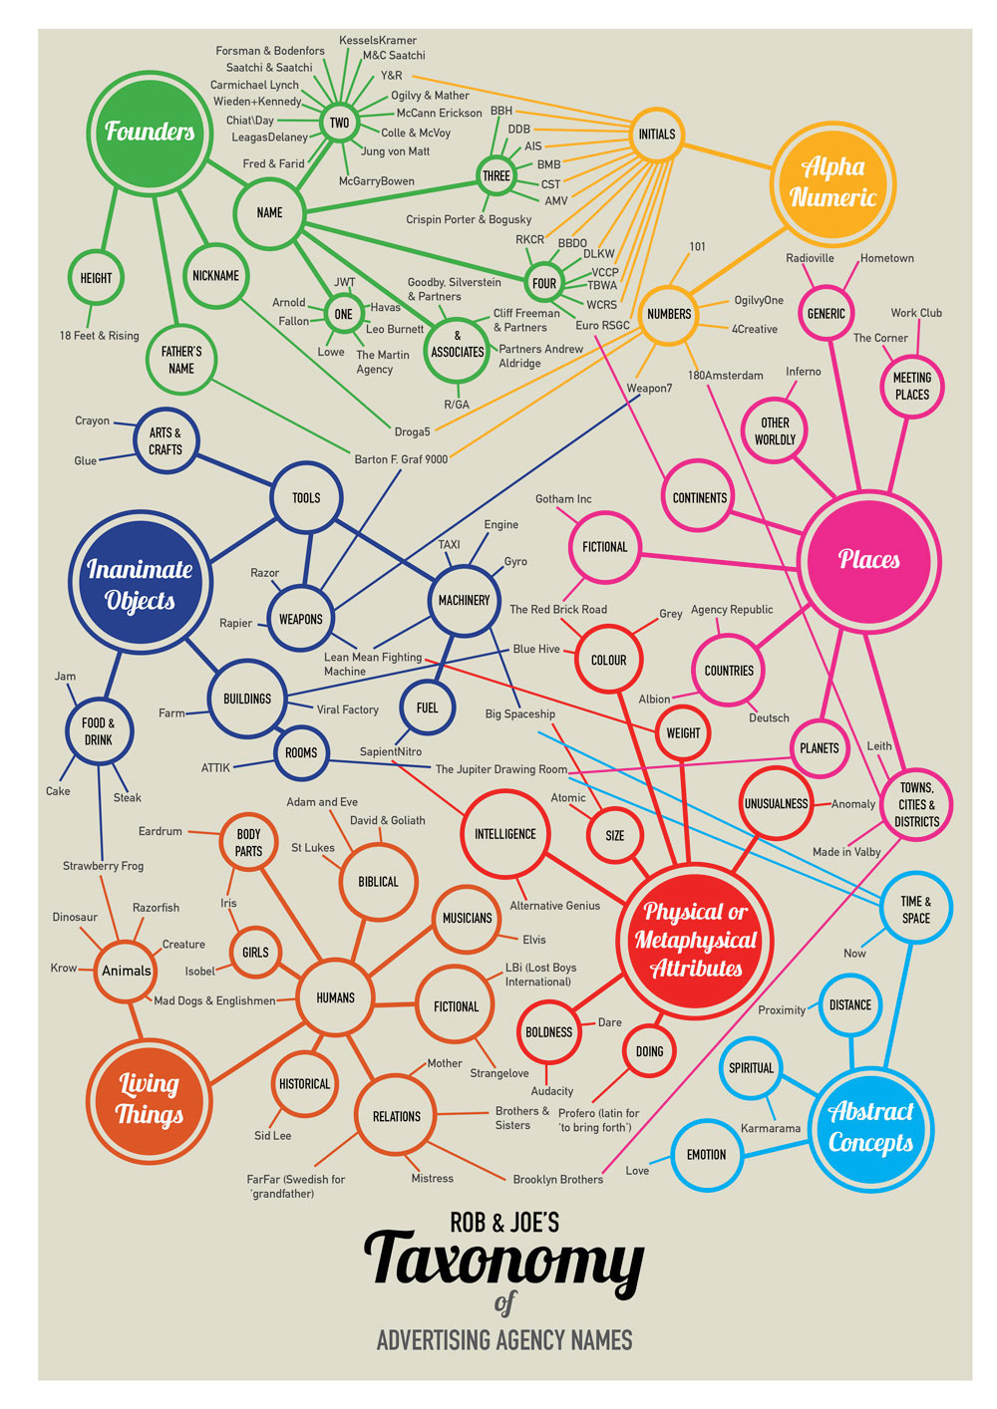

Slide 8
Know your position; Organize your agency
Exchange contact info (e.g., email), discuss workspaces (e.g., Google docs), and schedules.
Do not need to land on a specific name today but will need a name for your agency.
Schedule regular team meeting when all can attend; same for outside class meetings with me
Come prepared to lab and in-class “campaign planning” sessions throughout term

Slide 9
Marketing Communication and Strategic Research

Slide 10
The Full-Service Agency
Major staff functions:
Research and account planning
Account management/client service
Creative services
Media planning and buying
Pubic relations
Promotions and event planning
Direct response
Interactive

Slide 11
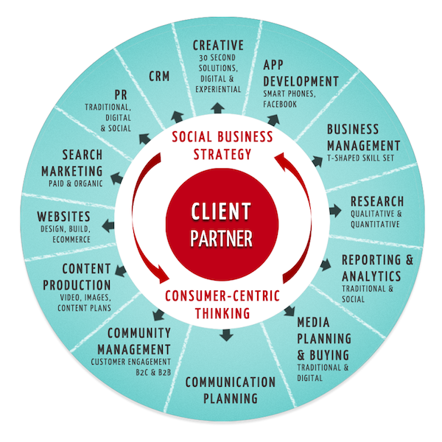

Slide 12
Services Provided
Analysis of marketing and cultural data
Formulation of core strategy and tactics
Recommendation of creative direction
Production of brand messages - Ad/PR
Create promotions and databases
Placement in print, broadcast & Internet
Verification of message placement

Slide 13
PR Agencies
Focused on reputation management
Pitching press releases to publications
Getting magazine features
Landing TV, radio, or podcast interviews
Securing thought leadership bylines
Handle brands, bands, celebrities, institutions, and government entities.

Slide 14
Creative Boutiques
Small agencies focus on creative
Specialize in producing ads
Little staff for research, strategy, media planning, or public relations
Sub-contract for creative work from full-service agencies
Often have short life spans

Slide 15
Digital and Social Shops
52% of CMO’s believe traditional ad agencies are ill-suited to conduct online marketing
Specialize in web design, e-mail drops, blogs, peer reviewing, social media, and viral video
Less siloed and more nimble about new media
Few mid-level managers who are over-specified
More open to experimentation and innovation

Slide 16
Medical/Political Shops
Entirely service specialized clients
Specialized knowledge of category
Provide full-service functions

Slide 17
Minority Agencies
Often full-service agencies
Specializing in campaigns that target minorities/specialized populations
Blacks, Hispanic/Latino, Asians, LGBTQ+

Slide 18
In-house Agencies
Owned and supervised by company
Reasons for in-house agencies:
Savings
Specialization
Priority service
But, minimum staffing of experts and possibility of “group-think”

Slide 19
Media Buying Services
Original format of ad agencies
Sole function is media buying
Growing complexity of media buying
Buying media in bulk
Though data science is allowing this to move “in house” or directly with tech firms in digital space

Slide 20
Emerging Agency Sectors
Growth Marketing Agencies - Sales-Driven
Performance Marketing Agencies - Analytics-Driven
Reputation Marketing Agencies - Reviews-Driven
SEO Agencies - Organic Search Focused
Influencer Marketing - Leverage Influencers
Content Marketing Agencies - Build Following
Video Production Agencies – Videos for Net
Branding Agencies - From Positioning to Messaging
Experiential Marketing – Events, Promo, Activation
Digital and Social Media Marketing Differentiating

Slide 21
Shift to “In House” Services
78% of companies in 2018 have some in-house agency functions, up from 42% in 2008
49% percent of in-house agencies have created in-house production capabilities in past five years
In 2018, over 36% of companies are bringing media strategy and planning functions in-house, compared to 22% in 2013. Buying still outside.
Bring select specialty functions in-house

Slide 22
How Agencies are Paid
The Commission System
The Fee System
Incentive-based / Value-based Systems
Hybrid systems that combine

Slide 23
The Commission System
Standard rate: 15% of media buys
Trend toward negotiated commission
Fierce competition among agencies

Slide 24
The Fee System
Negotiated hourly fee
Media buys billed directly to client
Hourly rate rule of thumb:
3 x hourly salary of each employee
Employee hourly salary =
Salary / Hours worked per year

Slide 25
Incentive/value-based Systems
Higher fees for good performance
Incentives negotiated in advance
Pay per performance system

Slide 26
Solutions for Social and Digital
Need ideas about how to address the decline in sales in an era of diminished effectiveness. How can you use social and mobile tools to drive sales up?
Viral Videos
Social Media Ad
Hashtag Promo
Ambient Media
Mobile Apps
Geo-local tools

Slide 27
First Step: Market Research
Must begin by understanding:
your client and its product or service
the competitive environment
the industry and its challenges
the audiences for the product or service
brand history and past creative efforts
current press and publicity

Slide 28
Strategic and Evaluative Research
Two Types of Research
Strategic Research
Used to develop creative, media, and PR plans
All relevant background info to make decisions
Grounds strategic direction in data and insights
Evaluative Research
Used to assess performance of these plans
All relevant data to gauge effectiveness of plan
Grounds judgment about plan performance in fact

Slide 29
Peril and Promise
The Problem - too much information
Need to prioritize what is most important
Qualitative Data - Insights about how and why people think and behave as the do.
Peril - generalizability
Quantitative Data - Numerical data used to describe markets and competitive environment.
Peril - decontextualization
What goes into the situation analysis?

Slide 30
Marketing Research Process
Situation Analysis and problem definition
Informal (exploratory) research: Secondary data (internal/external)
Construction of
research objectives
Formal research
• Quantitative
• Qualitative
Interpretation and
reporting of findings

Slide 31
Stages in Strategic Research
Review secondary research
Available info on product, industry, and consumers
Sales reports, annual reports, press coverage, trade articles, census data, syndicated market research
Consumer Reports reviews
Popular and trade press pieces
Develop primary research
Create or contract customized research
Conduct surveys, interviews, focus groups
Use to answer questions emerging from secondary sources

Slide 32
Secondary Research Sources
Government Agencies
e.g., Census, EPA, State Dept.
Trade Associations
e.g., AAAA, AAF, NAATA, etc.
Secondary Research Suppliers
e.g., Lexis/Nexis, Simmons/MRI, Roper Poll
Internet Sources
e.g., Google Search data and others

Slide 33
Library References and Resources
Information on Company
Company Website – Annual Reports / Press Room
OneSource – Company SWOT Analysis
Information on Industry
IBISWorld – Industry Profiles
Mintel – Market Research Report
Information on Coverage, Articles
Newspaper Source Plus Complete
ABI/Inform
Factiva and Lexis/Nexis
Information on Consumers
Simmons OneView
US Census

Slide 34
Primary Research Sources
Primary Research Suppliers
Custom runs Simmons OneView
Custom runs can be primary research
“OneView” in Business Reference Library
Internal Research Departments
Create primary research to generate unique insights unavailable to competition
Focus groups for consumer perspective
Interviews with experts
Surveys to gauge public opinion

Slide 35
Message Development Research
"Concept-testing” - Used to test approaches
Survey Research
Experimental Research
Direct Observation
Content Analysis
In-depth Interviews
Focus Groups
Single Source - The Future?

Slide 36
Account Planning
Developed in England in 60s and 70s
The “voice of the consumer” in the process
Use traditional and non-traditional methods
Quantitative data from surveys and experiments
Qualitative data from focus groups and interviews
Interpretation of cultural meanings and codes
Use to gain unique insights into the brand

Slide 37
Research Categories
History / Industry Trends
Competitive Environment
Consumer Analysis, including users and usage
Brand Analysis, mainly brand perception
Coordinate with Account Director
Media Usage Analysis
Coordinate with Media Director
Category Creative Analysis
Coordinate with Creative Director
Stakeholder Analysis, mainly public opinion
Coordinate with PR Director

Slide 38
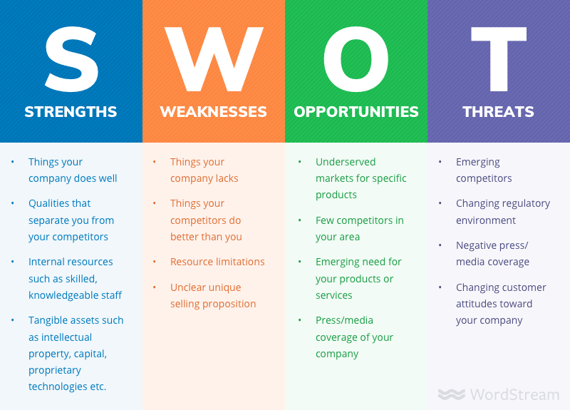
SWOT Analysis
Strengths
Key internal advantages
Weaknesses
Key internal limitations
Opportunities
Key external prospects
Threats
Key external risks
Use to synthesize key insights to drive strategy

Slide 39
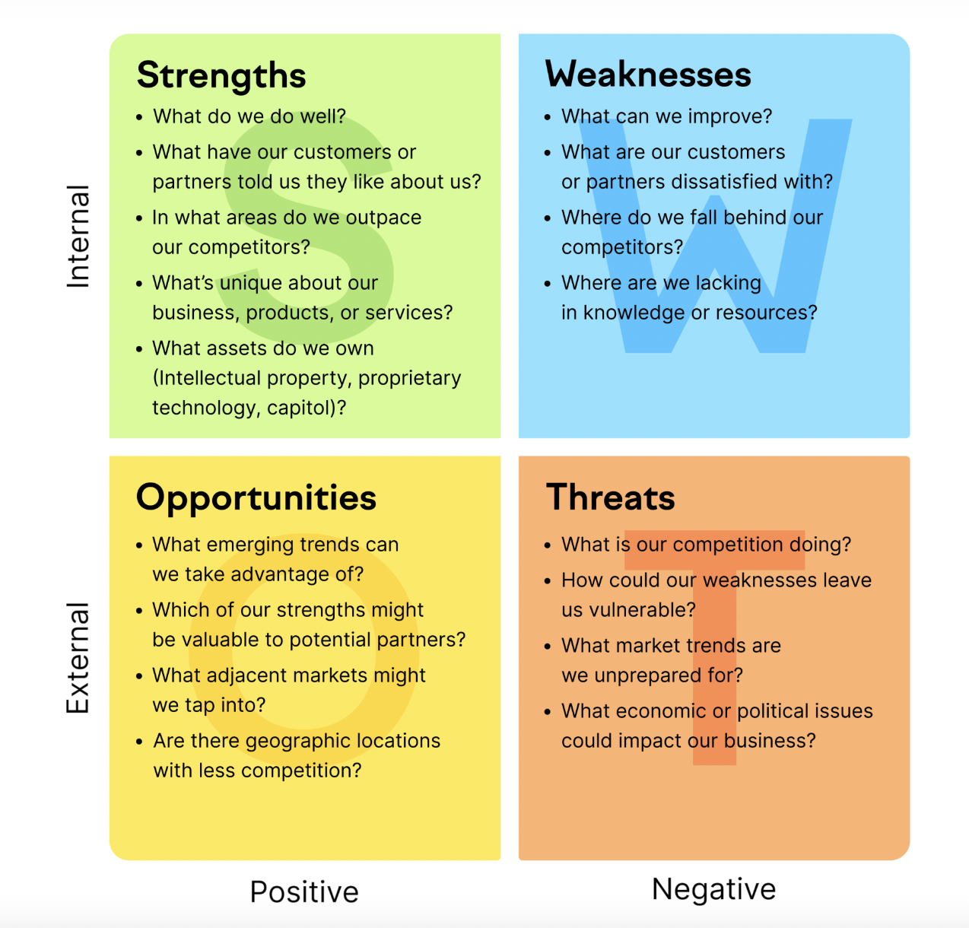
Internal/External by Helpful/Harmful

Slide 40
Organizing Information
Who is responsible?
Large agency: internal research department
Small agency: client service group
Account planner:
bridges these functions
coordinating research
incorporating research into strategic planning
For the project, the research director pulls the relevant insights from the group into sections and summarizes key points in a SWOT analysis

Slide 41
Evaluation Research Goals
What kinds of things might we want to know about the effectiveness of an ad?
Exposure?
Awareness?
Learning?
Liking? (Attitude toward the product and the ad)
How would you measure effectiveness?

Slide 42
Evaluation Research Methods
Memory Tests
Recall tests
Recognition tests
Persuasion tests
Direct-response counts
Communication tests
Focus groups
Physiological tests
In-market tests
Simulated Market tests

