Slide 1
Account Planning and Research-Driven Case Studies

Slide 2
Understanding Prospects
Critical for a Strategic Communicator to understand the audience/consumer:
  Identify the consumer and their media environment
  Craft message to fit the audience / aperture
  Select and cost media to target the audience
Starting point:
  Market research data:
    E.g., Simmons, MRI

Slide 3
Marketing Comm Environment
Clutter
Competition
Budget limitations
Only by understanding consumers and their viewpoints, can campaigns overcome these challenges

Slide 4
Audience limitations
Factors that inhibit message reception
  Divided attention
  Short Attention span
  Processing limitations
  Selective exposure
  Scorn and skepticism

Slide 5
Advertising Pyramid
Action
Desire
Conviction
Comprehension
Awareness

Slide 6
The First Step
Breaking through
  getting exposure
Keys to getting exposure:
  Understanding audience media use
  Understanding audience needs
Needs
  Different motivations
  Different gratifications sought

Slide 7
Involvement: A Key Audience Factor
Involvement shapes persuasion process
Types of involvement:
  Product
    High vs. low involvement products
  Consumer
    High vs. low involvement consumers
Cognitive vs. affective involvement
  Cognitive: thinking
  Affective: feeling

Slide 8
Product Involvement Grid
Affective involvement (feel)
Low
High
• Car
College •
High
• Video camera
Engagement ring •
Cognitive involvement (Think)
•
Motor oil
Greeting card •
•
Laundry detergent
Low
•
Paper towels
Flowers •

Slide 9
Individual Factors
Demographics
Geographics
Psychographics
Buying Behavior
  Used for segmentation and target marketing

Slide 10
Demographics
Age
Gender
Family status
Education
Occupation
Income
Race/ethnicity

Slide 11
Geographics
Region
City size
Population density
Population growth

Slide 12
Psychographics
Needs
Attitudes
Personality (self-concept)
Lifestyles

Slide 13
Buying Behavior
Category and Brand consumption
  Breakfast Cereal vs. Frosted Flakes
Volume of consumption
  Heavy, Medium, or Light
  Heavy consumers often drive marketing

Slide 14
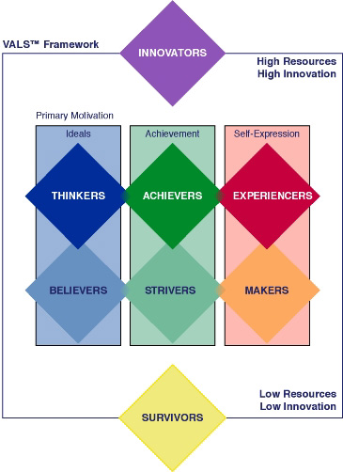
VALS 2 Typology

Slide 15
Example VAL2: Innovators
Characteristics:
  Successful, sophisticated, take-charge people with high self-esteem—leaders and trend-setters
Motivations:
  ideals, achievement and self-expression
Products:
  cultivated tastes, upscale, niche products & services
Image:
  An expression of taste, independence and personality rather than status/power

Slide 16
Example VAL2: Strivers
Characteristics:
  Trendy, fun-loving, job rather than career due to lack of skills, shopping as a social activity and opportunity to make statement, impulsive consumers
Motivations:
  Achievement, opinions/approval of others
Products:
  They favor stylish products that emulate the purchases of people with greater material wealth
Image:
  Money defines success as they don't have enough of it to meet their desires

Slide 17
Example VAL2: Experiencers
Characteristics:
  Young, enthusiastic, impulsive consumers
  Value the new, offbeat and risky
Motivations:
  Self-expression, Excitement through experience
Products:
  Exercise, sports, outdoor recreation, fashion, entertainment and socializing
Image:
  Emphasis on looking good and having "cool" stuff.

Slide 18
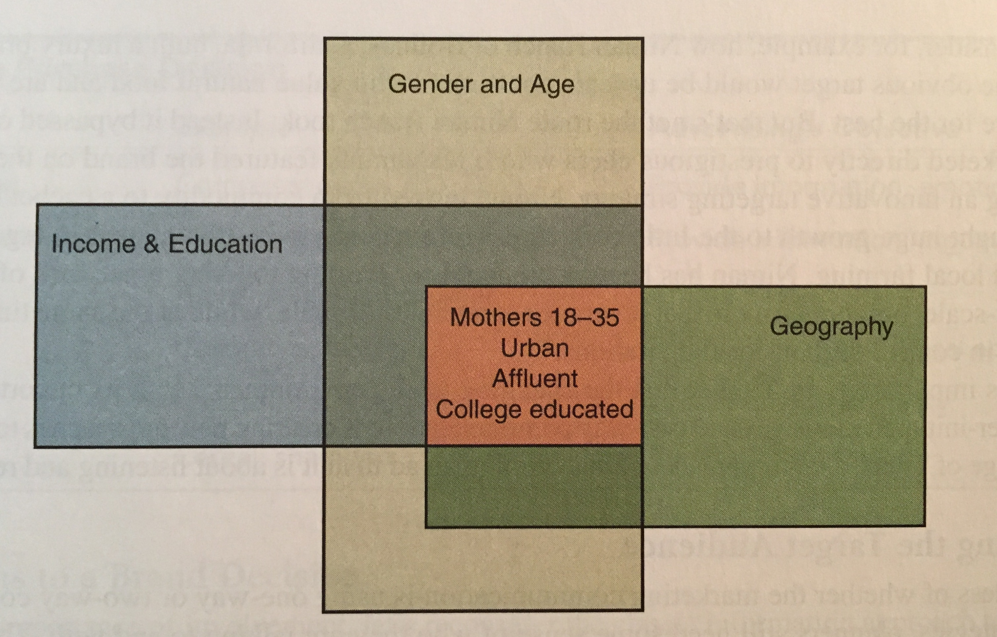
Profiles
Generating a deeper sense of the target audience in terms of their daily life
  Painting a vivid picture of the target
  Name them and provide “a portrait.”

Slide 19
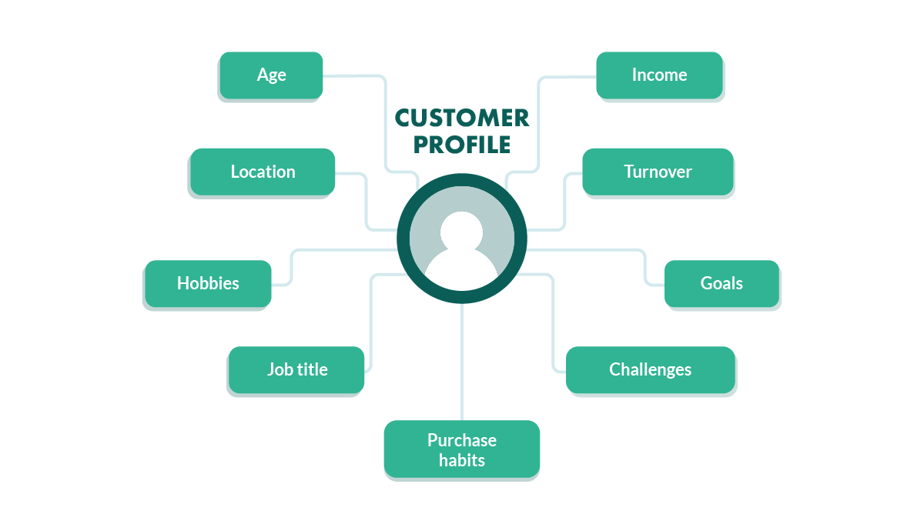
Profile goes beyond demographics

Slide 20
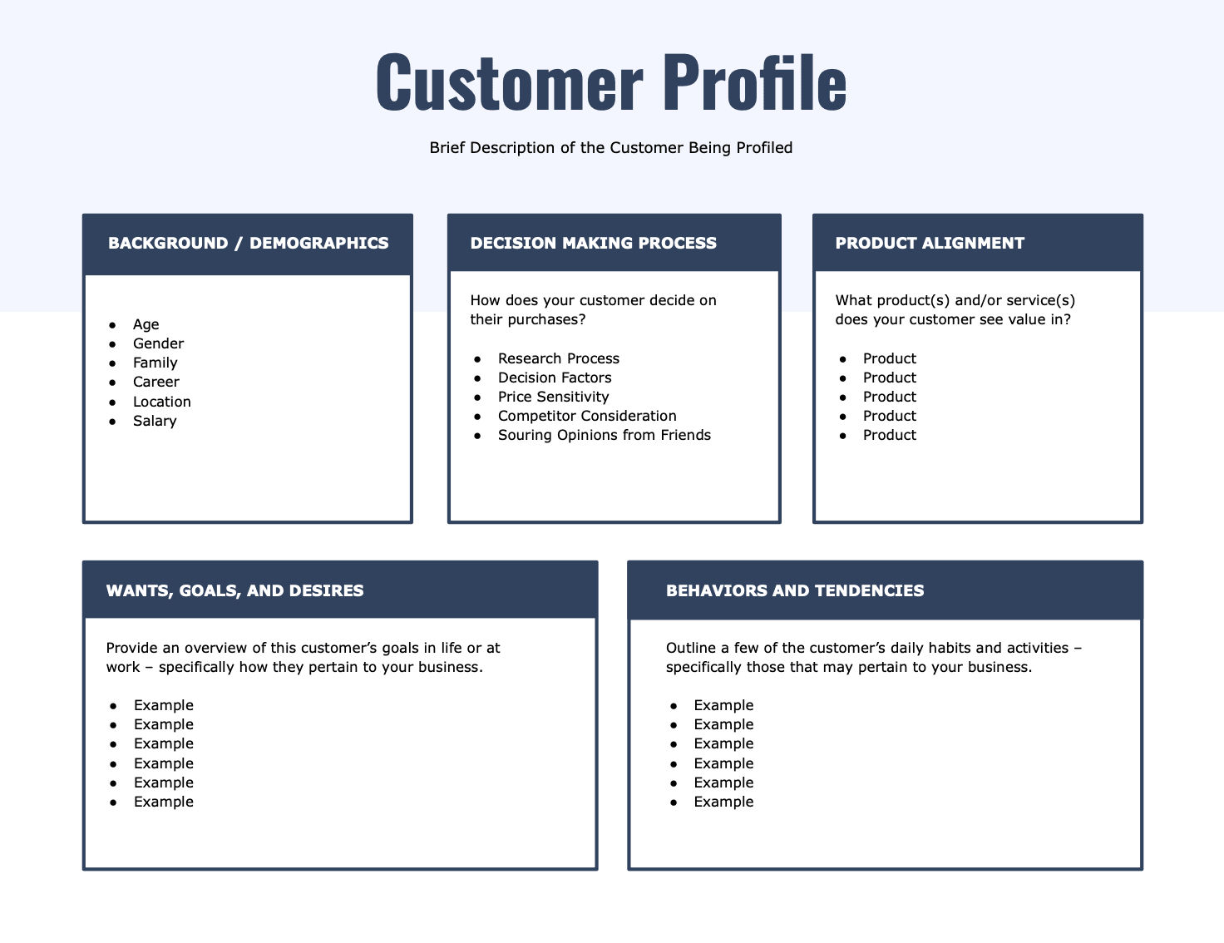

Slide 21
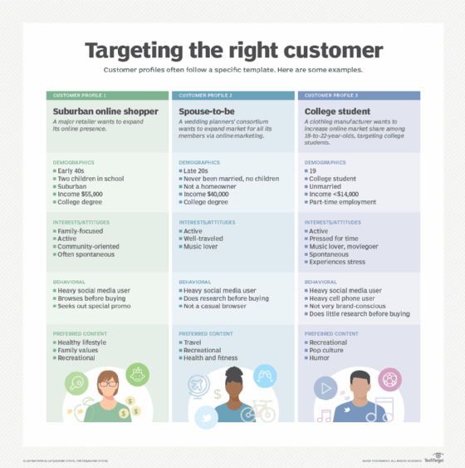
Amazon Alice
Savvy Sasha
Mediated Zack

Slide 22
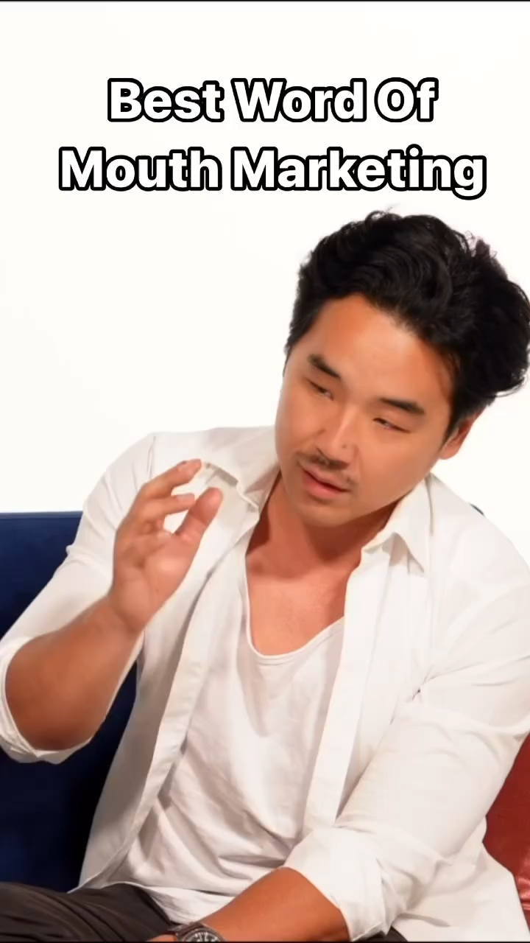
Consumers vs Purchase/Influence
Campaigns can target those who influence the purchase, the actual purchaser, or the end users
Some brands build profiles of all three.

Slide 23
Exercise
Who do you believe is the target audience(s) for Light Beer/Low Calorie Domestic Beer?
  Demographics
  Geographics
  Psychographics
  Buying Behavior
  Media Usage
  VALS Category
  Will share consumer data for discussion next week

Slide 24
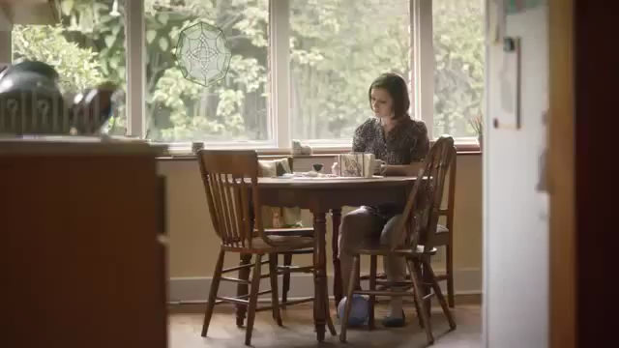
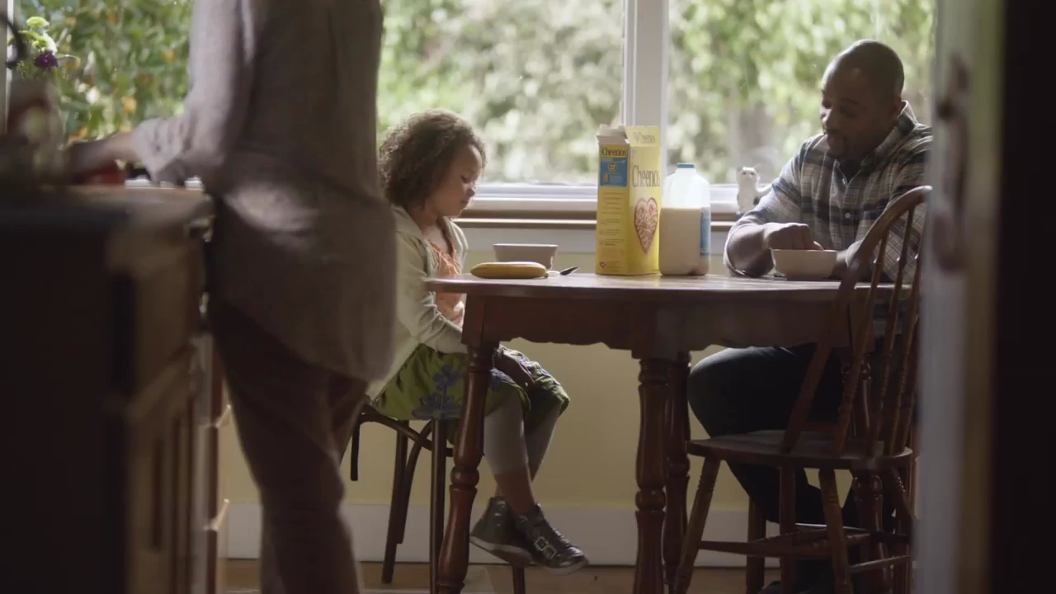
Smart Executions

Slide 25
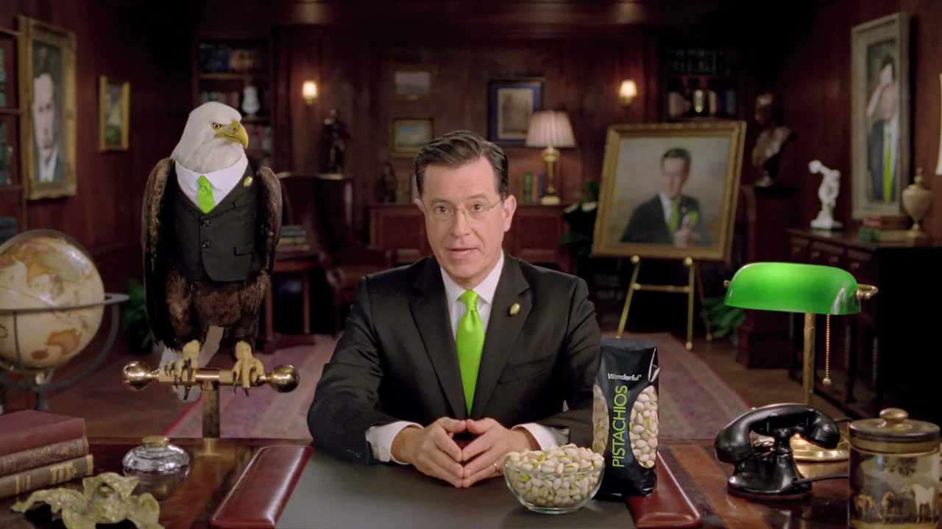
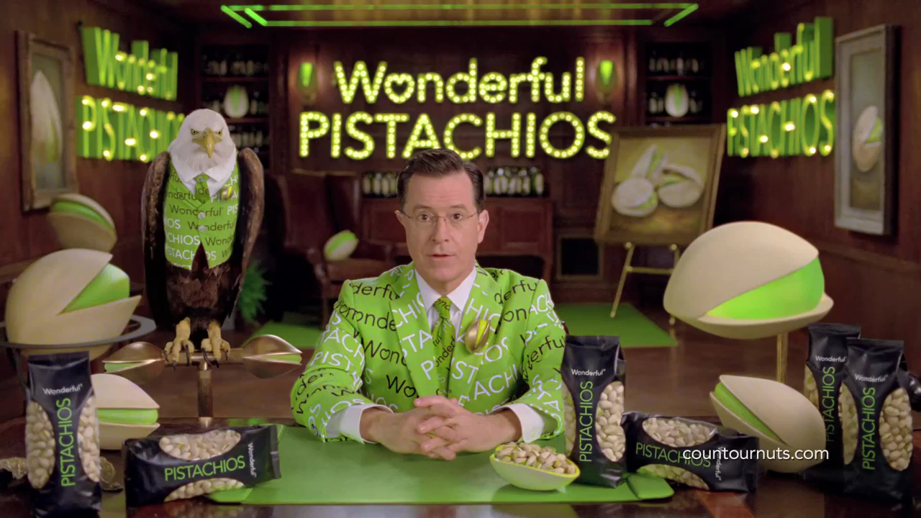
Smart Placement

Slide 26

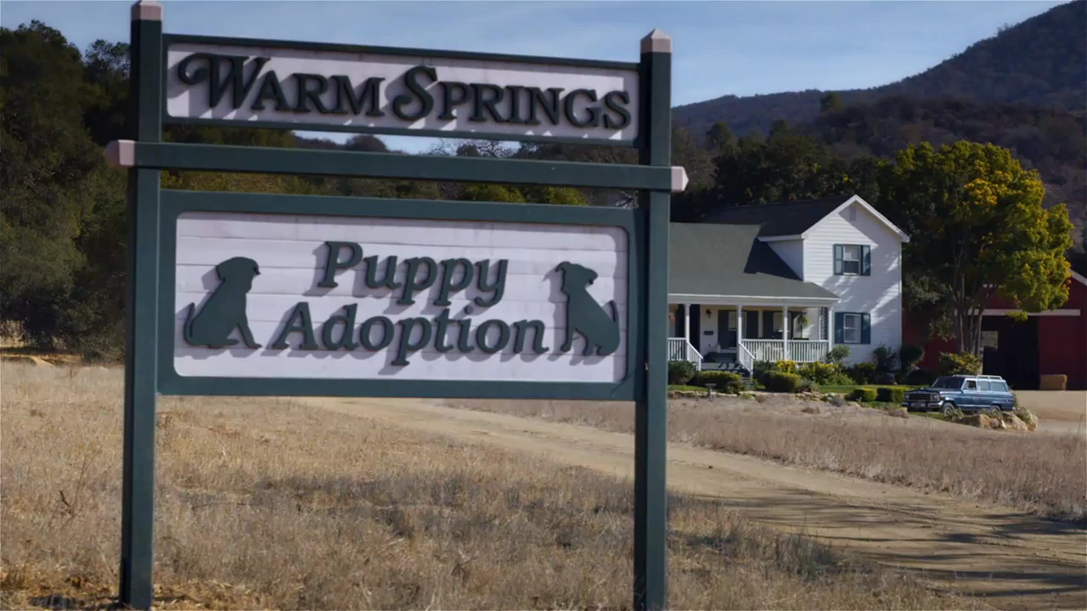
Smart Associations

Slide 27
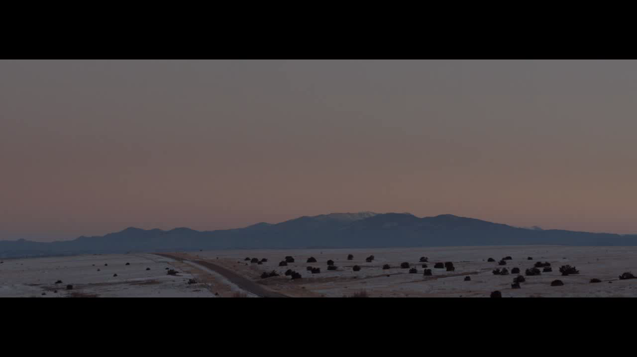
Smart Sponsorships

Slide 28
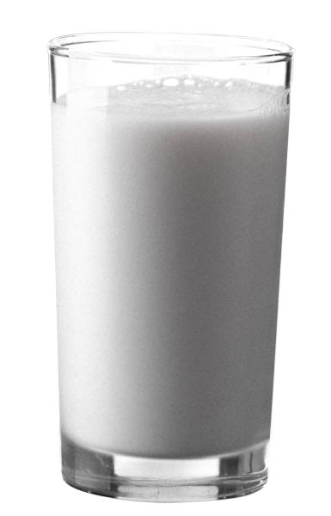
GOT MILK?
An Iconic Campaign

Slide 29
Sales prior to “Got Milk?”
-3%
-2%
-2%
Milk Sales in
million gallons
-3%
-2%

Slide 30
In search of insights
Conducted a lot of research:
Consumption habits
Food/beverage diaries
Strategy testing
Concept validation

Slide 31
Assessment
Trend towards out-of-home eating
Less than 5% of milk consumed out of home
“Milk does a body good.” 98% awareness!
70% of the general population drinks milk

Slide 32

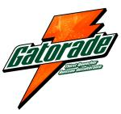
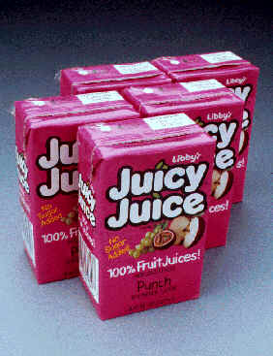

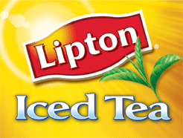


Enormous Competitors

Slide 33
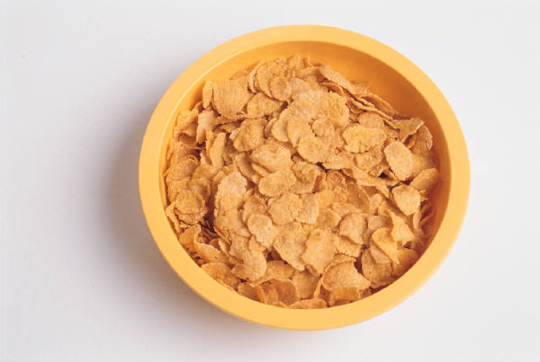

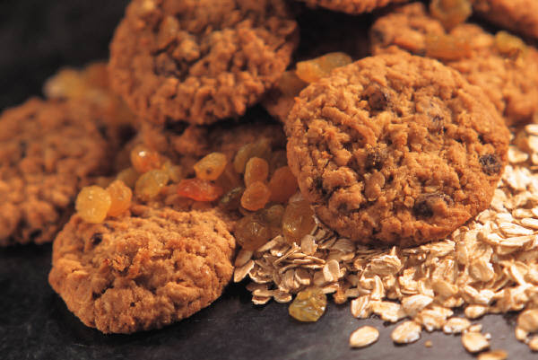
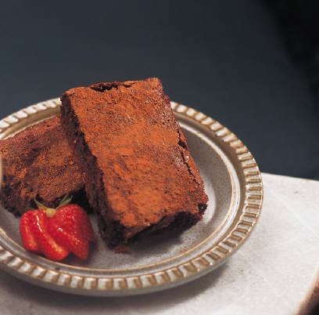
Milk Pairs with Food

Slide 34
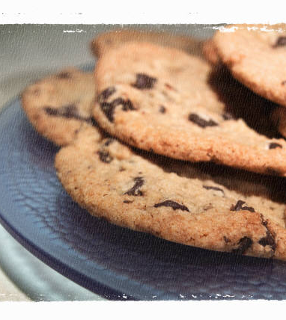
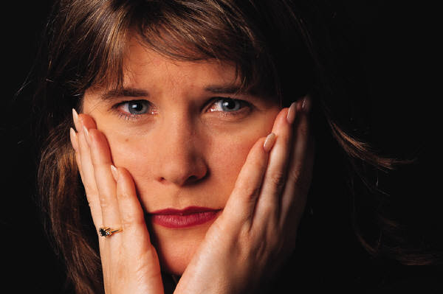
No Milk for a Week – “Deprivation” generates strong emotional response

Slide 35
The recommendation
No discussion of health benefits
  Get the 70% who currently consume to buy more
Feature complimentary foods
  Create a visceral reaction, a craving
Deprivation campaign
  Do not feature any milk

Slide 36
The reaction
Convinced them to take a risk
Doing the same thing wasn’t an option
Agreed to commit to campaign for 3 years

Slide 37


Dynamic Campaign

Slide 38

Cross Marketing Potential

Slide 39
New High in Sales by 2003
745 million gallons!
2%
2%
4%
3%
2%
-3%
0%
0%
Milk sales in million gallons

Slide 40
The Results
91% awareness level was achieved nationally
Campaign won every major advertising award.
Voted #1 slogan among marketing industry leaders since the advent of broadcast television in 1948
One of the most widely syndicated slogans in advertising history
Got milk? evolved far beyond a campaign to become part of the vernacular of this country

Slide 41


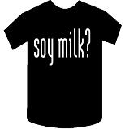


Got everything!

Slide 42
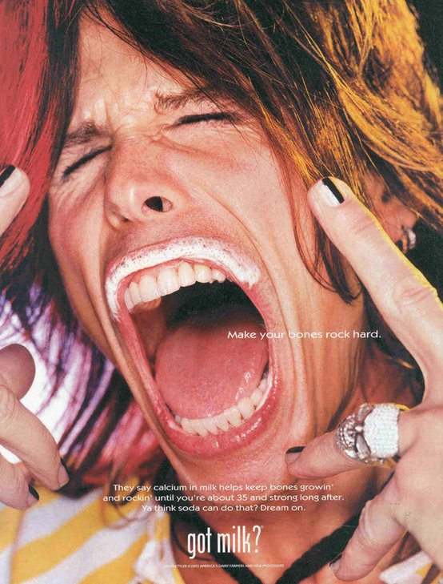
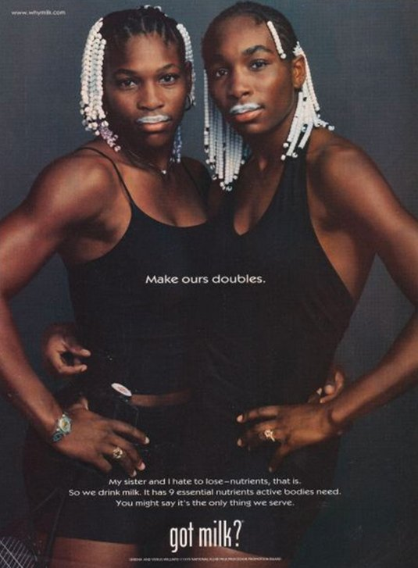
Milk Mustache Brand Extension
A Campaign spanning over 20 years, multiple brand extensions,
As well as countless parodies and media references – truly iconic

Slide 43
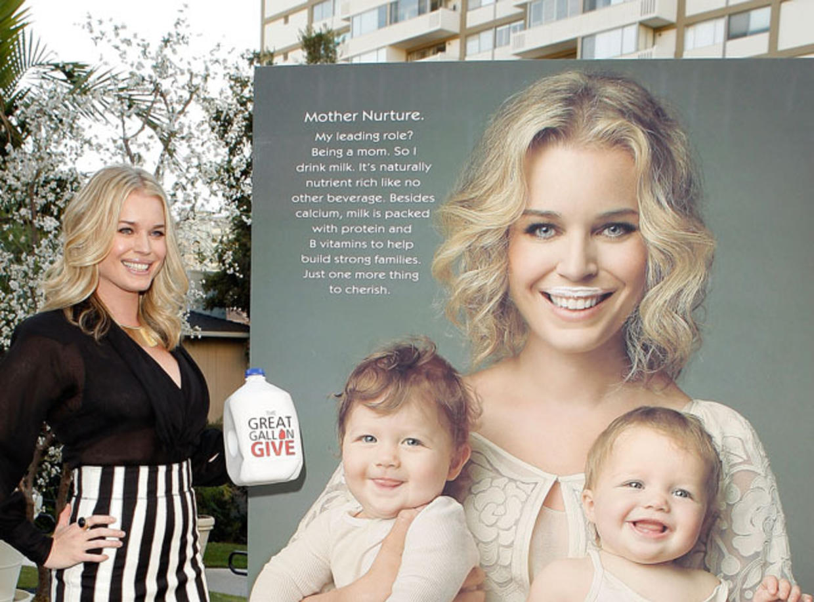
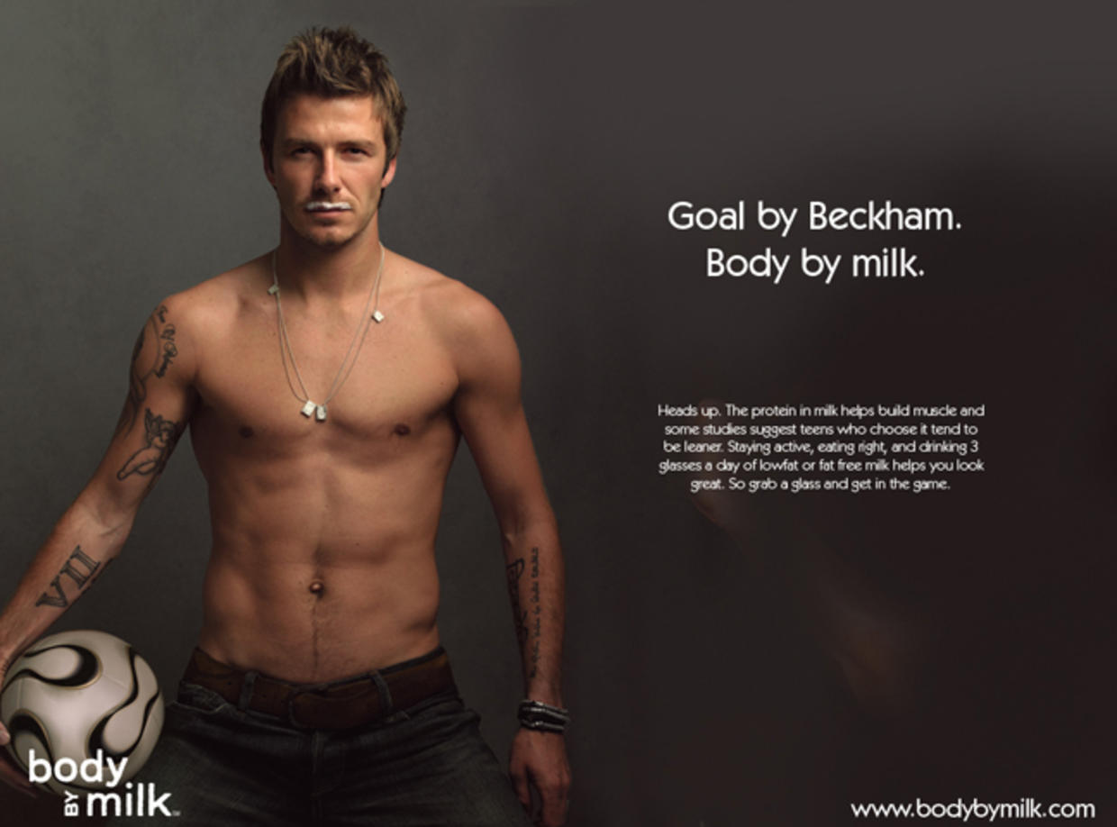
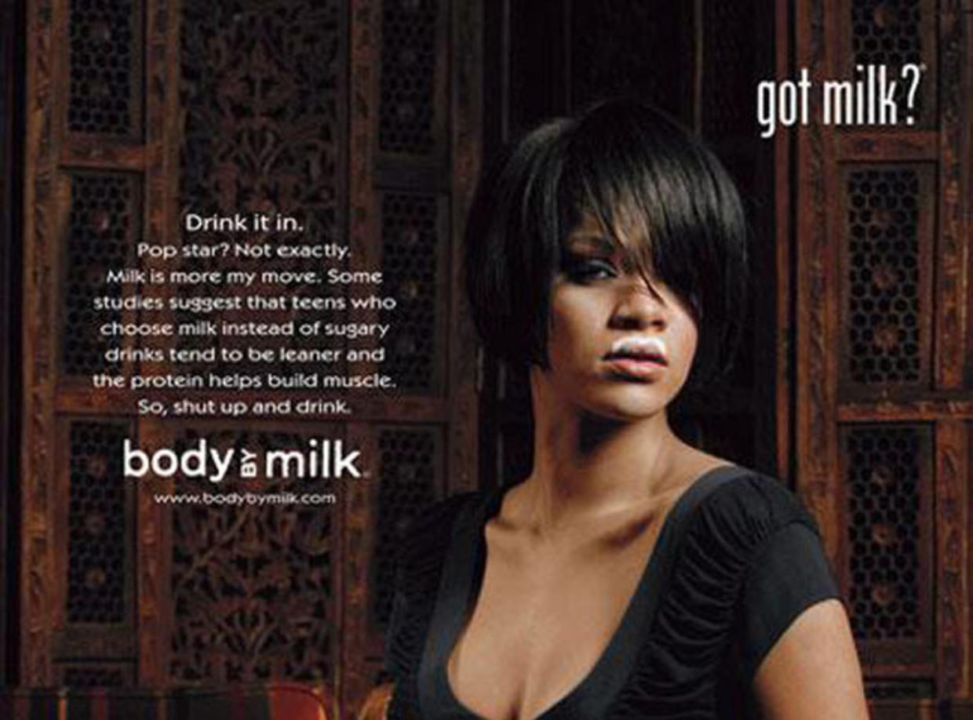
Milk Mustache Brand Extension

Slide 44
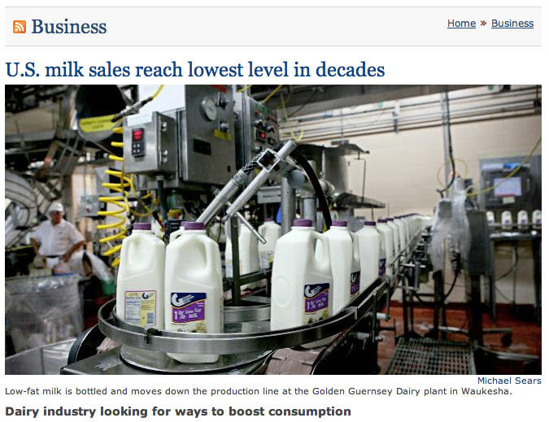

Slide 45
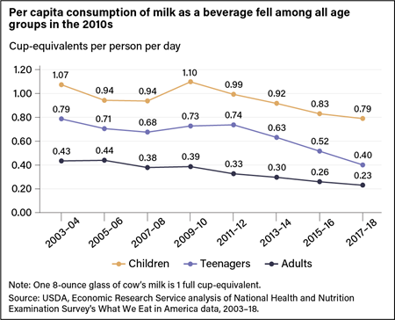
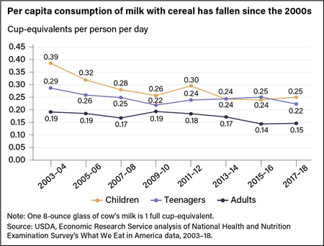
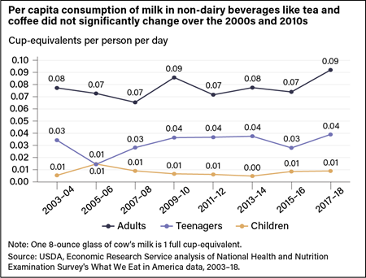
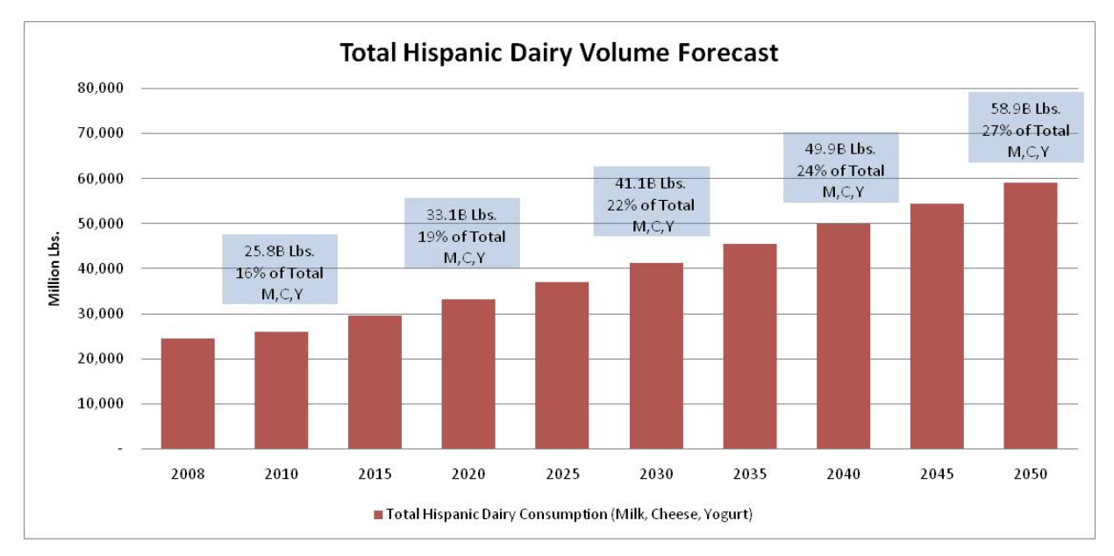
Declining Milk Sales Across Many Categories
Milk as a Beverage
Milk with Cereal
Milk with Beverage (e.g. Coffee)
Total Hispanic Dairy Volume

Slide 46

Effie Winning Extensions

Slide 47
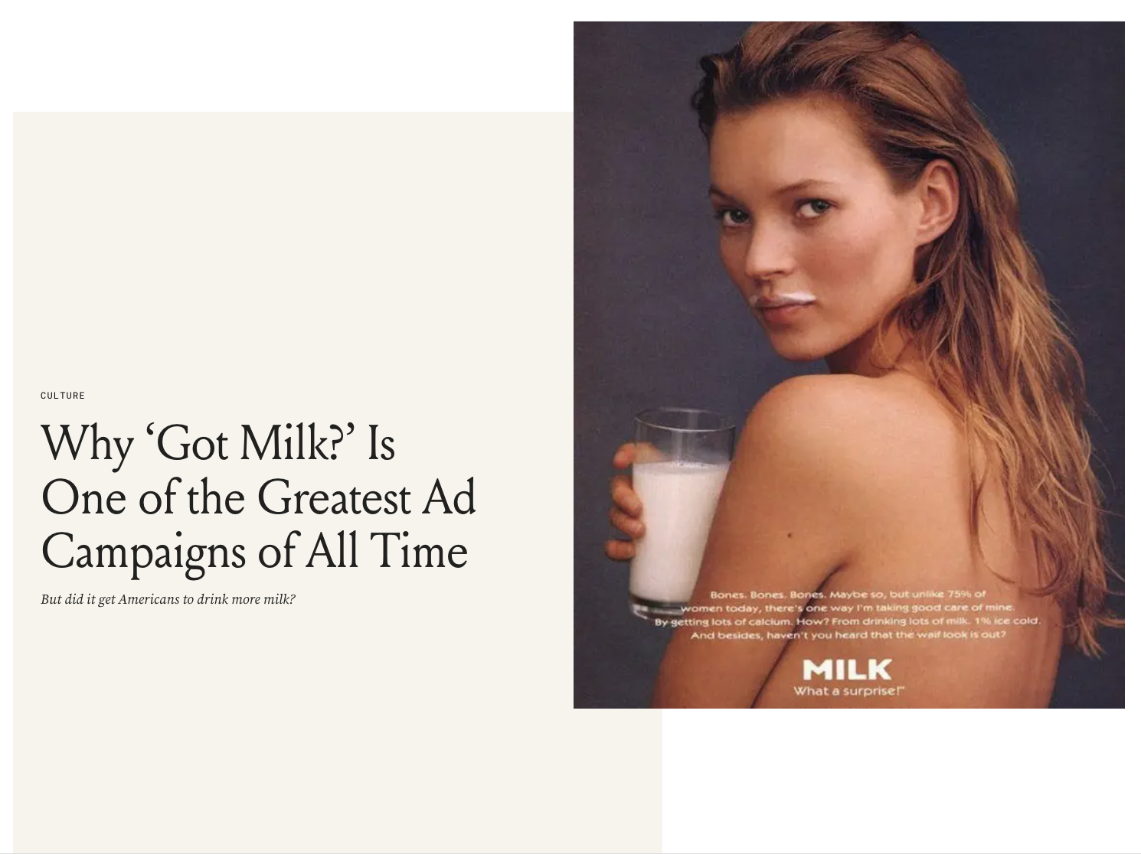
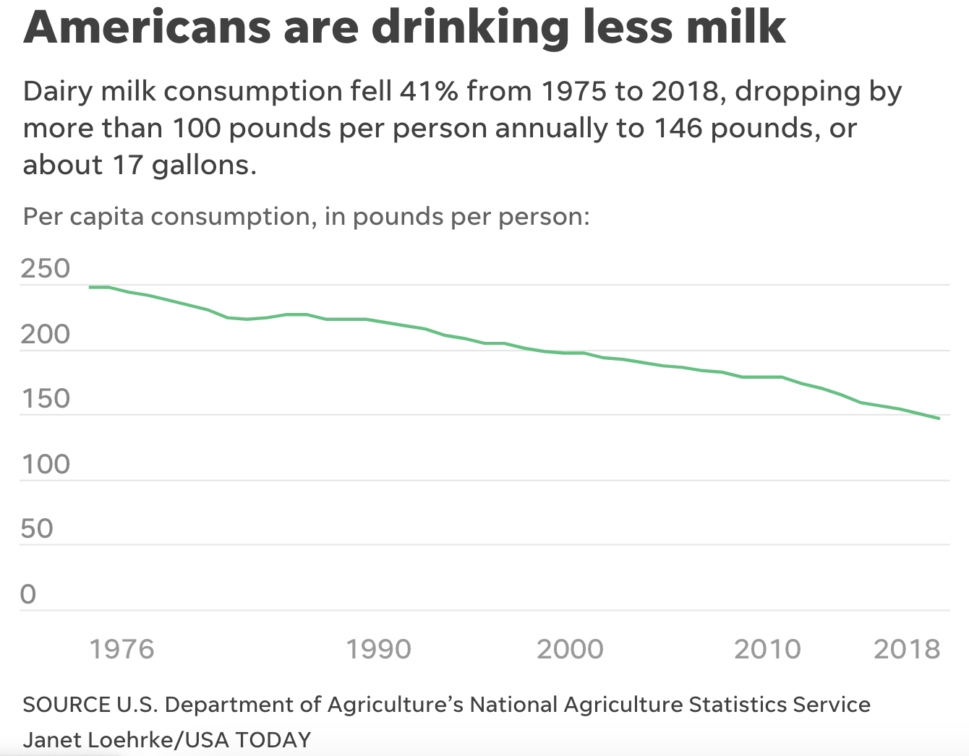
Major Threats Facing the Milk Market
Changing breakfast and eating habits
  Low carb and gluten-free diet patterns
  Dairy-free / plant-based vegan alternatives
    Almond, Soy, Oat, Coconut
  Environmental concerns with dairy farming
  Health concerns with dairy milk - fat content / BGH

Slide 48
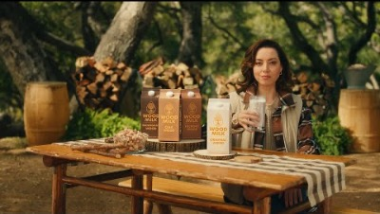
Revamping “Got Milk” for the Current Moment
Link to Video

Slide 49
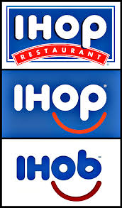
Another Breakfast Rebranding
June 2018, IHoP (International House of Pancakes) announced via Twitter that it was changing it name to IHob
  Immediately went viral with speculation about what the “b” signified.
Week later, they announced it stood for “Burgers,” inverting the “p” to a “b”
  Based on research of what their customers wanted outside breakfast
  Widely shared answer: Burgers!

Slide 50
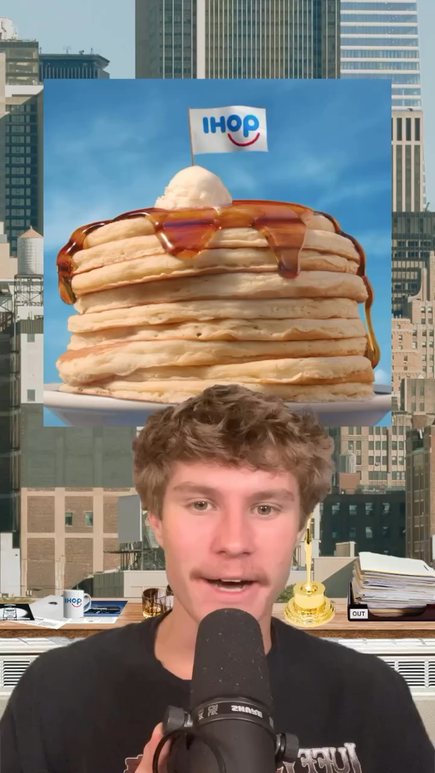
IHob back to IHoP
Based on that, IHOP's culinary team revamped its offerings, landing on a seven-burger lineup
  e.g., Big Brunch Burger, Cowboy BBQ Burger, etc)
  But Little awareness of new burger offerings.
Research also found low identification with meals outside of breakfast, even though open 24-7
  Store sales confirm little traffic outside breakfast
  Breakfast food makes up 65-70% of IHOP's business.
Temporary rebranding drives conversation, tons of free publicity for lineup, and refreshed the brand.
What else could they have done?

