Slide 1
Account Planning and the Iconic “Got Milk?” Campaign

Slide 2
Understanding Prospects
Critical for a Strategic Communicator to understand the audience/consumer:
Identify the consumer and their media environment
Craft message to fit the audience / aperture
Select and cost media to target the audience
Starting point:
Market research data:
E.g., Simmons, MRI

Slide 3
Marketing Comm Environment
Clutter
Competition
Budget limitations
Only by understanding consumers and their viewpoints, can campaigns overcome these challenges

Slide 4
Audience limitations
Factors that inhibit message reception
Divided attention
Short Attention span
Processing limitations
Selective exposure
Scorn and skepticism

Slide 5
Advertising Pyramid
Action
Desire
Conviction
Comprehension
Awareness

Slide 6
The First Step
Breaking through
getting exposure
Keys to getting exposure:
Understanding audience media use
Understanding audience needs
Needs
Different motivations
Different gratifications sought

Slide 7
Involvement: A Key Audience Factor
Involvement shapes persuasion process
Types of involvement:
Product
High vs. low involvement products
Consumer
High vs. low involvement consumers
Cognitive vs. affective involvement
Cognitive: thinking
Affective: feeling

Slide 8
Product Involvement Grid
Affective involvement (feel)
Low
High
• Car
College •
High
• Video camera
Engagement ring •
Cognitive involvement (Think)
•
Motor oil
Greeting card •
•
Laundry detergent
Low
•
Paper towels
Flowers •

Slide 9
Individual Factors
Demographics
Geographics
Psychographics
Buying Behavior
Used for segmentation and target marketing

Slide 10
Demographics
Age
Gender
Family status
Education
Occupation
Income
Race/ethnicity

Slide 11
Geographics
Region
City size
Population density
Population growth

Slide 12
Psychographics
Needs
Attitudes
Personality (self-concept)
Lifestyles

Slide 13
Buying Behavior
Category and Brand consumption
Breakfast Cereal vs. Frosted Flakes
Volume of consumption
Heavy, Medium, or Light
Heavy consumers often drive marketing

Slide 14
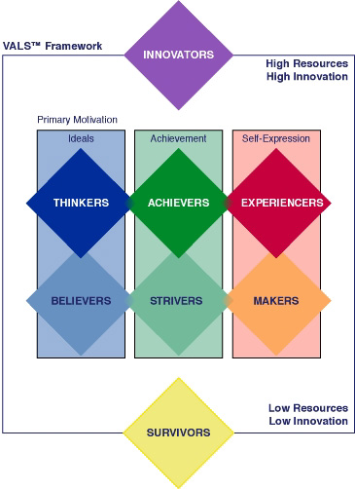
VALS 2 Typology

Slide 15
Example VAL2: Innovators
Characteristics:
Successful, sophisticated, take-charge people with high self-esteem—leaders and trend-setters
Motivations:
ideals, achievement and self-expression
Products:
cultivated tastes, upscale, niche products & services
Image:
An expression of taste, independence and personality rather than status/power

Slide 16
Example VAL2: Strivers
Characteristics:
Trendy, fun-loving, job rather than career due to lack of skills, shopping as a social activity and opportunity to make statement, impulsive consumers
Motivations:
Achievement, opinions/approval of others
Products:
They favor stylish products that emulate the purchases of people with greater material wealth
Image:
Money defines success as they don't have enough of it to meet their desires

Slide 17
Example VAL2: Experiencers
Characteristics:
Young, enthusiastic, impulsive consumers
Value the new, offbeat and risky
Motivations:
Self-expression, Excitement through experience
Products:
Exercise, sports, outdoor recreation, fashion, entertainment and socializing
Image:
Emphasis on looking good and having "cool" stuff.

Slide 18
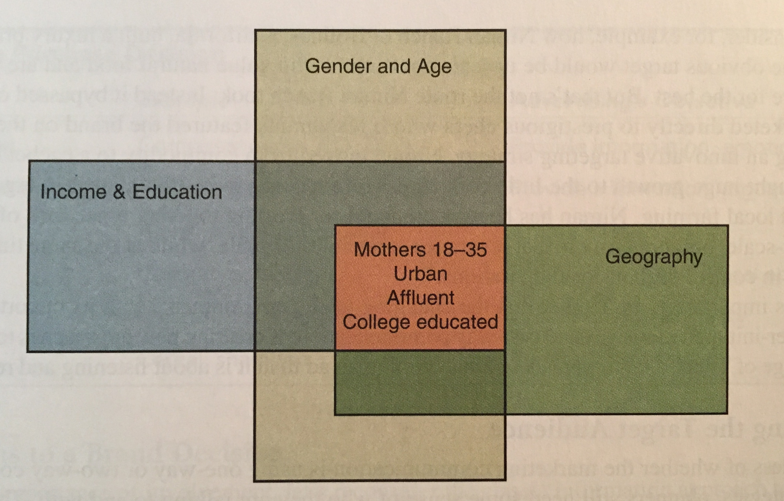
Profiles
Generating a deeper sense of the target audience in terms of their daily life
Painting a vivid picture of the target
Name them and provide “a portrait.”

Slide 19
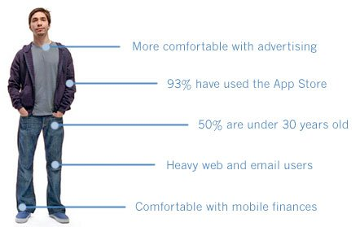
I’m a Mac…

Slide 20
Classic Profile Driver Campaign
Campaign driven by highlighting consumer differences in profile of users and using them to personify the brand

Slide 21
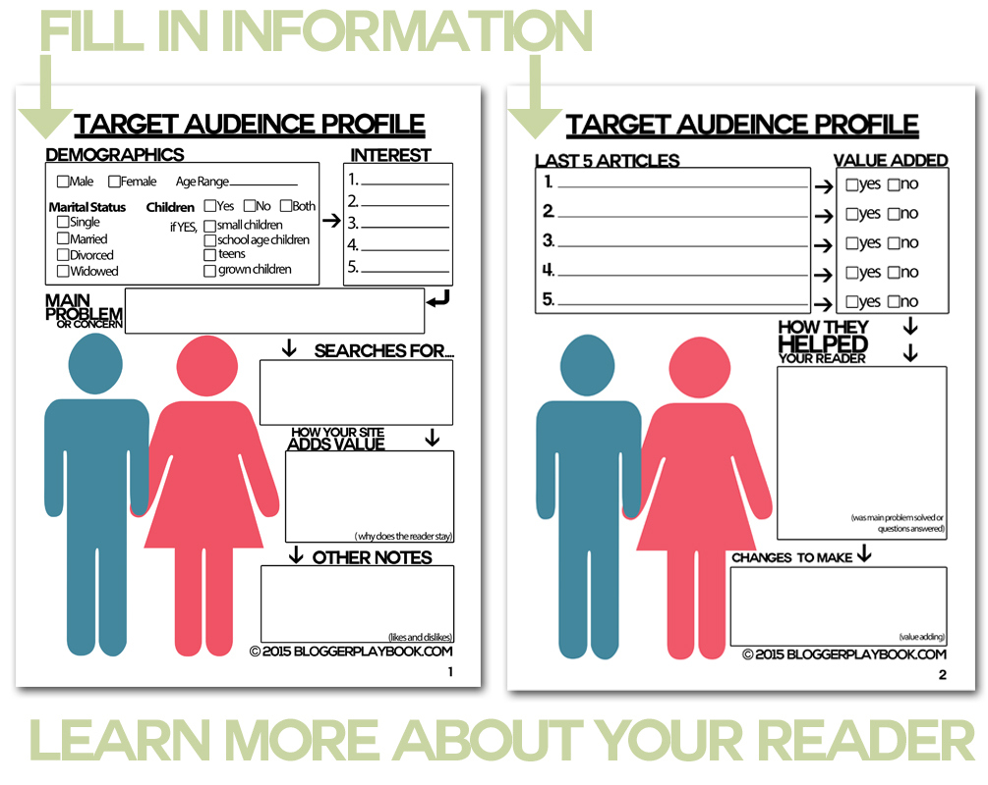
Media Mapping

Slide 22
Exercise
Who do you believe is the target audience(s) for Light Beer/Low Calorie Domestic Beer?
Demographics
Geographics
Psychographics
Buying Behavior
Media Usage
VALS Category
Will share consumer data for discussion next week

Slide 23
Smart Executions

Slide 24
Smart Placement

Slide 25
Smart Connections

Slide 26
Smart Sponsorships

Slide 27
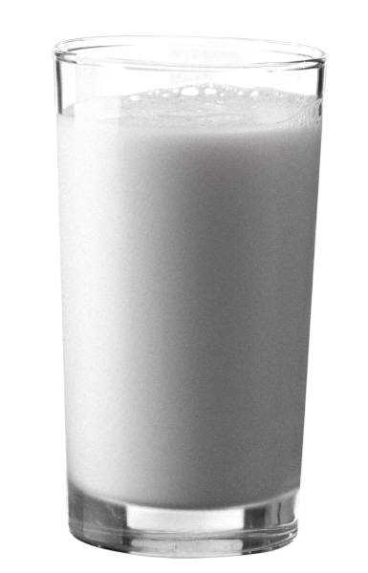
GOT MILK?
An Iconic Campaign

Slide 28
Sales prior to “Got Milk?”
-3%
-2%
-2%
Milk Sales in
million gallons
-3%
-2%

Slide 29
In search of insights
Conducted a lot of research:
Consumption habits
Food/beverage diaries
Strategy testing
Concept validation

Slide 30
Assessment
Trend towards out-of-home eating
Less than 5% of milk consumed out of home
“Milk does a body good.” 98% awareness!
70% of the general population drinks milk

Slide 31
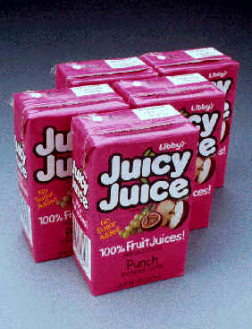
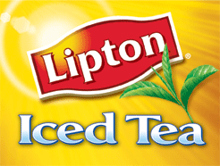
Enormous Competitors

Slide 32
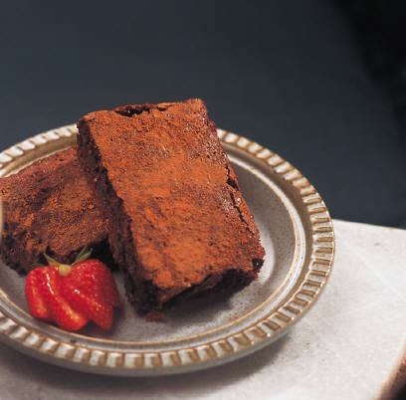
Milk Pairs with Food

Slide 33
No Milk for a Week – “Deprivation” generates strong emotional response

Slide 34
The recommendation
No discussion of health benefits
Get the 70% who currently consume to buy more
Feature complimentary foods
Create a visceral reaction, a craving
Deprivation campaign
Do not feature any milk

Slide 35
The reaction
Convinced them to take a risk
Doing the same thing wasn’t an option
Agreed to commit to campaign for 3 years

Slide 36
Dynamic Campaign

Slide 37
Cross Marketing Potential

Slide 38
New High in Sales by 2003
745 million gallons!
2%
2%
4%
3%
2%
-3%
0%
0%
Milk sales in million gallons

Slide 39
The Results
91% awareness level was achieved nationally
Campaign won every major advertising award.
Voted #1 slogan among marketing industry leaders since the advent of broadcast television in 1948
One of the most widely syndicated slogans in advertising history
Got milk? evolved far beyond a campaign to become part of the vernacular of this country

Slide 40
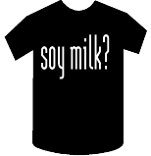
Got everything!

Slide 41
Milk Mustache Brand Extension
A Campaign spanning over 20 years, multiple brand extensions,
As well as countless parodies and media references – truly iconic

Slide 42
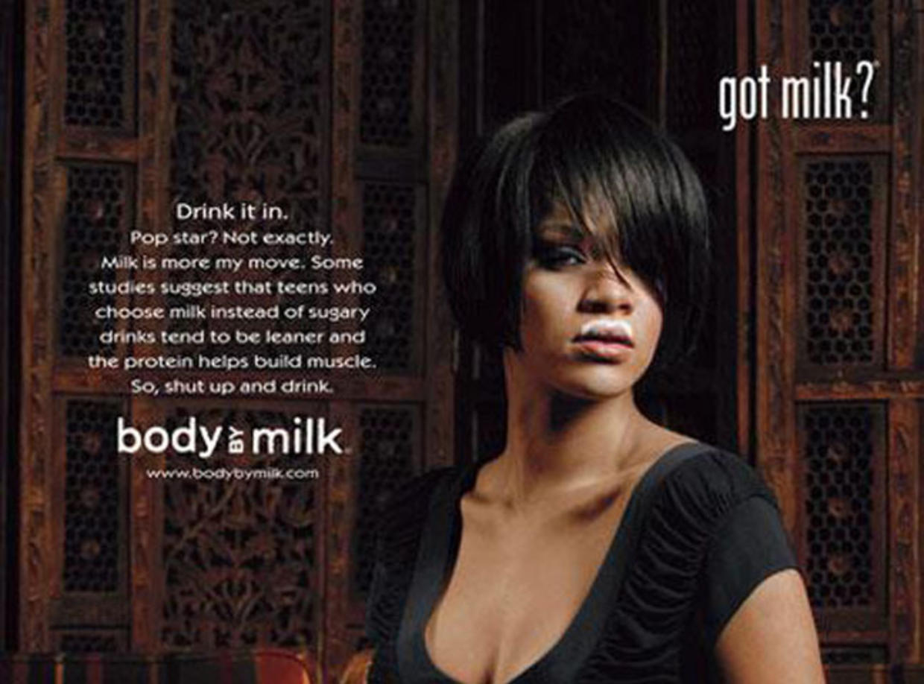
Milk Mustache Brand Extension

Slide 43
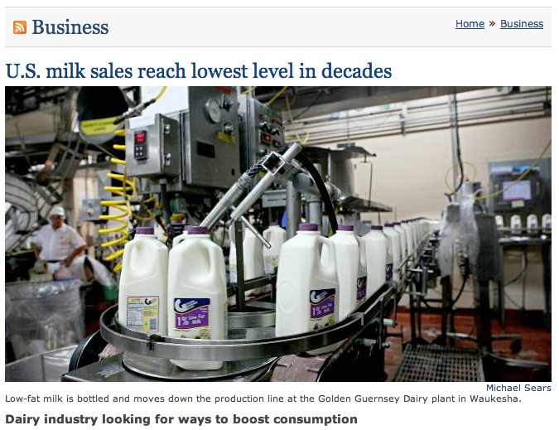

Slide 44
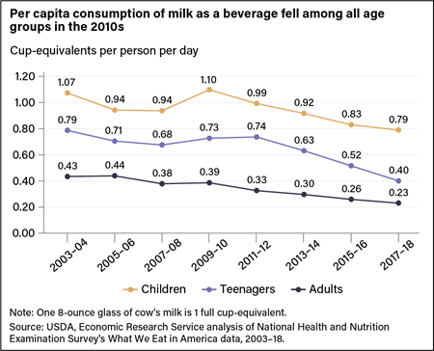
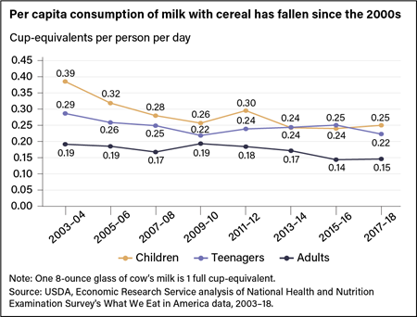
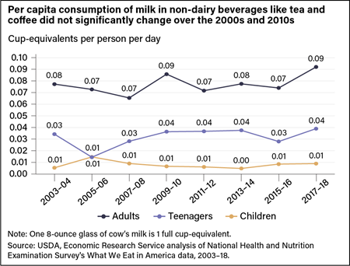
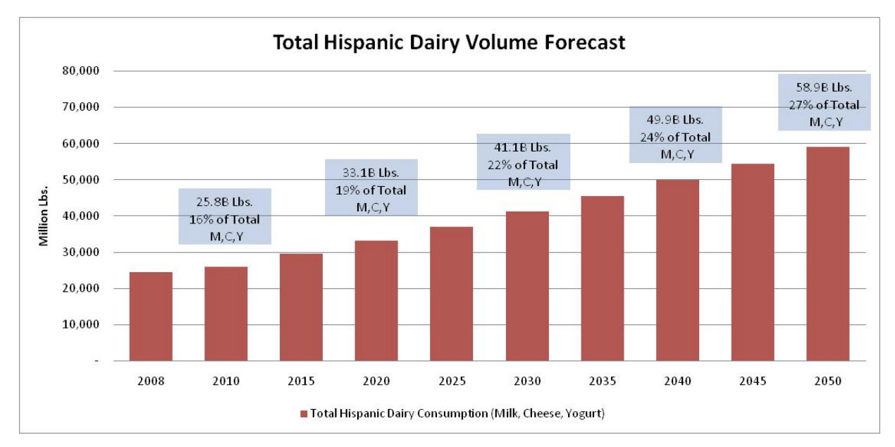
Declining Milk Sales Across Many Categories
Milk as a Beverage
Milk with Cereal
Milk with Beverage (e.g. Coffee)
Total Hispanic Dairy Volume

Slide 45
Effie Winning Extensions

Slide 46
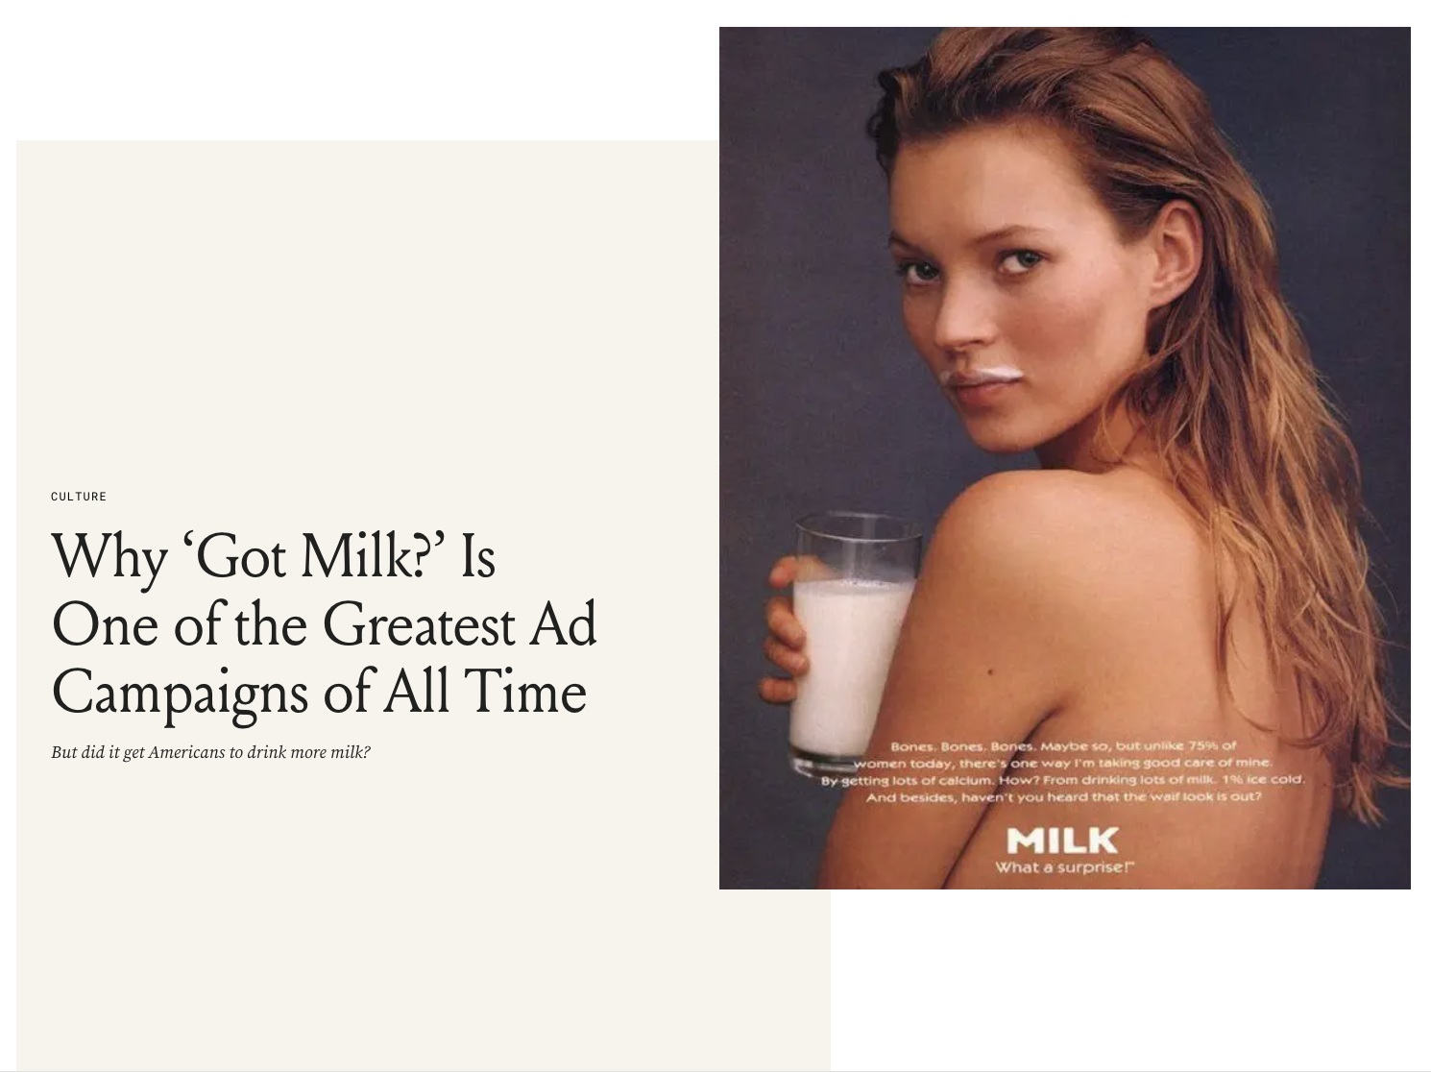
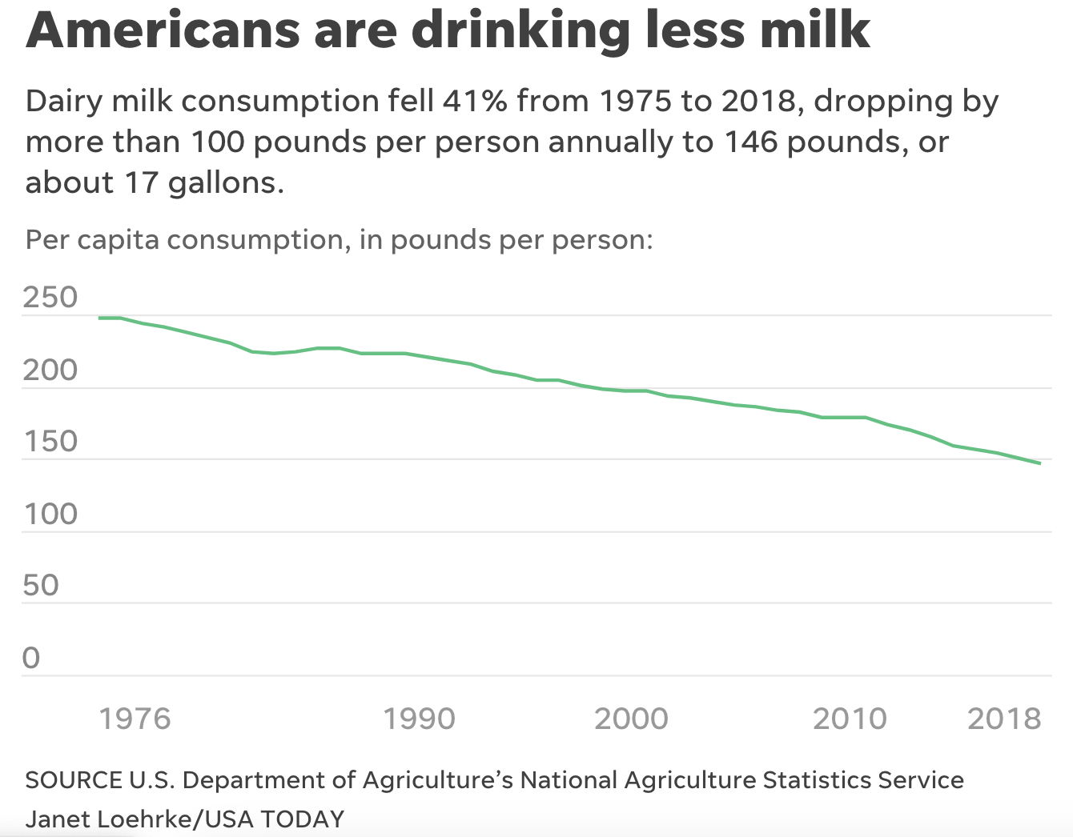
Major Threats Facing the Milk Market
Changing breakfast and eating habits
Low carb and gluten-free diet patterns
Dairy-free / plant-based vegan alternatives
Almond, Soy, Oat, Coconut
Environmental concerns with dairy farming
Health concerns with dairy milk - fat content / BGH

Slide 47
Revamping “Got Milk” for the Current Moment
Link to Video

