Slide 1
Using Marketing Data

Slide 2
Working with Simmons Data
Identifying potential consumers
Segment prospect markets
Narrow consumer targets
Characteristics
Media use patterns
Identifying efficient media options

Slide 3
Simmons/MRI
Multi-media audience estimates combined with extensive product/service use based on massive survey collection
Simmons Market Research Bureau (SMRB)
Mediamark Research Inc. (MRI) data
2019: Merged into MRI-Simmons
National syndicated studies
Random sample surveys conducted year round
Coterminous 48 states - One respondent per HH
Media measurement methodologies vary

Slide 4
Product Data
MRI-Simmons provide extensive product/service use data
By broad product category - ex. Salted Snacks to Luxury Hotels
Within categories, by type & brand to understand differences
Similar results for overall product use
Also measure volume of product use
Some categories have more detailed volume data

Slide 5
Use vs. Volume
Use: Number of people using a product
Ex. Number of airline travelers
Volume: Number of units or amount of the product used over a specified time period
Ex. Number of trips taken
Must consider use and volume
Offers better understanding of brand user

Slide 6
Volumetrics
MRI provided more volume data
Estimates based on respondent giving actual use figure for each item
MRI-Simmons provides less volume data
Estimates based on respondent checking a “use range” for entire category or kind

Slide 7
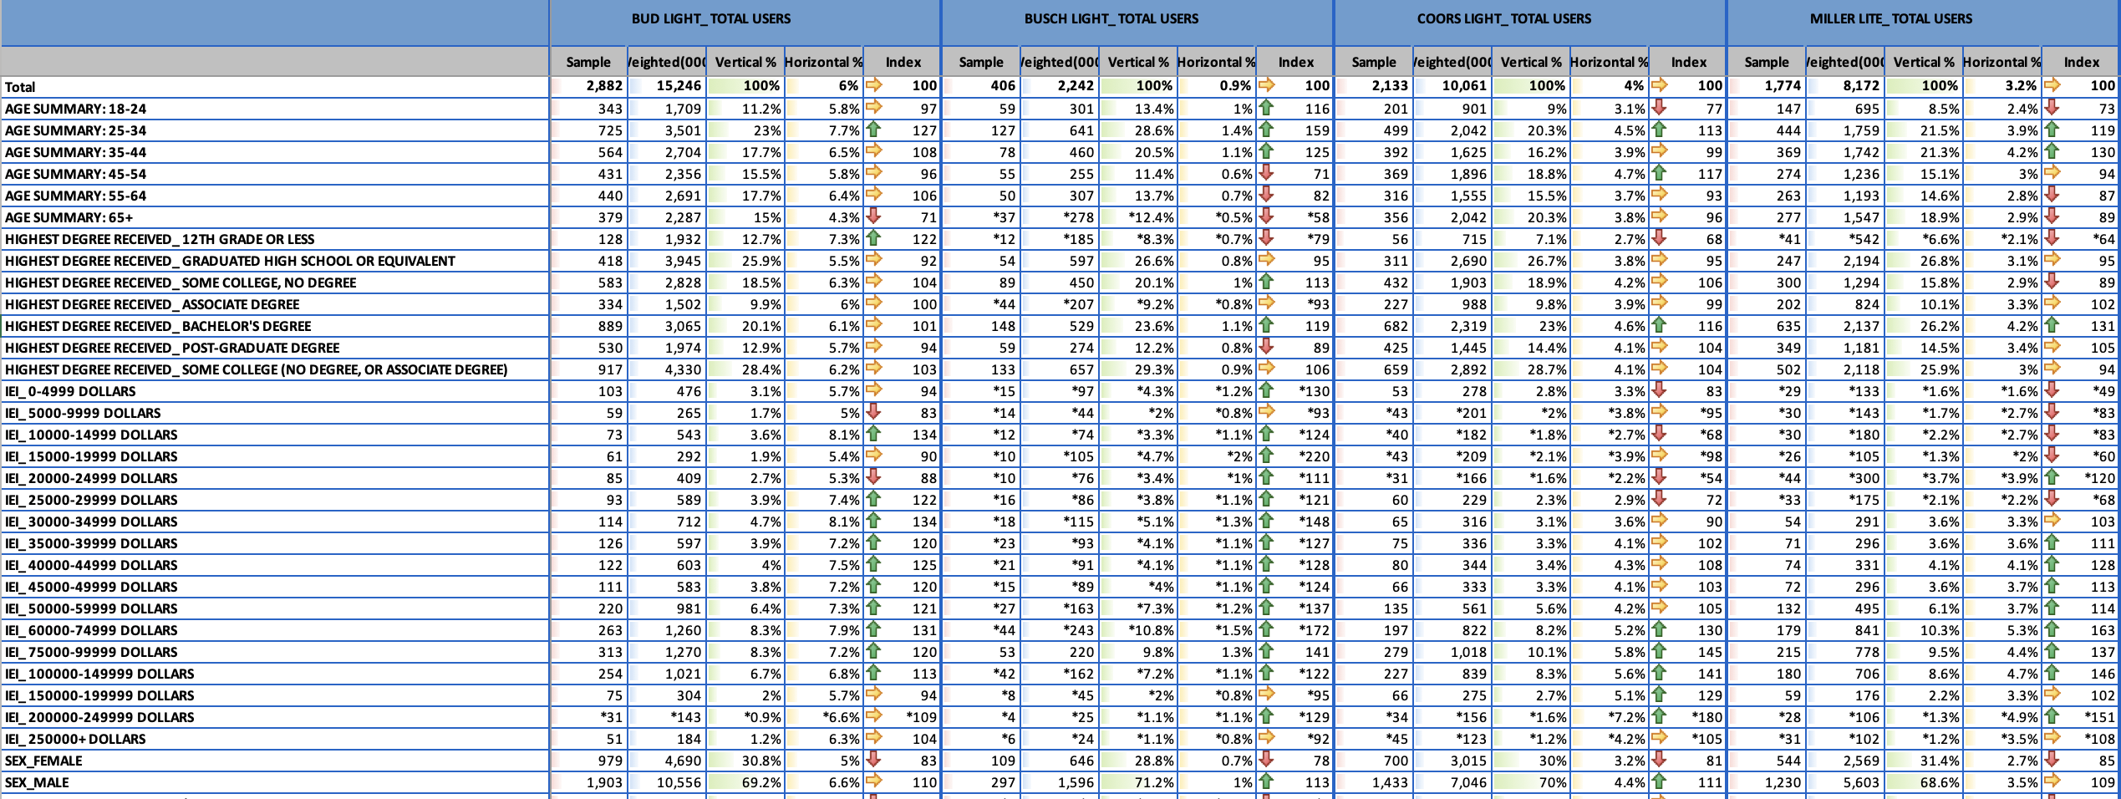
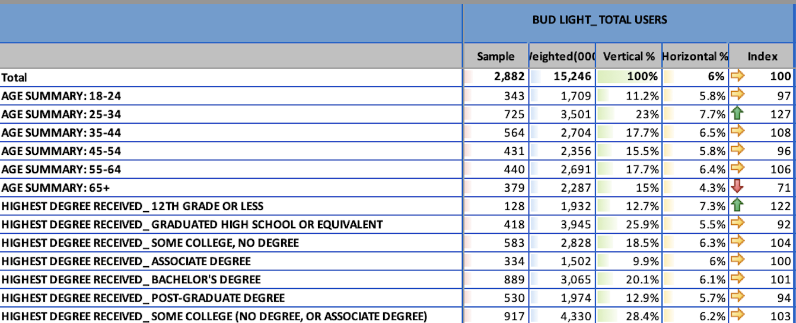
Generate a Crosstab View Report in Simmons

Slide 8
Sample of of US Adults who drink Bud Light
Estimated number of US Adults who drink Bud Light
Percent of US Adults who drink Bud Light
49,187 – Total Sample of US Adults
252,819,000 – Estimated # of US Adults
Percent of US Adults Age 24-34 who drink Bud Light
Index of Adults 25-34 who drink Bud Light (7.7/6.0)
Percent of US Adult Bud Light Drinkers who are 25-34

Slide 9
Vertical percentages
Base = the population that drinks
Bud Light most often
Of them, what % are 25-34?
23.0% of people who drink
Bud Light most often are age 25-34
Coverage of Users
Percent of Bud Light Drinkers who are 25-34

Slide 10
Horizontal percentages
Base = the population of 25-
34 years olds
Of them, what % drink
Bud Light most often?
7.7% of 25-34 years olds
choose Bud Light most often
Composition of Users
Percent of 25-34 who drink Bud Light most often

Slide 11
The Index
Index compares the coverage among the user group to overall coverage in total population
7.7% compared with 6.0%
7.68 / 6.03 = 1.27 = 127 Index
Means 25-34 years olds are 27% more likely to drink Bud Light “most often” than U.S. adults.
Percent of 25-34 who drink Bud Light most often

Slide 12
Must look at all
Vertical Percentage indicates coverage of that demographic group or media user group
is it a large group? Too large to ignore even is index is not high? It is too small to provide a market?
Horizontal Percentage indicates composition of product users in terms of demo or media
Do high percent of demo or media users consume the product? Is it higher than the population in general?
Index Number indicates the selectivity
Compares the composition of the selected group to the population in general. But don’t just look at this!

Slide 13
Two Sets of Data, Do Additional Runs
If you are marketing light beer, who are your possible markets?
If you are marketing light beer, who are your most heavy users?
If you are marketing Bud Light, who should be your target market?
Hilton Amex Groups
If you are marketing Miller Lite, who should be your target market?
Marriott Visa Groups
If there are multiple possible markets, which are the best primary
and secondary target markets for light beer?

Slide 14
Who are the consumer profiles
Generate a demographic, lifestyle, and media portrait of each prospect group?
How many different prospects are there?
How would you prioritize among them?
How would you “name” each target?
“Brock” vs “Bud” vs “Bradley”
“Urban Bro” vs “Gearhead” vs “Golf Dad”

Slide 15
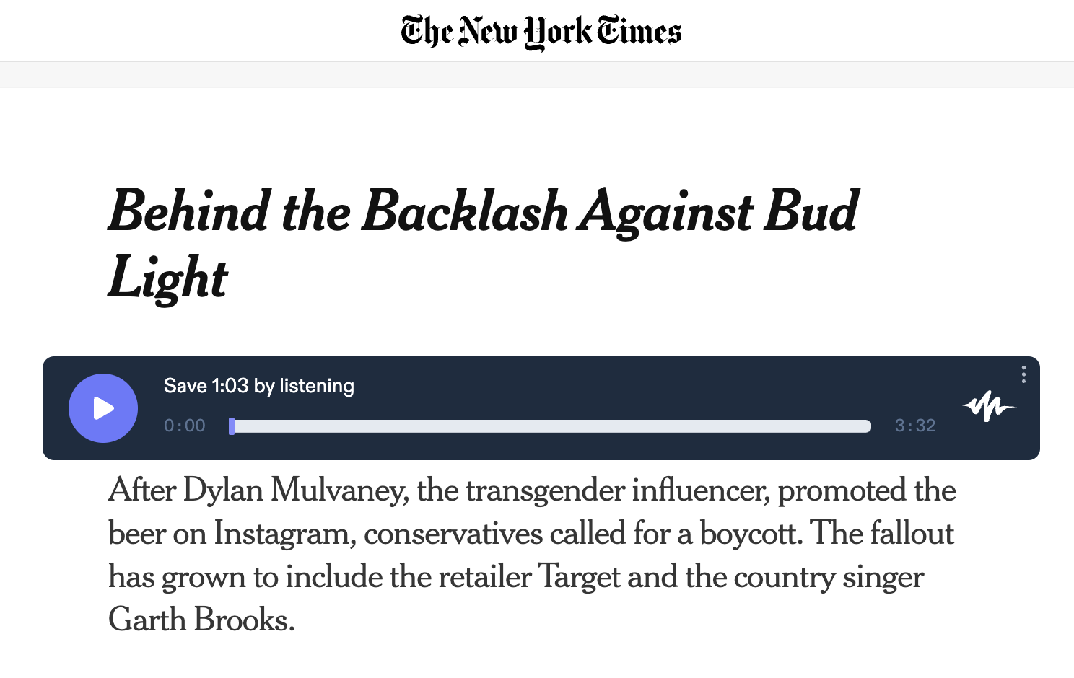
Dylan Mulvaney & 2023 Boycott of Bud Light

Slide 16
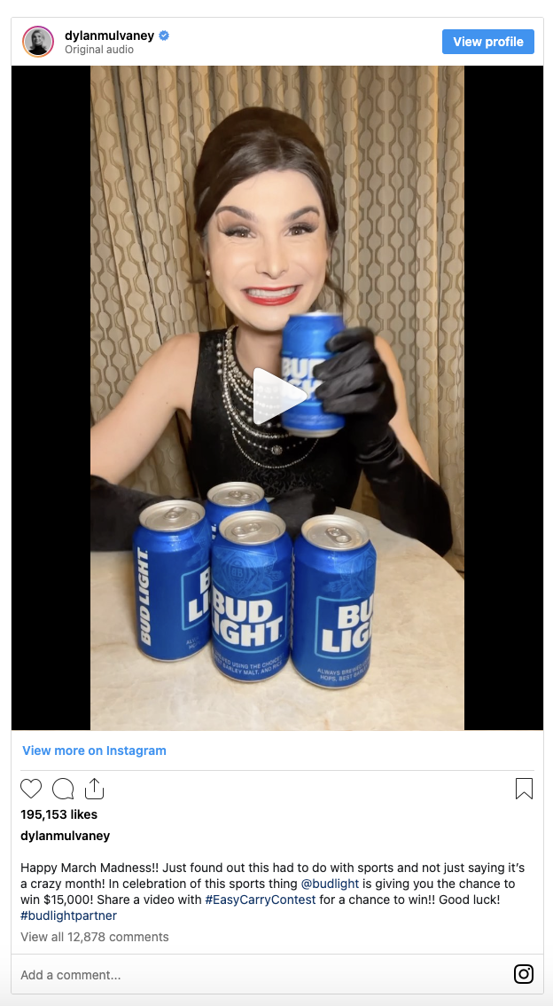
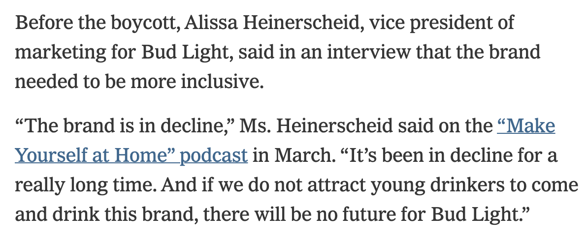
“Bud Light controversy cost parent company about $395 million in lost US sales. The world's largest brewer is counting the costs of being swept into a controversy over Bud Light in the United States. AB InBev said Thursday that US revenue fell 10% in the second quarter as sales of its top brand slumped” - CNN

