Slide 1
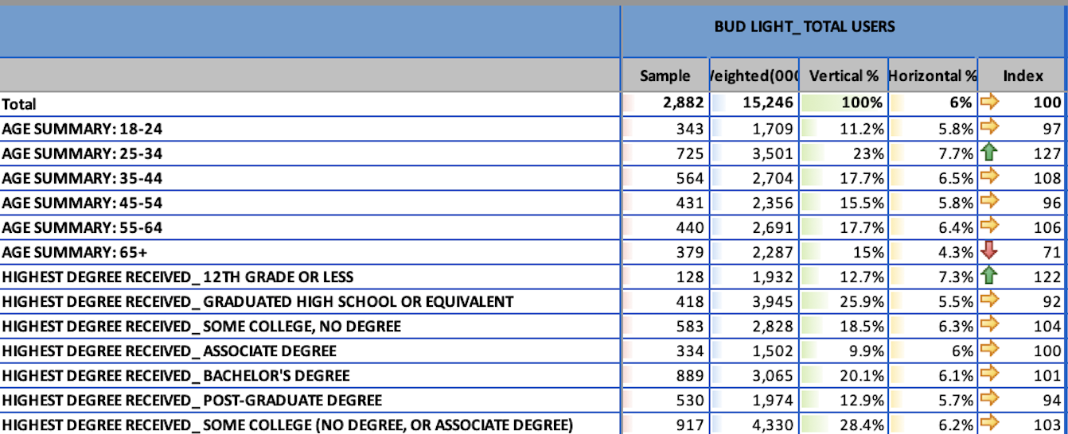
Sample of of US Adults who drink Bud Light
Estimated number of US Adults who drink Bud Light
Percent of US Adults who drink Bud Light
49,187 – Total Sample of US Adults
252,819,000 – Estimated # of US Adults
Percent of US Adults Age 24-34 who drink Bud Light
Index of Adults 25-34 who drink Bud Light (7.7/6.0)
Percent of US Adult Bud Light Drinkers who are 25-34

Slide 2
Vertical percentages
Base = the population that drinks
Bud Light most often
Of them, what % are 25-34?
23.0% of people who drink
Bud Light most often are age 25-34
Coverage of Users
Percent of Bud Light Drinkers who are 25-34

Slide 3
Horizontal percentages
Base = the population of 25-
34 years olds
Of them, what % drink
Bud Light most often?
7.7% of 25-34 years olds
choose Bud Light most often
Composition of Users
Percent of 25-34 who drink Bud Light most often

Slide 4
The Index
Index compares the coverage among the user group to overall coverage in total population
7.7% compared with 6.0%
7.68 / 6.03 = 1.27 = 127 Index
Means 25-34 years olds are 27% more likely to drink Bud Light “most often” than U.S. adults.
Percent of 25-34 who drink Bud Light most often

Slide 5
Infegy Atlas
Brand Insights based on observing social media and online news discourse about your brand – A social listening platform

Slide 6
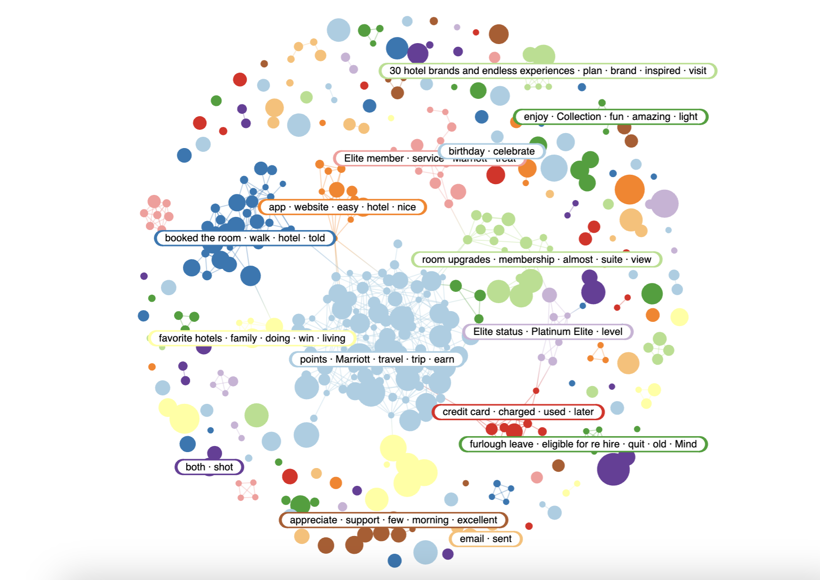
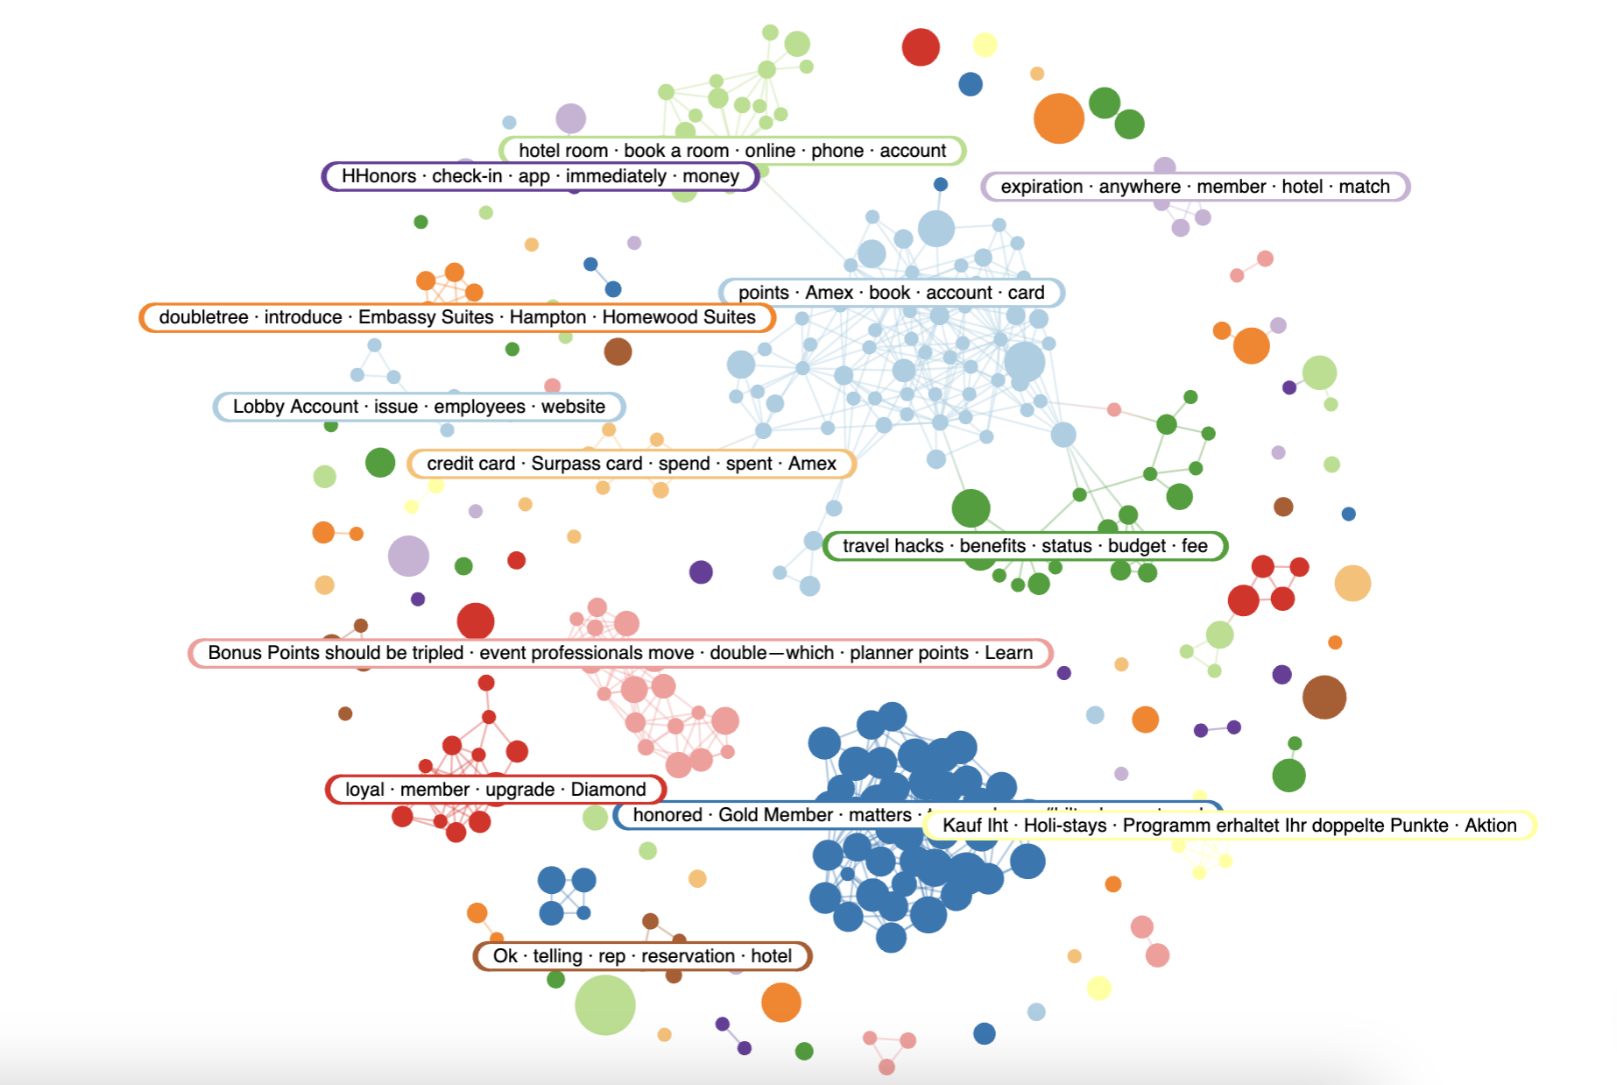
Major Narratives – Topic Modeling
Marriott Bonvoy
Hilton Honors

Slide 7
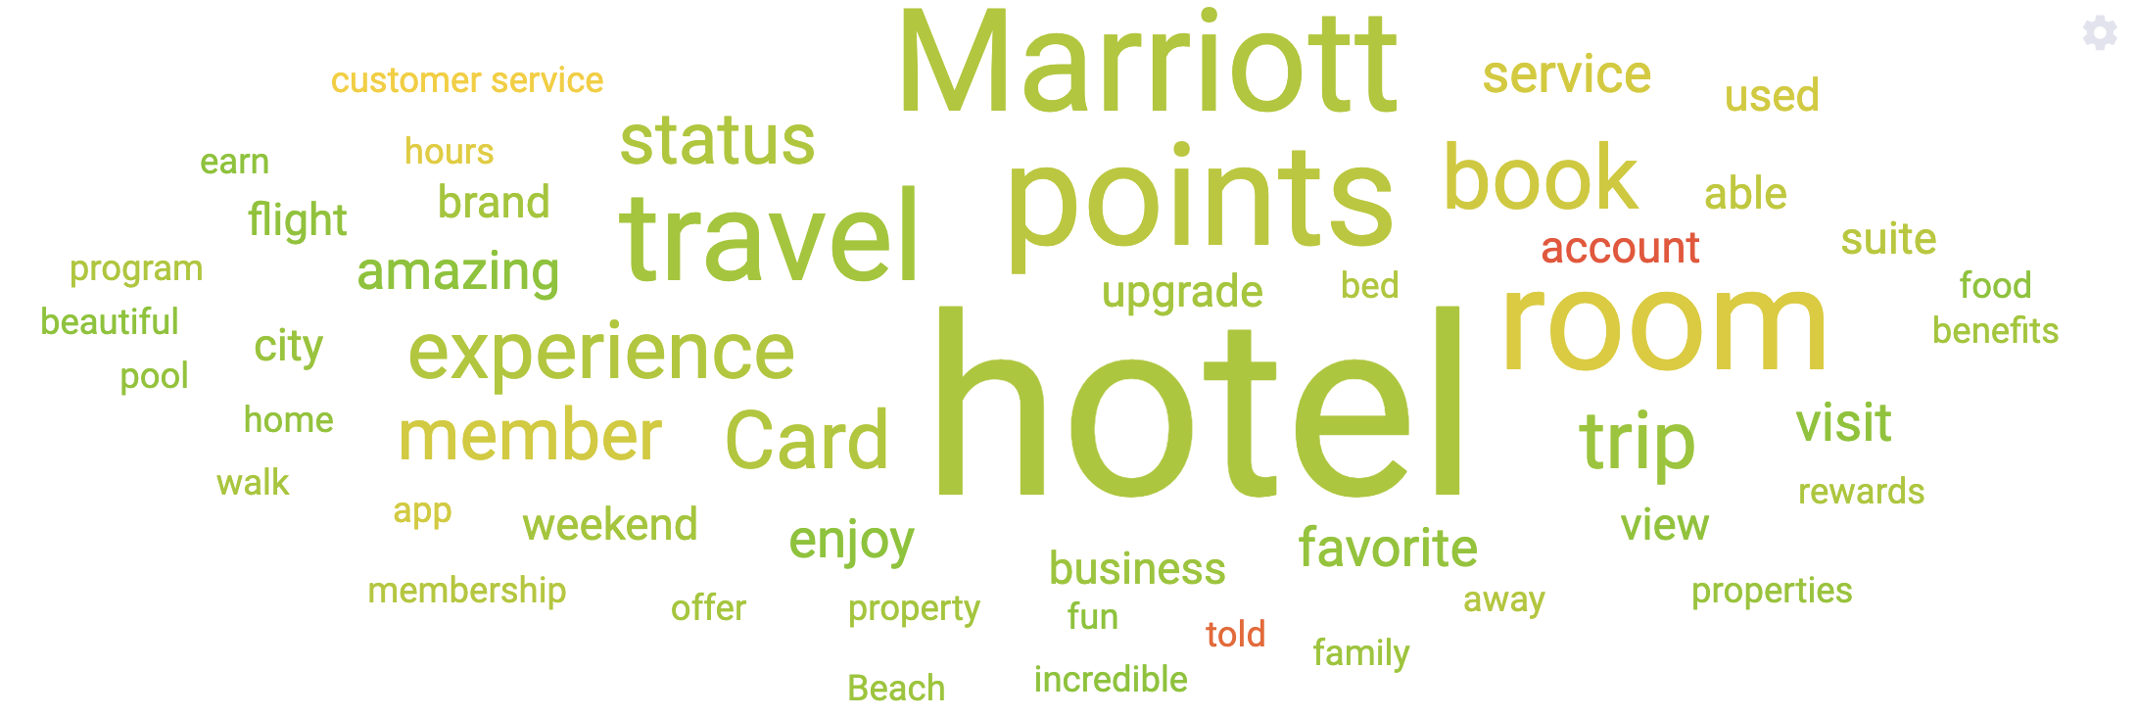
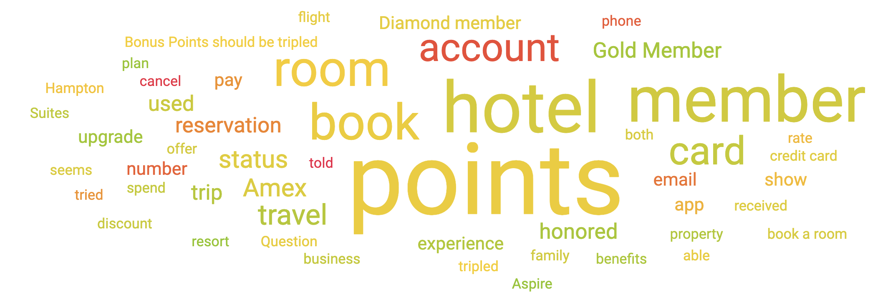
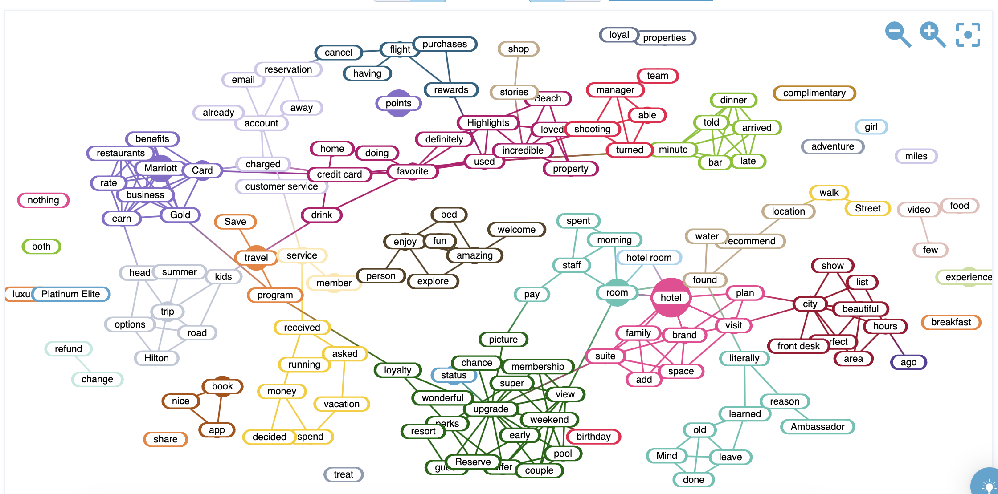
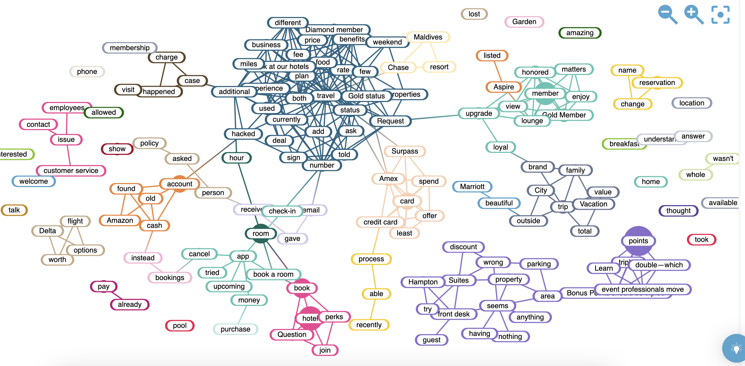
Linguistic Patterns – Word Mapping
Marriott Bonvoy
Hilton Honors

Slide 8
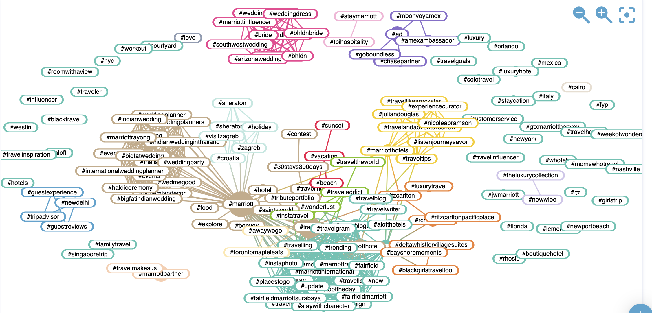
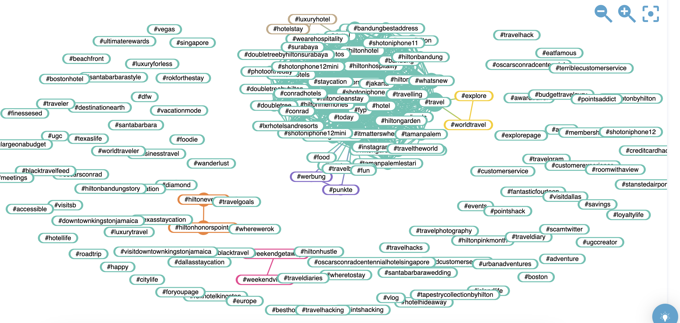
Hashtag Clusters – Network Analysis
Marriott Bonvoy
Hilton Honors

Slide 9
The Social Psychology of Strategy

Slide 10
How Does Marketing Communication Work?
The Mass Communication Approach
The Psychology Behind Effects
Information Processing
Mental Associations
Decision Making and Message Style
Framing and Emotion
Attitude Change

Slide 11
Message Reception and Comprehension
Simple sender-receiver model
Sender
Message
Noise
Receiver
Feedback

Slide 12
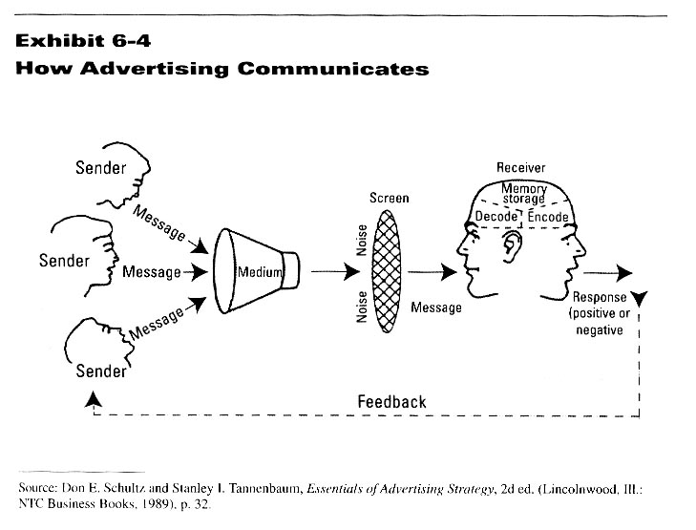
Mass Communication Model

Slide 13
Interactive Messaging Model
Both marketers and consumers are now message producers and receivers
Powerful effects of message expression, more so that message reception

Slide 14
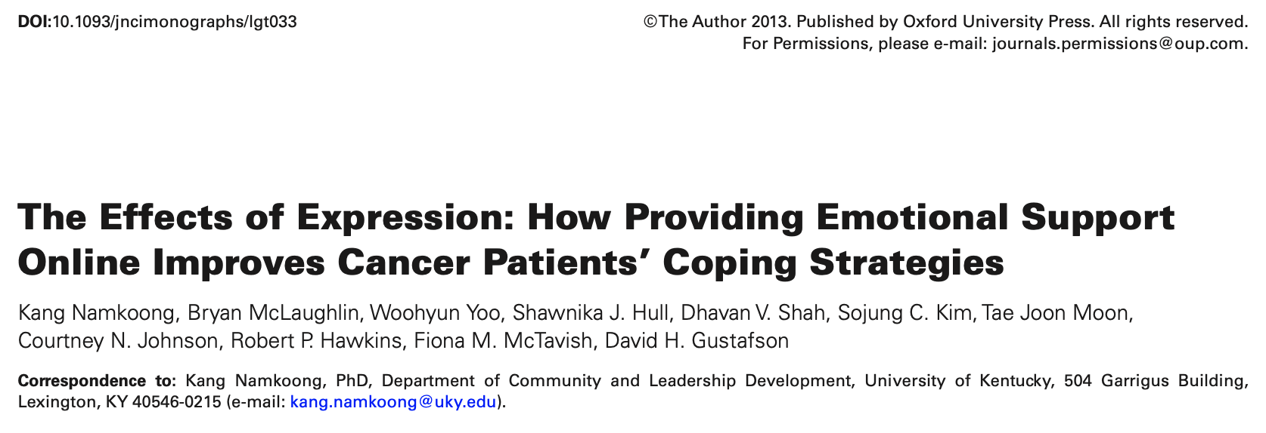
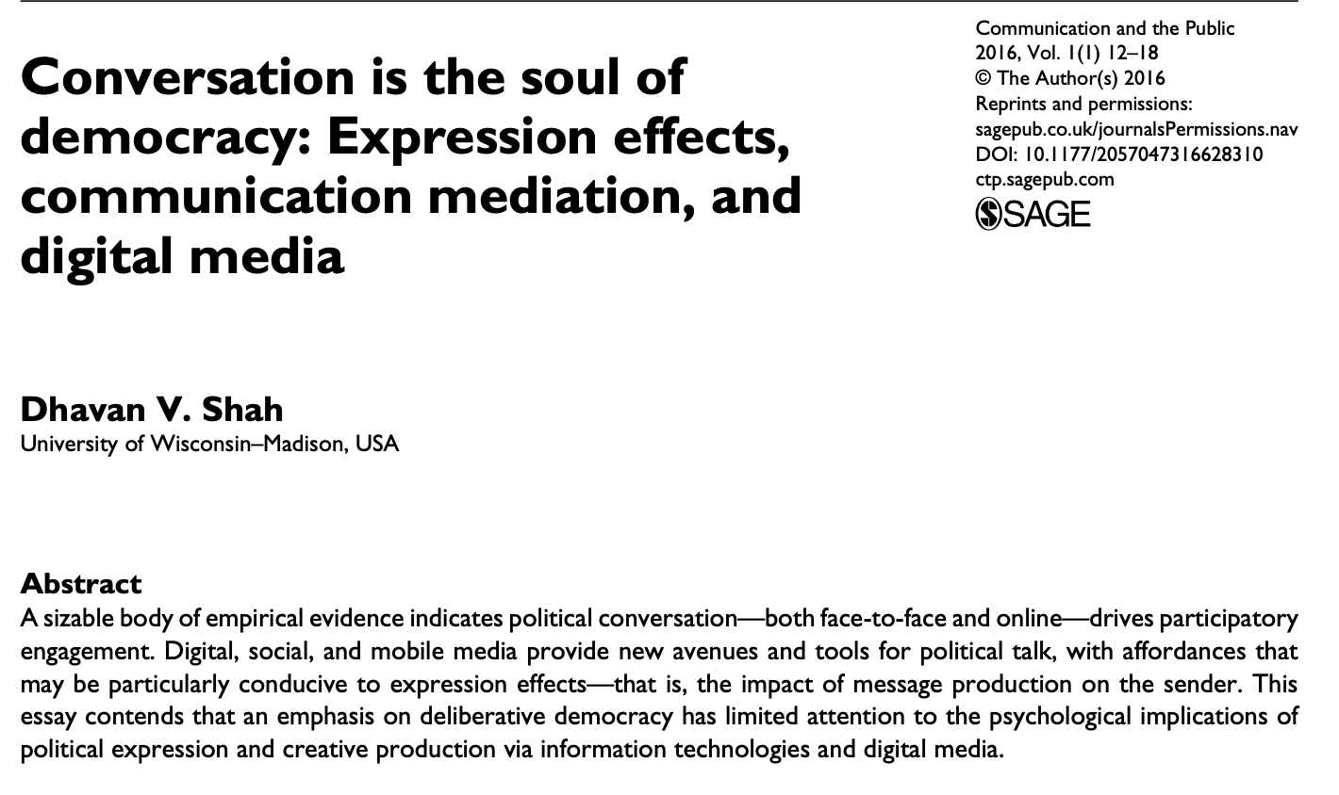

Slide 15
The Psychology Behind Message Effects

Slide 16
Information Processing and Consumer Behavior
Information processing:
How people take-in, manage, and use information and respond to it
Must understand thought process to create effective communication campaigns
Informed by psychological research on mental processing and decision-making

Slide 17
Message Processing
Multiple senders through multiple media
Noise produced by multiple messages
Consumers put up perceptual screens
Allows them to control flow of information
Allows them to sort through information
Decoding-encoding the message
Failure to decode, processing stops

Slide 18
Focused Attention

Slide 19
Storing and Retrieving
Incoming information subject to scanning
Two-types of memory
Short-term - temporary holding area
5 bits, +/- 2 (telephone number)
Long-term - complex and detailed information
Life history in nodes and networks
Node contains basic elements of an object
Node is connected to other nodes in the mind

Slide 20
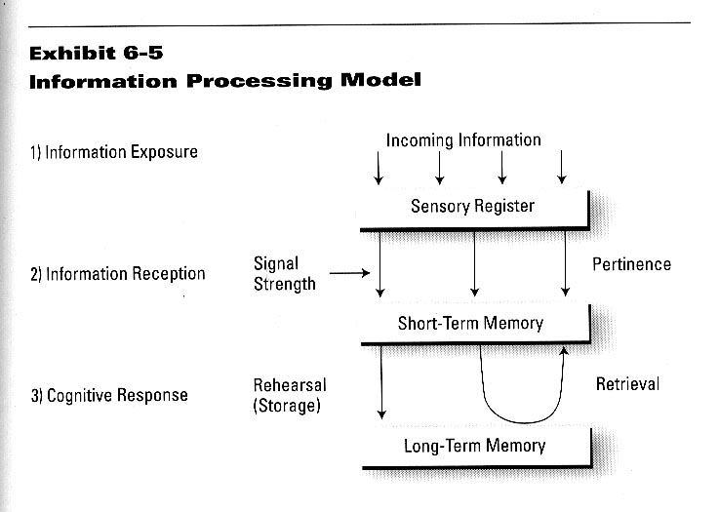
Processing and Memory

Slide 21
Information Storage
Objects are related to their attributes
Objects are related to other objects
Information is stored over-time
Contribute to brand knowledge
Brand awareness
Brand image

Slide 22
Brand Associations

Slide 23
Brand Knowledge
Brand Awareness
Recognize, recall, and associate
Name, symbol, color, package, and messages
Brand Image
Created through brand associations
Favorable and unfavorable linkages
“Schema” about a brand

Slide 24
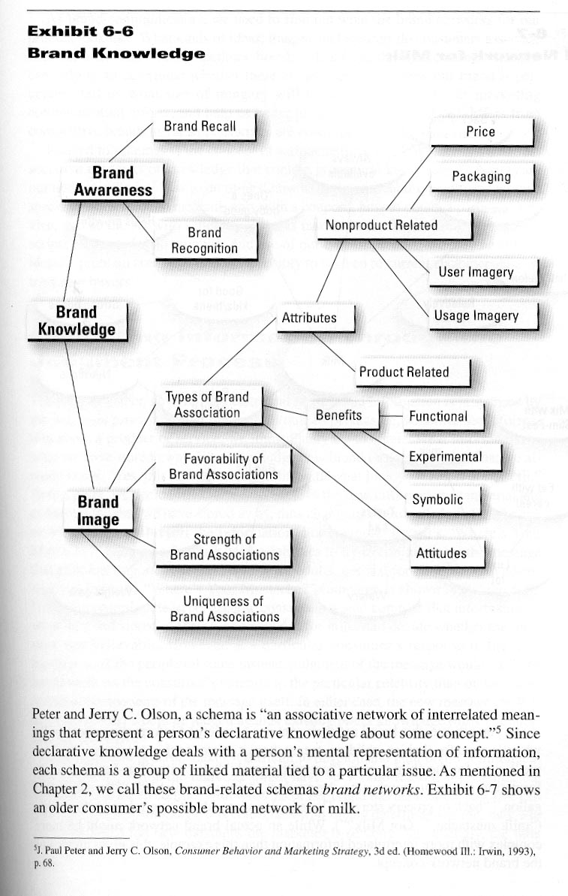

Slide 25
Mental Mapping
Must understand what networks looks like
Ideas, images, feelings that link to object
Mapping the most common linkages helps us determine problems and opportunities
How brand is perceived
What imagery/ideas will be most effective in strategic communication efforts

Slide 26
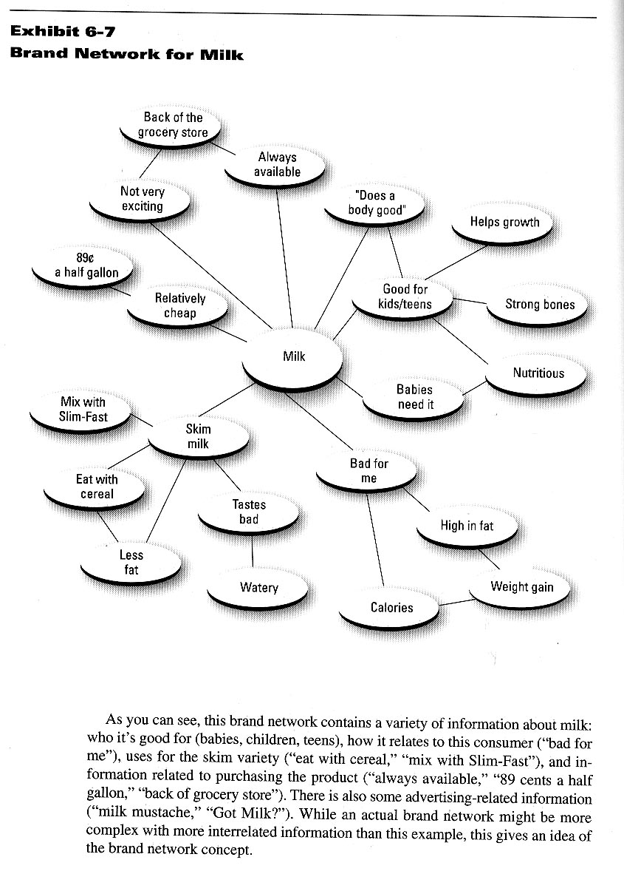

Slide 27
Linguistic Patterns – Word Mapping
Marriott Bonvoy
Hilton Honors

Slide 28
Decision Making
Stages in decision making
Problem Recognition
Information Search
Alternative Evaluation
Choice
Outcomes
Effort varies depending on involvement

Slide 29
Message Styles
Hard sell vs. Soft sell
Facts vs. Emotions
Informational vs. Transformational
Given attributes vs. Expand attributes
Utilitarian vs. Value-Oriented
Pragmatic vs. Self-expressive

Slide 30
Message Framing
Emphasize certain elements while excluding others – shift perspective
Build message concept around a value
Easily understood and shared
Easily processed and integrated into memory
Easily recalled for later use

Slide 31
Emotional Appeals
Not a continuum between good and bad
Can simultaneously feel “good” & “bad”
Feelings of mastery - positive state
Behavioral activation system
Broader processing of stimulus
Feelings of threat - negative state
Behavioral inhibition system
Increased attention to external threat

Slide 32
Key Psychological Concepts
Perception
Awareness
Understanding
Persuasion
Locking Power

Slide 33
Perception
Exposure
Responsibility of media planners/buyers
Placing ad where it will be seen by target market
Attention
The “trigger”
“Stopping power”
Intrusiveness
Originality

Slide 34
Perception Process
Physiological
Screens
(sensory)
Psychological
Screens
(emotional)
Physical Data
(stimuli)
Cognitive
(awareness)
Perception files
(memory)
• Ad/
commercial
• Promotion
• News item
• Product/store
• Price tag
• Conversation
Sight
Hearing
Taste
Smell
Touch
Personality
Self-concept
Attitudes
Beliefs
Habits
Information
Needs
Wants
Awareness
Non-awareness
Feedback

Slide 35
Awareness
Making an impression
Low-level effect
Awareness as a goal
Relevance
Product interest
Personal relevance
Maintaining interest
Consumer Involvement
High vs low involvement

Slide 36
Understanding
Making sense of the ad
Clarity
Literary tools
Definition
Explanation
Demonstration
Comparison
Contrast
Association
Image-building

Slide 37
Persuasion
Getting people to believe or do
Goals of persuasion:
Establishing attitudes
Reinforcing attitudes
Changing attitudes
Building an argument
Touching an emotion
Anchoring conviction/belief

Slide 38
Persuasion Concepts
Likability and brand loyalty
Logical reasoning
Emotional appeals
Beliefs and attitude structures

Slide 39
Elaboration Likelihood Model
Central and peripheral route attitude change
Persuasive communication has lasting effect on attitudes when…
Motivated to process the information
Ability to process the information
Cognitive responses are valenced
Otherwise, we rely on peripheral cues
Attitude change is temporary and unstable

Slide 40
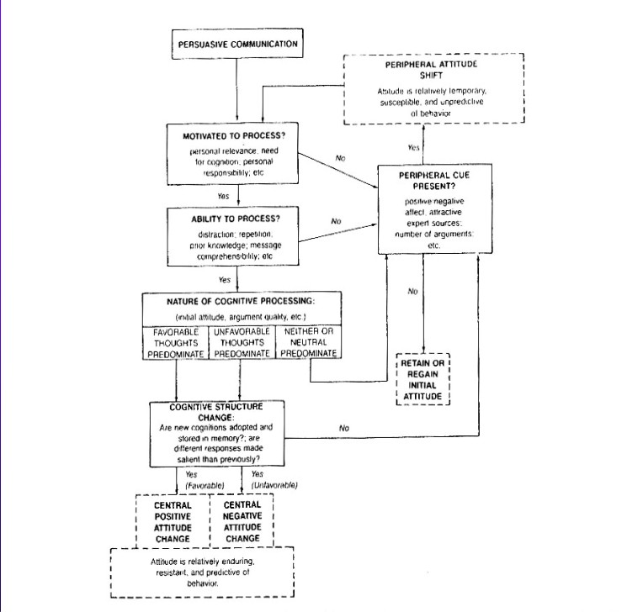

Slide 41
Locking Power
Effective ads must be remembered
Two types of memory:
Recognition
Recall
The problem of “vampire creativity”

Slide 42
Increasing Memorability
Repetition – multiple message placements
Jingles – verse or tune designed for memory
Slogans – short, striking or memorable phrase tailored to a particular message or campaign
Taglines – distillation of your corporate values and identity into a pithy, longstanding phrase

Slide 43
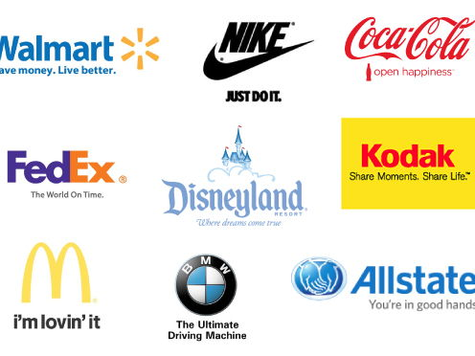

Slide 44
The Key Visual
Dominant image
Logos
Signatures
Superimposition

Slide 45
How Brand Images Work
The brand image
Identification elements
Product personality
Emotions
Associations
Persuasion and attitude change

Slide 46
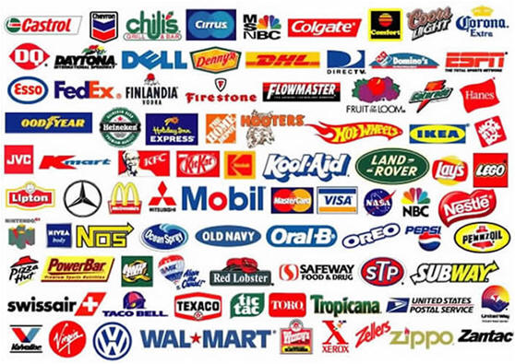
Building the Brand
Value
Brand equity
Brand name meaning
Brand personality
Trademark

Slide 47
Social Influences
Consumer as a social being
Culture – the ways of life, the social legacy
Invisible to those immersed in it
Yet it defines responses and behaviors
Values – Expressions of priorities
Values are enduring and shape action
Cultural capital – economic or social
Rituals – formalized symbolic behaviors
Holidays and celebrations

Slide 48
Core Values
A comfortable life
An exciting life
A sense of accomplishment
A world at peace
A world of beauty
Equality
Family security
Freedom
Happiness
Inner harmony
Mature love
National security
Pleasure
Salvation
Self-respect
Social recognition
True friendship
Wisdom

Slide 49
Social Position
Social Class
Upper Class
Upper Middle Class
Middle Class
Class mobility
Reference Groups
Aspirational Groups
Race and Gender
Family
Family structure
Kids in household
Marital Status
Parental Education
Intergenerational Influences
Indoctrination
Trickle-up
Community

Slide 50
Brand Analysis: Audience Perceptions
1) What are your offerings?
What is your market reach and your range of products? Consider your most popular items, your newest additions, your locations, and your newest market expansions. What are the strengths and weaknesses among these features?
2) What is the competitive landscape?
Who are your major competitors (established brands w/ larger budgets)? Who are your core competitors (highly similar brands, including new entrants)? Have competitors shifted their brand strategy in ways that threaten yours?
3) How is your brand perceived?
What’s your brand’s personality? What ideas do users associate with it? How is your brand positioned relative to competitors? What differentiates your brand? What makes ii unique in the market? What are its key attributes?

