Slide 1
Social Media Marketing
Alex Giedt
NOVEMBER 2024

Slide 2
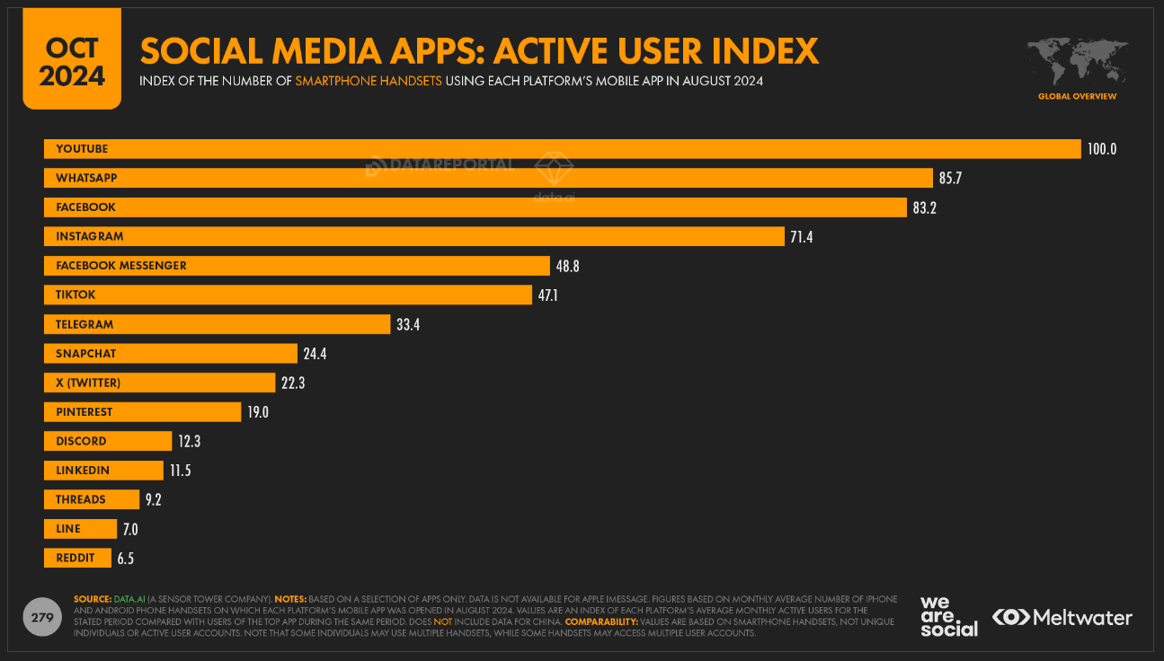
Social Media Marketing
Today’s Objective
Introduce you to a pragmatic approach to Social Media Marketing.
What is Social Media?
Social media is a way for people to communicate and share information online through virtual communities and networks.
Why Market on Social Media?
Social Media (writ large) is where audiences converge online. Marketers who deliver relevant content to these audiences are often rewarded with business success.
Notes:
By necessity, this is a brief overview. I have my own opinions about the platforms and what works and doesn’t. The only way to really know is test. Don’t take my word for it! If you want to work in marketing, I would encourage you to get an account and use as many as possible. Also, remember scale isn’t everything. Look at LinkedIn, you and I may look at it and see a lot cringey content, but there are very relevant pockets for B2B marketing. I’m currently giving Bluesky a try.

Slide 3
Alex Giedt
I’m a freelance marketing consultant, campaigner, and data analyst with over 25 years of marketing experience.
I work with both agencies and directly with clients to build and run their marketing processes. I am especially proud of my work with Here Be Dragons, a top-tier branding and strategy agency based in the San Francisco Bay Area.
I’m good at leveraging data to both target marketing and to measure business outcomes.
I live in California and Maine.
Website alexgiedt.com
Email alex@alexgiedt.com
LinkedIn Profile linkedin.com/in/alexgiedt
Notes:
I’m available to any of you that have questions, ideas or whatever. Just email me. I really feel like marketing and advertising is at a weird cross-roads with AI and automation, and I think it is the next wave, you folks, that will put it on a good path. HAVE FUN.

Slide 4
First Online Display/Banner Advertisement, 1994.

Slide 5
An Overall Approach to Social Media Marketing
Infrastructure Requirements | Your Marketing Building Blocks
A Note on Relevance
Planning | 01 Overview 02 Objective and Goals 03 Audience, Offer and Creative 04 Campaign Brief Process
Testing and Test Design | What Can and Should Be Tested
A Note on Budgets
Building a Campaign | 01 Case Study 02 Details 03 Test
A Note on AI
Campaign Build | 01 Case Study 02 Brief 03 Architecture Grid
Meta Campaign Build | 01 Campaign Creation 02 Adsets 03 Ads
Measuring, Optimization, and Reporting | 01 Discussion of KPI 02 KPI — Important Metrics 03 Ads Manager Data
Notes:
Process is important. Planning, Strategy and good tactics are necessary for success. We’re gonna fly through a lot of ideas/concepts. Stop me if something sounds wrong or confusing. If you are asking yourself “So What?” about something I’m blathering on about, ask me that. I think about “So What?” often.

Slide 6
Infrastructure Requirements
Website | You don't own your audience if it is on social media. Best to get them to your own website, your own property. Your website is the most likely way consumers will be introduced to your brand. Landing Page, a separate and campaign-specific page is very important.
Social Media Presence | Which platforms to utilize is up to you! Choose wisely, don't overcommit. Posting organically will help you build authenticity and understand your audience interests.
Site Analytics | Google Analytics 4 is the most common platform used. Site Data is required for optimization and evaluation.
Tag Management | Google Tag Manager is free and an industry standard tool. What are tags? Why do you need them?/So What?
Google Ads Account | Excellent Research Tools and audience management capabilities. Even if you aren't ready to advertise with Google it makes sense to have an account for access to the research tools and to build an audience. You want the audience ready when you are.
Google Search Console | SEO Data.
Looker Studio | Formerly known as Google Data Studio. I'll provide some dashboard templates that are easy to use.
Social Media Business Accounts | Business accounts for your social media pages.
Notes:
Be present. Better to choose a single platform and really be present than to build a presence and ignore it. That said, you can cross post easily. There are platforms to help you do that (like Sprout Social, etc). LANDING PAGES. Build ‘em and test ‘em. CONTENT

Slide 7
A Note on Relevance
Perhaps the most important element of any Social Media campaign is Relevance. In this instance, Relevance is a measure of how engaging your content is with your audience.
Platforms often provide relevance scores. Which is generally a match between a keyword/ad and your landing page.
A Campaign that is relevant will be given better and less expensive access to audiences.
A Campaign that is relevant will generally see better conversion performance.
Notes:
It is all about relevance. How do you know what is relevant? Start posting organically and see what gets attention? Organic posts are usually NON-statistically significant and qualitative in nature but you can intuit ideas from the results. If you go from 1 like/engagement to 20 and a couple of click-throughs to a site, take a look at that and try to see how you can mine in on it.

Slide 8
Planning
Planning is critical. It allows you important benefits:
Helps ensure your campaign is designed well and has the best chances to be successful.
Helps you document your effort so that you can look back on the “why” and the “what” of your campaign long after you have forgotten the details.
Notes:
Some of this is taken from an agency approach. But I use this for even teams of one or two. Documentation is the only way to capture both success and failures. You’ll encounter both (most fail) and the details will provide insight.

Slide 9
Planning
Objectives and Goals
I ALWAYS start with attempting to design an objective and a goal. A main reason for this is to focus all teams on the right objective and to ensure that the both the objective and goal are realistic.
Objective
A qualitative statement of the favorable outcome we hope to achieve.
Example: Through providing engaging video content, we hope to engage and bring social media audiences to our website and achieve sales.
Goal
A quantitative goal related to the objective.
Example: With a budget of $5,000 we will bring 2,500 engaged site visitors to our website and achieve 50 sales, or a 2% conversion rate.
Notes:
No matter what, take a stab at it! Murmmr example.

Slide 10
Planning
These three elements need to be considered:
01 Audience
Who are you targeting?
Is this a campaign where you are prospecting for new customers, subscribers, engagers?
Are you targeting existing customers, followers or subscribers?
02 Offer
What are you offering the audience? A product, a service, a subscription, content, information?
Discounts, premiums/freemiums, free shipping can all be filed under “Offer”.
03 Creative
How will you communicate your offer to the audience?
Where will you land the traffic from your campaign?
Notes:
Old school. This comes from pre-digital marketing, direct mail. Testable elements.

Slide 11
Planning
A good campaign planning tool is a campaign brief. A campaign brief is a brief form that is used to quickly document the main aspects of a campaign. A good process for a brief entails:
Quickly document the Who, What, Where, How, Why and When of a campaign.
Bring the document to the marketing team and decision makers for discussion and ratification.
Build a detailed project plan with team assignments to build and launch the campaign.
Template link here
Notes:
An agency thing. But I use it for EVERY campaign/effort I’m involved with. I think I have three different briefs in draft at the moment.

Slide 12
Testing and Test Design
One of the most advantageous elements of Digital Marketing is to do quick and rigorous tests. Among elements you can AND SHOULD test are:
01 Landing Page
It is relatively easy to obtain a click and relatively hard to keep that click. Designing an engaging landing page(s) and testing those pages is probably the best way to derive value from your campaign.
02 Audience
Who you target is critically important. Test different audiences
03 Offers
Product offers, information, bundles, pricing, discounts, etc are all excellent points for optimization.
04 Creative
This is generally what most marketers think about when testing. Yes, you should test you’re creative.
Notes:
Don’t think of testing as optional. While you want ROI/Revenue/Results, those are difficult. You can ALWAYS learn something and have something to optimize. Tests are how you get that optimizable data. NAIL DOWN THE FIRST THREE AND THE THEN IT IS ALL CREATIVE ALL THE TIME.

Slide 13
A Note on Budgets
A proper budget is important. Budgets are always limited. The key considerations for budget:
Test Fidelity
You need a statistically significant sample to be able to rely upon test results for future campaigns/marketing activities. Aim for 90% confidence.
ROI
Once you have run some campaigns and accumulate some data you can start to see if your return on the campaign is sufficient to warrant further campaign investments. There are many ways of determining ROI and value.
What if you have No Budget?
You can still engage in “organic” activities like creating and posting content, blogging/guest blogging, podcasting/guest podcasting. These activities build authenticity which greatly aid paid campaigns.
Notes:
As a marketer I have NEVER encountered a blank check. There are always (and there should be) constraints on budget. Be stingy.
I've seen things you people wouldn't believe. Attack ships on fire off (the) shoulder of Orion. I watched C-beams glitter in the dark near the Tannhäuser Gate. All those moments will be lost in time, like tears in rain. Time to die. – Roy from Blade Runner

Slide 14
Building a Campaign – Case Study
Let’s assume you’ve gone through the exercise of creating a brief for a campaign with the following client and objective:
Client
Large and Popular Attraction in California
Objective
Using Social Media (Meta/Facebook), engage job seekers to attend an employment information session held on Zoom. The info session is the first point of engagement for the client’s HR Recruiting team.
Goal
Fill 200 Reservations for the Info Sessions.
Challenge
Client is NOT located in a large metro area and employees must generally move to the region.
Media Budget
$7,500
Notes:
This is a brief narration of a campaign I’ve run several times a year for the last three or so years. NOTE: there is other marketing support including local terrestrial radio.

Slide 15
Building a Campaign – Case Study Details
Our campaign will be built and trafficked through Meta’s Facebook using Meta Ads Manager.
Geos
We’ll use several different geo regions within a larger region of California
Offer
We are asking interested job seekers to join us for an hour long “information sessions” where they can learn about the organization and the positions they offer.
Creative
We will use a host of different imagery of the organization and its mission. We have a wide array of copy to use in dynamic placements.
Conversion
A form-fill reservation to an information session
Placements
Facebook Feeds and Right-Hand Side. Many placements were explicitly excluded
Media Budget
$7,500

Slide 16
Building a Campaign – Test
Testing is a key means of providing a campaign with optimizable data. The following elements can be built to give test data. Note: Remember to look at data significance before concluding the test.
Geos
Some Geo are more expensive than others. E.g. NYC will cost more than Omaha.
Offer
The offer and call-to-action can significantly impact the relevance of your message.
Creative
Creative is paramount in providing relevance. Some formats are more expensive than others. E.g. Video is more expensive than a static image.
Landing Page
It is easy to get a click, very hard to keep it. Landing Pages are critical to a campaign’s success. Never use a homepage.
Funnel Pages
Often, there are additional ”funnel pages/steps” between a landing page and the conversion page. Testing different versions of these is often a critical optimization.
Notes:
Data Significance. Proper testing – hold all other attributes constant but what you test. Talk through info sessions and these attributes. The idea of testing is to get to a “control” state. You will then have a landing page wireframe, an offer, and an audience that is a good starting point. Then test, to beat the control.

Slide 17
A Note on AI
Every week, there are more AI tools incorporated into the Social Media Platforms. These algorithms have been in use in most Real-Time Bidding platforms for some time now.
While using AI for creative assets and copy can make creative development efficient, over time it may have the effect of regressing your creative to the mean and reducing authenticity.
I’m not implying you shouldn’t use it, but you should use it with caution and care.
Notes:
Coca-cola just releasted their ALL AI Holiday Ads. They are widely panned. Lots of Advertising People arguing online. Maybe they will work, but they really come off as weird to me. We’ve all seen extra hands and strange random image relics. LLMs hallucinate. These tools can be very useful and I use LLMs frequently, but I edit them rigorously.

Slide 18
Campaign Build – Case Study
Complete Brief
Complete Campaign Architecture Grid
Obtain/Create Creative Assets, Copy and Obtain Landing Page
Build Campaign in Meta Business Account
Perform Quality Assurance
Launch
Optimize
Evaluate/Report
Notes:
I have samples of all of this in a resources page and I’ve created a page on my website that contains links to everything. ALWAYS schedule time to perform QA. And then, really pay close attention when you launch. You’ll go into learning mode (limited serving) until the algo gets a handle on what you are doing. Make sure you spend is correct. You can’t go back to any platform and say I only meant to spend $100 not $5,000.

Slide 19
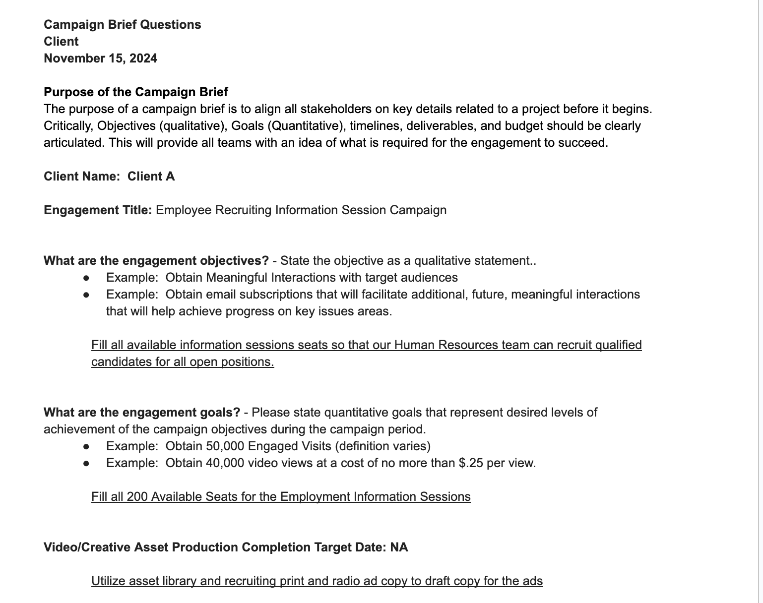
Campaign Build - Brief
Template link here
Notes:
I should note that some marketers/strategists consider the qualitative statement to be the goal and the quantitative to be the objective. The distinction is the important thing.

Slide 20
Campaign Build – Architecture Grid
Documentation of your campaigns is important. There are so many details incorporated into a basic campaign that if you don’t document it as you build it, you will forget what you did shortly after the campaign concludes. The use of an architecture grid, makes this easy.
Tracking Link Example – Google Analytics4
Ex:https://www.alexgiedt.com/resources?utm_source=fb&utm_medium=paid&utm_campaign=hr_info_sessions_2024&utm_content=fb_ProspectiingAudience1_1
Architecture Grid Template
Notes:
Quickly discuss tracking links. Nothing nefarious about this tracking. Just captures campaign, source, medium, and content info into Google Analytics 4.

Slide 21
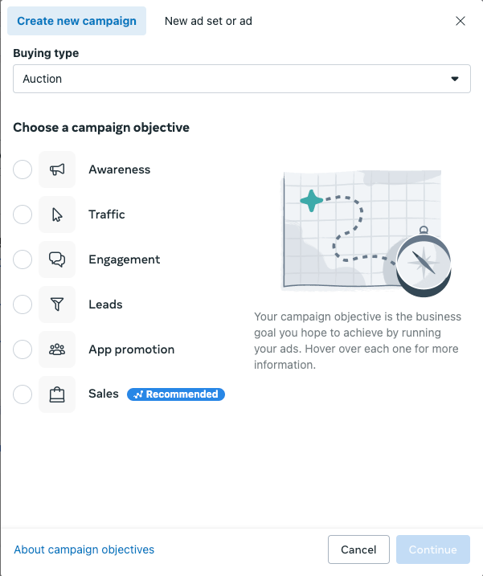
Meta Campaign Build – Campaign Creation
Campaign Creation – The first step of creating a Meta Campaign in Ads Manager is to choose a campaign type. All have different purposes.
Quick Notes:
Traffic – Optimizes towards clicks and landing page views. Reconcile GA4 to Meta to ensure Landing Page Views are valid.
Engagement – Optimizes towards video views and content engagements. Doesn’t always result in site views.
Leads – Using instant forms will result in some number of fraudulent leads.
Sales – Optimizes towards conversions. Conversions can be defined to whatever outcome is desired.
Notes:
STRUCTURE IS CAMPAIGN -> ADSET-> AD. Talk about leads campaigns. Leads on site, can work OK. B2B leads using an instant form is generally trouble, lots of fraud. Sales is the most concrete. Doesn’t have to be a monetary sale, but a conversion. Conversions are whatever outcome you configure. This is done in events and conversions inside of the Ads Manager in Meta (or google ads).

Slide 22
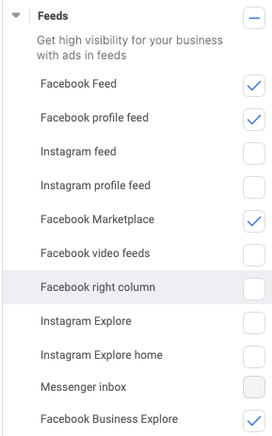
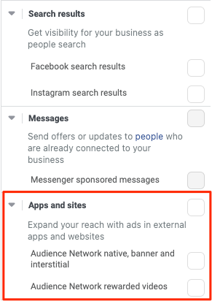
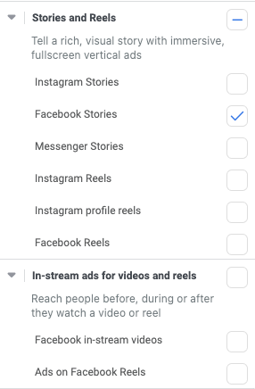
Meta Campaign Build - Adsets
Adset Creation – Adsets are where you define your conversion, audience selection, geographic range, budget, dates and placements.
Notes:
Let’s talk about placements. You can use ”automatic placements” and let Meta pick them for you. This to me, is insane. Will they ”perform”, probably on paper Meta will show you some impressive metrics but it often doesn’t pan out in reality. I know, “what, Meta isn’t truthful?” shocking stuff. STAY CLEAR OF AUDIENCE NETWORK.

Slide 23
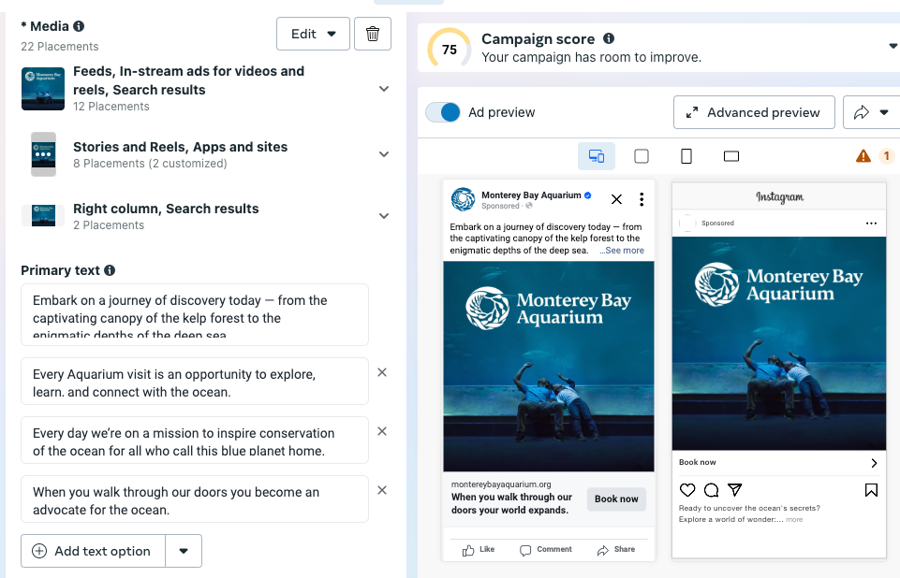
Meta Campaign Build - Ads
Campaign Ads – Consider your placements, Work to maximize your copy variation. If you use Meta’s AI to generate further copy, I highly encourage you to use it as a starting point and customize it into something new.
Landing Page Links – Always use a Google Analytics Tracking URL (with defined UTMs)
Notes:
There is a lot to do and to optimize to get to real power of creative. BUT that is where the magic happens. Don’t lean too hard on AI. It is within you.

Slide 24
Measuring, Optimization, and Reporting
Discussion of Key Performance Indicators (KPI)
Discussion of Optimization “levers”. You set up your “tests” to enable you to eliminate the underperforming elements and to double down on the overperforming elements.
Relevance Signals:
CTR
Engagement
Quality Ranking
Website Engagement Rate (GA4)
Conversion Rate
Notes:
By themselves none of these are conclusive (with the exception of “conversion rate”). Remember “conversions” are whatever you want them to be.

Slide 25
Measuring, Optimization, and Reporting
KPI — Important Metrics
Click-through Rate (CTR) | The percentage of impressions that are clicked. A click doesn’t mean that they clicker made it to the landing page, only that they clicked.
Quality Ranking | Meta’s indicator of Relevance. (Google has Quality Score)
CPM | Cost Per Mille – Cost Per 1,000 Ad Impressions
CPC | Cost Per Click
Cost Per Engaged Site Visitor | Cost Per Engaged Site Visitor (A site visitor that views two or more pages)
Conversion Rate | The percent of impressions that result in a conversion ( a defined outcome)
Audience A/B Result | A measure of which audience performed highest.
Creative A/B Result | A measure of which creative performed highest
Offer A/B Result | A measure of which offer performed highest
Landing Page A/B Result | A measure of which landing page performed highest
A note about attribution: Be wary of “View-Through Conversions”. A view-through occurs when an audience member converts but doesn’t click. It is likely the conversion had nothing to do with the ad.
Notes:
Combine metrics to better understand what is working and what isn’t. If you see an adset getting good engagement and an efficient price, take a look at the site data and see what happens when that traffic arrives. Does it actually arrive? Does it engage? Does it convert? Double down on the good and eliminate the bad.

Slide 26
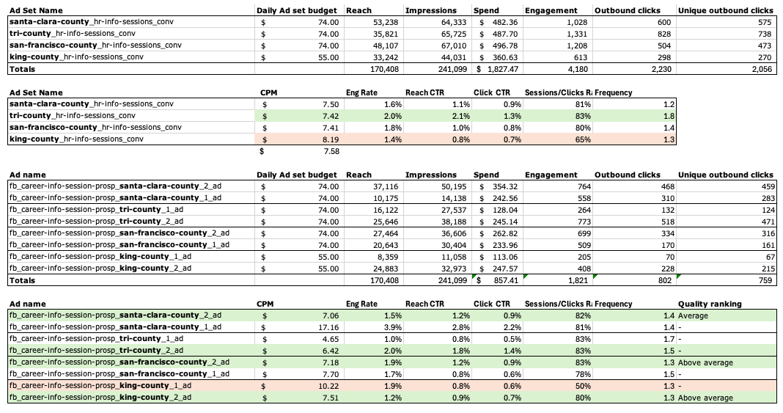
Measuring, Optimization, and Reporting
Ads Manager Data
Notes:
This is pretty close to an exact export out of Ads Manager. What is missing here is conversion rate. In this case, there wasn’t enough data to rely upon it. Using tracking URLs I can see how the data behaves by Adset once it arrives on the site.

Slide 27
Appendix
Resources
Looker Studio Dashboard Templates
Glossary
Looker Studio - Google Search Console Example Dashboard
Looker Studio - Google Analytics 4 Example Dashboard

Slide 28
Resources
Google Support - Getting Started with Google Tag Manager
Google Support - Setting up A Google Tag
Campaign Brief Template
Campaign Architecture Grid Template
These resources can also be found here.

Slide 29
Looker Studio Dashboard Templates
Looker Studio - GA4 Site Activity Dashboard Template
Looker Studio - Google Search Console Dashboard Template - SEO Overview

Slide 30
Glossary
Glossary of Digital Marketing Terminology
Impression - An impression is an instance of content (e.g. a facebook post, display ad, search ad, etc.) being presented to a user. Note: an impression is not necessarily seen by a user.
Click - A click occurs when a user clicks on a link, content, facebook post, etc.
Click-Through Rate (CTR) - CTR is the rate of clicks over impressions.
Cost/Spend - The total cost of a campaign, adgroup, ad, etc. during a defined time period.
Cost Per Click (CPC) - CPC is cost over the total clicks derived from that cost. Generally, lower CPCs are desirable. Note: CPC by itself, is not a complete metric. Attention must be paid to the quality of the click-derived visit by understanding different metrics like bounce rate and average session duration in order to understand the context of the CPC.
CPM - This metric is the cost per one thousand ad impressions (i.e. Cost Per Mille). This is the most common way of pricing digital media. An advertiser pays for the ad in CPM media rather than a click or other outcome.
Reach - The number of audience members reached with at least one impression during a define period.
Frequency - The number of impressions divided by the reach. It is the average number of impressions an audience member is served during a defined time period. This is a measure of how much a campaign is saturating an audience with impressions. Typically, a campaign will need a multiple impressions per person (or a frequency of greater than 1) to achieve a reaction/positive outcome.

Slide 31
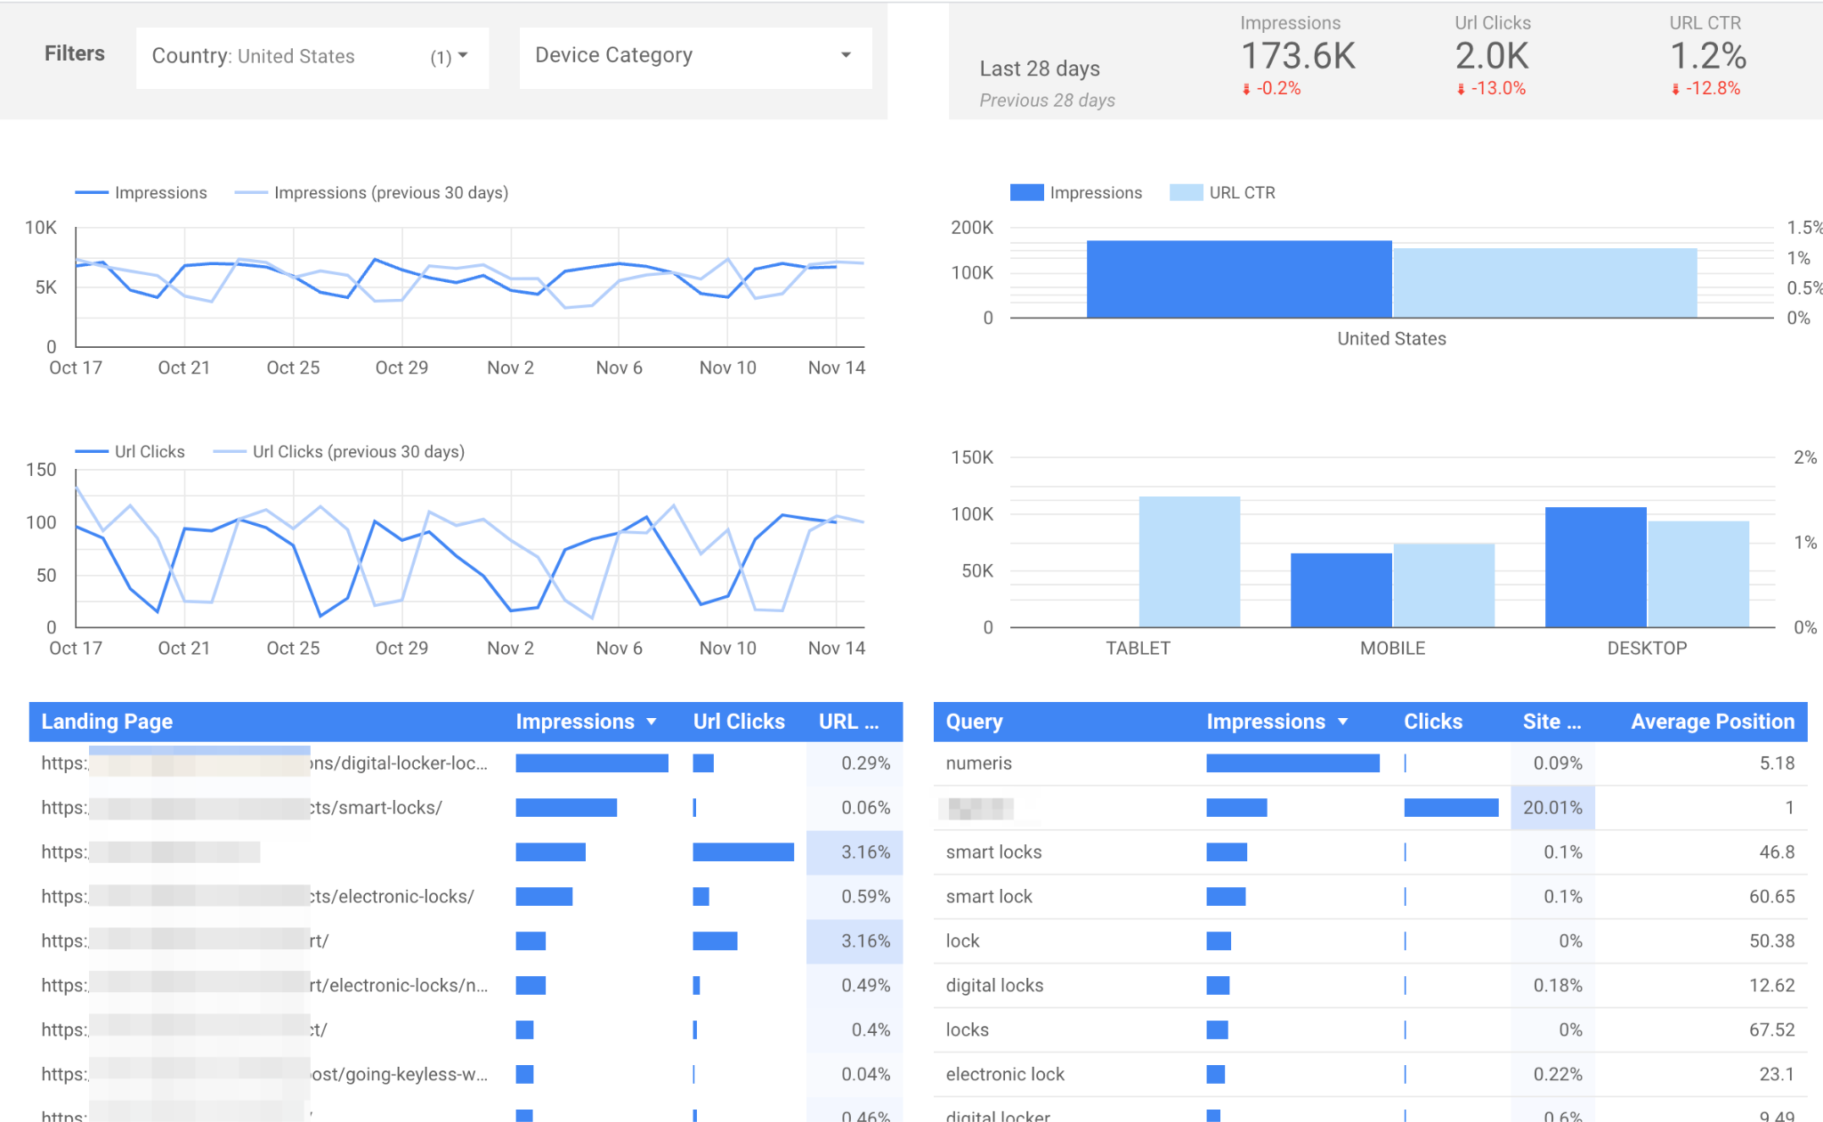
Looker Studio - Google Search Console Example
Notes:
Note that GSC provides context about organic terms that are successful

Slide 32
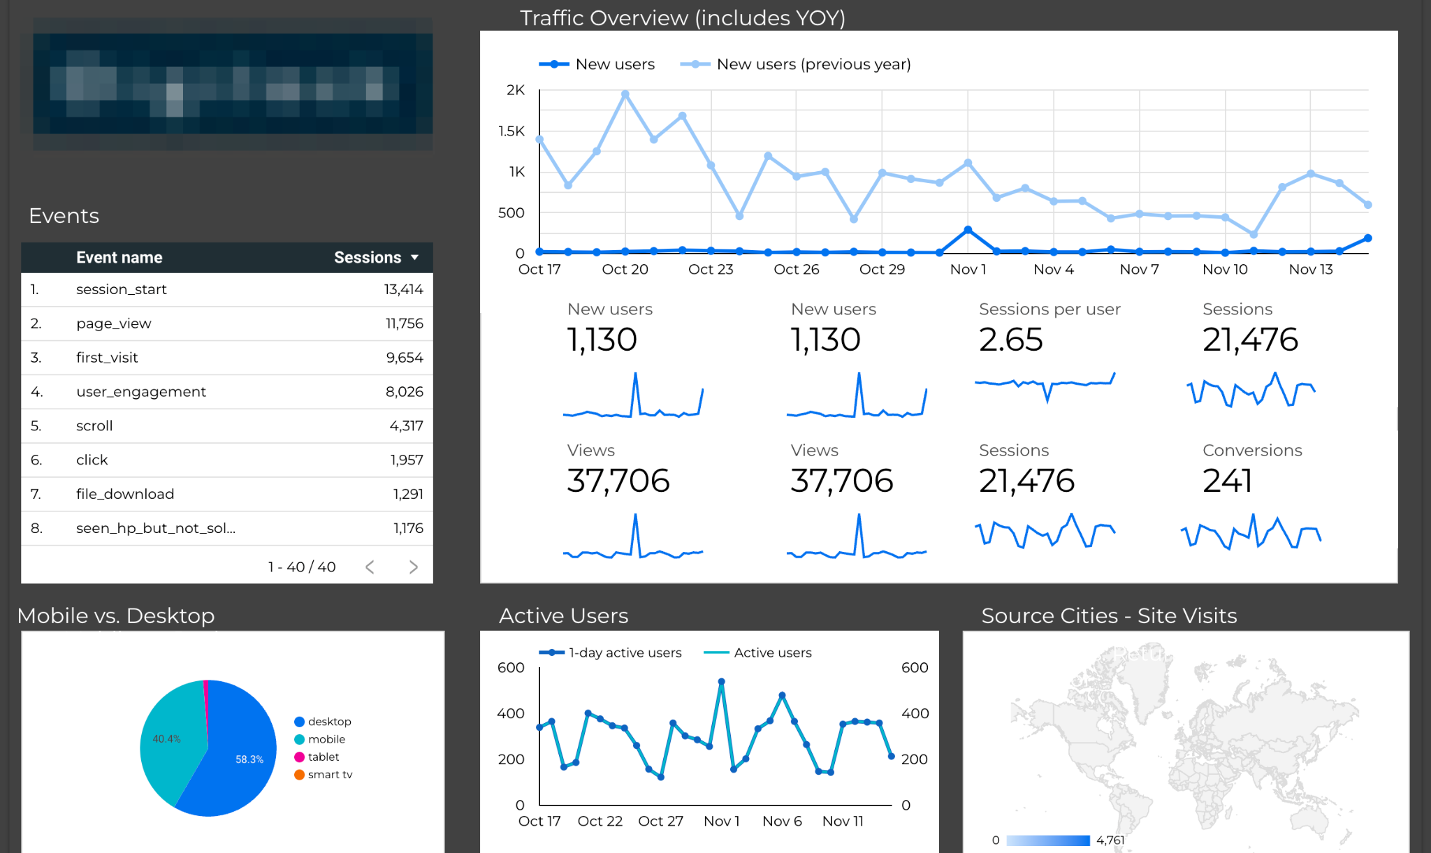
Looker Studio - Google Analytics 4
Notes:
Note “events” and their importance.

